Slide 1
Date: 17.02.24
Vehicle to Vehicle Visible Light Communication
Saransh Gautam
Supervised by: Dr. Rahul Singhal
Department of Electrical and Electronics Engineering

Slide 2
AS7341 Output:
Sensor kept at a distance of 30 cm from LED in a dark environment.
Both white LED and multi-colour LED Used

Slide 3
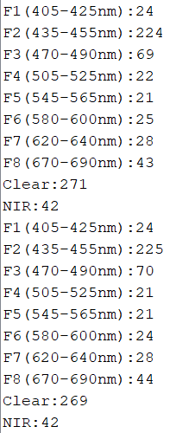
Blue LED

Slide 4
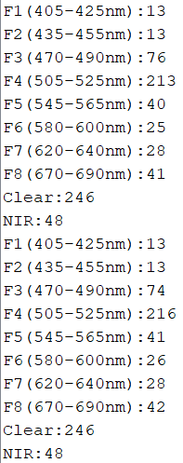
Green LED

Slide 5
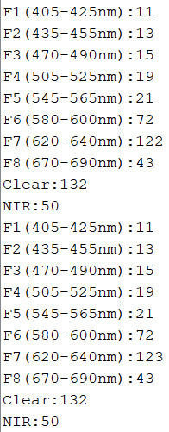
Red LED

Slide 6
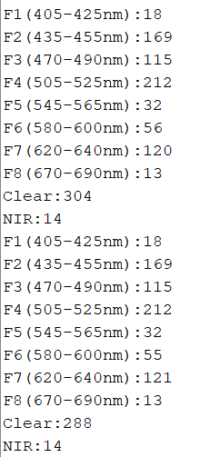
All 3 Colours

Slide 7
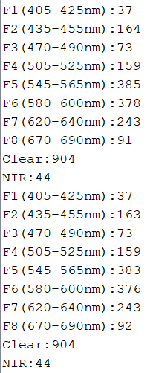
White LED

Slide 8
Half – Duplex Communication Demo

Slide 9
Thank You

