Slide 1

Trimble Global Hackathon 2023
Prometheus
TransHackAI

Slide 2
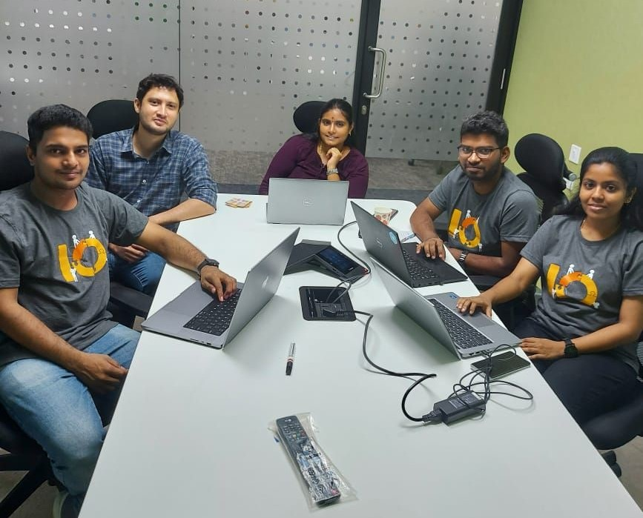
Team
Prometheus

Slide 3
Team
First name, Last name | Division, Location
Craig Dominic Savio Lazaro | TTM-EU, Chennai
Karthik Saravanan | TTM-EU, Chennai
Saranya A | TTM-EU, Chennai
Hemahlatha Radhakrishnan Narasimhen | TTM-EU, Chennai
Kathiravan Sethuraman | TTM-EU, Chennai

Slide 4
Problem
As a driver, in a high pressure environment, I need to make quick and effective decisions to deliver my shipments keeping in mind not to violate driving times.
As a dispatcher, to assign a task or a trip, I need to find the right driver with available driving times which is tedious and time consuming
High costs to the company, complex scheduling, drivers well-being and delay in delivery times.

Slide 5
Customer
Business with commercial cargos and transportation
Drivers and dispatchers

Slide 6
Solution
TransHackAI for drivers solves the problem of helping drivers stay organized, on schedule, and safe. It can do this by providing assistance with tasks such as scheduling, fuel management, navigation, and communication. Furthermore it helps reduce cost to the company and carbon emissions.

Slide 7
Technology stack
TensorFlow JS ML Training framework integrated with Trimble Maps
UI - Reactjs
Refining the results with ML algorithms with Random Forest.

Slide 8
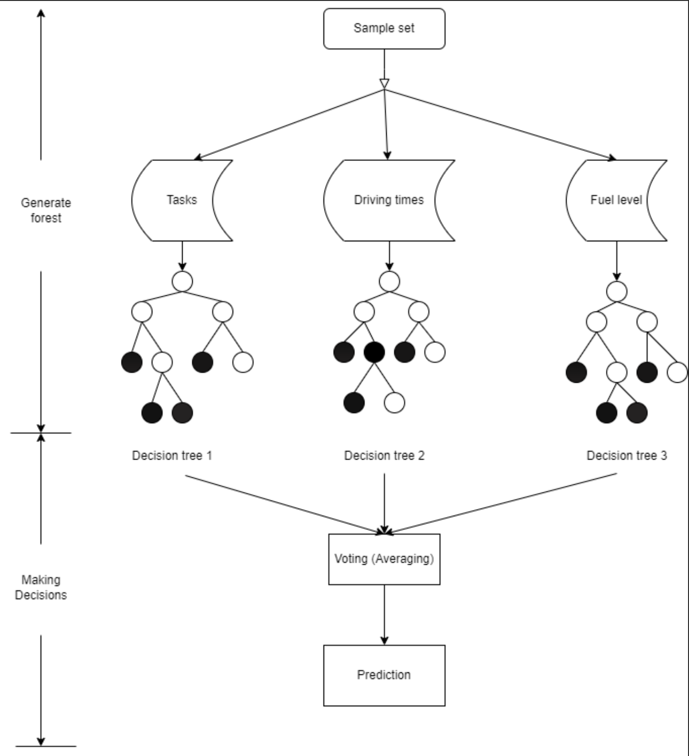
Architecture

Slide 9
Future Plan
Expand the current model to accommodate factors like fuel efficiency, emission rate, weather condition, POIs and train the model with different datasets to generate a more efficient, reliable, driver-dispatcher-friendly routes and to minimize the cognitive load on the drivers.

Slide 10
Video
Add your 5 minute video to this slide using insert > video, at the top of the screen.
(Keep content within this slide)
https://drive.google.com/file/d/1ZzE9K9o8Q61EtKPZ_BsgDL7gSvC9sjRV/view?usp=drive_link

Slide 11
Thank You

