Slide 1



DEPARTMENT OF ELECTRONICS AND COMMUNICATION ENGINEERING MINOR PROJECT FIRST REVIEW Turbidity Meter Using Arduino UNO
PRESENTED BY:
S.RAGAVI [927621BEC159] GUIDE:
S.REENA [927621BEC163] Dr.S.Vimalnath
V.PRITHIGA [927621BEC153] Assistant Professor/ECE
S.SARANYA [927621BEC186]

Slide 2
CONTENTS
Introduction
Objective
Abstract
Conclusion
References

Slide 3
TURBIDITY
Turbidity is the cloudiness or haziness of a fluid caused by large numbers of individual particles that are generally invisible to the naked eye, similar to smoke in the air. The measurement of turbidity is a key test of water quality.

Slide 4
OBJECTIVES
The main objective of this project is to understand the working and the design of the turbidity.
Specific Objective:
The gravity Arduino Turbidity sensor from DfRobot detects water quality by measuring the levels of turbidity.
It uses light to detect suspended particles in water by measuring the light transmittance and scattering rate, which changes with the amount of total suspended solids (TSS) in water.

Slide 5
ABSTRACT
Turbidity is a concept that is significant when discussing liquids since it is crucial to understanding liquid dynamics and is used to assess the cleanliness of the water.
To determine the condition of the water, the Arduino turbidity sensor monitors turbidity. TSS concentration has an impact on light transmittance and scattering rates, which can be employed to find out whether there are any suspended particles in water.

Slide 6
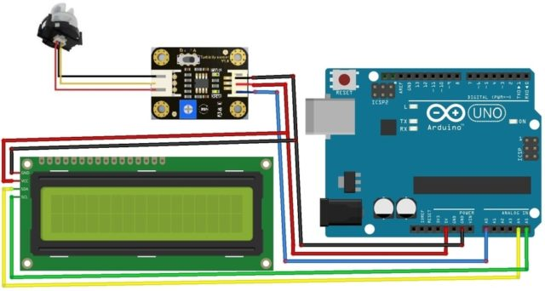
CIRCUIT DESIGN

Slide 7
CONCLUSION
Researchers can forecast natural processes in the environment, gain knowledge from them, and identify how humans affect an ecosystem by using the Water Quality Monitoring (WQM).
In addition to helping with restoration projects, these measurement efforts can guarantee that environmental regulations are being met. The WQM, which makes use of IoT technologies, must be a practical and effective system for tracking drinking water quality.

Slide 8
REFERENCES
J. G. Andrews, et al, “What will 5G be?,” IEEE Journal on Selected Areas in Communications, vol. 32, no. 6, pp. 1065-1082, June 2014.
Z. Ren, A. Zhao and S. Wu, "Dual-Band MIMO Antenna System for 5G Mobile Terminals," 2019 13th European Conference on Antennas and Propagation (EuCAP), Krakow, Poland, 2019, pp. 1-4.
S. Nej and A. Ghosh, "Design of Meander Line Triple Band Antenna for Wireless Applications," 2020

