Slide 1
FOOD WASTE MANAGEMENT SYSTEM
TEAM MEMBERS:
19Z305 – Akshara P
19Z314 – Gokul R
19Z317 – Harini S
19Z337 – Pavithra Yazhini GK
19Z343 – Samyuktha ASK
19Z345 – Saranya K

Slide 2
Introduction
Food Waste Management System is designed to reduce the wastage of food in family functions, private events and during festive time.
The remaining foods during the functions can be donated to the needy people through NGOs with the help of this system.
In this system donors and receivers can have their own account. From their account donors can request for food donation, receivers can accept the food and admin will verify donor’s and receiver’s verification request and approve them.

Slide 3
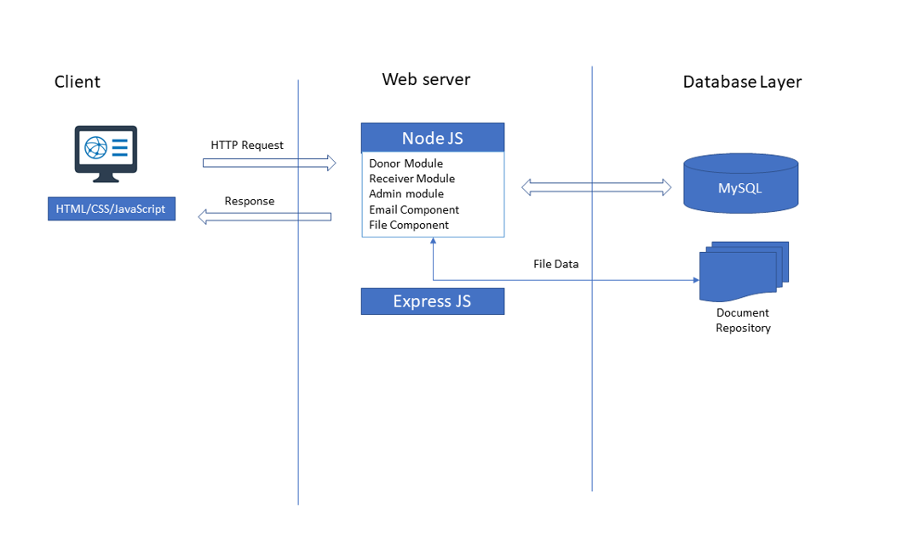
Architecture Diagram of the Project

Slide 4
Available features
Admin
Login
View the verification requests sent by donor/receiver
Accept/Decline the verification requests sent by donor/receiver.
Log out
Donor
Login
Sending food takeup request
View and edit profile
View Request history
Sending Verification request to admin
Logout
Receiver
Login
Accept food take up request
View and edit profile
View Accept history
Sending Verification request to admin
Log out
Achiever of the day
Donor who donates more people in a particular day is the achiever of the day

Slide 5
TOOLS USED IN FRONT-END & BACK-END
1. Visual studio
2. My SQL Workbench
3. Sublime text editor
4. Nodejs
5. Express framework
6. Notepad ++
Languages used:
Frontend – Html, CSS
Backend – Mysql, javascript

Slide 6
1.Contribution 2.Challenges faced
Akshara P | login page (front end), donor request history(front end and back end) 2. connecting front end and back end
Harini S | Worked on the receiver side features displaying the request of the donors and calculate the distance between donor and receiver using opencage api. displaying the accept history of the receiver Worked on the backend of login and register Worked on the overall integration of all the features. 2. Found difficult to integrate the OpenCage, Geocoding API to find the distance between two places
Gokul R | 1.Created the database tables
Pavithra Yazhini G K | 1.donor and receiver side - frontend and backend ( to give verification request for verified account )
Samyuktha A S K | 1.Admin features (Admin dashboard, Viewing donor/receiver verification requests, Accepting/declining donor/receiver verification requests) - front end and back end. Integrated all other's code. Home page. 2.Found difficult while integrating all other’s code
Saranya K | 1.Edit Profile feature(front end and back end) for donor and receiver Sign-up & donor food take-up request page(front end) 2.Faced some issues while doing back end

Slide 7
References:
https://www.tutsmake.com/create-registration-and-login-form-in-node-js-mysql/
https://codeshack.io/basic-login-system-nodejs-express-mysql/
http://www.w3big.com/nodejs/node-js-get-post.html
https://developer.mozilla.org/en-US/docs/Learn/HTML/Tables/Basics
https://www.w3schools.com/html/html_css.asp
https://codingstatus.com/how-to-display-data-from-mysql-database-table-in-node-js/
https://opencagedata.com/tutorials/geocode-in-nodejs
https://www.javatpoint.com/expressjs-tutorial
https://www.geeksforgeeks.org/html-tutorials/

