Slide 1
CAPSTONE · SEIDENBERG SCHOOL · SPRING 2026
THE FAIRNESS PARADOX
Fair Credit Risk Assessment
for Underserved Populations Using Machine Learning
A Dollar-Cost Fairness Framework — extending ECOA beyond approval-rate parity into financial harm.
1.26M
10
$6,310
HMDA NY APPLICATIONS · 2019–2021
ML MODELS · 3 INTERVENTION STRATEGIES
WORST PER-APPLICANT GAP · SVM, 2020
Neelima Verma · Saranya Attaluri · Nithish Kumar Vishwanath
Faculty Advisor: Prof. Hetali Chavda
MS Data Science · Pace University · Seidenberg School of Computer Science and Information Systems

Slide 2
01 · PROBLEM
ECOA compliance ≠ financial fairness.
A model can pass every approval-rate test while quietly inflicting greater financial harm on minority borrowers.
APPLICANT A
APPLICANT B
$100,000
$300,000
loan request
loan request
Wrongfully denied → forgoes a $100K mortgage.
Wrongfully denied → 3× the economic damage in NPV terms.
Under Disparate Impact, this denial weighs the same as any other.
Identical in DI. Invisible to every approval-rate metric in regulatory use.
HMDA 2019 NY: Non-white avg loan $191,632 · White avg loan $136,446 · a 40% gap that approval-rate fairness ignores.

Slide 3
02 · EXPLORATORY DATA ANALYSIS
A 10.4-point approval gap that's stable across three years.
1.26M
354K+
99 → 24
9.1%
applications, 2019–2021
cleaned records per year
features after SHAP audit
missingness, median-imputed
Approval rate by race · 2019 HMDA NY
Cleaned records · three-year study scope (K)
DI = 0.86 (above ECOA's 0.80 floor — yet a 10.4-pt gap persists)
Same 6-step pipeline applied per year — 1.26M total applications validated.
Takeaway: 2019's 10.4-pt approval gap isn't a snapshot — raw disparity remains stable across all three years (paper §4.9, validated on 1.26M applications).

Slide 4
03 · PROPOSED SOLUTION
The Dollar-Cost Fairness Framework.
Convert model errors into per-applicant dollar harm — then disaggregate by protected group.
FALSE NEGATIVE — WRONGFUL DENIAL
FALSE POSITIVE — MISSED DEFAULT
A creditworthy applicant is denied. The bank forgoes future interest revenue.
A non-creditworthy applicant is approved and defaults. The bank absorbs the balance loss.
NPV = Σ [ paymentt / (1 + r)t ] − loan
Cost = remaining balance × LGD
r = 5% (10-yr Treasury + spread) · amortized over term t
LGD = 0.40 (Fed residential standard) · default at loan term ÷ 2
METHODOLOGY PIPELINE
1
Data + Clean
2
SHAP Proxy Audit
3
Train 10 Models
4
Fairness Eval
5
Cross-Year
HMDA NY · 6-step pipeline
5 race proxies removed
LR · SVM · DT · RF · NN
DI, EOD, FPR + $-gap
2019 → 2020 → 2021

Slide 5
04 · RESULTS
The Fairness Paradox — replicates across three years.
SVM achieves the highest DI every year — and one of the worst dollar gaps every year.
Disparate Impact (higher = more parity)
Per-applicant racial $ gap (lower = less harm)
MECHANISM · LOAN-SIZE AMPLIFICATION
NPV-priced harm scales with principal, not denial rate. DI, EOD, and FPR-difference are all blind to this effect — which is why approval-rate fairness and dollar-cost fairness can move in opposite directions simultaneously.

Slide 6
04 · RESULTS
Ten models, four metrics — which one ships?
2019 HMDA NY deep dive · patterns replicate 2019–2021 (§4.9) · 10-fold stratified CV.
Model | AUC | DI | EOD | $ Gap | Verdict
LR Baseline | 0.798 | 0.916 | −0.006 | +$3,999 | —
LR Balanced | 0.803 | 0.827 | −0.064 | −$927 | —
LR Manual Reweighing | 0.802 | 0.898 | −0.010 | +$1,214 | —
LR Proxy Removal | 0.787 | 0.940 | +0.007 | +$4,977 | —
SVM Linear | 0.791 | 0.943 ★ | +0.011 | +$5,125 | ✗ worst $-gap
DT Constrained | 0.993 | 0.868 | −0.006 | −$438 | —
Random Forest | 0.993 | 0.880 | +0.002 | +$52 ★ | ✓ recommended
NN + Focal Loss | 0.993 | 0.872 | −0.002 | +$388 | ✓ recommended
WINNER
NN + Focal Loss
Highest AUC (0.993), passes ECOA, relative lowest dollar gap — and stable across all three years.
THE TRAP
A regulator looking only at DI would approve SVM — the highest-parity model — while permitting the largest dollar harm.
★ = best in metric column · ✗ = highest dollar gap · ✓ = recommended for deployment

Slide 7
04 · RESULTS · SUBGROUP
Lowest denial rate. Highest financial harm.
Binary White / Non-White encoding masked a third, sharper disparity entirely.
Group | N | FN Rate | Avg Loan | $ / app gap
White (baseline) | 53,056 | 3.6% | $136K | —
Hispanic | 5,034 | 3.3% | $140K | +$2,903
Black | 5,442 | 4.0% | $172K | +$4,074
Asian | 6,813 | 3.0% (lowest) | $226K | +$4,938 ★
THE MECHANISM
Loan-size amplification
Asian-denied loans average $226K — 66% larger than the White average ($136K). NPV scales with principal, not denial rate, so a smaller fraction of denials inflicts a larger per-applicant gap.
2019 HMDA NY · DI for Asian subgroup = 0.962 → no ECOA flag raised.
Subgroup $ gap across 2019 → 2021 (vs White baseline)

Slide 8
04 · RESULTS · SUBGROUP DEEP DIVE
Two failures of binary White / Non-White encoding.
Shown on 2019 reference year — patterns replicate across 2019–2021 (§4.9). One drives the harm. The other hides it.
THE MECHANISM · LOAN-SIZE AMPLIFICATION
THE BLIND SPOT · BINARY MASKING
As principal grows, NPV-priced harm grows in step.
Aggregation hides the worst-harmed subgroup.
Avg loan amount ($K)
WHAT ECOA'S BINARY VIEW SHOWS
Aggregate Non-White
DI = 0.86
✓ ECOA compliant
+$3,999
avg $ gap (LR Baseline)
Per-applicant $ gap vs White baseline
WHAT DISAGGREGATION REVEALS
Hispanic
Black
Asian ★
+$2,903
+$4,074
+$4,938
Asian principal +66% over White → +$4,938 per-applicant harm.
Asian — lowest FN rate (3.0%) — bears the highest harm. The aggregate hides it.
REGULATORY IMPLICATION: subgroup-aware metrics matter. Binary encoding both masks the worst-harmed group and misses the principal-driven mechanism that produced the harm.

Slide 9
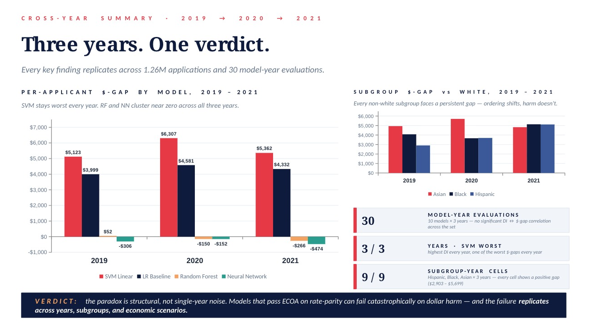

Slide 10
05 · CONCLUSION & FUTURE WORK
Three findings. One recommendation.
01
02
03
Decoupling is structural.
Loan-size amplification is the mechanism.
Some models clear both bars.
Across 30 model-year evaluations, DI and dollar-gap show no significant correlation. SVM topped DI every year and produced one of the worst dollar gaps every year — not noise.
NPV-priced harm scales with principal, not denial rate. Asian applicants — lowest FN rate, highest avg loan — bear the largest per-applicant gap. Every approval-rate metric misses this.
NN + Focal Loss and Random Forest hold ECOA compliance and a relatively lowest dollar gap across 2019–2021. The conventional accuracy / fairness trade-off may not apply to dollar-cost fairness.
RECOMMENDATION
Adopt dollar-cost metrics as a complementary regulatory standard. ECOA's DI ≥ 0.80 is necessary — but not sufficient — for equitable lending.
FUTURE WORK
·
Cross-state replication
·
Governance & Lifecycle monitoring
·
Dynamic LGD via LTV
·
Causal inference frameworks

