Slide 1
Bodinatham Saranya Computer Science and Engineering, 3rd year SEM-2, RGUKT-AP,IIIT-Rk Valley.
Final Project in Cyber security Conducted by APSSDC

Slide 2
PROJECT TITLE
Key Logger and Security

Slide 3


AGENDA
AGENDA
AGENDA
→ Define Project Scope and Objectives: Clearly outline the goal of developing a keylogger for educational purposes on Linux, focusing on understanding input event handling and system security within Linux distributions like Kali Linux or Ubuntu.
→ Set Up Development Environment: Install essential tools and libraries for Linux development, ensuring compatibility with Kali Linux or Ubuntu. Configure the environment to facilitate smooth coding and testing.
→Implement Logging Mechanism: Design and implement a logging mechanism to securely store captured keystrokes, prioritizing file access permissions and secure storage practices within Linux file systems.
→Documentation and Reporting: Finalization and Archiving: Finalize all documentation, code, and reports, ensuring they are securely stored and archived for future reference or educational purposes related to Linux-based keylogger development.
3/21/2024 Annual Review

Slide 4

PROBLEM STATEMENT:Development of a Keylogger for Educational Purposes on Kali Linux/Ubuntu
Objective:
The objective of this project is to develop a keylogger software specifically for educational purposes on Linux-based operating systems such as Kali Linux or Ubuntu. The keylogger will serve as a practical learning tool to deepen understanding of system-level programming, input event handling, and data security within the Linux environment.

Slide 5

PROJECT OVERVIEW
This project aims to develop a keylogger for educational purposes on Linux-based systems like Kali Linux or Ubuntu. The keylogger will capture keystrokes discreetly, emphasizing secure logging practices and ethical considerations. Its goal is to deepen understanding of system-level programming, input handling, and data security, while promoting responsible use of monitoring tools in educational settings.

Slide 6

WHO ARE THE END USERS? Students and Learners: Those studying cybersecurity, computer science, or related fields who use the keylogger as an educational tool to understand system-level programming, input handling, and data security concepts. Researchers and Developers: Individuals conducting research or developing software who may use the keylogger to test security measures, study behavior patterns, or explore potential vulnerabilities in systems. Ethical Hackers and Security Professionals: Professionals in cyber security who may use the keylogger for educational purposes, such as understanding attack vectors, monitoring system behavior, or demonstrating security risks to stakeholders. General Public (with Consent): In specific cases where consent is obtained and privacy laws are respected, the general public might use the keylogger for personal educational purposes or to understand software functionality and security implications.
3/21/2024 Annual Review

Slide 7

PACKAGES AND LANGUAGE USED ==>Python is used in this project ==>The Packages that are needed to install → pip install pynput → pip install jsonlib

Slide 8

THE WOW IN YOUR SOLUTION By integrating advanced security features, hands-on learning experiences, and ethical considerations, our keylogger project on Kali Linux/Ubuntu not only educates but also inspires students and educators alike. It sets a benchmark in cybersecurity education by offering practical insights and promoting responsible use of technology, ensuring learners are well-prepared for the complexities of modern cybersecurity challenges.
3/21/2024 Annual Review
<number>

Slide 9
MODELING The code used in this project implements a basic keylogger using Python's tkinter for the GUI, pynput for capturing keyboard events, and json for storing keystroke data. Let's break down the modeling used in this keylogger project: System Architecture Diagram:
→ Components identified: GUI (Tkinter), keylogger logic (pynput), and file handling (json).
→ Interactions visualized: User interacts with GUI to start/stop keylogger; keylogger captures keyboard events; data is stored in JSON and text files. Use Case Diagram: → Actors: User, keylogger component, file system.
→ Use cases defined: Starting keylogger, stopping keylogger, and file writing. Sequence Diagrams:
→ Sequences depicted: User clicks "Start" -> GUI triggers start_keylogger() -> keylogger starts capturing events (on_press, on_release) -> User clicks "Stop" -> GUI triggers stop_keylogger() -> keylogger stops capturing events.
<number>

Slide 10
Class Diagram:
→ Classes and relationships: Tkinter widgets (Label, Button), keylogger class (on_press, on_release), file handling classes (json).
State Diagram:
→States: Idle (keylogger inactive), Active (keylogger capturing events), Stopped ( keylogger stopped).
→ Transitions: Start keylogger (Idle to Active), Stop keylogger (Active to Stopped).

Slide 11
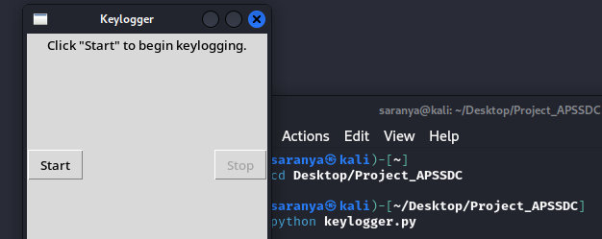
RESULTS/OUTPUT → Initial State:The GUI window titled "Keylogger" opens with a label displaying the message: "Click 'Start' to begin keylogging." → File Output: → key_log.txt: Contains all captured keystrokes in a single continuous string format. Each time the keylogger is started anew, the file is overwritten with the new keystrokes.
<number>

Slide 12
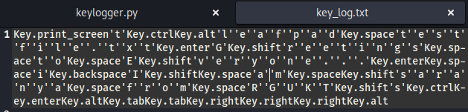
→ key_log.json: Stores structured data in JSON format, where each keystroke event is recorded with a timestamp. This file provides a more organized and timestamped log of all keystrokes captured during the keylogger's operation.

Slide 13
CONCLUSION The keylogger project output not only captures and logs keystrokes effectively but also demonstrates essential skills in software development, data handling, and GUI design. It serves as a valuable educational tool for learning about system-level programming and cybersecurity fundamentals on Linux platforms like Kali Linux or Ubuntu.
GitHub Link:

