Slide 1

Seshadri Rao Gudlavalleru Engineering College
Department of CSE (Artificial Intelligence & Machine Learning)
Machine Learning Project On
Predictive Loan Approval System

Slide 2
Abstract
In the financial sector, the sheer volume of loan applications challenges traditional manual processing, often leading to delays and inconsistencies. Our project leverages machine learning to streamline this process, aiming for faster decisions and improved accuracy.
This presentation will outline our approach, from data handling to model selection and results.
This isn't just about algorithms and code; it's about streamlining a critical process, minimizing errors, accelerating decision-making, and ultimately providing customers with a faster and clearer experience.

Slide 3
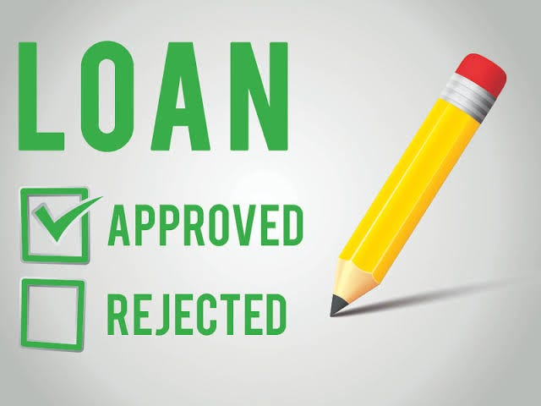
Objectives
Build a machine learning model to predict loan approval status.
Identify key factors influencing loan decisions.
Improve accuracy using appropriate preprocessing and feature engineering.
Automate and enhance decision-making in loan processing.

Slide 4

Dataset Overview
Dataset: loan approval_dataset
Resource: Kaggle Website
Total Rows: 4269
Total Columns: 13
Target column: loan_status
Features include:Applicant income, loan amount,
education, employment, etc.
Dataset link:
https://www.kaggle.com/datasets/architsharma01/loan-approval-prediction-dataset

Slide 5
Methodology
Preprocessing:
Handled missing values → Filled or removed missing data to ensure clean input.
Categorical encoding →Converted categories into numerical format using One-Hot Encoding.
Normalization → Scaled data to bring all features to a similar range.
Modeling:
Random Forest Classifier → 0.98
Logistic Regression → 0.94
K-Nearest Neighbours (KNN) → 0.88
Support Vector Machine (SVM) → 0.91

Slide 6
System Architecture
Data collection
Data
Preprocessing
Feature Selection
Predicted
Output
Evaluation
Model Training

Slide 7
Requirements
Hardware Requirements:
Minimum: 8 GB RAM, Intel Core i5 Processor
Recommended: Dedicated GPU (NVIDIA) for faster training and processing
Software & Tools:
Programming Language: Python 3.9
Development Environment: Jupyter Notebook / Google Colab
Libraries Used:
Pandas: Data manipulation and analysis
NumPy: Numerical operations
Scikit-learn: Machine learning algorithms and model evaluation
Matplotlib & Seaborn: Data visualization

Slide 8
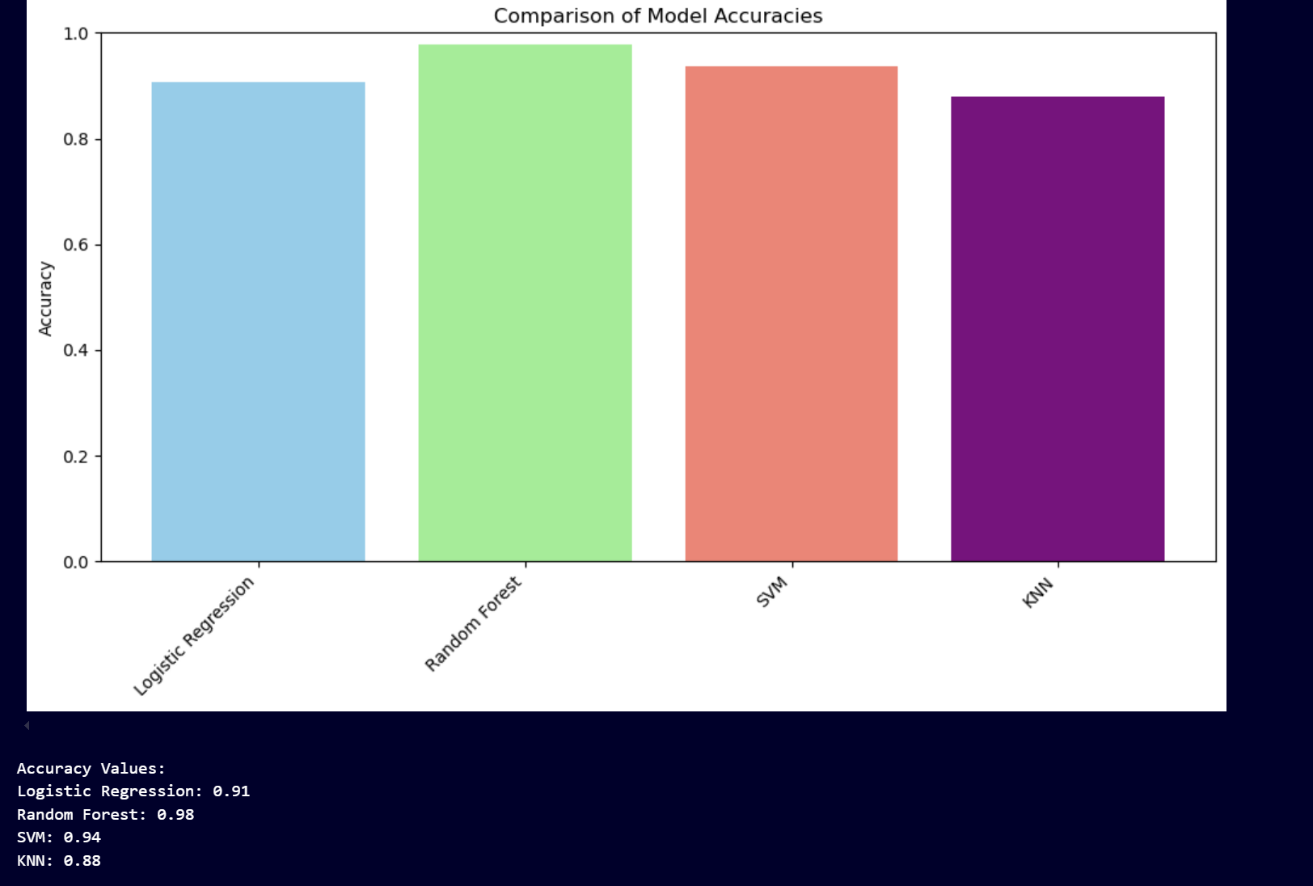
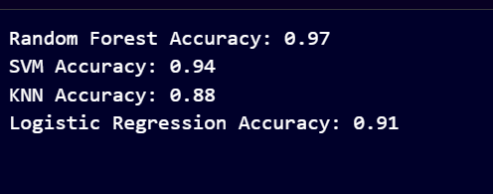
Output
Comparison:
Accuracy:

Slide 9
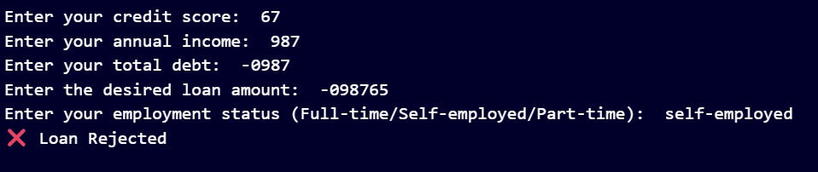
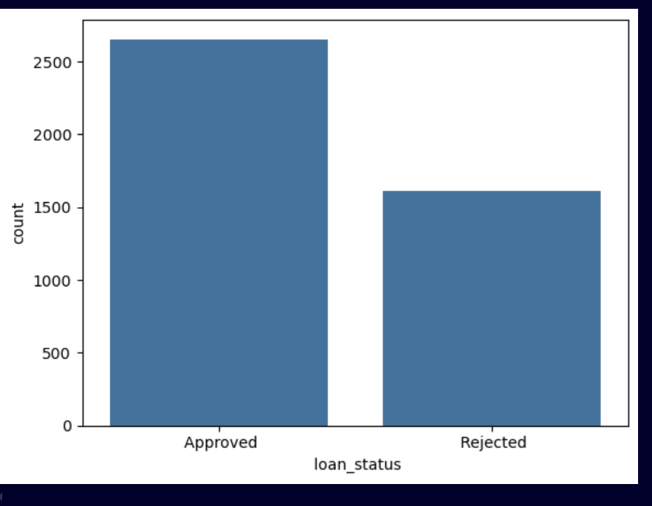
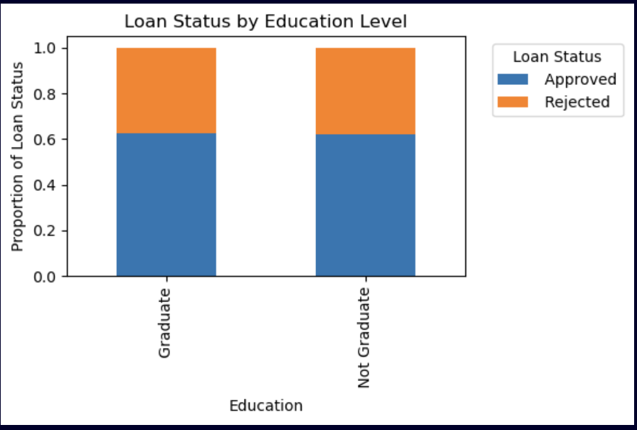
Visualization
Working:
Visualization:

Slide 10


