Slide 1
LegalEase – AI-Powered Legal Document Generator
Automated Legal Drafting, Inline Editing, and Multi-Format Export
Final Project Documentation Presentation

Slide 2
Project Overview & Tech Stack
Project Mission: Streamline contract creation and legal document generation using Generative AI.
Frontend: Streamlit (Dynamic UI, Live Preview, Multi-format file downloads).
Backend: FastAPI (Asynchronous REST API, Request handling, Gemini Integration).
LLM Engine: Google Gemini API (gemini-1.5-pro).
Document Formatting: Python-docx (Word) & ReportLab (PDF).

Slide 3
System Architecture & Workflow
1. User Input: Collects contract details via Streamlit UI (Document Type, Parties, Terms, Date).
2. FastAPI Request: Transmits structured JSON payloads to backend endpoints.
3. Gemini Processing: Prompts gemini-1.5-pro to construct legally structured agreements.
4. Dynamic Preview: Renders formatted preview with inline editing capabilities.
5. Multi-Format Export: Generates .txt, .docx, and .pdf documents with formatted layouts.

Slide 4
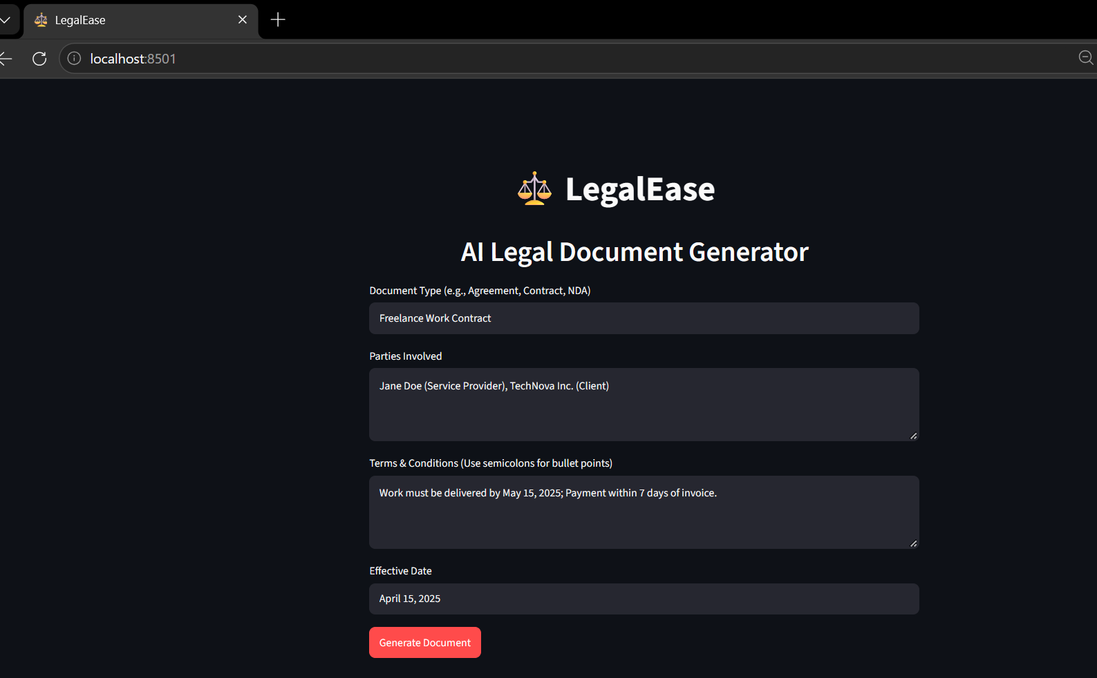
UI Walkthrough: Input Interface
Clean, dark-themed Streamlit user interface.
Form Fields Supported:
• Document Type (e.g., Freelance Service Contract)
• Parties Involved (e.g., Jane Doe vs. TechNova Inc.)
• Terms & Conditions (Payment terms, NDA, IP clauses)
• Effective Date (e.g., October 1, 2026)

Slide 5
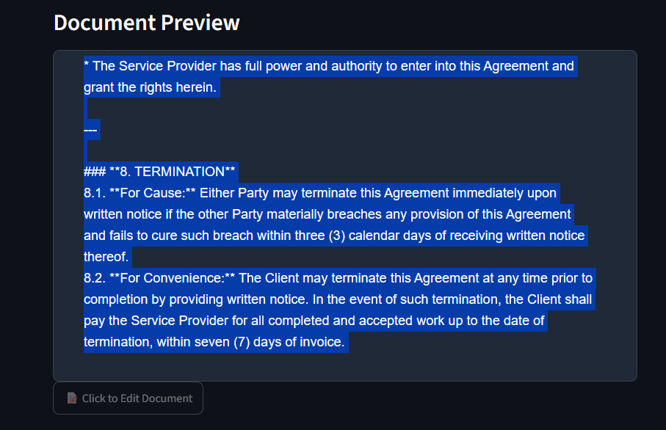
UI Walkthrough: Preview & Editing
Real-time Generation: Displays AI-generated legal text instantly.
Click to Edit Feature: Built-in inline editor allowing real-time modifications before export.
Live HTML/Markdown Preview: Updates formatting on the fly based on user edits.
[INSERT SCREENSHOT: Inline Editor & Dynamic Preview]

Slide 6
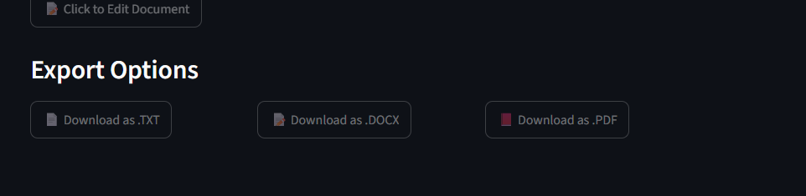
UI Walkthrough: Export Capabilities
Plain Text (.txt): Unformatted raw text export for quick sharing.
Word Document (.docx): Styled headers, company logos, bold section titles, and dynamic tables.
PDF Document (.pdf): Clean, print-ready layout created via ReportLab.
[INSERT SCREENSHOT: File Download Buttons & Sample Export Files]

Slide 7
Verification & Testing Summary
✓ API Connectivity: Backend successfully processed requests and received responses from Gemini.
✓ State Management: Streamlit session state persisted inline edits accurately.
✓ Export Integrity: Logos, tables, headers, and signatures rendered cleanly across .docx and .pdf.
✓ Error Handling: Authentication and missing input errors handled gracefully.

Slide 8
Conclusion & Future Roadmap
Project Conclusion: LegalEase successfully bridges complex legal drafting and AI-driven automation.
Future Enhancements:
• Contract Redlining & Analysis: AI-assisted risk and clause detection.
• Legal Database Integration: Linking with regional legal repositories.
• Multi-Language Support: Automated translation for international contracts.

