Slide 1


Insurance management system
By team ASR:
RUCHA MANGALEKAR
SARANYA MACHAVARAM
ANANTHAKRISHNA KALLE

Slide 2
Project statement:
To develop an Insurance Management System that offers varying features for 2 roles :
1) Customer
2) Administrator

Slide 3
Project Technical overview
Insurance Management System using Eclipse with Java, Java FX and FXML
Maven dependencies used to manage the external libraries and dependencies of fxml and mysql jar files
MVC Framework with Java
User and Insurance(Model)
.fxml files(View)
.java Files(Controller)
Connection with database – DB.java

Slide 4
Database And Models
MySQL DB Tables:
user_registration
JDBC to establish connection to Mysql database, execute SQL statements, and retrieve and update data.
Create/Add
Read, Update, and Delete records of users having plans by insertRecord(), addRecord(), setRecord(), getRecord(), searchRecord and deleteRecord()
UserSession.java - To keep track of the user information till the end of session.
InsuranceOfPerson.java - Model to retrieve all insurance data of an individual
DAO to encapsulate the details of database access, and to provide a simple and consistent interface for accessing data from MySQL
insurance_plan

Slide 5
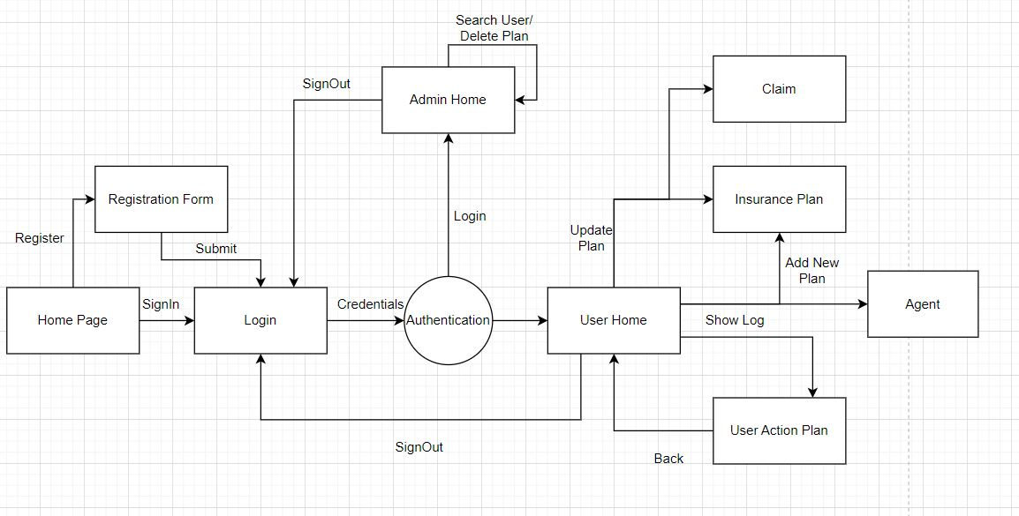
System DESIGN

Slide 6
Operations Overview
Registration/ login
Insurance planning (CRUD operations)
Activity Log
Admin (Search and Delete)

Slide 7
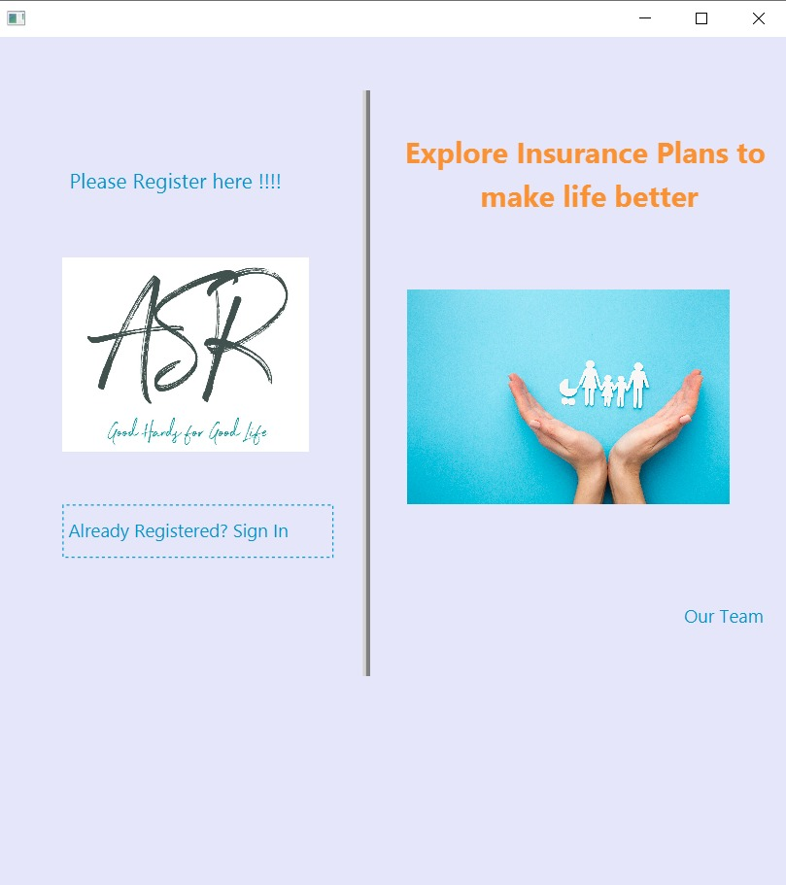
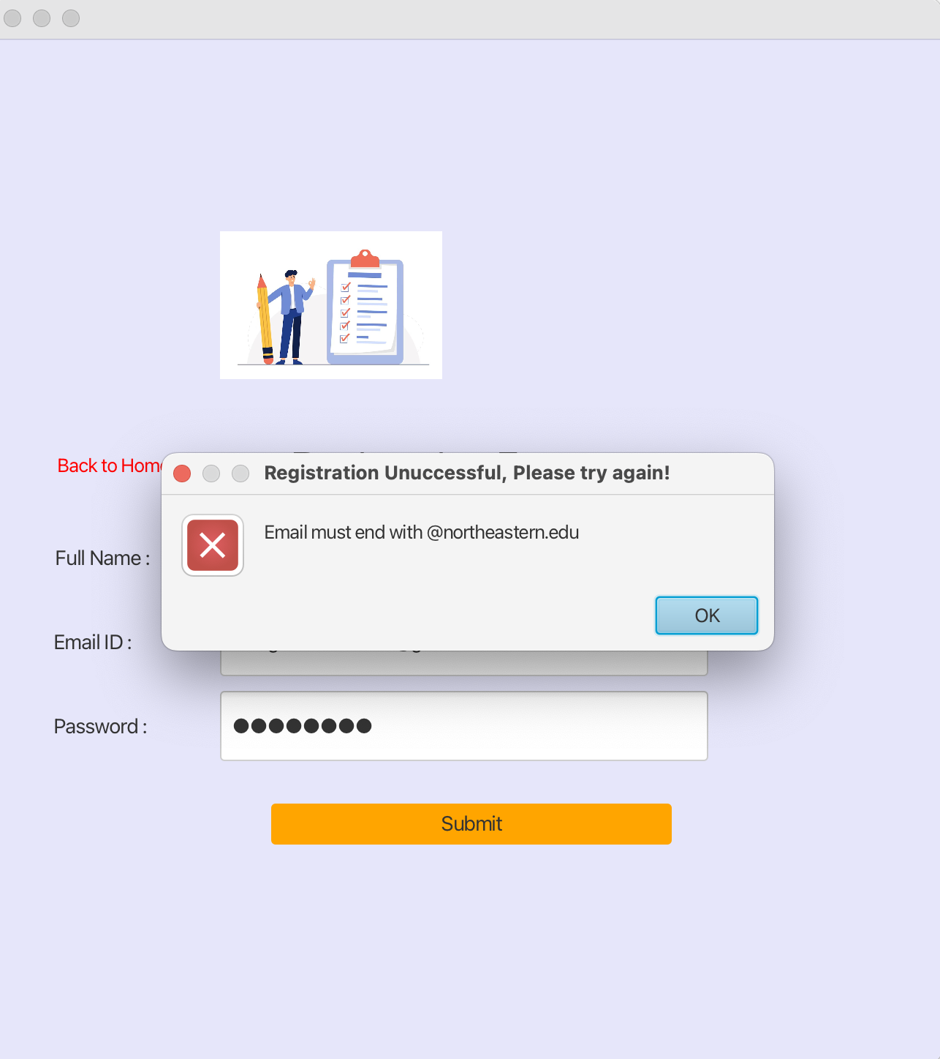
Registration page
The user starts on the Home.fxml page but can navigate to the registration page (primaryview.fxml).
If the registration is successful, the user is redirected to the Logininto.fxml page.
Alerts are used to ensure that the user enters all required data in the correct format before they can register.
When the user clicks the submit button, a Java file is prompted to connect to the database and add the customer's information to the User DB.

Slide 8
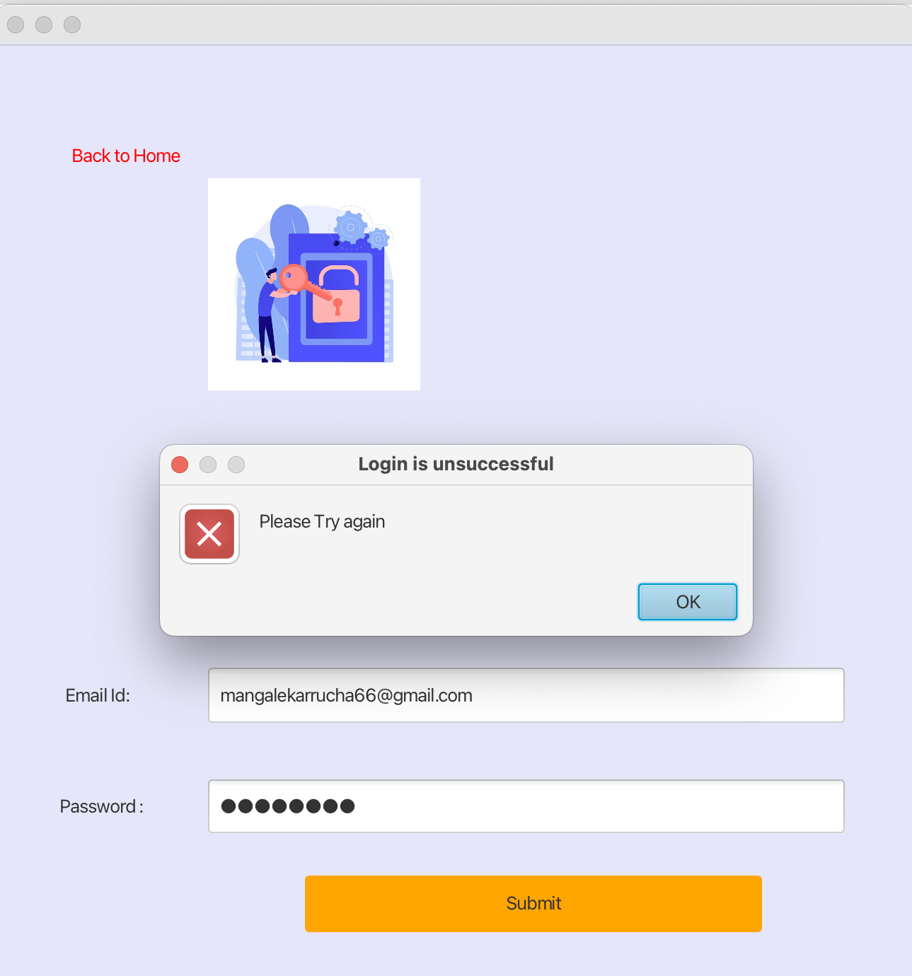
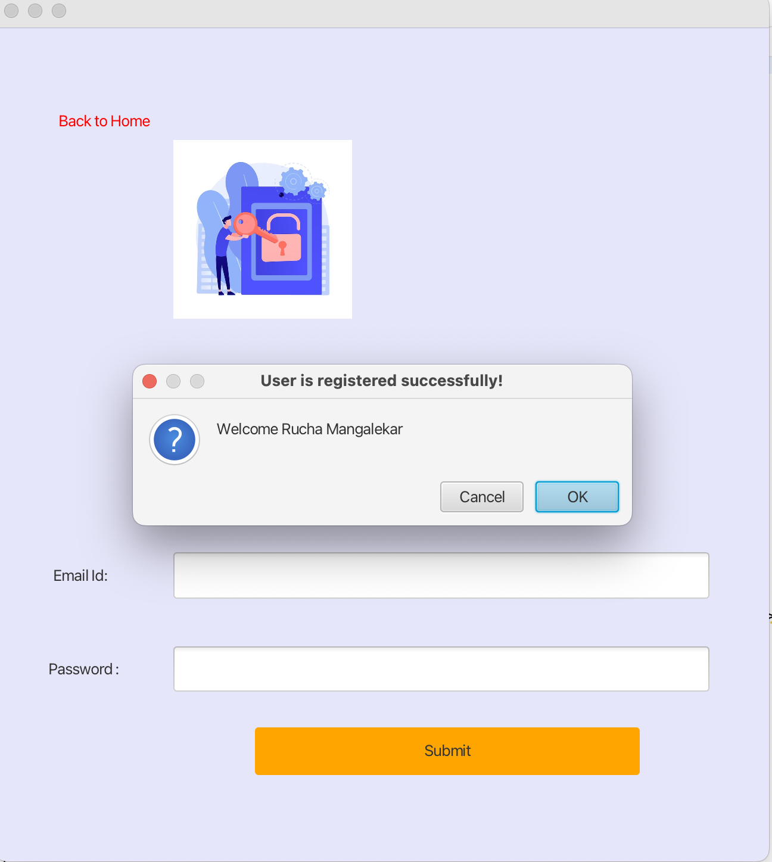
Login page
The user can navigate from the registration page (primaryview.fxml) to the login page (Logininto.fxml).
When the user clicks the submit button, the searchAdminRecord and searchRecord functions are prompted to authenticate the user's credentials.
Alerts are used to inform the user if they have entered incorrect login credentials.
If the login is successful, the user is redirected to the UserHome page (AfterLogin.fxml).

Slide 9
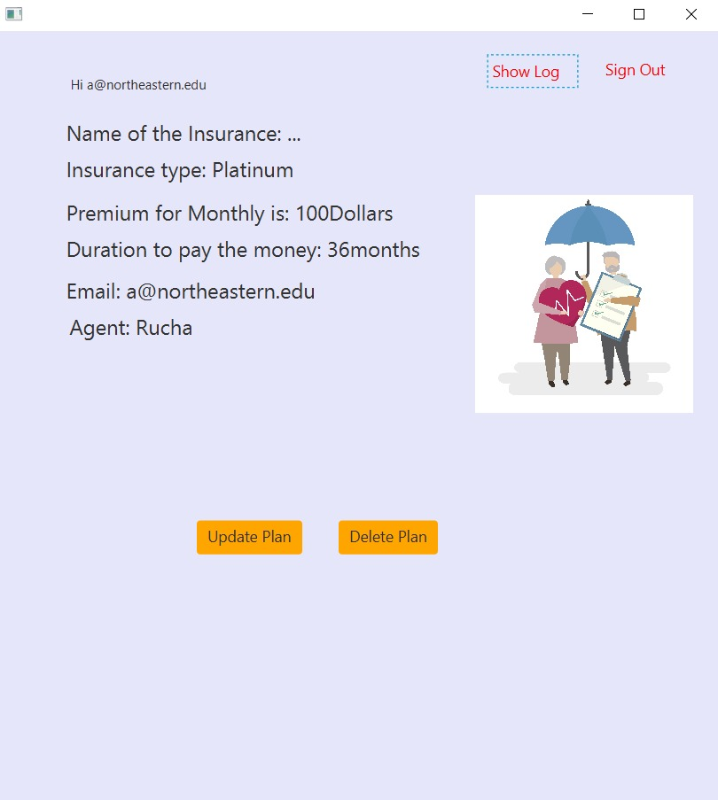
USER HOME
The application then login to AfterLogin.fxml page where customer can be able to enter into his login system.
Customer can be able to Add, update the plan and make claim to the existing plan
If the customer has no existing plan setup, the 'add plan' button is visible or else 'update plan' and 'delete plan' buttons are shown in the login page
Clicking any of Add plan button leads to planadd.fxml page, delete button refreshes the page with your insurance plan removed from DB.

Slide 10
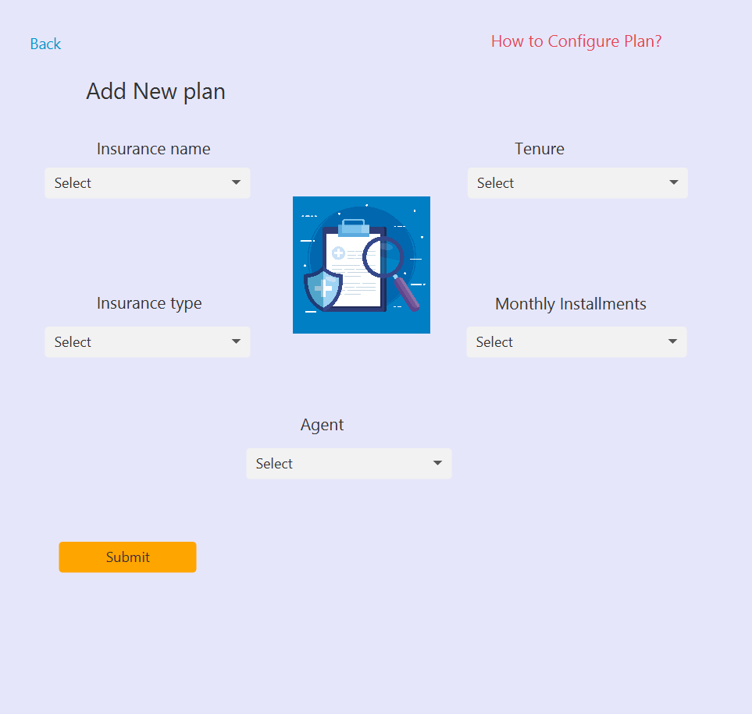
ADD PLAN
The AfterLogin.fxml page has an Add Plan button that leads to the planadd.fxml page for first-time users to add a new insurance plan.
Alerts prevent the user from submitting the plan without selecting all required fields.
Submit button triggers a Java file to add insurance information to the database.
After adding or updating the plan, customer is redirected to the AfterLogin.fxml page

Slide 11
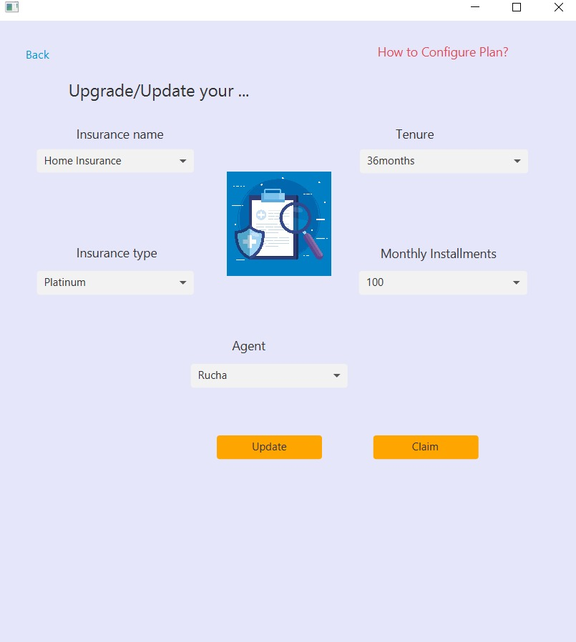
UPDATE Plan
Update button is visible only if the customer has an existing plan in the database.
Update button retrieves the data from Database and shows it in a ComboBox in planadd.fxml
Update button prompts java file to update current Insurance information in the database
On updating the plan , the customer is redirected to AfterLogin.fxml and the updated information of the insurance plan is shown in AfterLogin.fxml

Slide 12
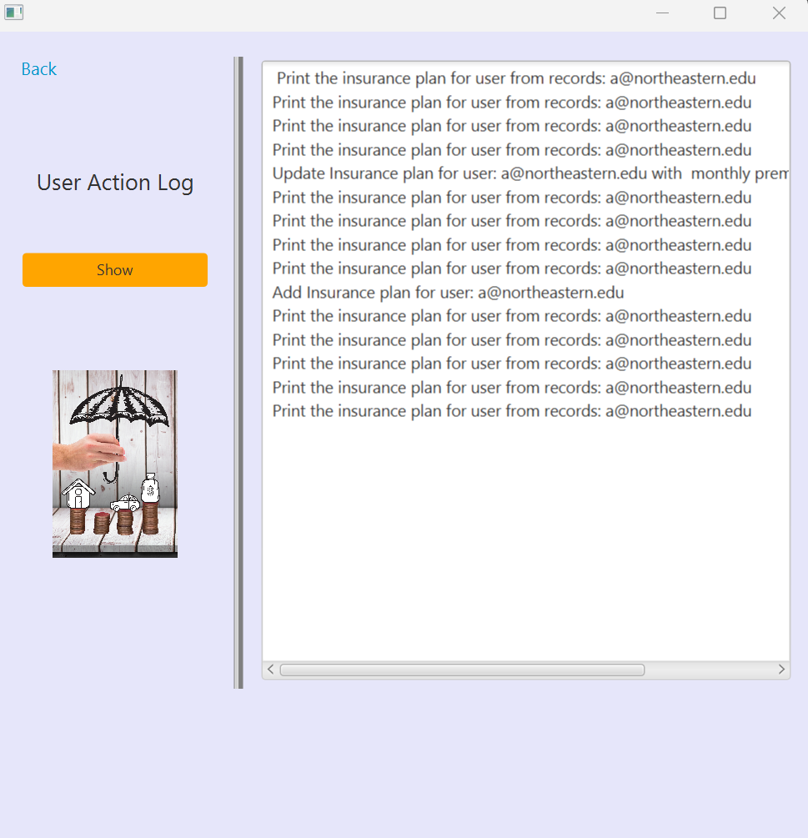
USER ACTION LOG
For every DB action performed, data is pushed into a stack instance.
Show button will the all display the actions performed by customer
To print the log, stack is emptied using pop() and to store the order of actions after printing dequeue is used
Back button we redirect the page into AfterLogin.fxml
When user hits on back button, all data get pushed back to the stack retaining its original order from dequeue

Slide 13
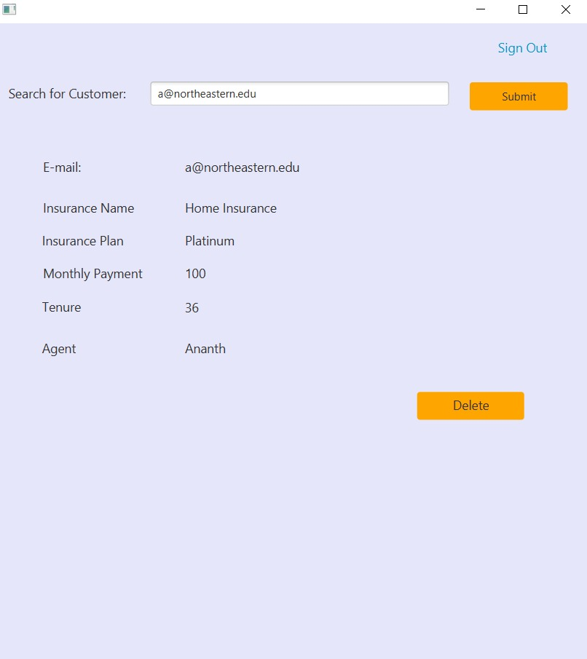
Admin OPERATIONS
The Admin account does not require an "@northeastern.edu" email address.
New Admin accounts can be created by hardcoding them into the DB.java file or by adding them to the database.
Admin can search for insurance plan records in the database using a SQL query.
The deleteRecord instance can be used to remove a user’s plan from the database, and the Signout button redirects to the Logininto.fxml page.

Slide 14
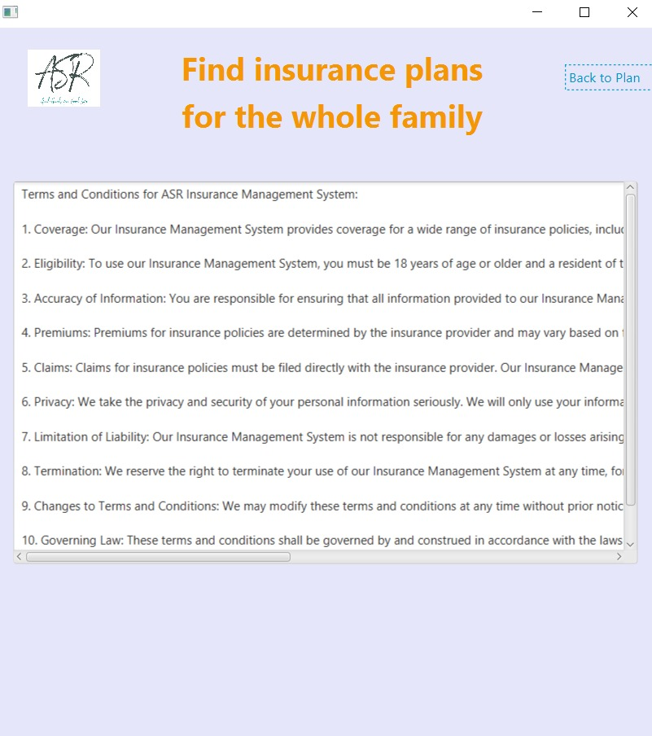
Activity LOG
Description of Available plans and Services:

Slide 15
Future Scope
Adding a chat box to communicate with administrators
Offering an online payment option
Allowing customers to add multiple insurance plans and upgrading the user interface with dynamic content on FXML pages to enhance user experience.

Slide 16
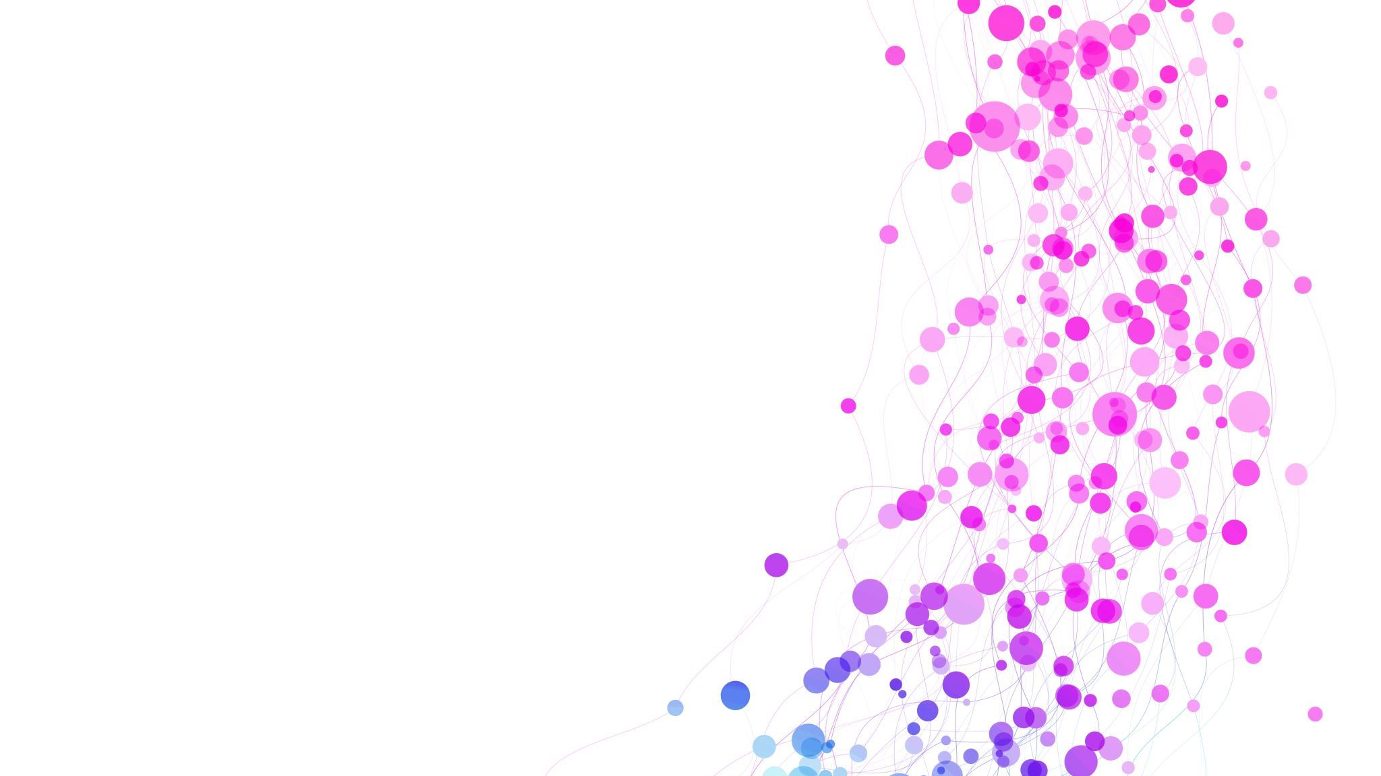
THANK YOU!

