Slide 1

Breast Cancer Immune Heterogeneity within the PAM50 subtype
Saranya Narayana
BINF 5003
Notes:
Good afternoon everyone.
My name is Saranya Narayana and today I'll be presenting my work on breast cancer immune heterogeneity within PAM50 molecular subtypes.

Slide 2
The clinical problem
2.3M
most common cancer in women
New cases worldwide per year
685K
2nd leading cause of cancer death in women
Deaths annually worldwide
30%
despite initial response to treatment
of patients eventually relapse
5
Basal, Her2, LumA, LumB, Normal-like
PAM50 molecular subtypes
References: [1-5]
Notes:
Let me start with why this matters clinically.
Breast cancer affects 2.3 million women worldwide every year and nearly 685K patients die.
Despite significant advances in treatment, around 30% of patients eventually relapse — even those who initially responded well to therapy.
We currently classify breast cancer into five molecular subtypes using the PAM50 system, but this classification describes tumour cell biology. It tells us nothing about the immune microenvironment surrounding the tumour.

Slide 3
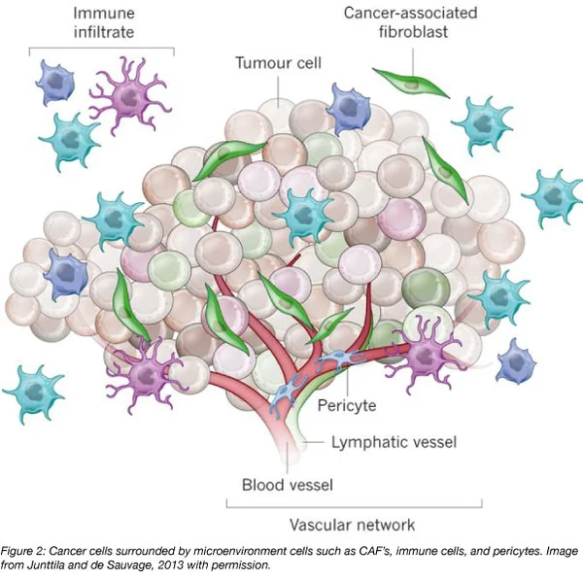
The clinical problem
The Core Problem
▸
Same subtype, different outcomes
▸
Standard classification is incomplete
▸
Immune context is missing
▸
Treatment decisions ignore immunity
Notes:
Let me walk you through the core problem with how we currently classify and treat breast cancer.
On the left you can see a diagram of a breast tumour — and notice it's not just cancer cells.
There are immune cells infiltrating from outside, cancer-associated fibroblasts, pericytes lining the blood vessels, and an entire vascular and lymphatic network supporting it.
This is the tumour microenvironment — and it is just as important as the tumour cells themselves.“
"Now here is the critical point. Our current classification system. PAM50 — only reads the cancer cells in the centre. It completely ignores everything else you see in this diagram. And that is where the problem begins.“
And this gap has real consequences.
For example Take two LumA patients — identical classification, same treatment protocol. One is cured. One relapses within three years. Why? Because One tumour has dense immune infiltration. The other is an immune desert. PAM50 cannot distinguish them.
This matters because treatment decisions cannot afford to ignore the immune landscape.

Slide 4
Research question
Do immune-related gene expression patterns reveal biologically meaningful heterogeneity within breast cancer PAM50 subtypes beyond what is captured by standard molecular subtyping?
Hypothesis:
There is an immune-related heterogeneity within the PAM50 subtype
Notes:
"This is exactly what motivated my research question — can we use immune gene expression to find meaningful subgroups within PAM50 subtypes?
my hypothesis is yes —Let me show you how I approached that."

Slide 5
Methodology
01. Data
03. Consensus Clustering
04. DE analysis
02. Immune deconvolution
05. Pathway analysis
Obtained from TCGA-BRCA
QC-Meta data: remove duplicates, missing values
QC-Counts:60,660 genes filtered to 23,059; 1 outlier removed (n=1,013)
7 methods:
GSVA, ssGSEA,
quanTIseq, MCP, EPIC, xCell, CIBERSORT
PCA + ConsensusClusterPlus
Elbow PC selection
10% balance rule per subtype
DESeq2 differential expression
Normal-cluster based
Other subtypes-cytotoxic gene groups
Fgsea: Hallmark + Reactome
18,568 genes tested
Notes:
My pipeline has five steps.
I started with TCGA-BRCA RNA-seq data — 1,013 primary tumour samples. after stringent quality control, reducing from an initial 60K genes to 23K expressed genes.
I then applied 7 computational immune quantification methods to extract immune features per sample.
These features feed into consensus clustering with a 10% balance rule to identify stable immune subgroups.
The resulting subgroup labels are used for differential expression using DESeq2,
and finally I performed pathway enrichment using fgsea with Hallmark and Reactome gene sets.

Slide 6
How was the immune microenvironment measured?
Gene Set Variation Analysis
ssGSEA
Single-sample GSEA
GSVA
ssGSEA
Gene set enrichment (-1 to +1 score)
Per-sample enrichment score
✓ Pathway-level immune signatures
✓ Consistent with GSVA, independent
Quantitative Immune Cell Deconv.
MCP-counter
Microenvironment Cell Populations
quanTIseq
MCP-counter
Marker gene relative enrichment
Absolute cell-type fractions (0-1)
✓ Calibrated against cytometry data
✓ Reliable for abundant cell types
xCell
Cell-type Enrichment Analysis
EPIC
Estimating Prop. of Immune Cells
xCell
Tumour-purity-aware fractions
64 cell-type enrichment scores
✓ Handles stromal/cancer cells well
✓ Broadest cell-type coverage
CIBERSORT (7th method) withheld as an independent validation tool
Notes:
7 complementary computational methods were applied to bulk RNA-seq data to estimate immune cell composition
This is done because each method has different strengths and biases.
GSVA and ssGSEA provide pathway-level enrichment scores.
QuanTIseq, MCP-counter, EPIC, and xCell estimate the abundance of specific immune cell types.
Crucially, CIBERSORT was held out entirely from feature construction and used only for independent validation

Slide 7
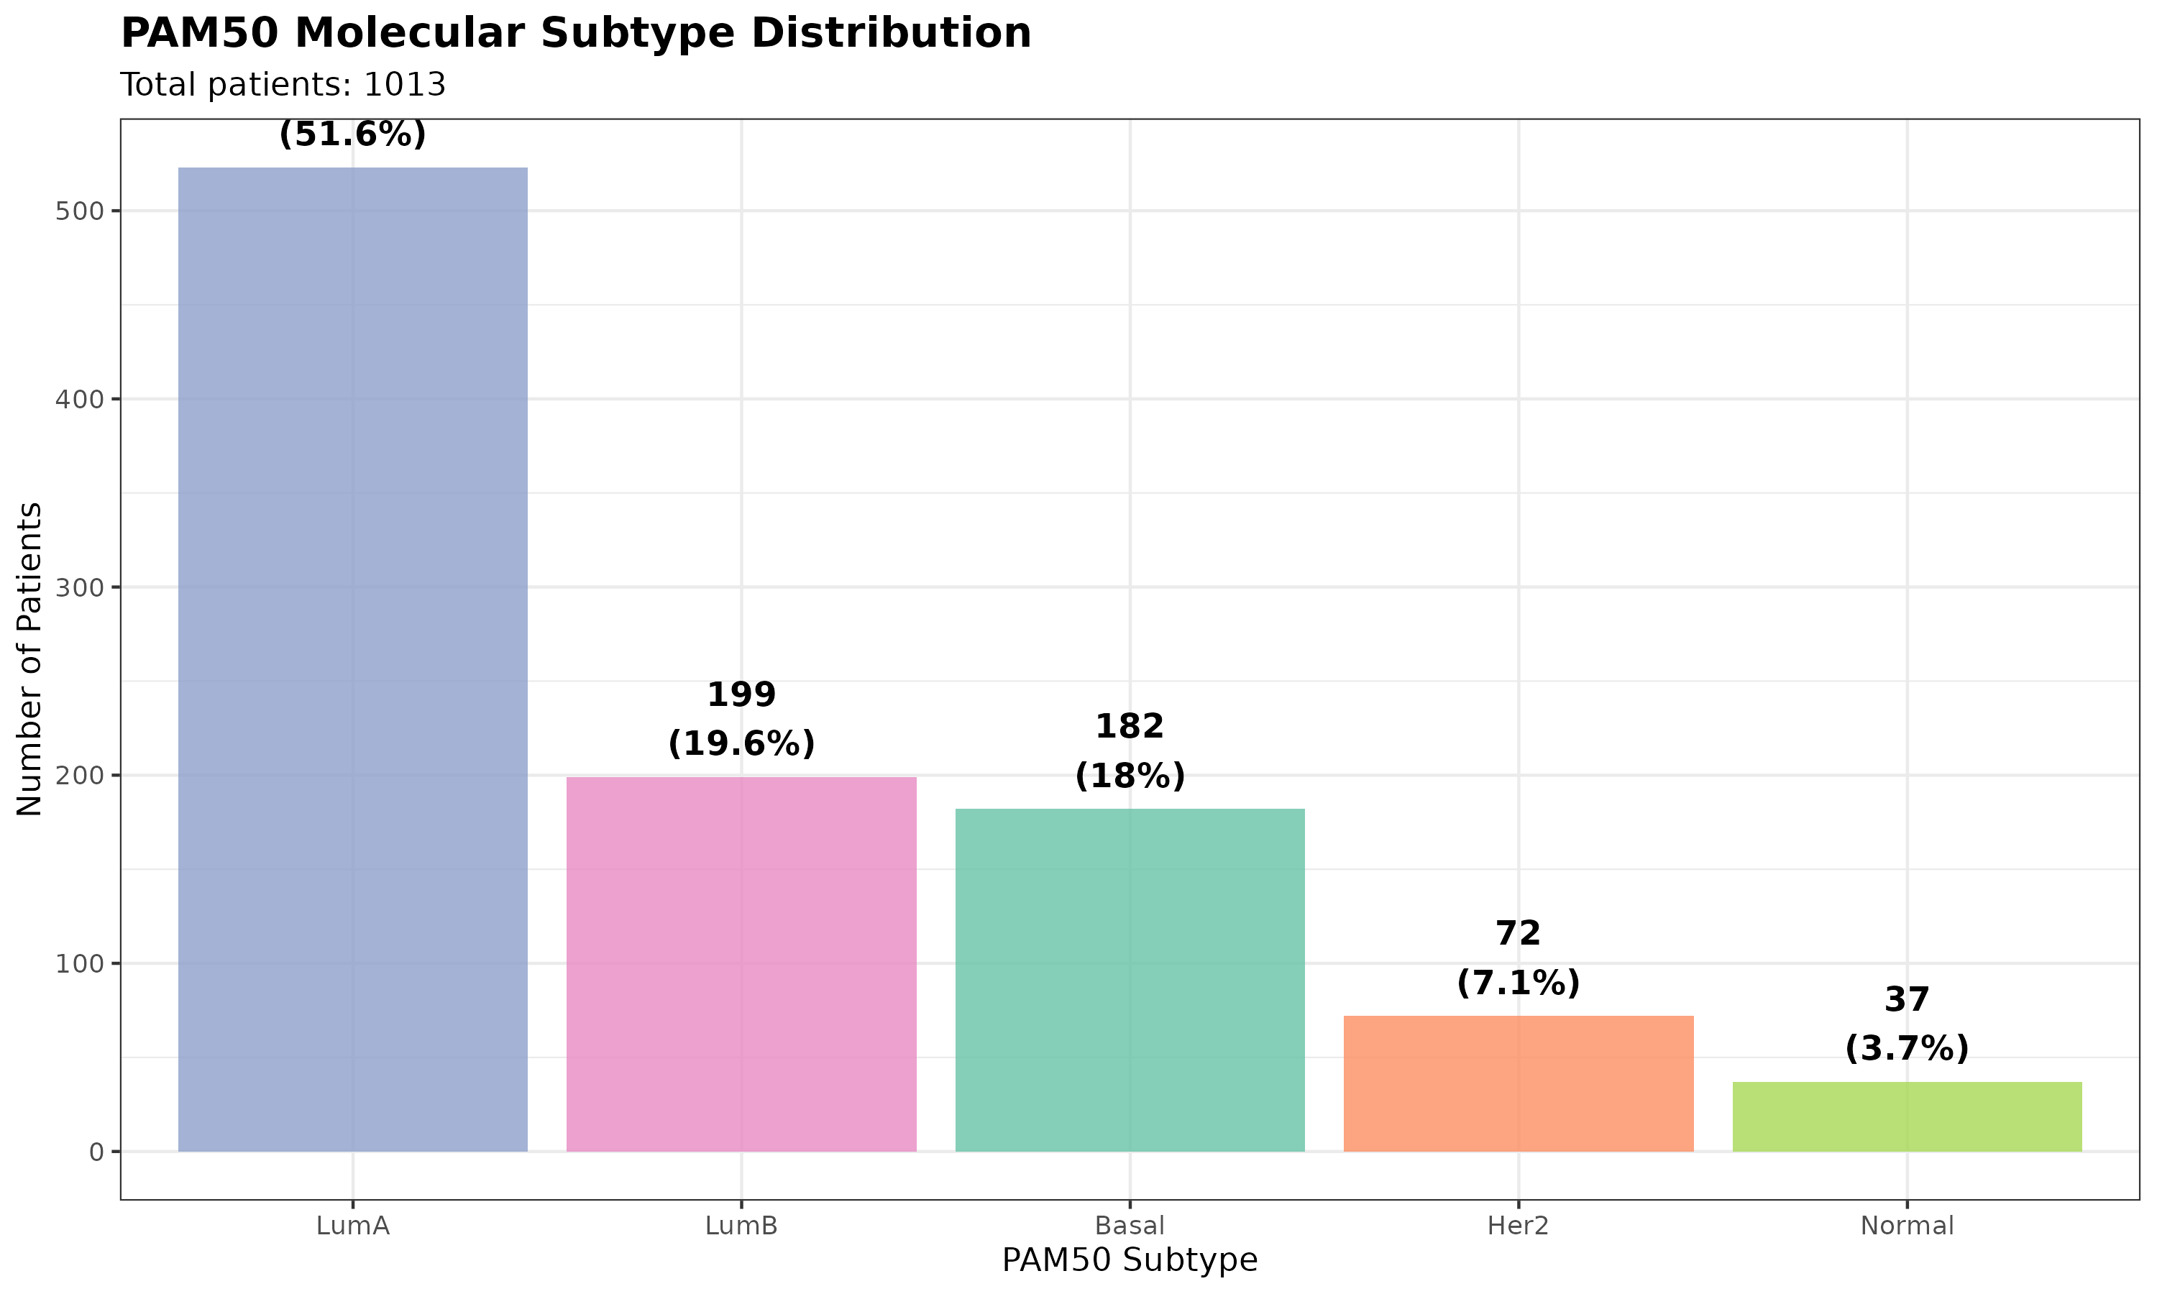
Meta Data
Data & QC Summary
Source: TCGA-BRCA (GDC portal)
Pipeline: STAR-Counts (harmonised)
Started: 1,111 samples downloaded
After deduplication: 1,095 patients
After clinical QC: 1,014 patients
Final: n = 1,013 (1 QC outlier removed)
Genes: 60,660 → 23,059 (TPM>1 in ≥10%)
Normalisation: DESeq2 VST (primary)
523
Notes:
Now moving to results.
This bar chart shows sample distribution across 5 PAM50 subtypes.
Final data had 1,013 samples across five PAM50 subtypes, with LumA being the most common at 52%, and this is consistent with population-level ER-positive breast cancer prevalence.
Of all subtypes, Normal had few sample of 37.

Slide 8
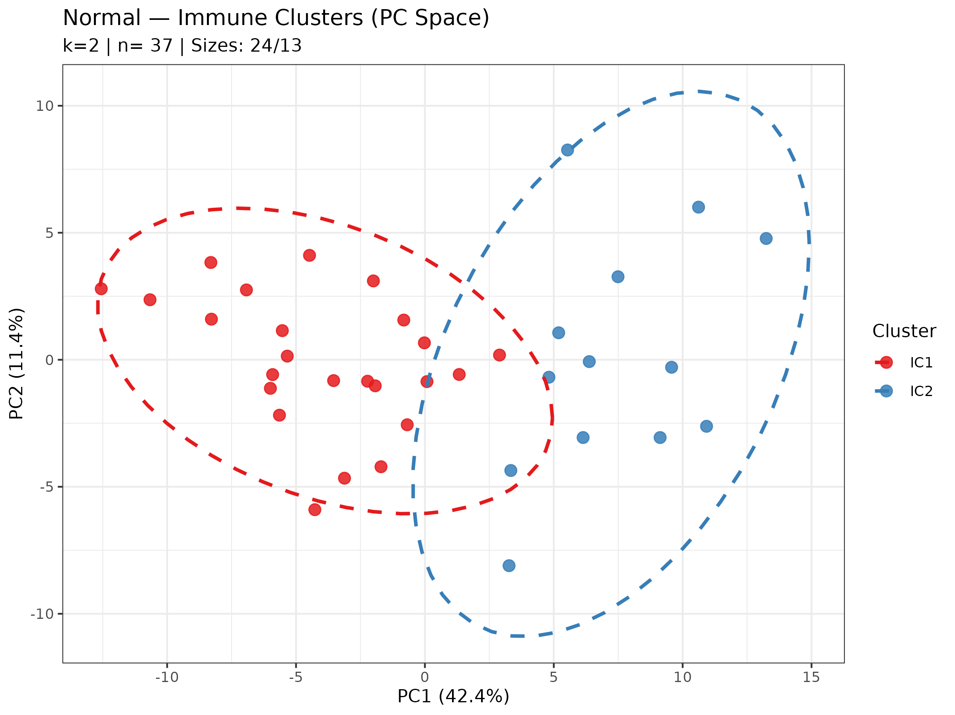
Immune deconvolution & consensus clustering
159 immune features per sample
Clustering Results (10% Balance Rule)
Basal (n=182): 166/16 | 8.8% | FAIL
Her2 (n=72): 66/6 | 8.3% | FAIL
LumA (n=523): 520/3 | 0.6% | FAIL
LumB (n=199): 191/8 | 4.0% | FAIL
Normal (n=37): 24/13 | 35.1% | PASS ✓
Only Normal-like subtype → genuine IC1 / IC2 immune subgroups
Notes:
Here is one of the most important results.
Immune deconvolution using all 7 methods yielded 159 immune features.
I applied consensus clustering to each subtype independently and tested whether stable immune subgroups exist with 6 Immune deconvolution methods only except the cibersort which was used for the validation.
The 10% balance rule requires that the smaller cluster contains at least 10% of the subtype's samples — otherwise we're just finding a handful of outliers.
Basal, Her2, LumA, and LumB all fail this test — their immune landscapes were relatively homogeneous.
Only Normal-like passes, with 37 samples splitting into IC1 of 24 and IC2 of 13 samples — that's 35% in the smaller cluster
The PCA scatter plot confirms this separation, with PC1 explaining 42% of the immune variance separating the two groups.

Slide 9
Normal-like:IC1 vs IC2 Biological characterization
IC1: Immune-Cold (n = 24)
IC2: Immune-Inflamed (n = 13)
Low immune infiltration across all methods
Stromal genes upregulated (ACSM1, PEBP4)
No T cell activation markers
Immune-excluded phenotype (M2-mediated)
TCR variable genes: TRBV5-1, TRAV8-2 → clonal expansion
CD8A, GZMB, PRF1, IFNG → cytotoxic killing
PDCD1, CD274, LAG3, TIGIT → checkpoint activation
MS4A1, PRKCB → B cell presence confirmed
VS
✓ CIBERSORT independent validation: B cell memory significantly higher in IC2 (p < 0.01) -> cross-method confirmation
Notes:
So what makes IC1 and IC2 biologically different?
IC1 is immune-cold — low infiltration across all methods, stromal gene upregulation, and No T-cell activation markers.
M2 macrophages actively suppress cytotoxic immunity and likely drive the immune exclusion in these tumours.
IC2 is strikingly different.
We see T cell receptor variable genes — TRBV5-1 and TRAV8-2 — indicating clonally expanded, antigen-specific T cells.
These aren't just T cells that wandered in; these are T cells that recognised a tumour antigen and proliferated in response.
Alongside this, we see the checkpoint genes PD-1, PD-L1, LAG3, and TIGIT co-elevated
Also, the elevated presence of B-cells
And this IC1 vs IC2 difference is validated independently by CIBERSORT,, which was not used in constructing these clusters-B cell was significantly higher in cluster 2 — confirming this is real biology, not an algorithmic artefact.

Slide 10
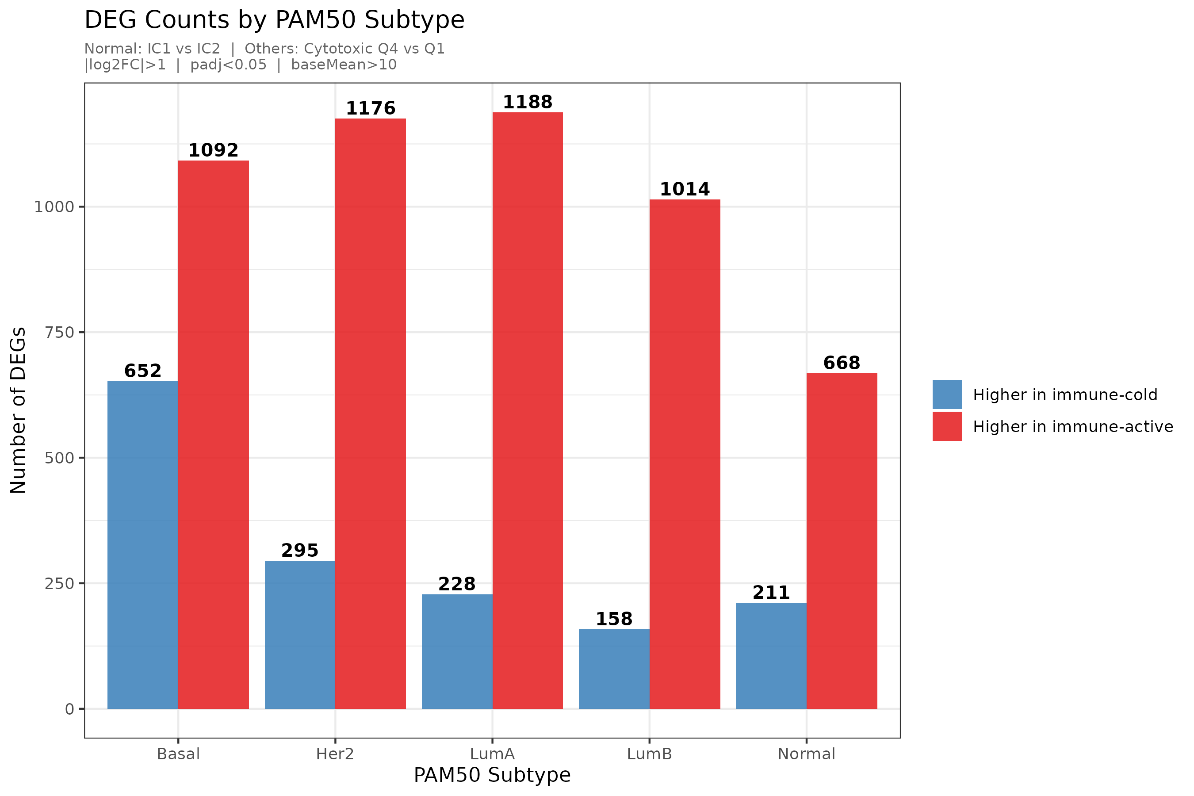
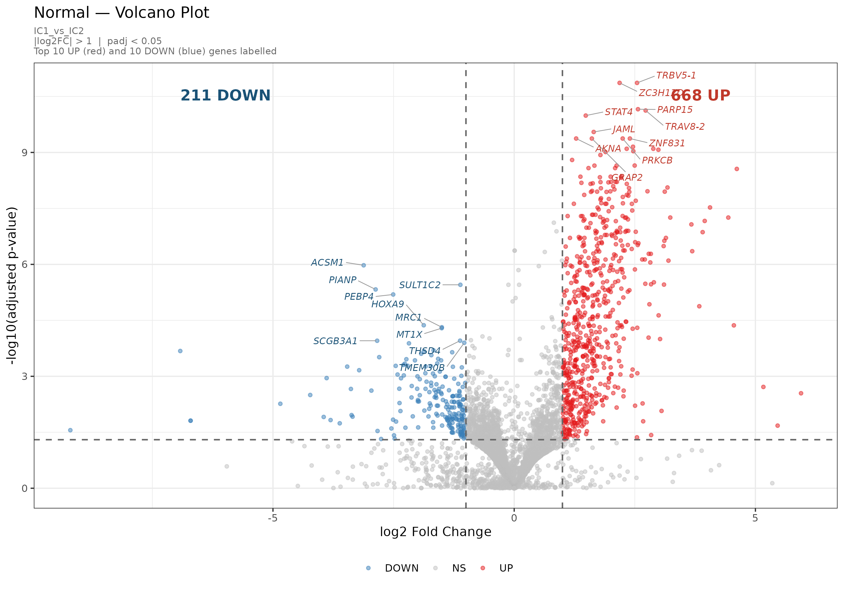
Differential expression results
Universal UP genes across 4 subtypes: NKG7, CD247, CD8A, TBX21, CD2, GZMA -> canonical cytotoxic T cell
Normal-unique: TRBV5-1, TRAV8-2 -> TCR variable genes indicating antigen-specific clonal expansion
Notes:
Across all five subtypes, DESeq2 identifies hundreds to over a thousand differentially expressed genes between immune-active and immune-cold groups.
The bar chart shows a consistent pattern — far more genes are upregulated in immune-active tumours than downregulated
Two findings stand out. First, six genes — NKG7, CD247, CD8A, TBX21, CD2, and GZMA — are upregulated in at least four of the five subtypes. These form a universal cytotoxic T cell signature.
Second, unique to Normal-like IC2 are the TCR variable genes TRBV5-1 and TRAV8-2 — indicating the clonal T cell expansion we identified in the clustering.

Slide 11
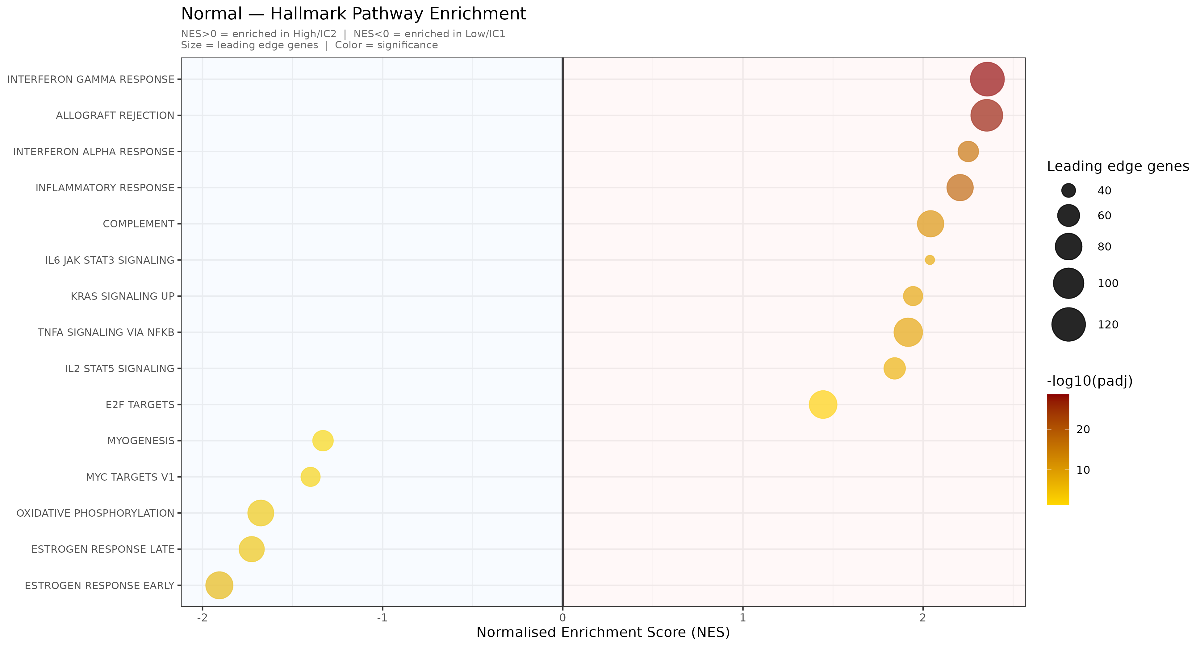
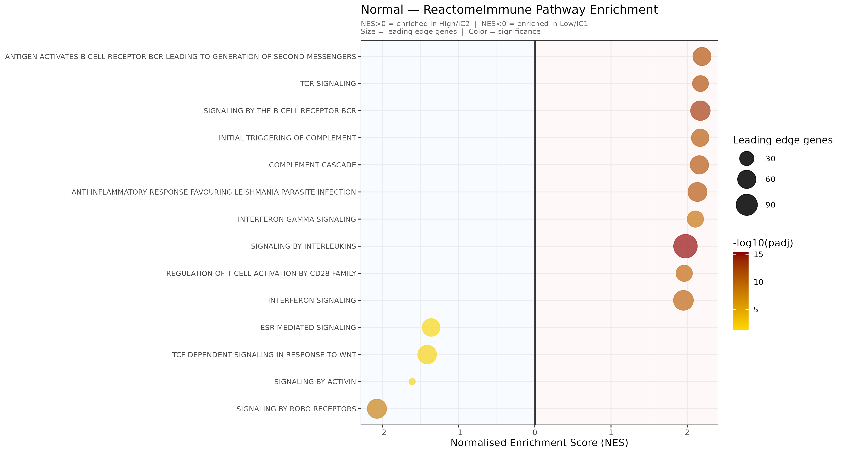
Pathway analysis
NES > 0 = enriched in IC2 (immune-active) | NES < 0 = enriched in IC1 (immune-cold) | Dot size = leading edge genes | Colour = significance (-log10 padj)
Universal (all 5 subtypes): HALLMARK_ALLOGRAFT_REJECTION + HALLMARK_INTERFERON_GAMMA_RESPONSE -> core cytotoxic T/NK programme active in ALL PAM50 subtypes when immune infiltration is high.
Notes:
This 2 bubble plots are for the hallmark enrichment and the Reactome immune pathway
On the left side, bubble plots for Normal-like show that immune-active IC2 is enriched for interferon-gamma response and allograft rejection pathways — both hallmarks of active cytotoxic immunity.
However, The left side of this plot shows immune-cold IC1 enriched for estrogen response and proliferation pathways, consistent with the luminal/stromal biology of that group.
If we look at the reactome bubble plot on the right IC2 is enriched for B cell related pathways and highly emriched for interluckin pathway.
Importantly, HALLMARK_ALLOGRAFT_REJECTION and HALLMARK_INTERFERON_GAMMA_RESPONSE are significant in all five PAM50 subtypes — this is our universal finding and it tells us that the core anti-tumour T and NK cell is conserved across breast cancer biology.

Slide 12
Key findings
1
Only Normal-like has genuine immune subgroups
2
Clonal T cell expansion in Normal IC2
3
Stromal content as the primary immune axis
4
Universal cytotoxic T cell programme
Notes:
Let me summarise the four key findings.
First: only Normal-like shows genuine discrete immune subgroups — the other four subtypes are immune-homogeneous by this analysis.
Second: IC2 demonstrates clonal antigen-specific T cell expansion with co-elevated checkpoint molecules — this is the phenotype that checkpoint blockade is designed to treat.
Third: Normal-like classification may partly reflect stromal gene dilution.
Fourth: a universal cytotoxic T cell operates across all PAM50 sutypes

Slide 13

Conclusion & clinical relevance
Normal-like IC2 tumors express immune checkpoints alongside cytotoxic T cells -> potential candidates for checkpoint blockade therapy.
The cytotoxic T cells are universal across all PAM50 subtypes, suggesting immunotherapy targets apply across breast cancer subtype classifications.
Normal-like PAM50 classification likely reflects stromal gene dilution -> clinical reclassification may be warranted for this subgroup.
Notes:
In conclusion, our analysis shows that immune gene expression reveals clinically meaningful heterogeneity that PAM50 classification misses.
Normal-like IC2 patients express the full checkpoint activation signature alongside cytotoxic T cells — they may be candidates for checkpoint blockade.
The universal cytotoxic cells suggests immune landscape scoring should complement PAM50 in treatment decisions.
The Normal-like stromal finding warrants investigation into whether these patients are currently misclassified.
Future work should validate these subgroups in independent cohorts and test whether IC2 patients indeed have superior responses to immunotherapy.

Slide 14
References
WHO (2022). Breast cancer fact sheet. https://www.who.int/news-room/fact-sheets/detail/breast-cancer
GLOBOCAN/IARC (2022). Global Cancer Observatory. https://gco.iarc.fr/
Parker JS et al. (2009). Supervised risk predictor of breast cancer based on intrinsic subtypes. J Clin Oncol 27:1160-1167.
Perou CM et al. (2000). Molecular portraits of human breast tumours. Nature 406:747-752.
The Cancer Genome Atlas Network. Comprehensive molecular portraits of human breast tumours. Nature 490, 61–70 (2012). https://doi.org/10.1038/nature11412
Chen DS & Mellman I (2017). Elements of cancer immunity and the cancer-immune set point. Nature 541:321-330.
Hanahan D (2022). Hallmarks of Cancer: New Dimensions.Cancer Discovery 12:31-46.
Schmid P et al. (2018). Atezolizumab and nab-paclitaxel in advanced triple-negative breast cancer (IMpassion130). NEJM 379:2108-2121.
Denkert C et al. (2018). Tumour-infiltrating lymphocytes and prognosis in different subtypes of breast cancer: a pooled analysis of 3771 patients. Lancet Oncol19(1):40-50.
Hänzelmann S et al. (2013). GSVA: gene set variation analysis. BMC Bioinformatics 14:7.
Finotello F et al. (2019). quanTIseq. Genome Medicine 11:34.
Becht E et al. (2016). MCP-counter. Genome Biology 17:218.
Racle J et al. (2017). EPIC. eLife 6:e26476.
Aran D et al. (2017). xCell. Genome Biology 18:220.
Newman AM et al. (2015). CIBERSORT. Nature Methods 12:453-457.

Slide 15

Notes:
Thank you — I'm happy to take questions.

Slide 16
limitations
1. Bulk RNA-seq cannot distinguish between cell types within a tumour — it measures the mixture-only spatial transcriptomics or single-cell RNA-seq can resolve this.
2. The Normal-like subgroup is very small (n=37 total, IC2 n=13). Validation in larger independent cohorts is essential before clinical application.
3. This is a retrospective analysis of archived TCGA data — we have no prospective treatment or immunotherapy response data to directly validate the clinical predictions.
4. Survival analysis (Script 07) was planned but not presented here — the association between immune scores and patient outcomes requires further analysis.
5. The clustering was performed within each PAM50 subtype independently — we may have missed cross-subtype immune phenotypes that span multiple subtypes.

Slide 17
The clinical problem
2.3M
most common cancer in women
The Core Problem
New cases worldwide per year
▸
Same subtype, different outcomes
Two LumA patients get the same treatment. One is cured. One relapses. Why?
685K
2nd leading cause of cancer death in women
Deaths annually worldwide
▸
Standard classification is incomplete
PAM50 describes tumour cell biology, not the surrounding immune microenvironment.
30%
despite initial response to treatment
▸
Immune context is missing
of patients eventually relapse
TILs, macrophage polarisation, and checkpoint expression vary enormously within each subtype.
5
Basal, Her2, LumA, LumB, Normal-like
▸
Treatment decisions ignore immunity
PAM50 molecular subtypes
Immunotherapy eligibility based on PAM50 alone misses the immune landscape determining response.
References: [1-5]
Notes:
Let me start with why this matters clinically.
Breast cancer affects 2.3 million women worldwide every year and nearly 685K patients die.
Despite significant advances in treatment, around 30% of patients eventually relapse — even those who initially respond well to therapy.
We currently classify breast cancer into five molecular subtypes using the PAM50 system, but this classification describes tumour cell biology only. It tells us nothing about the immune microenvironment surrounding the tumour.
5. Let me walk you through the core problem with how we currently classify and treat breast cancer."
6. Same subtype, different outcomes
PAM50 gives two patients the same label — but their tumours behave completely differently and so their response to treatment
The subtype label tells us what kind of cancer it is — but not why one patient responds and the other doesn't
Something beyond the molecular subtype is driving this difference — and I believe it's the immune microenvironment
▸ Standard classification is incomplete
PAM50 was built using 50 genes that reflect tumour cell biology — proliferation rate, hormone receptor status, HER2 expression
Those 50 genes were deliberately chosen to exclude stromal and immune signals
So by design, PAM50 is blind to everything happening around the tumour cell
We are making clinical decisions with a classification that only sees half of the picture
▸ Immune context is missing-TILs, macrophage polarisation, and checkpoint expression vary enormously within each subtype. None of this is captured with PAM50 subtype. None of this informs treatment decisions. That is the gap this project addresses.
▸ Treatment decisions ignore immunity
Checkpoint blockade drugs like pembrolizumab and atezolizumab only work in tumours where T cells are present and active
A patient with an immune-cold LumA tumour will not respond — but a patient with an immune-active LumA tumour might benefit enormously
PAM50 classification alone cannot tell us which patient is which
We are potentially denying immunotherapy to patients who would respond, and offering it to patients who won't — because we are not looking at the immune landscape

Slide 18
Why immune heterogeneity matters
Clinical impact: patient selection for immunotherapy
Checkpoint Blockade Response Prediction
01
Two patients with the same PAM50 subtype may have completely different immune landscapes. One eligible for immunotherapy, one is not. Without immune profiling, this distinction is missed. Eg: PD-1/PD-L1 inhibitors work only in tumors with T cell infiltration.
Clinical impact: independent prognostic biomarker
Survival Beyond Standard Prognostic Factors
02
Immune signal is not captured in standard clinical staging. Eg: Tumour-infiltrating lymphocyte (TIL) scores predict survival independently of tumour stage, grade, and PAM50 subtype. High TIL patients have better outcomes in Basal and Her2 breast cancer.
Subtype-Specific Treatment Stratification
Clinical impact: novel treatment stratification beyond PAM50
03
Understanding shared immune programmes across subtypes may unlock cross-subtype treatment strategies.
Notes:
This gap has three direct clinical consequences.
First, checkpoint blockade therapies like pembrolizumab only work in tumours with T cell infiltration — without immune profiling, we cannot identify which patients will benefit.
Second, tumour-infiltrating lymphocyte scores predict survival independently of stage and PAM50 subtype — this information exists in the expression data but we don't currently use it for treatment decisions.
Third, Understanding shared immune programmes across subtypes may unlock cross-subtype treatment strategies
The tumour microenvironment (TME) consists of tumour cells, immune cells, stromal cells and their signalling molecules. The composition of the TME determines therapy response and patient survival. While patients might share the same clinical label (like Luminal A), their biological "soil"—the Tumor Immune Microenvironment (TIME)—can be completely different, leading to varied treatment responses.
Slide 5 — Why Immune Heterogeneity Matters
"PD-1/PD-L1 inhibitors work only in tumours with T cell infiltration"
Reference: Topalian SL et al. (2012). Safety, activity, and immune correlates of anti–PD-1 antibody in cancer. NEJM 366:2443–2454. doi:10.1056/NEJMoa1200690
Reference: Schmid P et al. (2018). Atezolizumab and nab-paclitaxel in advanced triple-negative breast cancer. NEJM 379:2108–2121. doi:10.1056/NEJMoa1809615 — IMpassion130, the landmark breast cancer immunotherapy trial.
"TIL scores predict survival independently of tumour stage, grade, and PAM50 subtype"
Denkert and colleagues showed in a pooled analysis of 3,771 patients that increased TIL concentration predicted response to neoadjuvant chemotherapy in all molecular subtypes and was associated with a survival benefit in HER2-positive breast cancer and TNBC. The Lancet
Reference: Denkert C et al. (2018). Tumour-infiltrating lymphocytes and prognosis in different subtypes of breast cancer: a pooled analysis of 3771 patients treated with neoadjuvant therapy. Lancet Oncology 19(1):40–50. doi:10.1016/S1470-2045(17)30904-X
"Immune-hot LumA tumours have biologically identical programmes to immune-hot Basal"
Reference: This is a finding from your own analysis (Script 08 DEG results). Supported by: Gruosso T et al. (2019). Spatially distinct tumour immune niches in human breast cancers are associated with clinical outcome. Nature Communications 10:5093. doi:10.1038/s41467-019-13007-0

