Slide 1
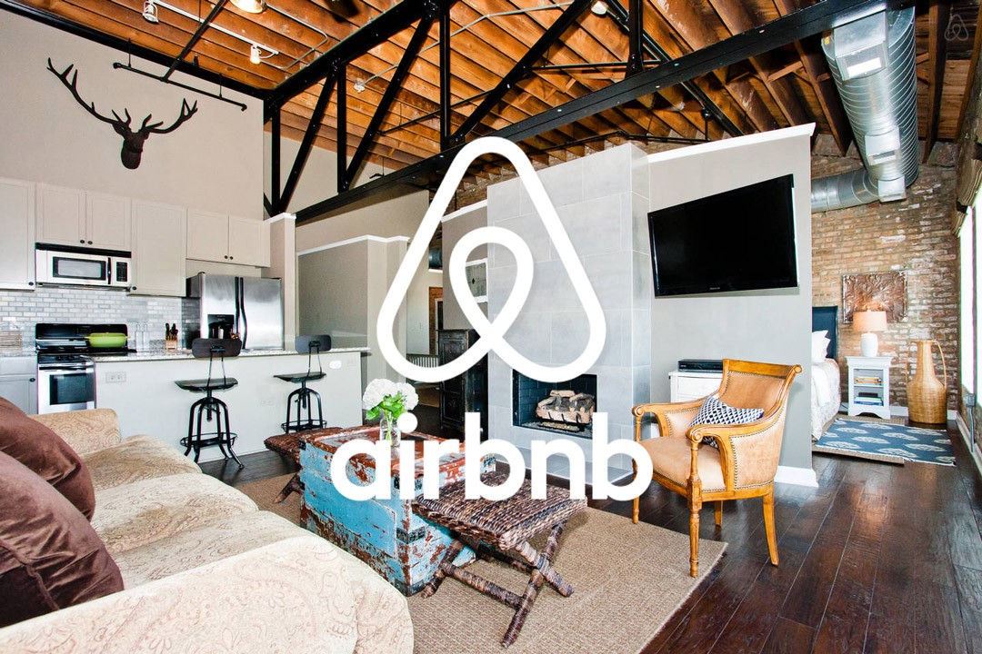
Futuristic
Saranya
Vaish
Madhavi
Olga

Slide 2

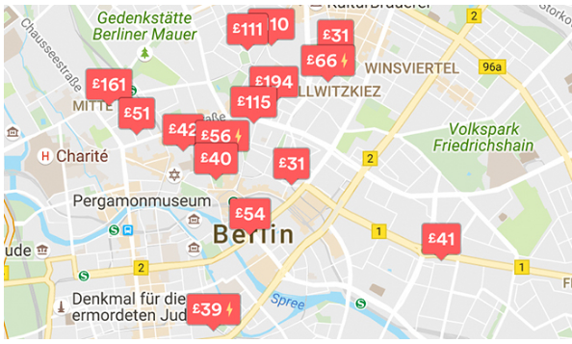

Motivation
To find a better Accommodation for the guests in Berlin based on customer requirements.
To improve the Host’s business in Airbnb Berlin.

Slide 3

Topics Covered in Presentation
Data Sources
Data Clean up & Exploration
Data Analysis
Outcomes/Take Aways
Conclusion
Future Work

Slide 4
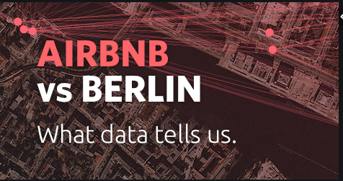
Data Sources
https://www.kaggle.com/brittabettendorf/berlin-airbnb-data
http://insideairbnb.com/get-the-data.html

Slide 5
