Slide 1
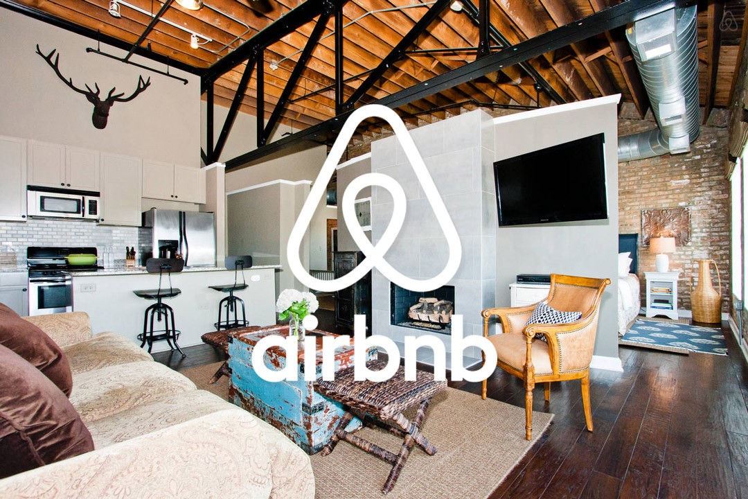
Futuristic
Saranya
Vaish
Madhavi
Olga

Slide 2

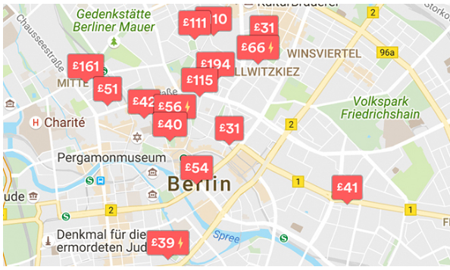

Motivation
To find a better Accommodation for the guests in Berlin based on their requirements.
To improve the Host’s business in Airbnb Berlin.

Slide 3

Topics Covered in Presentation
Data Sources
Data Clean up & Exploration
Data Analysis
Outcomes/Take Aways
Conclusion
Future Work

Slide 4
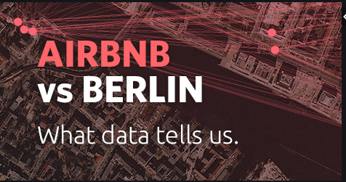

Data Sources
Source Data
API Data
https://www.kaggle.com/brittabettendorf/berlin-airbnb-data
http://insideairbnb.com/get-the-data.html
https://api.yelp.com/v3/businesses/search
https://maps.googleapis.com/maps/api/geocode/json?

Slide 5

Data Sources Description
Source Data :
The Kaggle datasets were scraped on November 07th, 2018 and contains the detailed listings data, review data and calendar data of current Airbnb listings in Berlin from 2008 to 2018.
The Kaggle datasets were scraped from the insideairbnb.com source.
API Data :
We have used the yelp and google api to retrieve the top 5 star ratings restaurants/café/bars around the top accommodations in berlin.

Slide 6
Data Clean Up & Exploration

Slide 7
