Slide 1

Futuristic
Saranya
Vaish
Madhavi
Olga

Slide 2

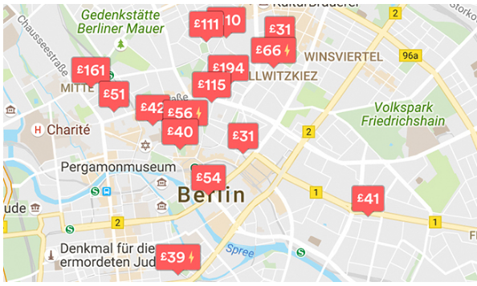

Motivation
To find a better Accommodation for the guests in Berlin based on their requirements.
To improve the Host’s business in Airbnb Berlin.

Slide 3

Topics Covered in Presentation
Data Sources
Data Clean up & Exploration
Data Analysis
Outcomes/Take Aways
Conclusion
Future Work

Slide 4


Data Sources
Source Data
API Data
https://www.kaggle.com/brittabettendorf/berlin-airbnb-data
http://insideairbnb.com/get-the-data.html
https://api.yelp.com/v3/businesses/search
https://maps.googleapis.com/maps/api/geocode/json?

Slide 5

Data Sources Description
Source Data :
The Kaggle datasets were scraped on November 07th, 2018 and contains the detailed listings data, review data and calendar data of current Airbnb listings in Berlin from 2008 to 2018.
The Kaggle datasets were scraped from the insideairbnb.com source. The latest scrapped was on 8th June, 2019. ( We will be using the 8th June 2019 data for our analysis)
API Data :
We have used the yelp and google api to retrieve the top ratings restaurants/café/bars around the top accommodations in berlin.

Slide 6
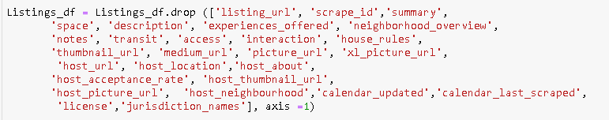
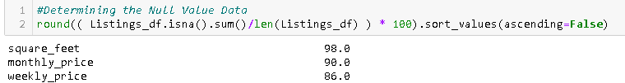
Data Clean Up & Exploration
There were around 106 features in Airbnb Listing Dataset consisting of various descriptive, categorical, numerical, Boolean, etc. fields. Few fields in the dataset had its own limitations. Below are the few data cleaning process implemented using Pandas as part of this Dataset.
Few unnecessary columns were dropped in the Listing Data frame which were not used as part of analysis. (By just seeing the data)
The below columns were dropped because it had more than 85% of null values.

Slide 7

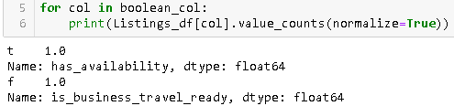
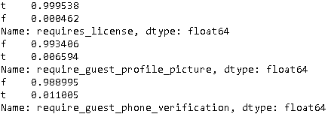
Data Clean Up & Exploration (cont..)
Similar type of columns were dropped by just keeping the important column.
Locations related columns which had similar values in all the rows were dropped.
Boolean Columns which had just 1 category values were dropped.

Slide 8
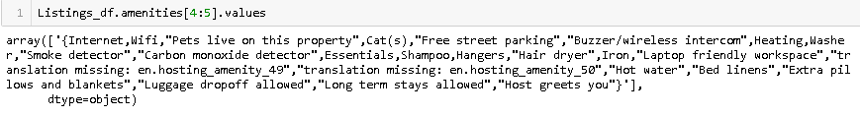
Data Clean Up & Exploration (cont..)
Amenities Column were stored as one big block of text.
Date Columns were converted to date time format.
Price Related Columns were stored as string with dollar signs and comma separated values.
Similar column values were replaced with the respective values for a better plot. (for ex. Property type, Cancellation policy”)
Used Reverse Geocoder to retrieve the exact place name using Latitude & Longitude

Slide 9
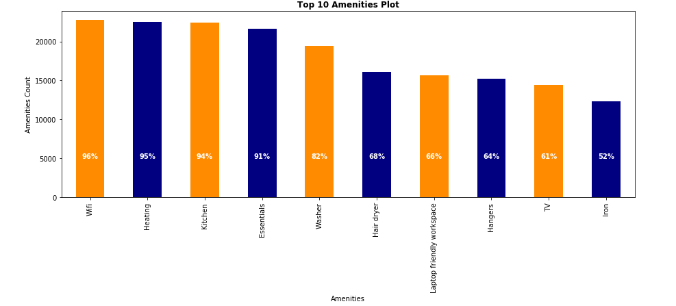
Factors for Business Growth

Slide 10
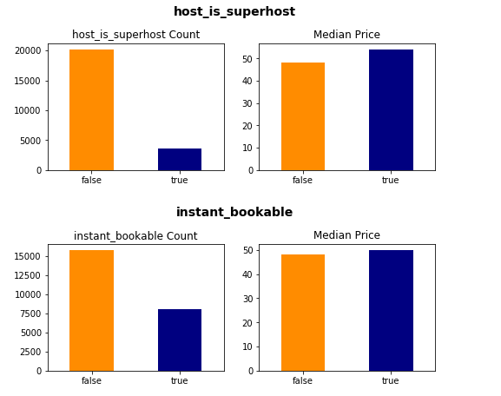
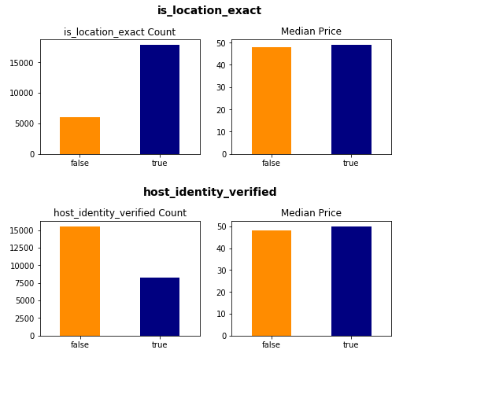
Boolean Features Vs Price
Does the Hosts really need the below Features?

Slide 11
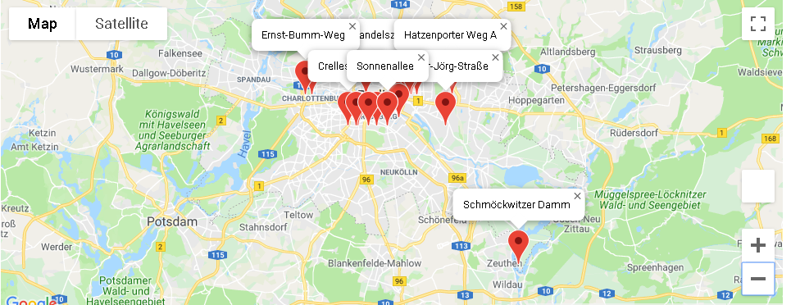
Top 20 Berlin Airbnb Locations
Based on Property Ratings

Slide 12
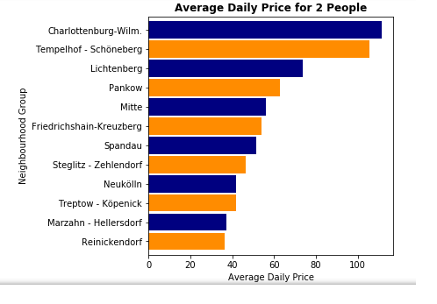
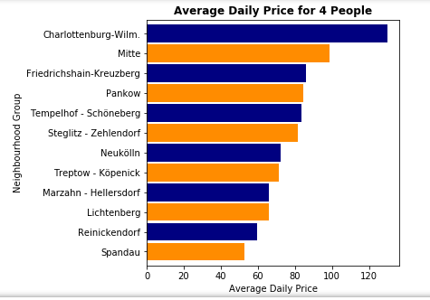

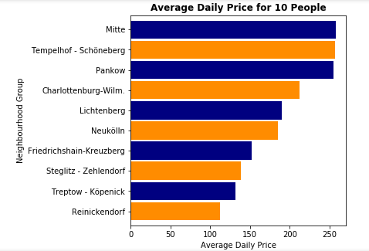
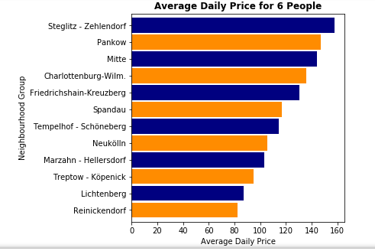

Slide 13
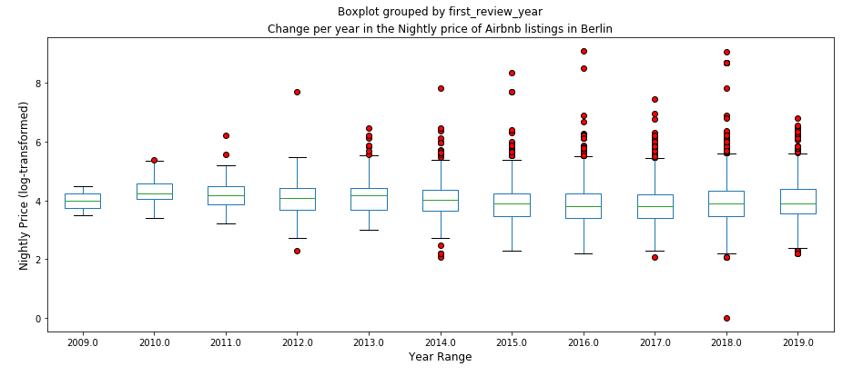
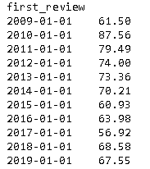
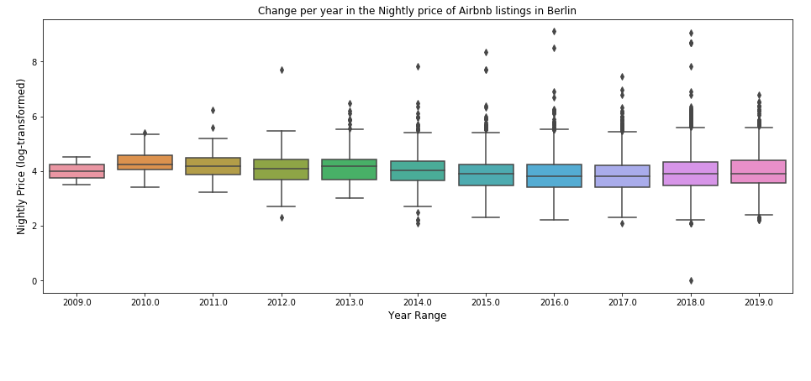
How Have Prices Changed over time?

Slide 14
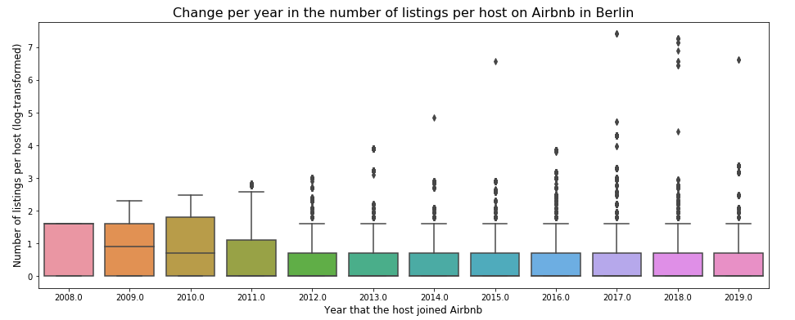
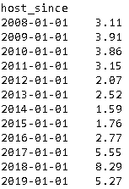
Change per year in the number of listings per host on Airbnb in Berlin

Slide 15
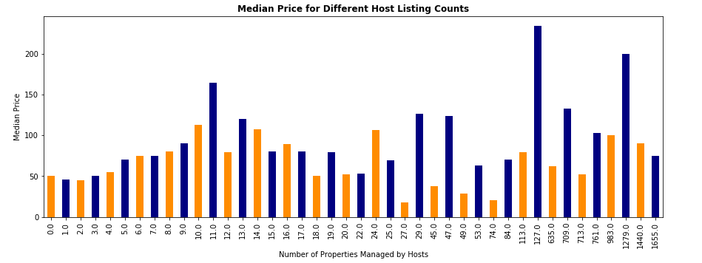
How many other listings the host manages in Airbnb?
Does it mean Hosts having more properties will gain higher prices??

Slide 16
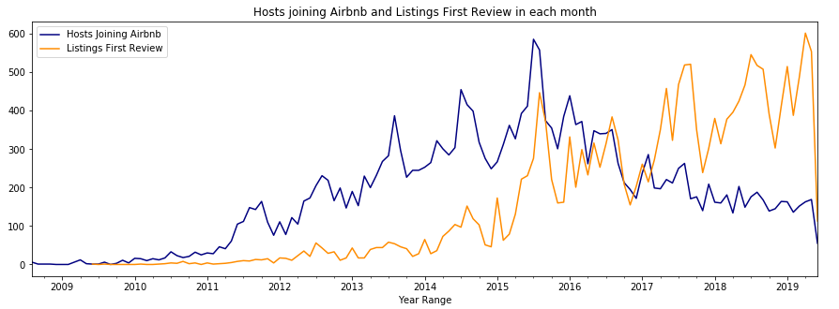
Does Reviews Matter for the Hosts Joining Airbnb?

Slide 17
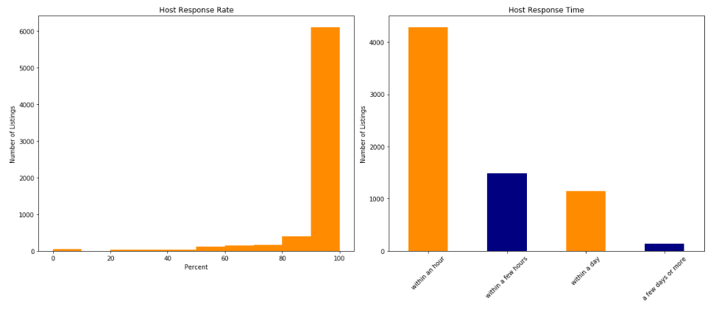
Judging the Hosts Response ?

Slide 18
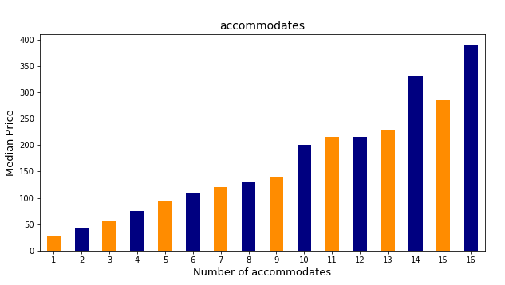
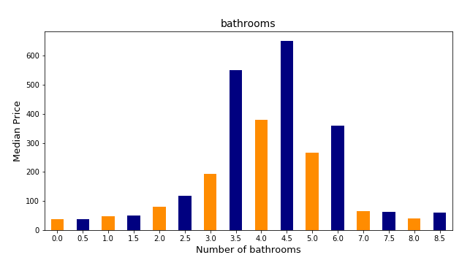

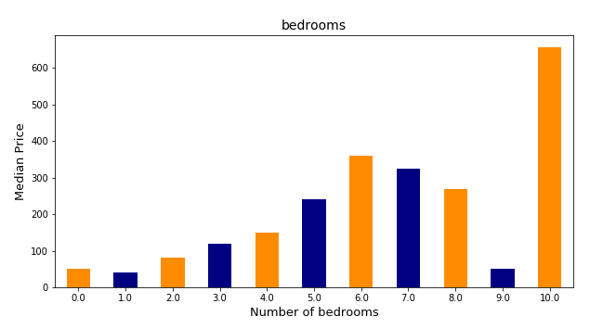
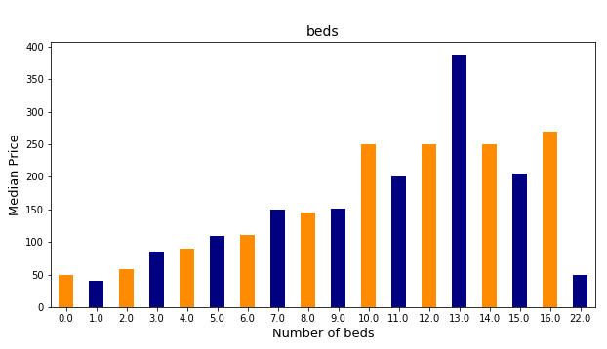

Slide 19
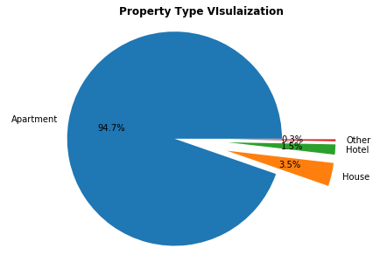
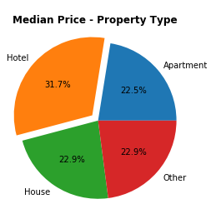
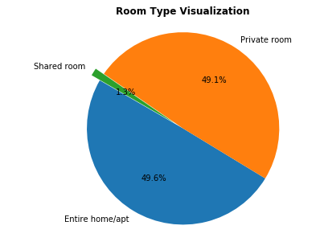
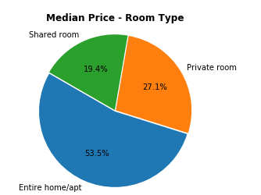
Property , Room Types Vs Price

Slide 20
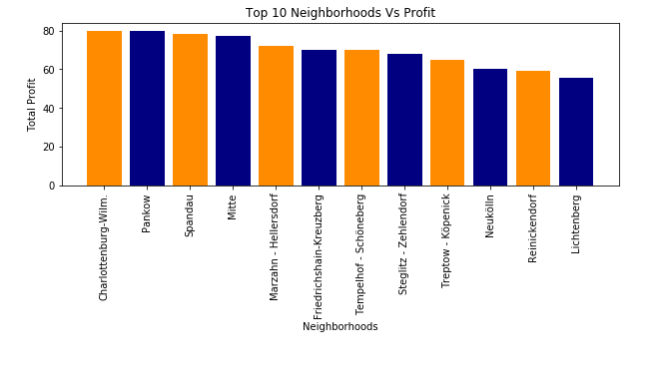
Neighbourhood Vs Profit

Slide 21
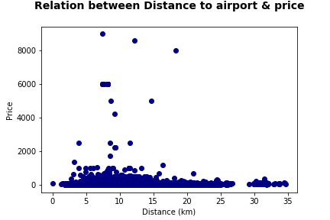
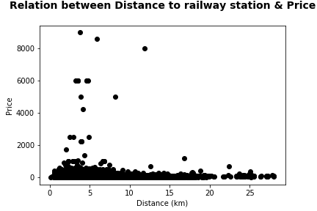
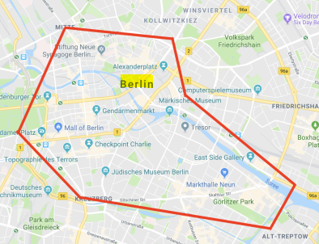
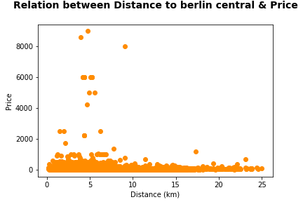
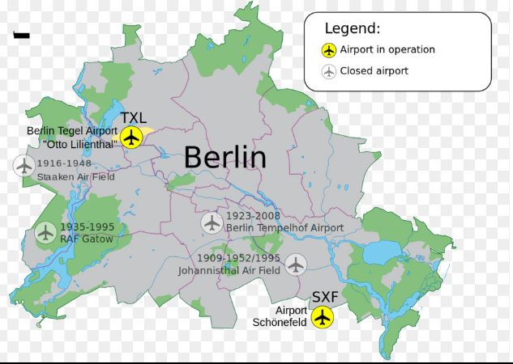
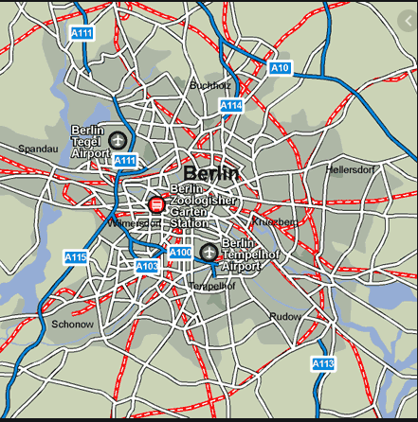
Distance Vs Price

Slide 22
Future Work
Performing

Slide 23
References
http://insideairbnb.com/berlin/
https://www.dataquest.io/blog/tutorial-time-series-analysis-with-pandas/
https://www.movable-type.co.uk/scripts/latlong.html

Slide 24


