Slide 1




AN ANALYSIS OF CAREER TRAJECTORIES
( INDUSTRY INSIGHTS FROM A GLOBAL SALARY SURVEY)
Saranya R
DA&DS
May Batch - 2025

Slide 2
TABLE OF CONTENT
Objective
Dataset Overview
Data Cleaning Process SQL queries performed
Pivot Tables and Charts Dashboard
Key Insights Recommendations Conclusion

Slide 3






OBJECTIVE
This project aims to analyze global salary trends and uncover insights across demographics and job attributes using real-world data.
Tools & Technologies Used:
Excel for data cleaning, pivot analysis, and dashboard creation. MySQL for structured data storage and querying.

Slide 4

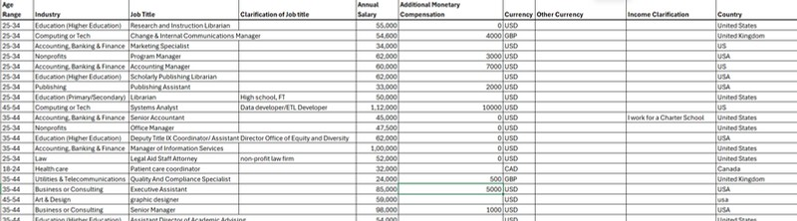

DATASET OVERVIEW
The dataset contains information on global salary and career trends.
Rows: 28,104
Columns: 16

Slide 5
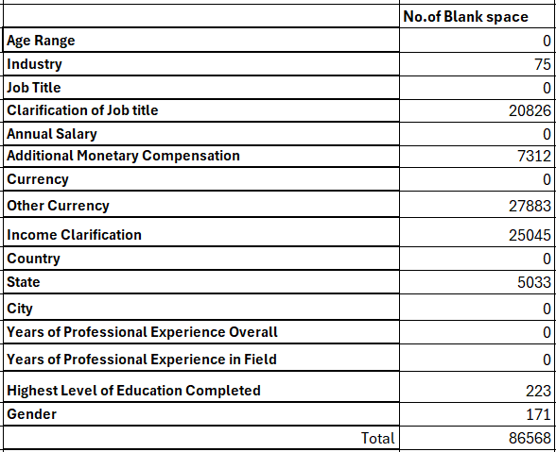

DATA CLEANING PROCESS
Removed Rows
Missing values in the following 4 critical columns were not tolerated — such rows were entirely removed:
Years of Professional Experience Overall Years of Professional Experience in Field Highest Level of Education Completed Gender
Imputed Remaining Columns
Categorical columns → filled with "Unknown" Numerical columns → filled with 0

Slide 6
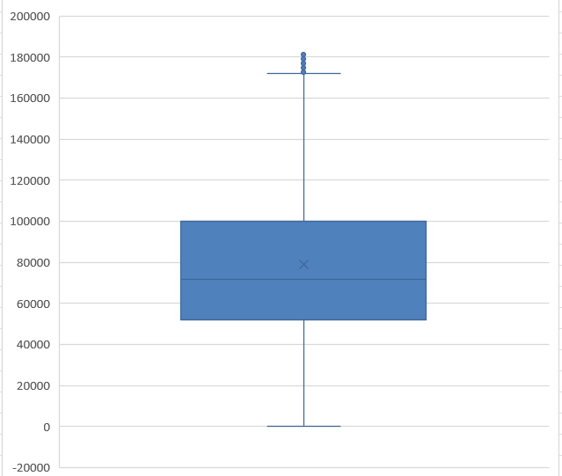
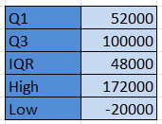
OUTLIER HANDLING
Outlier data is a datapoint that differ from rest of datapoint.
There are outlier value occurs in salary column.

Slide 7

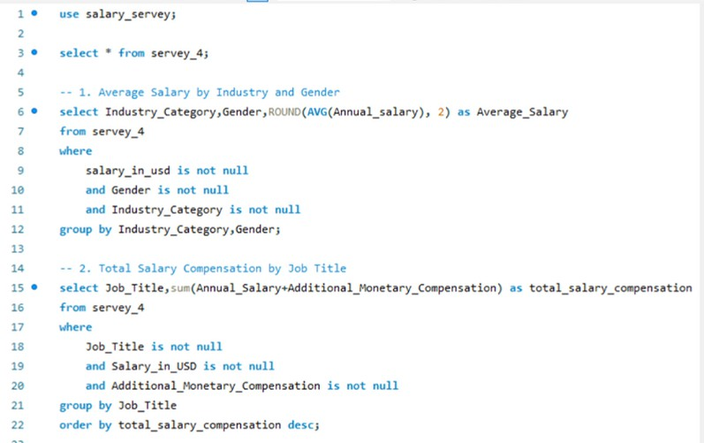
SQL QUERIES PERFORMED
Executed multiple SQL queries to analyze salary trends, gender pay gaps, experience-based earnings, and country- wise variations.
After executing the queries, the results were exported to CSV files for further processing and visualization.

Slide 8

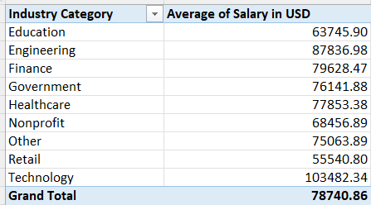
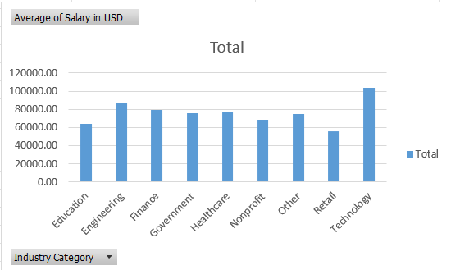
PIVOT TABLES & CHARTS
Created pivot tables to summarize and compare salaries, experience, education, and gender across industries and countries.
Developed interactive charts from these pivots to highlight key patterns and support dashboard visualizations.

Slide 9


DASHBOARD
Integrated multiple pivot tables and charts into a single interactive dashboard for quick insights.
Enabled dynamic filtering by industry, gender, country, and experience for deeper analysis.

Slide 10
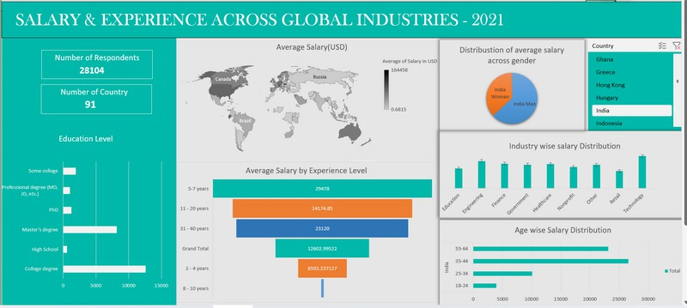
DASHBOARD

Slide 11

KEY INSIGHTS
The survey covers 28,104 respondents from 91 countries, providing a global perspective on salary trends.
The majority of respondents hold a college degree, followed by a master’s degree, suggesting higher education is common among the surveyed workforce.
Professionals with 5–7 years of experience have the highest reported average salary ($29,478 USD), indicating strong earning potential at mid-career stages.
The Technology sector reports the highest industry-wise average salaries, outpacing fields like Education, Government, and Retail.
The 2–4 years of experience earn just $6,592 USD on average, underscoring the initial struggle for higher pay early in careers.

Slide 12
RECOMMENDATION
Low salaries for professionals with 2–4 years of experience can lead to early job exit.
Provide competitive starting packages and rapid skill development to quickly bridge the gap
.
As the tech sector commands higher salaries, encourage cross-training and skill upgrades to help employees in lower-paying sectors transition to tech-related jobs.
Since most high earners hold college or master’s degrees, invest in tuition reimbursement or scholarship programs to encourage higher education among employees.

Slide 13
CONCLUSION
Analysis is based on self-reported survey data, capturing salary trends across industries, experience levels, education, and locations.
Experience strongly impacts salary, with rapid early growth, then leveling off in later years.
Higher education levels correspond to higher reported salaries.
Results reflect survey participants and may not fully represent the entire job market.

Slide 14
THANK YOU

