Slide 1
Wired LANs: Ethernet

Slide 2
IEEE STANDARDS
The LAN market has several technologies such as Ethernet, Token Ring, Token Bus, FDDI, and ATM LAN.
In 1985, the Computer Society of the IEEE started a project, called Project 802, to set standards to enable intercommunication among equipment from a variety of manufacturers. Project 802 is a way of specifying functions of the physical layer and the data link layer of major LAN protocols.
Topics discussed in this section:
Data Link Layer
Physical Layer

Slide 3

Figure IEEE standard for LANs
The IEEE has subdivided data link layer into two sublayers: logical link control (LLC) and media access control (MAC).

Slide 4
Logical Link Control
In IEEE Project 802, flow control, error control and part of framing duties are collected into one sublayer called the logical link control.
The LLC provides one single data link control protocol for all IEEE LANs.
A single LLC protocol can provide interconnectivity between different LANs because it makes the MAC sublayer transparent.
Framing
LLC defines a Protocol data unit(PDU) has the header field which is used for flow and error control.
The two other header fields define the upper-layer protocol at the source and destination that uses LLC – destination service access point and source service access point.

Slide 5

Figure HDLC frame compared with LLC and MAC frames

Slide 6
Medium Access Control
It specifies the media access method for each LAN.
For example, it defines CSMA/CD as the media access method for Ethernet LANs and the token-passing method for Token Ring and Token Bus LANs.
It defines the access method and the framing format specific to corresponding LAN protocol.

Slide 7
STANDARD ETHERNET
The original Ethernet was created in 1976 at Xerox’s Palo Alto Research Center (PARC). Since then, it has gone through four generations. We briefly discuss the Standard (or traditional) Ethernet in this section.
Topics discussed in this section:
MAC Sublayer
Physical Layer

Slide 8

Figure Ethernet evolution through four generations
13.<number>

Slide 9
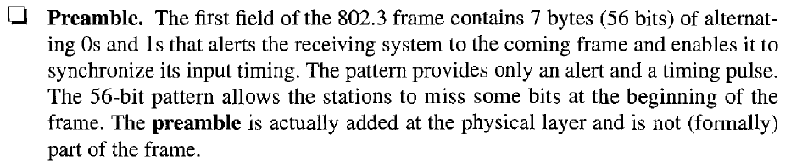
MAC Sublayer
In standard Ethernet, the MAC sublayer governs the operation of the access method.
It also frames data received from the upper layers and passes them to the physical layer.
Frame Format
Ethernet does not provides any mechanism for acknowledging received frames.
This frame contains 7 fields: preamble, SFD, DA, SA, length or type of protocol data unit, upper-layer data and CRC.

Slide 10

Figure 13.4 802.3 MAC frame

Slide 11
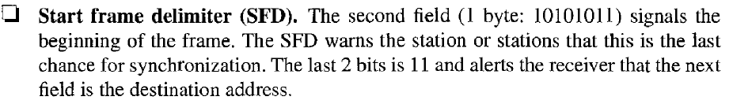
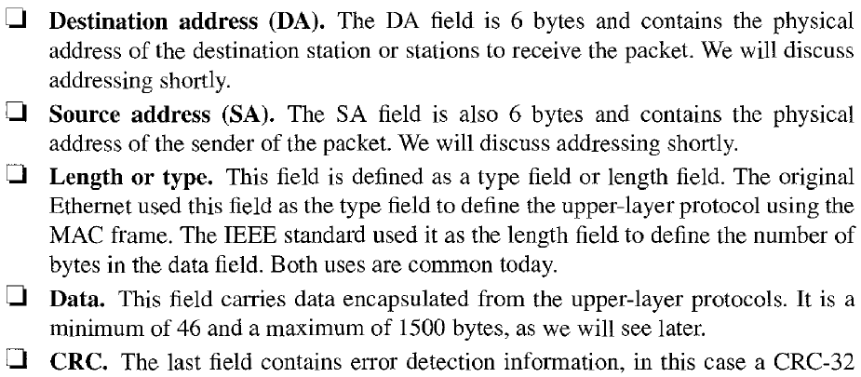

Slide 12

Figure Minimum and maximum lengths

Slide 13

Note
Frame length:
Minimum: 64 bytes (512 bits)
Maximum: 1518 bytes (12,144 bits)

Slide 14

Addressing
Each station on an Ethernet network has its own Network Interface Card (NIC).
The NIC fits inside the station and provides the station with a 6-byte physical address.
The Ethernet address is a 6-byte(48 bits), normally written in hexa-decimal notation, with a colon between bytes.
Figure Example of an Ethernet address in hexadecimal notation

Slide 15

Unicast, multicast and broadcast addresses
A source address is always a unicast address- the frame comes from only one station.
The destination address, however, can be unicast, multicast or broad cast address.
If the least significant bit for the first byte in a destination address is 0, the address is unicast; otherwise it is multicast.
A unicast destination address defines only one recipient and the relationship between sender and receiver is one-to-one.
A multicast destination address defines a group of addresses and the relationship between sender and receiver is one-to-many.
The broadcast address is a special case of multicast address and the recipients are all the stations in the LAN.

Slide 16
Note
The least significant bit of the first byte
defines the type of address.
If the bit is 0, the address is unicast;
otherwise, it is multicast.

Slide 17
Note
The broadcast destination address is a special case of the multicast address in which all bits are 1s.

Slide 18
Example 13.1
Define the type of the following destination addresses:
a. 4A:30:10:21:10:1A b. 47:20:1B:2E:08:EE
c. FF:FF:FF:FF:FF:FF
Solution
To find the type of the address, we need to look at the second hexadecimal digit from the left. If it is even, the address is unicast. If it is odd, the address is multicast. If all digits are F’s, the address is broadcast. Therefore, we have the following:
a. This is a unicast address because A in binary is 1010.
b. This is a multicast address because 7 in binary is 0111.
c. This is a broadcast address because all digits are F’s.

Slide 19

Figure Categories of Standard Ethernet

Slide 20

Figure Fast Ethernet implementations

Slide 21

Figure Gigabit Ethernet implementations

Slide 22

Figure Taxonomy of multiple-access protocols

Slide 23
Carrier Sense Multiple Access with Collision Detection (CSMA/CD)
When a station has data to transmit, it first listens to the cable to see if a carrier(signal) is being transmitted by another station. This may be achieved by monitoring whether a current is flowing in the cable.
Data is sent when no carrier is observed and the physical medium is therefore idle.
The collision will result in the corruption of the frame being sent, which is subsequently be discarded by the receiver.
This may happens when two stations send the data at the same time when the medium is idle.
CSMA/CD augments the algorithm to handle the collision.
In this method, a station monitors the medium after it sends a frame to see if the transmission was successful.
If so the station is finished. If however, there is a collision, the frame is sent again.

