Slide 1
Unit – III Network Essentials
Network Models

Slide 2
OSI Model
Open Systems Interconnection (OSI) is a set of internationally recognized, non-proprietary standards for networking and for operating system involved in networking functions.
7 Layers
7. Application Layer
6. Presentation Layer
5. Session Layer
4. Transport Layer
3. Network Layer
2. Data Link Layer
1. Physical Layer

Slide 3

Note
ISO is the organization. OSI is the model.

Slide 4

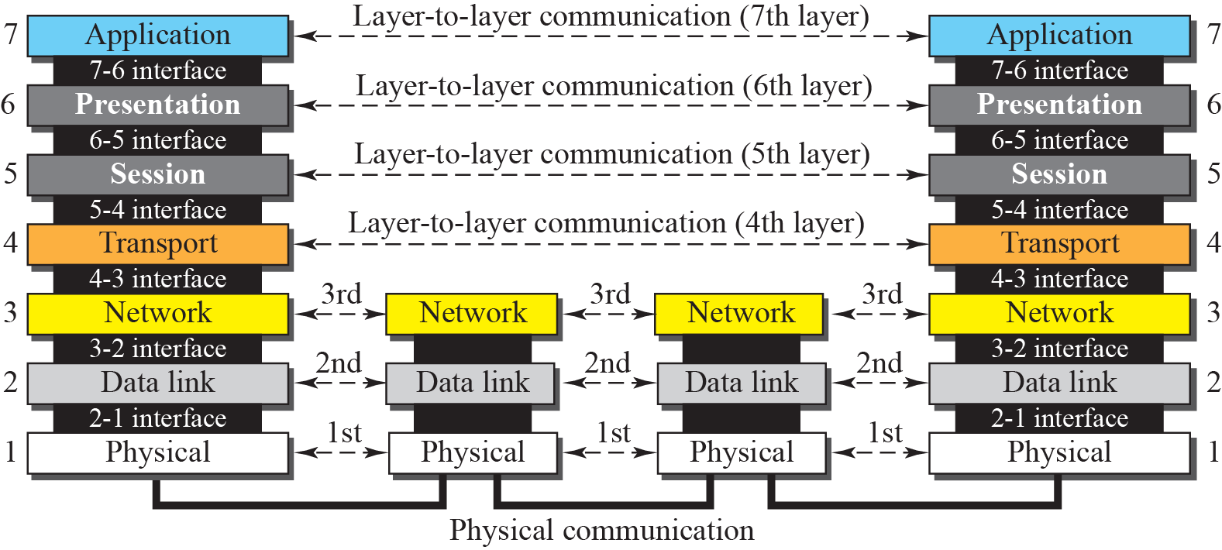
Figure 2.4 OSI layers

Slide 5
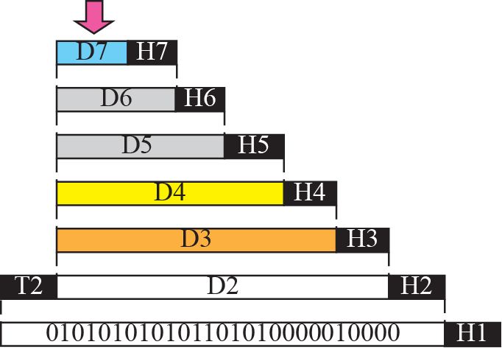


Figure 2.5 An exchange using the OSI model

Slide 6
Layer Architecture
OSI Model
Layer architecture simplifies the network design.
It is easy to debug network applications in a layered architecture network.
The network management is easier due to the layered architecture.
Network layers follow a set of rules, called protocol.
The protocol defines the format of the data being exchanged, and the control and timing for the handshake between layers.

Slide 7
Note
The physical layer is responsible for movements of
individual bits from one hop (node) to the next.

Slide 8
Physical Layer
OSI Model
Provides physical interface for transmission of information.
The physical layer is responsible for movements of individual bits from one hop (node) to the next.
This layer tells the driver software for the MAU (media attachment unit, ex. network interface cards (NICs, modems, etc.)) what needs to be sent across the medium.
This layer manages the interface between the the computer and the network medium (coax, twisted pair, etc.)
Defines rules by which bits are passed from one system to another on a physical communication medium.
Covers all - mechanical, electrical, functional and procedural - aspects for physical communication.
Such characteristics as voltage levels, timing of voltage changes, physical data rates, maximum transmission distances, physical connectors, and other similar attributes are defined by physical layer specifications.

Slide 9
Note
The data link layer is responsible for moving frames from one hop (node) to the next.

Slide 10
Data Link Layer
OSI Model
Data link layer attempts to provide reliable communication over the physical layer interface.
Breaks the outgoing data into frames and reassemble the received frames.
Create and detect frame boundaries.
Handle errors by implementing an acknowledgement and retransmission scheme.
Implement flow control.
Supports points-to-point as well as broadcast communication.
Supports simplex, half-duplex or full-duplex communication.

Slide 11
Note
The network layer is responsible for the delivery of individual packets from
the source host to the destination host.

Slide 12
Network Layer
OSI Model
Implements routing of frames (packets) through the network.
Defines the most optimum path the packet should take from the source to the destination
Defines logical addressing so that any endpoint can be identified.
This layer also handles packet switching and network congestion control
Facilitates interconnection between heterogeneous networks (Internetworking).
The network layer also defines how to fragment a packet into smaller packets to accommodate different media.

Slide 13
Note
The transport layer is responsible for the delivery of a message from one process to another.

Slide 14
Transport Layer
OSI Model
Purpose of this layer is to provide a reliable mechanism for the exchange of data between two processes in different computers.
Manages the flow of data between parties by segmenting long data streams into smaller data chunks (based on allowed “packet” size for a given transmission medium).
Ensures that the data units are delivered error free.
Ensures that data units are delivered in sequence.
Ensures that there is no loss or duplication of data units.
Provides connectionless or connection oriented service.
Provides for the connection management.
Multiplex multiple connection over a single channel.

Slide 15
Note
The session layer is responsible for dialog control and synchronization.

Slide 16
Session Layer
OSI Model
Session layer provides mechanism for controlling the dialogue between the two end systems. It defines how to start, control and end conversations (called sessions) between applications.
This layer requests for a logical connection to be established on an end-user’s request.
Any necessary log-on or password validation is also handled by this layer.
Session layer is also responsible for terminating the connection.
This layer provides services like dialogue discipline which can be full duplex or half duplex.
Session layer can also provide check-pointing mechanism such that if a failure of some sort occurs between checkpoints, all data can be retransmitted from the last checkpoint.

Slide 17
Note
The presentation layer is responsible for translation, compression, and encryption.

Slide 18
Presentation Layer
OSI Model
Presentation layer defines the format in which the data is to be exchanged between the two communicating entities.
This layer is also responsible for certain protocol conversions, data encryption/decryption, or data compression/decompression
Also handles data compression and data encryption (cryptography).

Slide 19
Note
The application layer is responsible for providing services to the user.

Slide 20
Application Layer
OSI Model
Application layer interacts with application programs and is the highest level of OSI model.
Application layer contains management functions to support distributed applications.
Provides a set of interfaces for sending and receiving applications and to use network services, such as: message handling and database query processing
Responsibility: It provides the services to the user.
Examples of application layer are applications such as file transfer, electronic mail, remote login etc.

Slide 21
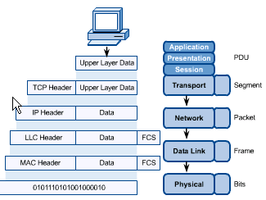
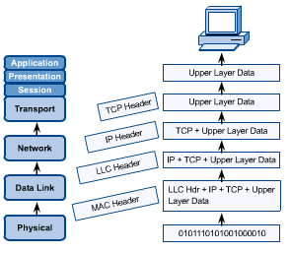
OSI in Action
OSI Model
A message begins at the top application layer and moves down the OSI layers to the bottom physical layer.
As the message descends, each successive OSI model layer adds a header to it.
A header is layer-specific information that basically explains what functions the layer carried out.
Conversely, at the receiving end, headers are striped from the message as it travels up the corresponding layers.

Slide 22
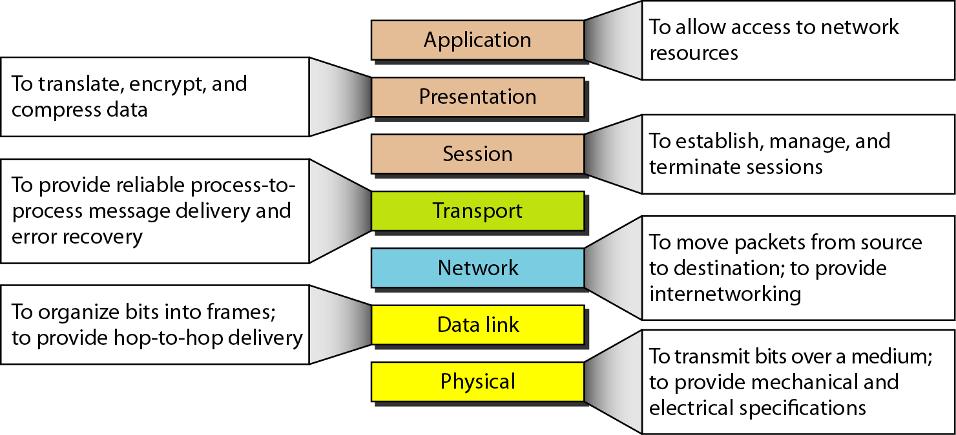
Summary

Slide 23
TCP/IP Model
TCP/IP MODEL

Slide 24
What is TCP/IP?
TCP/IP is a set of protocols developed to allow cooperating computers to share resources across a network
TCP stands for “Transmission Control Protocol”
IP stands for “Internet Protocol”
They are Transport layer and Network layer protocols respectively of the protocol suite
The most well known network that adopted TCP/IP is Internet – the biggest WAN in the world

Slide 25
What is a protocol?
A protocol is a collection of rules and procedures for two computers to exchange information
Protocol also defines the format of data that is being exchanged

Slide 26
Why TCP/IP is so popular?
TCP/IP was developed very early
Technologies were widely discussed and circulated in documents called “Request for Comments” (RFC) – free of charge
Supported by UNIX operating system

Slide 27
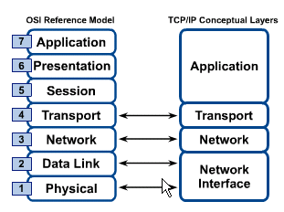
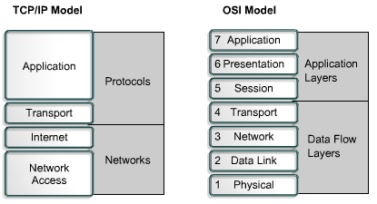
OSI & TCP/IP Models
TCP/IP Model

Slide 28
TCP/IP Model
TCP/IP Model
Application Layer
Application programs using the network
Transport Layer (TCP/UDP)
Management of end-to-end message transmission,
error detection and error correction
Network Layer (IP)
Handling of datagrams : routing and congestion
Data Link Layer
Management of cost effective and reliable data delivery,
access to physical networks
Physical Layer
Physical Media

Slide 29
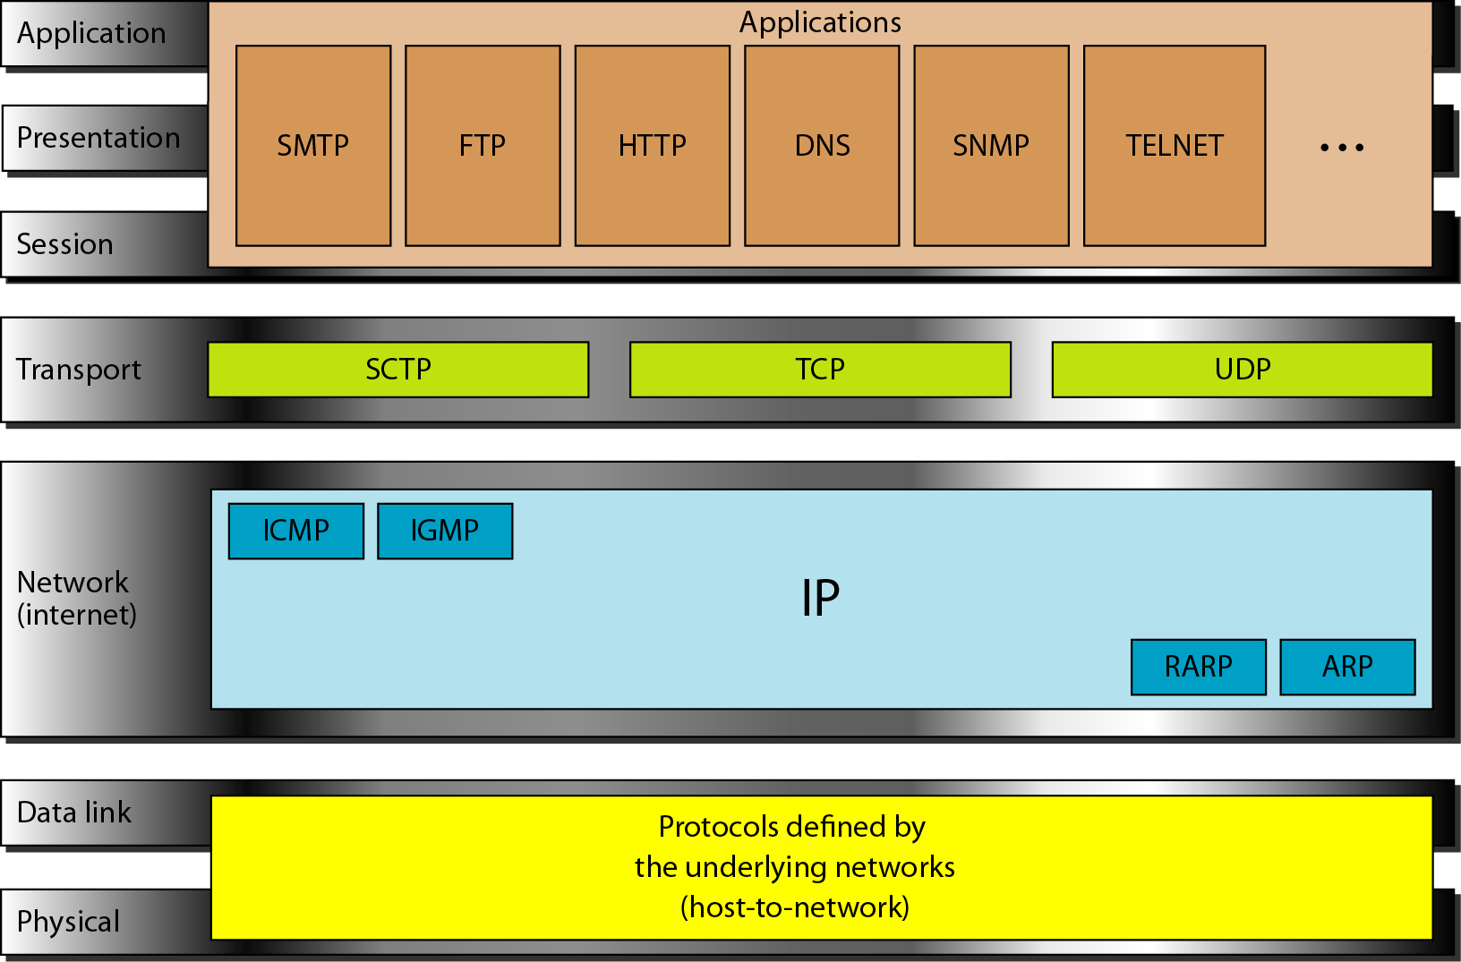
TCP/IP and OSI model

Slide 30
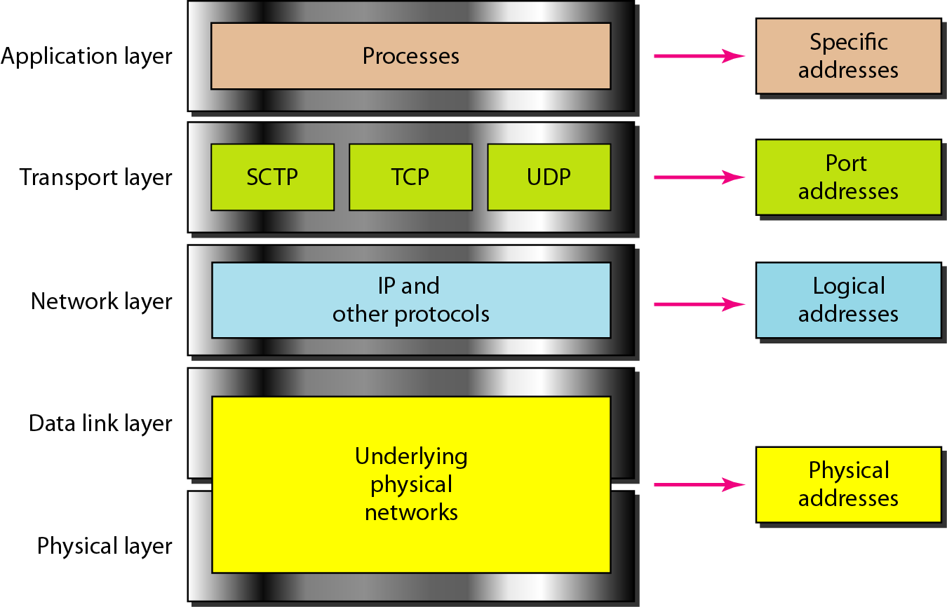
Relationship of layers and addresses in TCP/IP

Slide 31
Layer-1 Application Layer
Application layer protocols define the rules when implementing specific network applications
Rely on the underlying layers to provide accurate and efficient data delivery
Typical protocols:
FTP – File Transfer Protocol
For file transfer
Telnet – Remote terminal protocol
For remote login on any other computer on the network
SMTP – Simple Mail Transfer Protocol
For mail transfer
HTTP – Hypertext Transfer Protocol
For Web browsing

Slide 32
Layer-2 Transport Layer
Application
Transport
Network
Network Interface
Message
Segments
h
M
h
M
h
M

Slide 33
TCP and UDP
TCP – Transmission Control Protocol
TCP is a connection-oriented protocol
Does not mean it has a physical connection between sender and receiver
TCP provides the function to allow a connection virtually exists – also called virtual circuit
TCP provides the functions:
Dividing a chunk of data into segments
Reassembly segments into the original chunk
Provide further the functions such as reordering and data resend
Offering a reliable byte-stream delivery service

Slide 34
Layer-3 Network Layer
Application
Transport
Network
Network Interface
Message
Segments
h
M
h
M
h
M
h
h
M
h
h
M
h
h
M
Datagrams / Packets

Slide 35
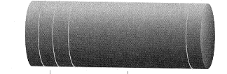
Network Addresses and Subnets
A header is added to each segment in the Network layer
 |  | Total Length
Time to Live | Protocol | Header CheckSum
Source Address
Destination Address
Segment
3
IP
Segment

Slide 36
Layer-4 Data Link and Physical Layers
Application
Transport
Network
Network Interface
Message
Segments
h
M
h
M
h
M
h
h
M
h
h
M
h
h
M
Packets
h
h
h
M
h
h
h
M
Frames

Slide 37
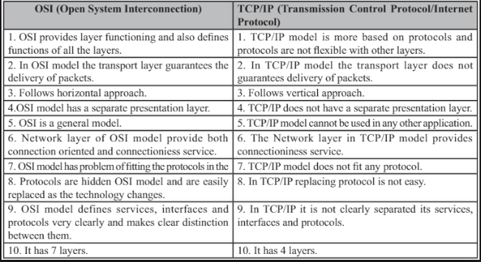

Slide 38
