Slide 1
Introduction to WIFI

Slide 2
Contents
Introduction
Wi-Fi Technology
Wi-Fi Network Elements
Wi-Fi Network Topologies
Hotspots
How a Wi-Fi Network Works
Advantages
Limitations
Conclusion

Slide 3
WIFI Technology
WIFI is an alternative network to wired network which is commonly used for connecting devices in wireless mode.

Slide 4
WIFI Technology
WIFI is stand for Wireless Fidelity is generic term that refers to IEEE802.11 standard for Wireless Local Networks or WLANs.

Slide 5
Introduction
WIFI connects computers to each other, to the internet and to the wired network.

Slide 6
The WIFI Technology
WIFI uses radio technology to transmit and receive data at high speed.
IEEE 802.11b
IEEE 802.11a
IEEE 802.11g

Slide 7
IEEE 802.11b
Appear in Late 1999
2.4Ghz radio spectrum
11Mbps (theoretical speed) within 30m range
4-6Mbps (actual speed)
100-150 feet range
Most popular and Less expansive
Interference from mobile phones and Bluetooth devices which can reduce the transmission speed

Slide 8
IEEE 802.11a
introduced in 2001
5.0Ghz radio spectrum
54Mbps (theoretical speed)
15-20Mbps (actual speed)
50-75 feet range
more expansive
not compatible with IEEE 802.11b

Slide 9
IEEE 802.11g
introduced in 2003
combine the feature of both standards (a,b)
100-150 feet range
54Mbps speed
2.4Ghz radio spectrum
compatible with b

Slide 10
Elements of WIFI network
Access Point
(AP) - The AP is a
wireless LAN
transceiver or “base station” that can connect one or
many wireless devices Internet.
simultaneously to the
Wi-Fi cards - They accept the wireless signal and relay information. They can be internal and external.

Slide 11
Elements of WIFI network
Safeguards - Firewalls and anti-virus software protect networks from uninvited users and keep information secure.

Slide 12
WIFI Topologies
Peer-to-peer topology (Ad-hoc Mode)
AP-based topology (Infrastructure Mode)

Slide 13
Peer-to-peer Topology
AP is not required.
Client devices within a cell can communicate with each other directly.
It is useful for setting up a wireless network quickly and easily.

Slide 14





Peer-to-peer Topology

Slide 15
Infrastructure network
The client communicate through Access Point.
Any communication has to go through AP.
If a Mobile Station (MS), like a computer, a PDA, or a phone, wants to communicate with another MS, it needs to send the information to AP first, then AP sends it to the destination MS.

Slide 16


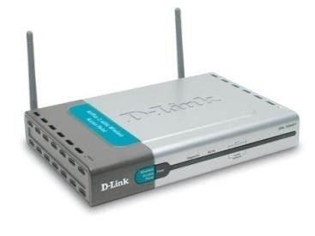


Infrastructure network

Slide 17
Hotspots
A Hotspot is a geographical area that has a readily accessible wireless network
Hotspots are equipped with Broad band Internet connection and one or more Access points that allow users to access the internet wirelessly

Slide 18
Hotspots
Hotspots can be setup in any public location that can support an Internet connection. All the locations discussed previously are examples of Hotspots.

Slide 19

Hotspots

Slide 20
Hotspots can be setup in any public location that can support an Internet connection. All the locations discussed previously are examples of Hotspots.

Slide 21
How a Wi-Fi Network Works
A Wi-Fi hotspot is created by installing an access point to an internet connection.
An access point acts as a base station.
When Wi-Fi enabled device encounters a hotspot the device can then connect to that network wirelessly.

Slide 22
How a Wi-Fi Network Works
A single access point can support up to 30 users and can function within a range of 100 – 150 feet indoors and up to 300 feet outdoors.
Many access points can be connected to each other via Ethernet cables to create a single large network.

Slide 23
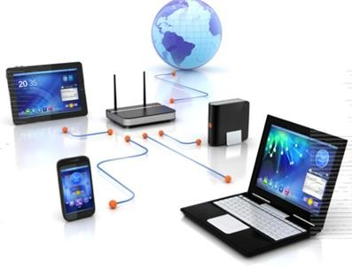
How a Wi-Fi Network Works

Slide 24
Advantages
Mobility
Ease of Installation
Flexibility
Cost
Reliability
Security
Use unlicensed part of the radio spectrum
Roaming
Speed

Slide 25
Limitations
Interference
Degradation in performance
High power consumption
Limited range

Slide 26
Wi-Fi is a simple and cost effective way to connect to internet without the need of wires.
It is growing in popularity because of decreasing costs and the freedom it gives to users.

