Slide 1
IEEE 802.11 Wireless Local Area Networks (RF-LANs)

Slide 2
Wireless Networks
Wireless communication is one of the fastest-growing technologies.
The demand for connecting devices without the use of cable is increasing everywhere.
Wireless LANs can be found in on college campuses, Bus stations, Railway Stations, Airport, in office buildings, and in many public areas.

Slide 3

IEEE 802.11
IEEE has defined the specifications for a wireless LAN, called IEEE 802.11, which covers physical and data link layers.
Architetcure:
  The standard defines two kind of services: BSS and ESS.
  Basic Service Set(BSS):
    IEEE 802.11 defines a BSS as the building blocks of wireless LANs.
    A BSS is made of stationary or mobile wireless stations and an optional central base station called, Access Point.

Slide 4
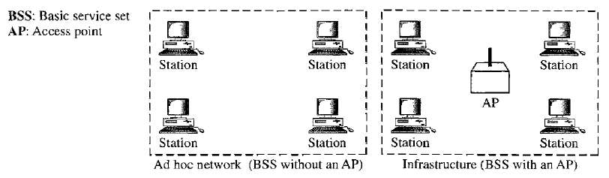
The BSS without an AP is a stand-alone network and cannot send the data to other BSSs. It is called an ad-hoc architecture.
In this architecture, stations can form a network without the need of an AP, they can locate one another and agree to be part of a BSS.
A BSS with an AP is sometimes referred to as an infrastructure network.

Slide 5
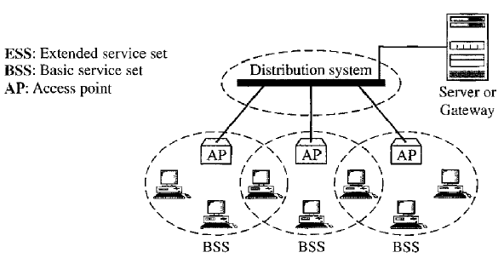
Externded Service Set
An Extended Service Set is made up of two or more BSSs with APs.
In this case, the BSSs are connected through a distributed system, which is usually a wireless LAN.
The distributed system connects the APs in the BSSs.
The ESS uses two types of stations: mobile and stationary.
The mobile stations are normal stations inside a BSS.
The stationary stations are AP stations that are part of a wired LAN.

Slide 6
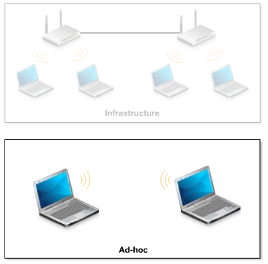
Types of Wireless LANs
Infrastructure (BSS and ESS)
Ad-hoc (BSS)

Slide 7
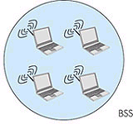
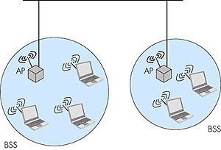
IEEE 802.11 Architecture
IEEE 802.11 defines the physical (PHY), logical link (LLC) and media access control (MAC) layers for a wireless local area network
802.11 networks can work as
  basic service set (BSS)
  extended service set (ESS)
BSS can also be used in ad-hoc
networking
Network
LLC
MAC
802.11
FHSS
PHY
DSSS
IR
DS,
ESS
LLC: Logical Link Control Layer
MAC: Medium Access Control Layer
PHY: Physical Layer
FHSS: Frequency hopping SS
DSSS: Direct sequence SS
SS: Spread spectrum
IR: Infrared light
BSS: Basic Service Set
ESS: Extended Service Set
AP: Access Point
DS: Distribution System
ad-hoc network

Slide 8
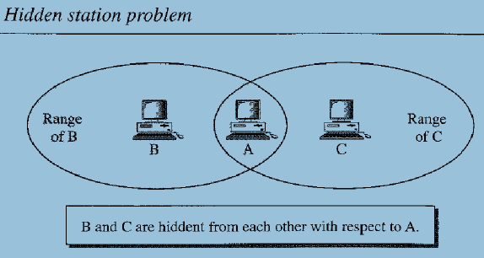
Hidden and Exposed Terminal Problems
Hidden Terminal Problem
Station B has a transmission range shown by the left oval and every station in this range can hear any signal transmitted by station B.
Station C has a transmission range shown by the right oval and every station in this range can hear any signal transmitted by station C.
Station C is outside the transmission range of B; similarly, station B is outside the transmission range of C.
Station A can hear both the transmission of B and C.

Slide 9
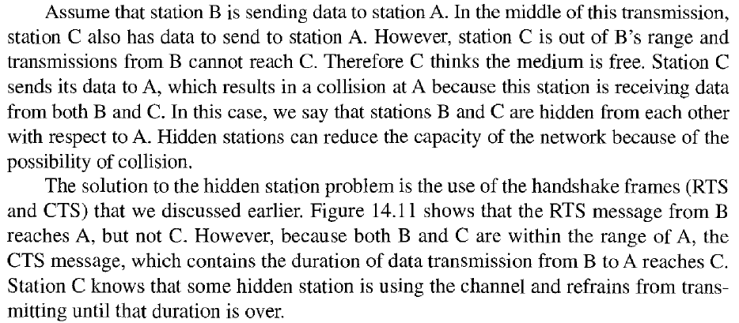
Hidden Station Problem

Slide 10
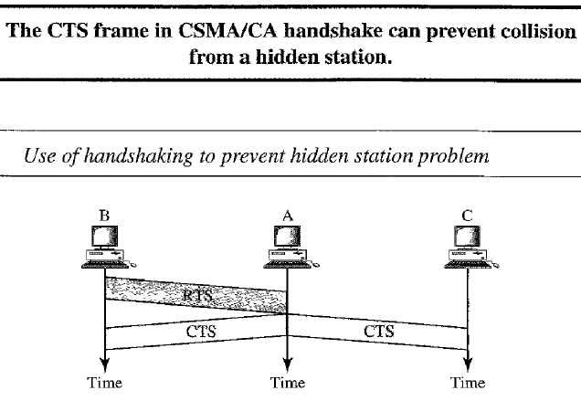
Hidden Station Problem

Slide 11
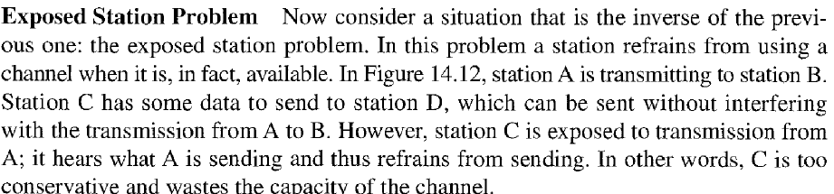
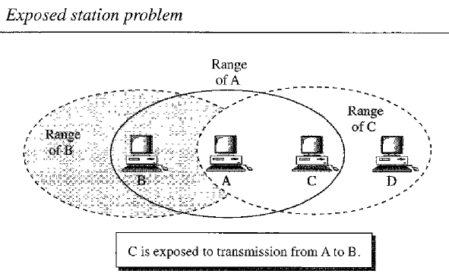
Exposed Terminal Problem

Slide 12
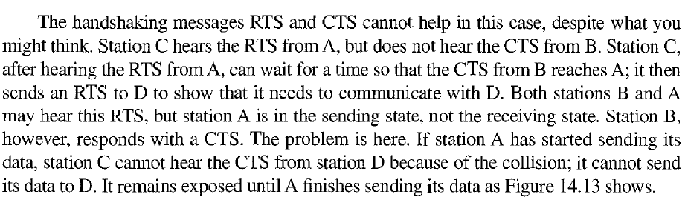
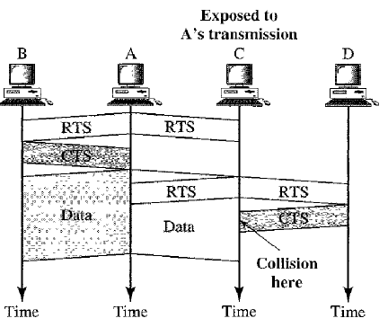
Exposed Terminal Problem

Slide 13
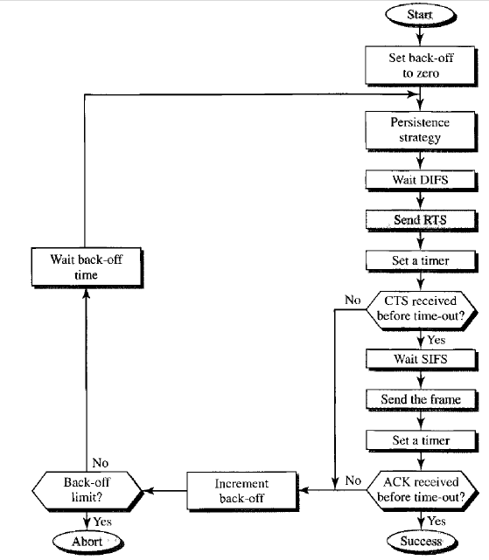
Carrier Sense Multiple Access with Collision Avoidance
Before sending a frame, the source station senses the medium by checking the energy level at the carrier frequency.
  The channel uses a persistence strategy with back-off until the channel is idle.
  After the station is found to be idle, station waits for a period of time called the distributed inteeframe space (DCF), then station sends a control frame called the request to send (RTS).

Slide 14
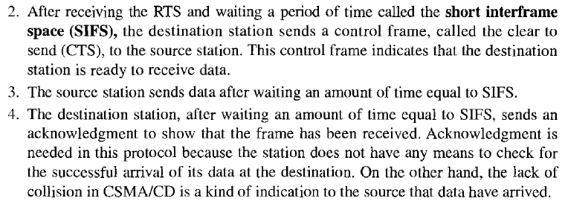
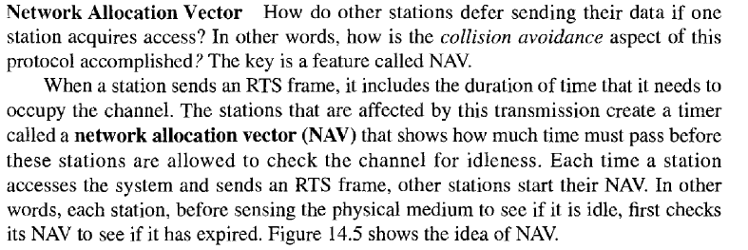

Slide 15
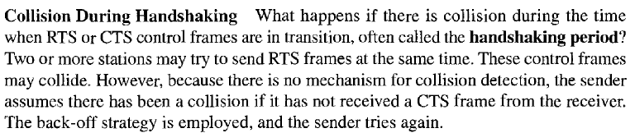
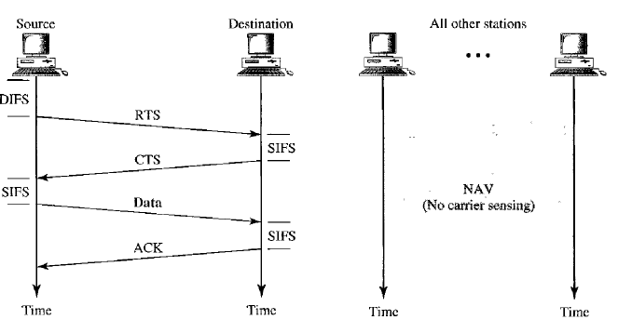
Figure CSMA/CA and NAV

Slide 16
WLAN benefits
Mobility
  increases working efficiency and productivity
  extends the On-line period
Installation on difficult-to-wire areas
  inside buildings
  road crossings
Increased reliability
  Note: Pay attention to security!
Reduced installation time
  cabling time and convenient to users and difficult-to-wire cases

Slide 17
WLAN benefits (cont.)
Broadband
  11 Mbps for 802.11b
  54 Mbps for 802.11a/g (GSM:9.6Kbps, HCSCD:~40Kbps, GPRS:~160Kbps, WCDMA:up to 2Mbps)
Long-term cost savings
  O & M cheaper that for wired nets
  Comes from easy maintenance, cabling cost, working efficiency and accuracy
  Network can be established in a new location just by moving the PCs!

Slide 18
WLAN technology problems
Date Speed
  IEEE 802.11b support up to 11 MBps, sometimes this is not enough - far lower than 100 Mbps fast Ethernet
Interference
  Works in ISM band, share same frequency with microwave oven, Bluetooth, and others
Security
  Current WEP algorithm is weak - usually not ON!
Roaming
  No industry standard is available and propriety solution are not interoperable - especially with GSM
Inter-operability
  Only few basic functionality are interoperable, other vendor’s features can’t be used in a mixed network

Slide 19
WLAN implementation problems
Lack of wireless networking experience for most IT engineer
No well-recognized operation process on network implementation
Selecting access points with ‘Best Guess’ method
Unaware of interference from/to other networks
Weak security policy
As a result, your WLAN may have
  Poor performance (coverage, throughput, capacity, security)
  Unstable service
  Customer dissatisfaction

