Slide 1




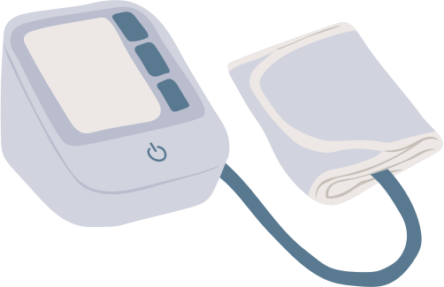
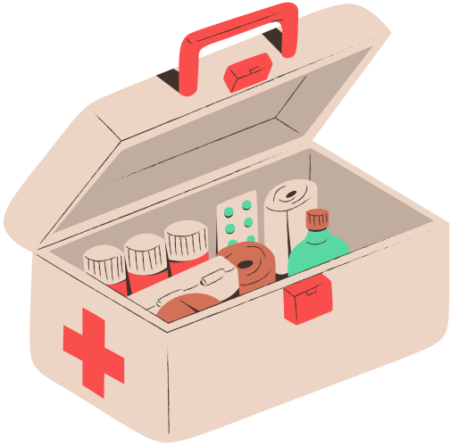


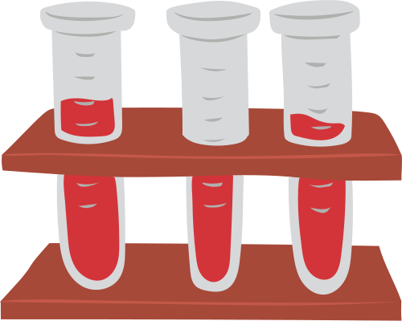
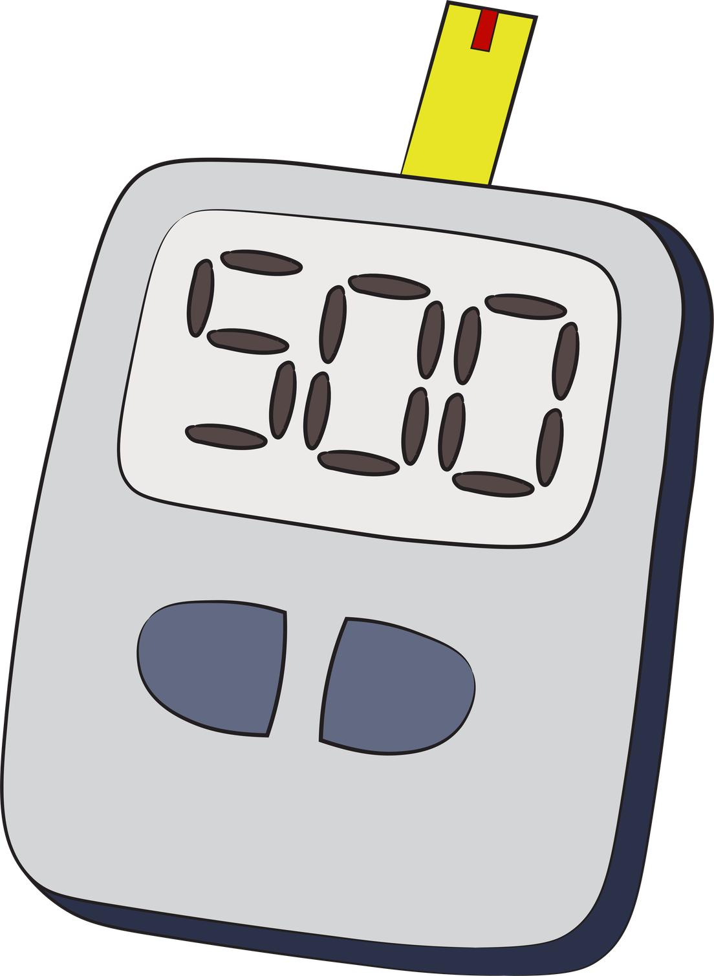
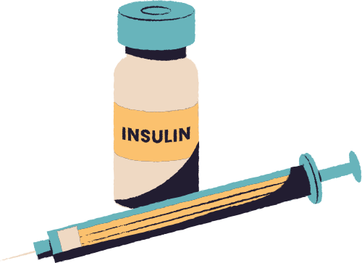
TEAM 11
DATA DETECTIVES
SQL HACKATHON
Presented By :
Saranya Shanmugam(Team Lead)
Apurva Khangar
Jayasree Deekonda
Poornima Srinivasan

Slide 2

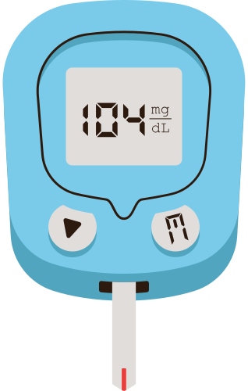


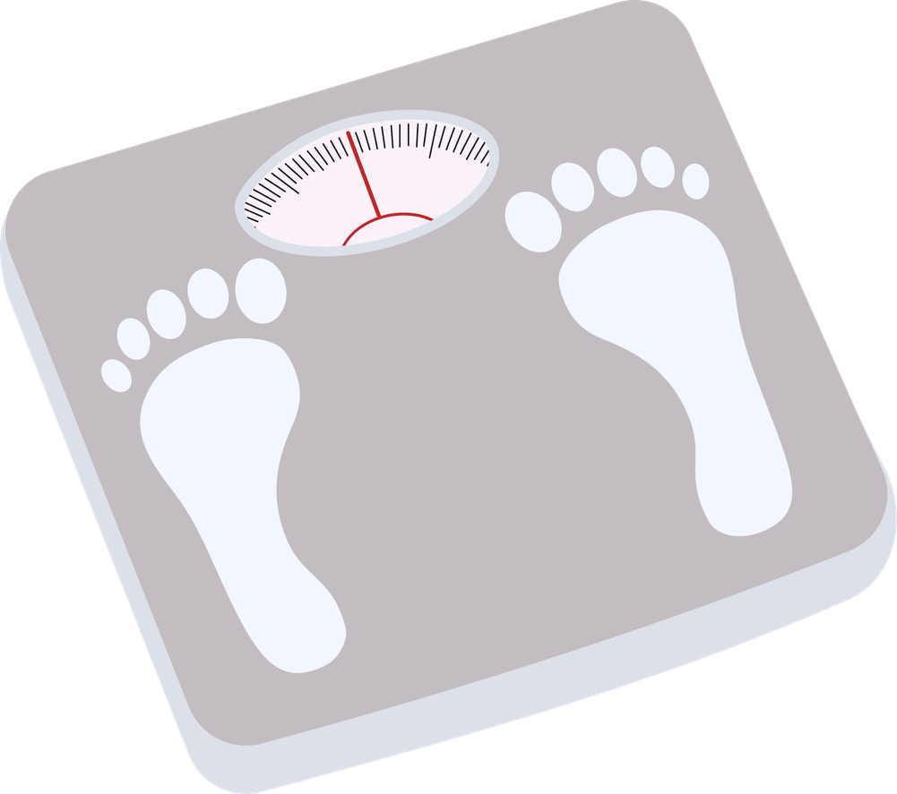
A real-world multi-sensor health dataset combining glucose monitoring, wearable signals, and nutrition data to understand patient health behaviour.
🩸 Dexcom (CGM Data): Continuous glucose levels with insulin and carb events
❤️ Heart Rate (HR): Cardiovascular activity tracking over time
⚡ IBI (Heart Variability): Measures stress and autonomic response
🌡 Temperature: Body temperature for anomaly detection
💧 EDA: Stress and emotional activity signals
🍽 Food Log: Meal intake with carbs, calories, and nutrition details
👤 Demographics: Patient-level profile information
MULTI-MODAL HEALTHCARE DATASET

Slide 3
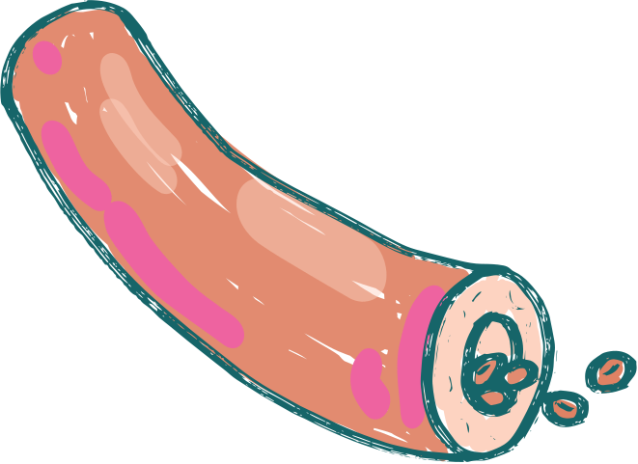
DATA CLEANING
Data cleaning operations
Data Transformation
Feature Engineering
Raw and Staging
  scheme inspection’
  null value detection
  duplicate record identification
  Mixed timestamp format identification
  standardized timestamps
  filtered invalid physiological ranges
  event filters
  clean data layer
  indexing
  temperature anomaly detection
  EDA spike detection
  clinical event flags.
  removed duplicates
  missing/null values
  data type consistency
  column name standardization

Slide 4

QUERIES AND INSIGHTS
Category 1 — Foundational Insight
Category 2 —
Pattern Detection
Category 3 —
Reusable Clinical Tools
  Time-in-Range glucose classification
  Single-pass CASE + window function
  50% of readings are prediabetic range
  Only 1.87% reach full hyperglycemia
  LAG() flags Rapid Rise / Rapid Drop events
  Coefficient of variation ranks instability fairly
  Rolling EDA detects sustained stress periods
  Percentile ranking flags cohort-relative outliers
  Stored procedure: cardiovascular summary
  Recursive CTE: hourly glucose timeline
  Trigger: real-time high-glucose alert log
  User-defined function: reusable stress score

Slide 5
LEARNING
  Understood real-world healthcare time-series data analysis (CGM, HR, nutrition)
  Learned SQL optimization techniques like GROUP BY, window functions, and CTEs
  Built experience in stored procedures, triggers, and UDFs for automation
  Improved ability to translate business/clinical questions into SQL logic
  Gained understanding of glucose metrics (TIR, HbA1c, variability, risk classification)
  Learned data cleaning techniques for large multi-table datasets
  Improved storytelling using data insights for healthcare decision-making

Slide 6
CHALLENGES
  Handling large multi-table joins across clinical datasets
  Large-scale table joins required pre-aggregation techniques to make queries efficient and executable
  Cross-sensor data (glucose, HR, activity) had timestamp misalignment issues, requiring careful time-series alignment strategies
  Managing data inconsistencies and missing values in time-series data
  Designing correct logic for clinical thresholds (glucose, HbA1c, HR ranges)
  Avoiding errors in aggregation vs row-level interpretation
  Optimizing SQL queries for performance and readability
  Ensuring consistent naming and standardization across datasets
  Debugging complex SQL issues (NULLIF, GROUP BY, CASE logic errors)
  Balancing clinical accuracy vs technical implementation constraints
  Coordinating teamwork across different time zones, impacting collaboration speed and sync

Slide 7
THANK YOU

