Slide 1

Core Course Project - 5
Department of Electrical and Electronics Engineering
SIH-1582(2024)
Mentor- Dr.Sankar
Sai Samicsha Shri D -23EE041
Saranya Shree R S -23EE045
AI-Enabled Smart Earthing Health Monitoring with Predictive Analytics and Fail-Safe Bypass

Slide 2
Problem Statement
Problem Statement ID: 1582 (2024)
Title: System to check the healthiness of earthing system and alert staff in case of any malfunction
Description: Large numbers of electrical pole lights at public areas like parking and stations rely on earth leakage protection. However, malfunctions can pose serious public safety risks, and manual checking requires significant manpower. A sensor-based system is needed to continuously monitor earth leakage current and earthing continuity. It should transmit real-time data to a centralized location and alert the maintenance team through audible and visual signals if earth resistance deviates from safe limits.

Slide 3
Objective
To design an IoT-enabled ELCB monitoring system for enhanced electrical safety.
To detect leakage current and verify whether the ELCB trips correctly.
To provide alerts and notifications (mobile) during unsafe conditions.
To implement dual response modes: direct power cut or bypass supply for continuity.
To enable cloud data logging for historical analysis and remote monitoring.
To use AI/ML prediction for early detection of ELCB degradation or failure trends.
To incorporate a self-test mechanism that automatically checks ELCB health.

Slide 4
Abstract
The proposed solution is an IoT-based ELCB monitoring system that ensures both safety and reliability. A current sensor checks for leakage, and if the ELCB fails to trip, the ESP32 raises alerts via buzzer, LED, and mobile notifications while either cutting power or switching to bypass mode for temporary supply. Leakage data is uploaded to the cloud for AI analysis, which predicts abnormal patterns and gives early warnings of ELCB degradation. A self-test mode is also included, where artificial leakage is injected to verify breaker health, ensuring timely detection of faults.

Slide 5
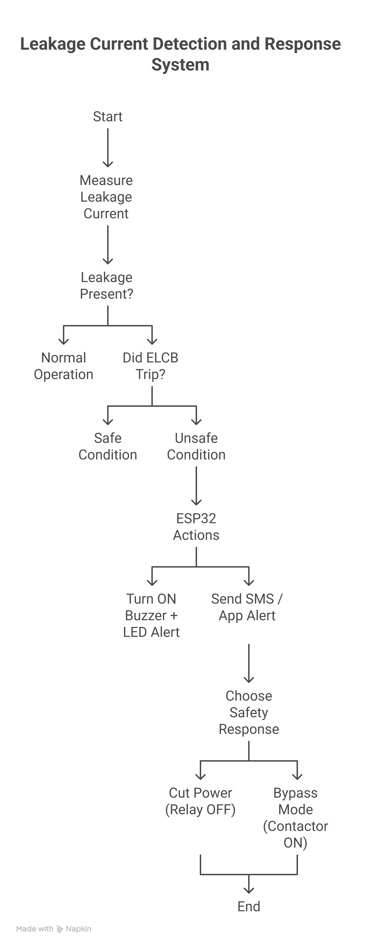
ELCB Fault Detection → Bypass

Slide 6
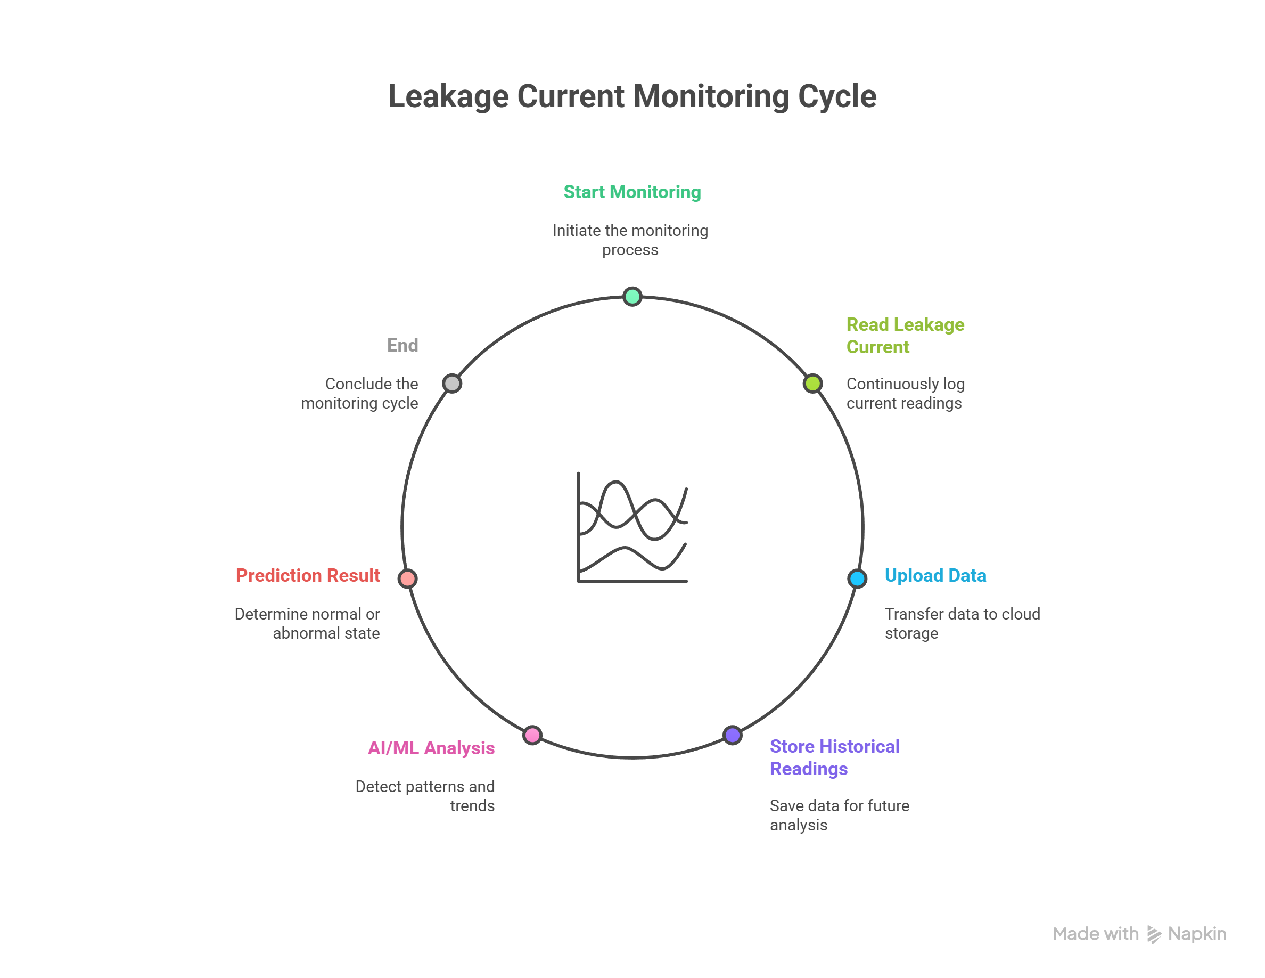
Data & AI

Slide 7
Uniqueness & Novelty
Ensures continuous protection + predictive maintenance in a single compact system.
Integrates IoT alerts (SMS/app) for real-time notification.
Provides dual safety modes → direct power cut or bypass supply for essential loads.
Goes beyond standard ELCB by detecting when the breaker fails to trip.
Cloud-based data logging with AI/ML for predictive fault detection.
Self-test mode with artificial leakage injection for automatic breaker health check.

Slide 8
Feature | Existing System | Proposed System
Leakage Detection | Trips only if leakage is detected and breaker works. | Detects leakage and also checks if ELCB fails to trip.
User Alerts | No alert mechanism. | Mobile notifications.
Data Logging | Not available. | Leakage data stored in cloud for history and analysis.
Predictive Maintenance | Not possible. | AI/ML predicts abnormal leakage patterns and ELCB degradation.

Slide 9
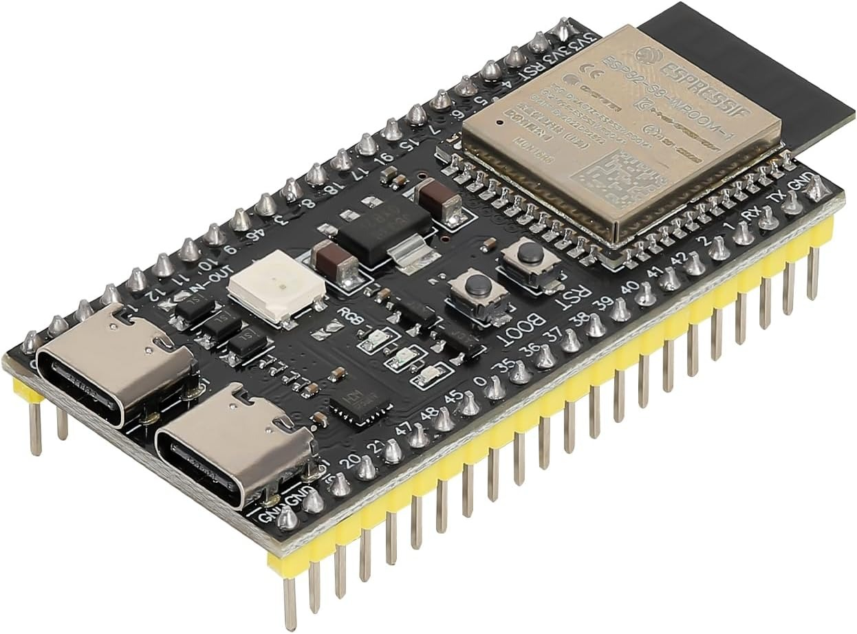
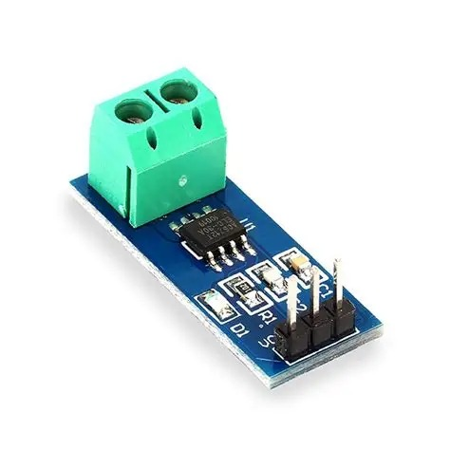
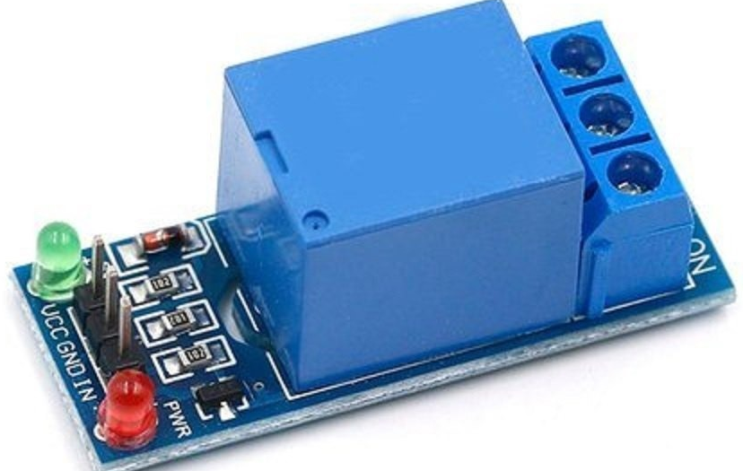


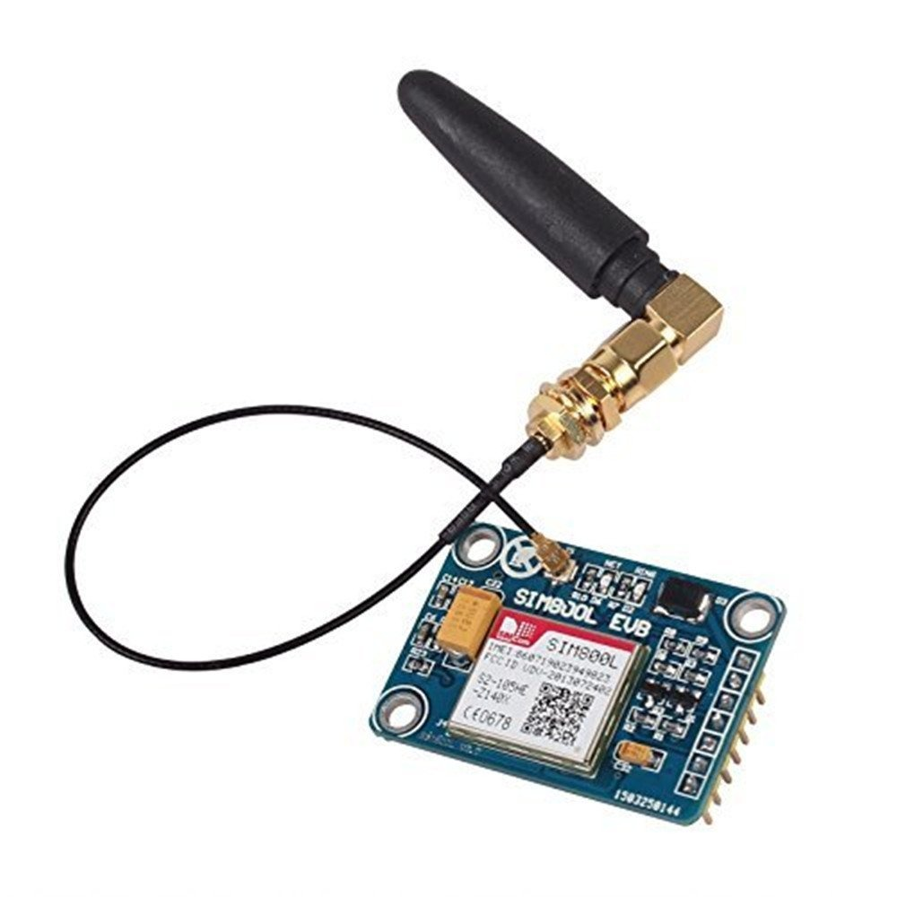


Tech Stack
ESP32
Current Sensor
Relay
GSM Module

Slide 10
Conclusion
The proposed system successfully enhances the safety and reliability of conventional ELCBs by integrating IoT-based monitoring, smart prediction, and self-test functionalities. By continuously sensing leakage current, the system ensures immediate protection even if the breaker fails to trip, while providing options to either disconnect the load or switch to a bypass mode for uninterrupted supply. With cloud data logging and AI analysis, it can identify abnormal leakage patterns and give early warnings about possible breaker degradation, enabling preventive maintenance. Additionally, the self-test feature allows automatic verification of the ELCB’s health without manual intervention. Overall, the solution combines real-time protection, predictive intelligence, and smart diagnostics to deliver a safer and more reliable electrical protection system than traditional ELCBs.

Slide 11
Reference Papers
Development of Smart Earth Leakage Circuit Breaker Using IoT and Power Electronics
Design of Leakage Current Monitoring System for Low Voltage Power Grid Based on NB-IoT
Fault Prediction Based on Leakage Current in Contaminated Insulators Using Enhanced Time Series Forecasting Models
Artificial Intelligence based Sensor Data Analytics Framework for Remote Electricity Network Condition Monitoring

Slide 12
THANK YOU

