Slide 1
Insurance
And its types
-Suman Sharma and Saranya Somepalli

Slide 2
Contents
Definition
Terms used in insurance
Lifecycle of an insurance
Types of insurances
Insurance provided by chubb
Top insurance companies

Slide 3
Insurance
Insurance is an agreement in which one party agrees to pay an amount in case of any mishappening.
Insurance companies evaluate the risks and take a gamble if that risk is worth investing.

Slide 4
Terms used in insurance
Risk: Chance of a loss from an uncontrolled event
Accident: An unforeseen or and unintended event
Premium: A recurrent amount to be paid in monthly/yearly basis for the insurance
Policy: Terms and conditions mentioned in the insurance

Slide 5
Assured/Insurer/Policy holder: Someone who has taken the insurance
Insurer: Someone who provides the insurance
Annuity plans: Pension or lumpsum paid to the policy holder
Assignment: Legal transference of the policy
Beneficiary: Person who receives the assured sum after the death of the asured

Slide 6
Deductible: Amount you need to pay before insurance company starts paying.
For example: If your policy says the deductible clause is $100.
Say you have a medical surgery and the surgery costs about $10000.
Then You pay the $100 for the surgery and the rest amount is paid by the insurer.
Co-pay: The fixed amount you pay

Slide 7
Coinsurance: Certain percentage of the loss is paid by the insured and the remaining percentage by the insurer.
Out of pocket maximum: Suppose you have a deductible clause of $100 and coinsurance of 20:80. And if I have a surgery costing about $2000 and my pocket maximum is $300.
You pay the first $100. Remaining amount= 2000-100=$1900
20% of 1900= $380
Total amount to be paid= 100+380= $480
Which is higher than the pocket maximum.
So you pay the $300 and the insurer pays the rest amount.

Slide 8
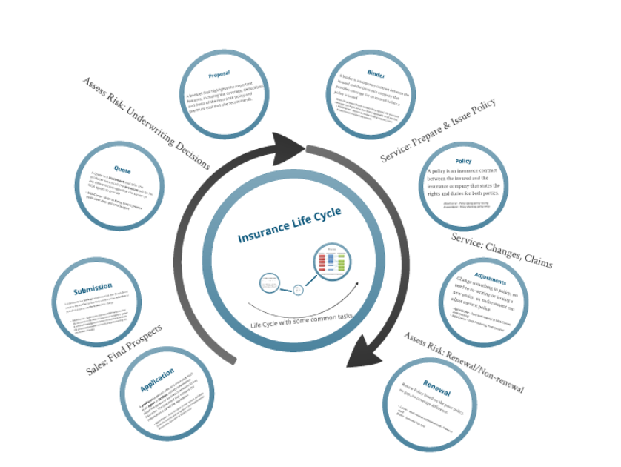
Lifecycle of an insurance

Slide 9
Application
A producer(agent or broker who sells insurance policy) collects information about a person or business that wants to buy the insurance. The document that contains the information is called application.
The agent/ broker enters the data in their system, pull data from the internet and set up accord and supplemental documents; Send the application to Mga/carrieer

Slide 10
Submission
A submission is a package of information that the producer sends to the carrier so that they can determine whether to provide insurance and how much to charge.

Slide 11
Quote
Quote is a statement that tells the producer how much the premium will be for the different coverages that the carrier or MGA agrees to provide.
MGA/Carrier: Prepares the cover letter of the quote and send it to the agent.

Slide 12
Proposal
A booklet that highlights the important features, including the coverage, deductibles, and limits of the insurance policy and premium cost.

Slide 13
Binder
A temporary contract between the insured and the insurance company that provides coverage for an insured before a policy is issued.
The MGA/carrier issues binder/related documents.

Slide 14
Policy
A policy is an insurance contract between the insured and the insurance company that states the rights and duties for both the parties.
The MGA/carrier issues the policy.

Slide 15
Adjustments
Change something in policy, no need to rewrite or issue new policy, an endorsement can adjust new policy.
Agent/broker sends the endt request.
MGA/carrier processes the endt.
Endt=Insurance endorsement: Contract that changes the terms of the current policy.

Slide 16
Renewal
Renew policy based on the prior policy. No gap, no coverage differences.
The carrier sends the renewal notification letter to the insured.

Slide 17
Claims
When a catastrophe hits and you need to file a claim, insurance companies require basic information about what happened to thoroughly investigate the claim. Insurance adjusters then decide if the claim is valid and how much payment the contract requires.

Slide 18
Payout
If the claim is valid, insurance companies pay out claims either to the individual or to a service provider based on the terms of the contract. If policy premiums have been paid with pretax dollars or paid by an employer, the payout will be taxable. Premiums that were paid with after-tax money are tax free.

Slide 19
Types of insurance
Two types:
Life insurance
General insurance

Slide 20
Life insurance
Further divided into sub categories:
Whole life policy
Sum assured is only paid when the insurer dies, to the family members
Endowment life assurance policy
After a certain period of time, if the person does not die, he will be paid the assured sum
Joint life policy
Two or more people jointly take the insurance policy, If one person dies, the other person gets the assured sum

Slide 21
Annuity policy
After a certain period of time, the assured sum will be paid on monthly, half yearly or annual basis
Children’s endowment policy
The child is paid the assured sum after he/she reaches a certain age

Slide 22
General insurance
Health insurance
Property insurance
Fire insurance
Marine insurance
Disability insurance
Crop insurance
Automobile insurance
Travel insurance
Home insurance
Mobile insurance
Cycle insurance

Slide 23
Health insurance
If you don't have health insurance and something goes wrong, it's not just your money at risk -- it's your life. Health insurance is intended to pay for the costs of medical care.
Individual Health Insurance - These are healthcare plans that offer medical cover to just one policyholder.
Family Floater Insurance - These policies allow you to avail health insurance for your entire family without needing to buy separate plans for each member. Generally, husband, wife and two of their children are allowed health cover under one such family floater policy.
Critical Illness Cover - These are specialised health plans that provide extensive financial assistance when the policyholder is diagnosed with specific, chronic illnesses. These plans provide a lump-sum payout after such a diagnosis, unlike typical health insurance policies.

Slide 24
Senior Citizen Health Insurance - As the name suggests, these policies specifically cater to individuals aged 60 years and beyond.
Group Health Insurance - Such policies are generally offered to employees of an organisation or company. They are designed in such a way that older beneficiaries can be removed, and fresh beneficiaries can be added, as per the company’s employee retention capability.
Maternity Health Insurance - These policies cover medical expenses during pre-natal, post-natal and delivery stages. It covers both the mother as well as her newborn.
Personal Accident Insurance - These medical insurance policies only cover financial liability from injuries, disability or death arising due to accidents.
Preventive Healthcare Plan - Such policies cover the cost of treatment concerned with preventing a severe disease or condition.

Slide 25
Property insurance
Home Insurance - With such a policy, you remain free from all financial liabilities that may arise from damage to your home or contents inside due to fires, burglaries, storms, earthquakes, explosions and other events.
Shop Insurance - If you own a shop, which acts as a source of income for you, it is integral to protect yourself from financial liability arising from the same. Whether the liability occurs due to natural calamities or due to accidents, with these plans, you can immediately undertake repairs to the shop.
Office Insurance - Another type of property insurance policy, office insurance ensures that the office building and all the equipment inside are significantly protected in the event of unforeseen events. Generally, office spaces include expensive equipment, such as computers, servers and much more. Thus, availing these plans is essential.
Building Insurance - If you own a complete building, opting for home insurance may not be sufficient. Instead, you can purchase building insurance to cover the entire premises.

Slide 26
Fire insurance
Fire insurance pays or compensates for the damages caused to your property or goods due to fire.
It covers the replacement, reconstruction or repair expenses of the insured property as well as the surrounding structures.
It also covers the damages caused to a third-party property due to fire.
In addition to these, it takes care of the expenses of those whose livelihood has been affected due to fire.

Slide 27
Marine insurance
Marine Insurance is a type of insurance policy that provides coverage against any damage/loss caused to cargo vessels, ships, terminals, etc. in which the goods are transported from one point of origin to another.

Slide 28
Disability insurance
Disability insurance provides risk coverage for the lost income due to failure to work in case of any permanent or temporary disability.
It covers sick leave, and offers disability benefits for short and long-term periods.

Slide 29
Crop insurance
Crop insurance is purchased by agricultural producers, and subsidized by the federal government, to protect against either the loss of their crops due to natural disasters, such as hail, drought, and floods, or the loss of revenue due to declines in the prices of agricultural commodities.

Slide 30
Automobile insurance
Automobile insurance is for your car or bike what health insurance is for your health.
It is a general insurance cover that offers financial protection to your vehicles from loss due to accidents, damage, theft, fire or natural calamities
You can also get motor insurance for your commercial vehicles.

Slide 31
Travel insurance
A travel insurance compensates you or pays for any financial liabilities arising out of medical and non-medical emergencies during your travel abroad or within the country.
What all does travel insurance usually cover?
Loss of baggage
Emergency medical expenses
Loss of passport
Hijacking
Delayed flights
Accidental death

Slide 32
Home insurance
Home insurance is a cover that pays or compensates you for damage to your home due to natural calamities, man-made disasters or other threats.
It covers liabilities due to fire, burglary, theft, flood, earthquakes, and sabotage. It not only offers financial protection to your home, but also takes care of the valuables inside the property.

Slide 33
Mobile insurance
Comprehensive protection for new devices - The value of phones tend to decline with time. Thus, when the handset is new, phone insurance can help safeguard its significant value.
Coverage against Damage to Screen - If you accidentally damage the smartphone screen, which is one of the most important parts of such devices, your insurance plan will pay for the repair expenses.
Theft or Robbery of Smartphone - Nothing is worse than buying your dream smartphone and losing it due to theft or burglary. Well, phone insurance will help you afford a replacement handset if such an unfortunate thing happens.

Slide 34
Cycle insurance
Worldwide Coverage - Depending on the insurance provider, cycle insurance policies provide financial assistance regardless of where your bicycle undergoes damage. Even if you meet with a cycling accident in a different country, such a plan will offer aid.
Protection against Fires and Riots - If your bicycle sustains damage due to accidental fires and/or rioting, insurance policies will provide the necessary financial assistance to repair or undo the damage.
Accidental Death Benefit - If you pass away due to bicycle accidents, the insurance policy for the cycle would offer a lump-sum payout to your surviving family members.

Slide 35
Insurances provided by chubb
Individual and families
1. Home insurance
2. Auto insurance

Slide 36
3. Valuables insurance
4. Boats and yachts insurance
5. Liability insurance

Slide 37
6. Travel insurance
7. Natural disasters insurance
8. Cyber insurance
9. Life and health insurance

Slide 38
Business
1. Aerospace
2. Agriculture
3. Food
4. Technology

Slide 39
5. Transportation
6. Food
7. Railroad
8. Wineries
9. Marine
10. Property

Slide 40
Top insurance companies
Health insurance companies:
IMG.
Foyer Group.
AXA.
Generali Global Assistance.
Cigna.

Slide 41
Home insurance companies
Nationwide
Hippo
Chubb
Travelers
State farm

Slide 42
Travel insurance companies
World Nomads Travel Insurance.
AIG Travel.
Seven Corners.
Generali Global Assistance.
IMG Travel Insurance.

Slide 43
Property/casualty insurance companies
State farm
Berkshire Hathaway
Progressive group
Liberty mutual
Allstate
Travelers group
Usaa
Chubb

Slide 44
Life insurance company
New York Life Insurance Company
Lincoln National Life Insurance Company
MassMutual (Massachusetts Mutual Life Insurance Company)
Northwestern Mutual Life Insurance Company
Principal Financial Group.

