Slide 1
CS689 Project Neural Machine Translation
Dr. Arnab Bhattacharya
Dept. of CSE, IIT Kanpur
Sourit Saha
200998
sourits20@iitk.ac.in
Saranya Pal
210930
saranyap21@iitk.ac.in

Slide 2
Contents
Challenges faced in Dependency Parsing
Introduction and Problem Statement
Data Sources and Description
Model Description
Model Training
Model Evaluation
Error Analysis
Conclusion

Slide 3
Challenges Faced in Dependency Parsing
Firstly, we thought of implementing the translation model based on dependency parsing. However, we didn’t receive any reply from the authors of the paper. So, we tried the same two examples using spaCy:
Example 1
Example 2
আমাকে দিল্লি যেতে হবে।
AmAke --> compound --> dilli
dilli --> nsubj --> yete
yete --> ROOT --> yete
have| --> dobj --> yete
বইটা তাকে দিয়ে বলল কাল পড়িস।
vaiTA --> compound --> diYe
tAke --> compound --> diYe
diYe --> compound --> valala
valala --> ROOT --> valala
kAla --> appos --> valala
paDa়isa| --> npadvmod --> valala
We encountered similar errors as described in the paper for using single layer dependency parsing.
There was not enough time to implement the grammar-based rules, so we switched to NMT.

Slide 4
Introduction and Problem Statement
Objective: Build robust Neural Machine Translation (NMT) models for seamless translation between English and Indian languages, focusing on articles and editorials.
Architectures Explored:
Primarily Seq2Seq models known for NMT challenges.
Encoder aims to learn a meaningful representation of the source language.
Decoder generates accurate translations, word by word.
Decoding Strategies:
Includes methods like greedy decoding, beam search, and top-k sampling.
The choice of decoding strategy critically affects translation quality.
Training Challenges:
Models are trained from scratch, presenting substantial computational challenges.
Resource constraints (use of platforms like Google Colab and Kaggle) limit model size and extend training times, influencing the feasibility of using more complex models or larger datasets.

Slide 5
Data Sources and Description
Source: Samanantar benchmark dataset
Bengali-English Translations:
Training Dataset:
Combined `dev.bn`, `test.bn` from `benchmarks/wat2020-devtest/en-bn/`, and `test.bn` from `benchmarks/wat2021-devtest/`.
Corresponding `.en` files merged to `create train_df_bn_en.csv` and `train_df_en_bn.csv`.
Testing Dataset:
Used `dev.bn` and corresponding `.en` files from `benchmarks/wat2021-devtest/` to form `test_df_bn_en.csv` and `test_df_en_bn.csv`.
Bengali-Hindi Translations:
Training Dataset:
Due to limited multilingual data, concatenated `test.bn` and `dev.bn` along with corresponding `.hi` files from `benchmarks/wat2021-devtest/` to create `train_df_bn_hi.csv` and `train_df_hi_bn.csv`.
Testing Dataset:
Created similarly to the English-Bengali setup, presumably using the same sources for consistency.

Slide 6
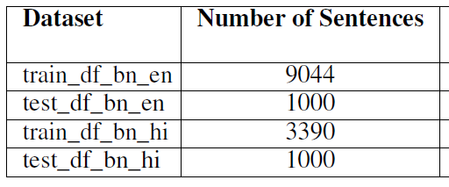
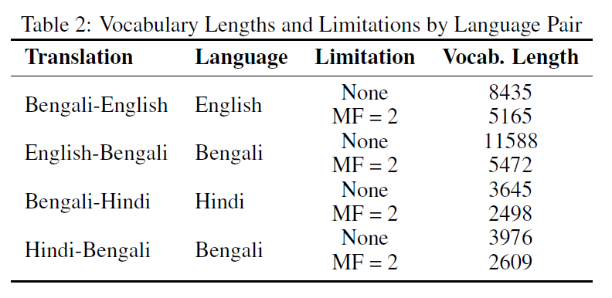
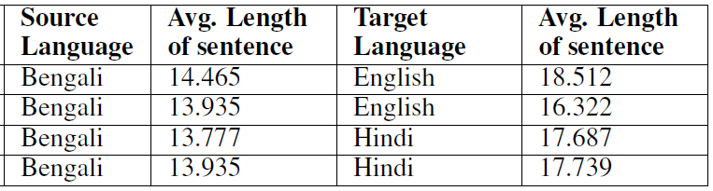
Dataset Statistics Summary
Corpus Statistics
Vocabulary Statistics

Slide 7
Model Description
Inference:
Initially experimented with both greedy search and top-k sampling.
Top-k sampling led to suboptimal results, often outputting premature <EOS> tags
Due to these issues, subsequent models exclusively used greedy search for inference.
Loss Function:
Cross Entropy Loss was consistently used across all models.
Final Model Configuration:
Standard transformer architecture as per foundational literature.
Implementation includes:
An embedding layer that converts input indices into input embeddings.
Positional encodings added to these embeddings.
The model processes these inputs to return probabilities over each word, which are then decoded using the selected inference strategy.

Slide 8
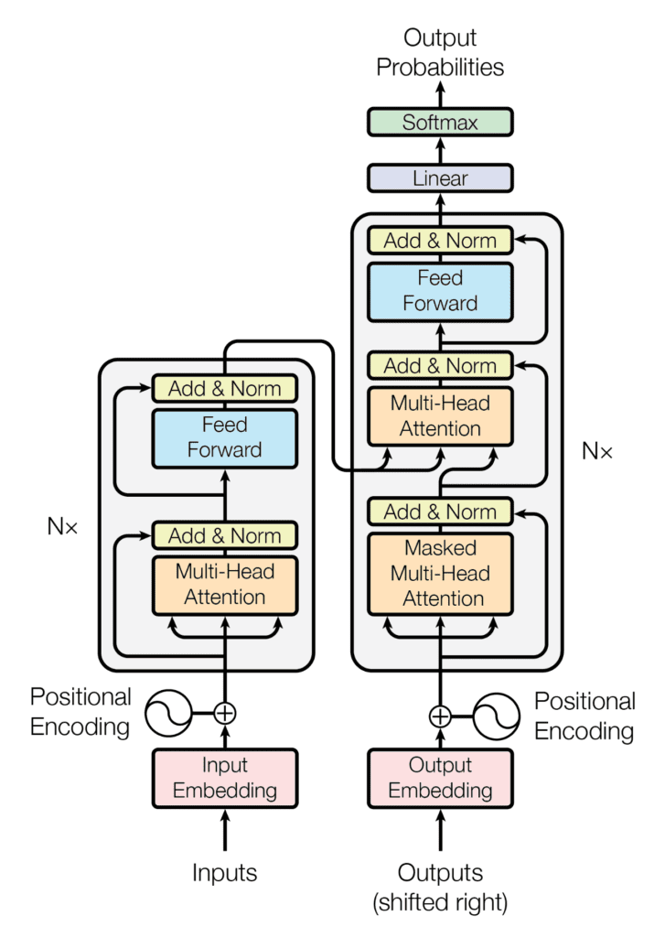
Transformer Attention Architecture
Pipeline of the transformer architecture
Key Components:
Encoder
Input Embeddings
Positional Encoding
Multi-Head Attention
Query, Key, Value
Decoder
Masked Multi-Head Attention
Feed Forward Network
Training
Inference

Slide 9
Model Training
Data Pre-Processing:
English sentences converted to lowercase as case don't make any sense for Indic languages
`Vocabulary` Class: Handles tokenization, build vocabulary dictionaries and convert text data into numerical representations
`Train_Dataset` Class: designed to serve as a dataset for training the model
`get_train_loader` function: Creation of PyTorch Dataloader, shuffling and padding with zeros
`master_loader` function: Only this function is called in the main notebook, thus serving as a packaged and short function, thus acting as a high-level interface
Training:
Optimizer: Adam
Learning-rate: 0.0003 in the transformer
Epochs: Various epochs were tried, from 25 to 150
The training took around 10 seconds for English-Bengali and 3 seconds for Hindi-Bengali translations for each epoch

Slide 10
Hyperparameter Tuning:
EMB_SIZE = 64, 128
NHEAD = 8
FFN_HID_DIM = 64, 128
BATCH_SIZE = 64, 128, 256
NUM_ENCODER_LAYERS = 3, 4
NUM_DECODER_LAYERS = 3, 4
NUM_EPOCHS = 50, 75, 100, 150
The best results were obtained for the highlighted hyperparameters in the Transformer Model

Slide 11
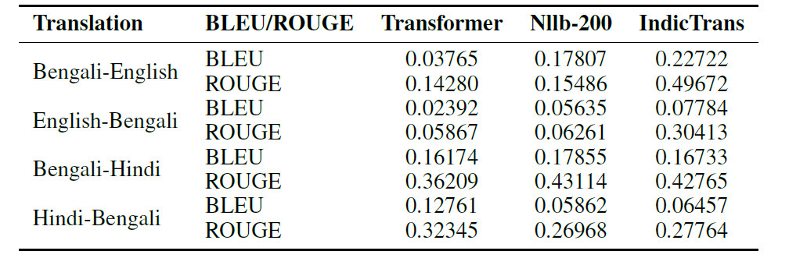
Model Evaluation
Bengali-English translations consistently outperform English-Bengali translations, a trend also observed with pre-trained models.
Exceptionally high scores for Bengali-Hindi and Hindi-Bengali translations are attributed to the model being inadvertently trained on test cases.
The performance of the custom transformer model was benchmarked against existing pre-trained models as per Assignment 3.

Slide 12
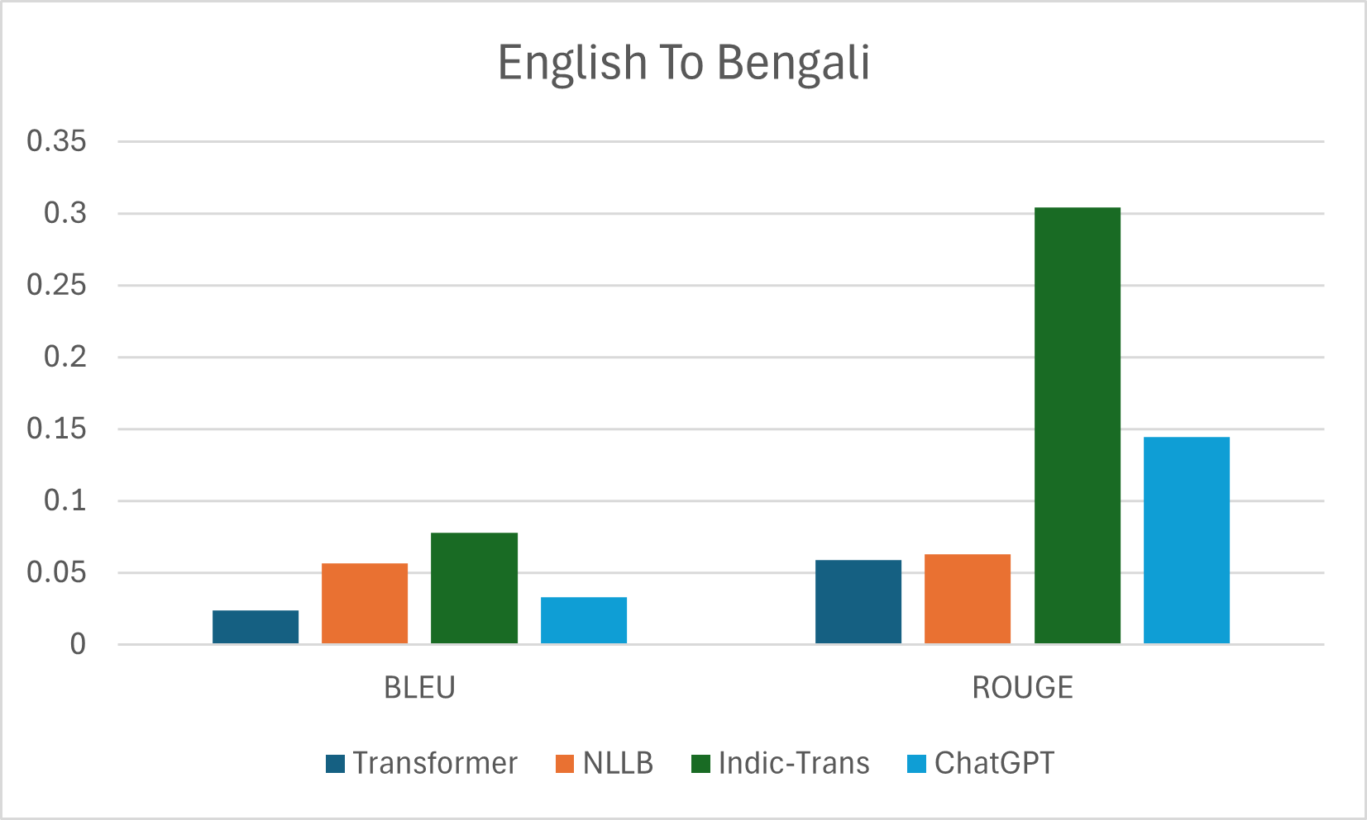
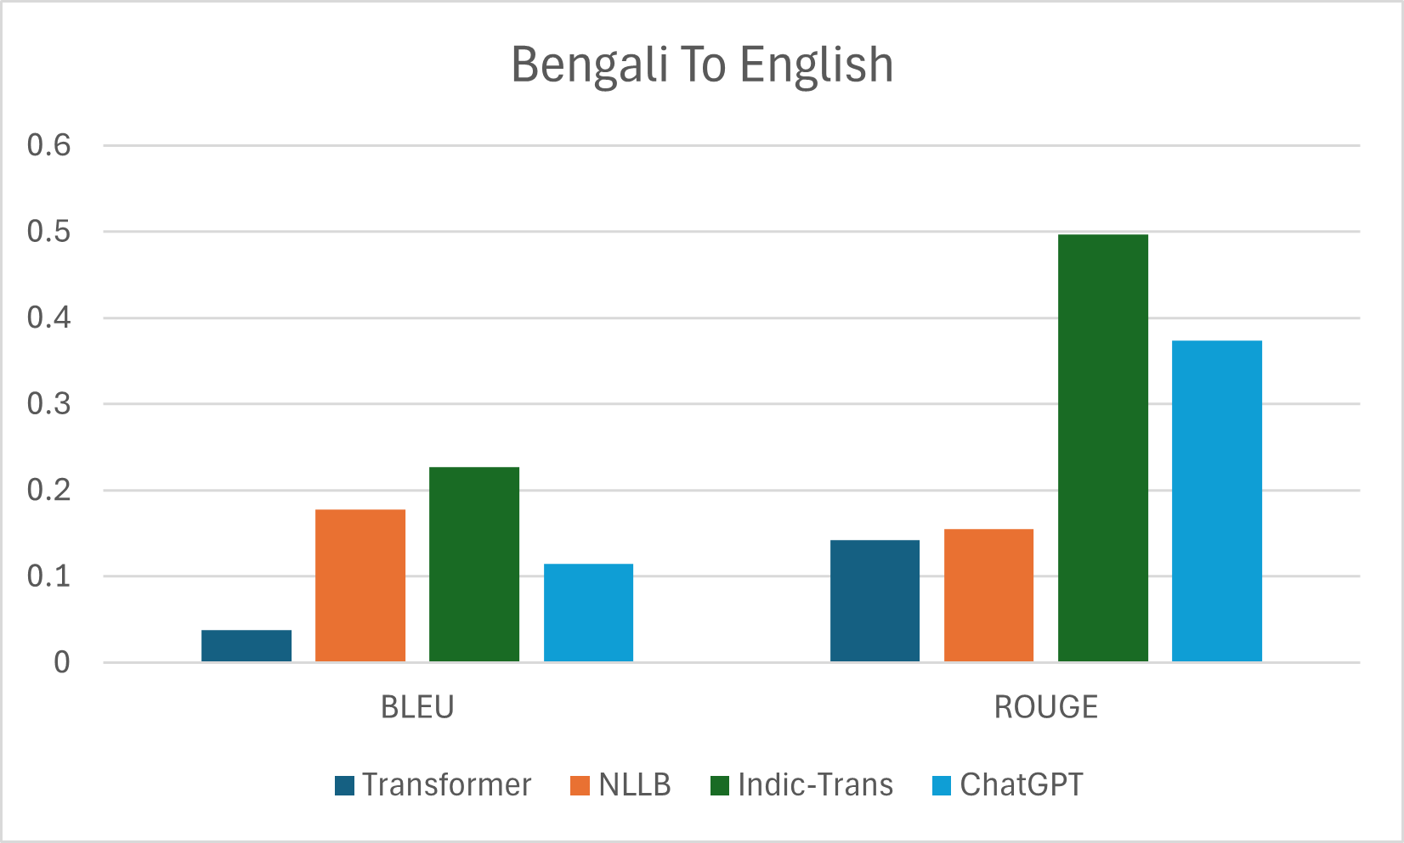
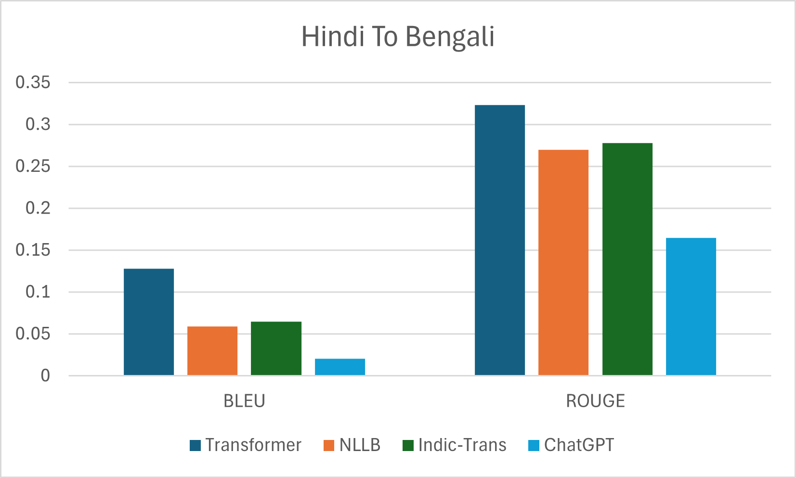
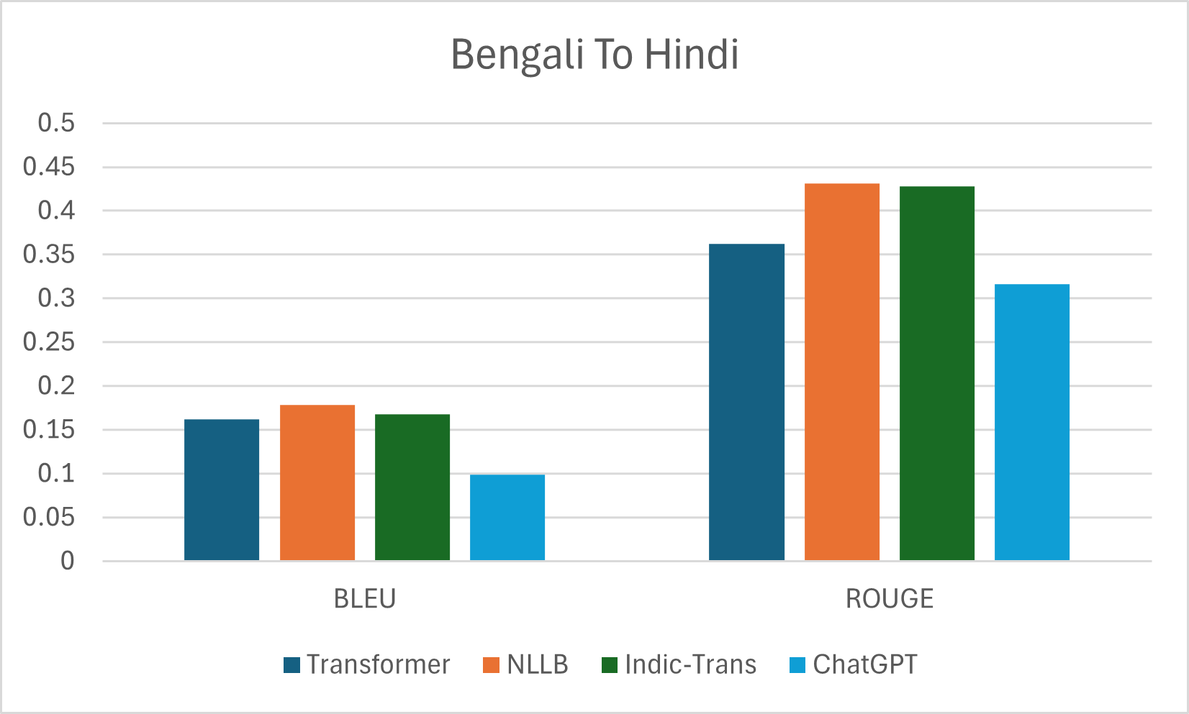
Comparison with Pre-Trained models
IndicTrans model outperforms the other 3 models
ChatGPT translations are done on 50 sentences only
NLLB-200 employs a transformer-based architecture, that’s why we can see similarities between the performance of our model and NLLB model.

Slide 13
Conclusion
Model Limitations:
Resource constraints significantly impacted model performance; datasets were insufficient for training optimal models.
Google Colab's limitations restricted the ability to train larger models and build extensive vocabularies, which could have improved model accuracy.
Transformer Architecture:
Various models within the Transformer architecture were explored and tested.
Despite challenges, the Transformer models achieved decent performance metrics such as BLEU and ROGUE scores, underlining their potential in machine translation tasks.
Overall Findings:
The project highlights the feasibility and effectiveness of Transformer-based models in translation tasks, even with constrained resources. These findings demonstrate the architecture's resilience and adaptability in less-than-ideal conditions.

Slide 14
Resources
A. Vaswani, N. Shazeer, N. Parmar, J. Uszkoreit, L. Jones, A. N. Gomez, L. U. Kaiser, and I. Polosukhin, “Attention is all you need,” in Advances in Neural Information Processing Systems (I. Guyon, U. V. Luxburg, S. Bengio, H. Wallach, R. Fergus, S. Vishwanathan, and R. Garnett, eds.), vol. 30, Curran Associates, Inc., 2017.
P. Tutorials, “Sequence-to-sequence modeling with nn.transformer and torchtext.” Available: https://pytorch.org/tutorials/beginner/translation_transformer.html, 2023.
Umar Jamil, YouTube channel, 2023.
14

Slide 15
Thank You

