Slide 1
Employee Data Analysis using Excel
STUDENT NAME: Saranya.s
REGISTER NO:122203099
DEPARTMENT:B.com c.s
COLLEGE mahalashmi women's college of art and science

Slide 2
PROJECT TITLE
Employee Performance Analysis using Excel

Slide 3


AGENDA
Problem Statement
Project Overview
End Users
Our Solution and Proposition
Dataset Description
Modelling Approach
Results and Discussion
Conclusion
3/21/2024 Annual Review

Slide 4

PROBLEM STATEMENT
1.A problem statement is a business document that outlines an organisation's issue and proposes a detailed solution to prevent its recurrence.
2.Problem statements serve as important communication tools, providing insights about potential threats, fostering innovation and promoting technological development.
3.Crafting an effective problem statement involves clearly defining the problem, explaining its relevance, supporting claims with data, proposing practical solutions, and demonstrating the benefits of these solutions.

Slide 5

PROJECT OVERVIEW
1.The second step to writing a project overview is determining the scope of your project. Determine what your goals are and the timeline you have availabl
2.When you begin drafting your project overview, ensure you are communicating with your client or management team so your project is guaranteed to satisfy its goals
3.When writing your project overview, consider how to format the goals and objectives you want to include. The format an affect how easy your project overview is to read for you clients, team members and investors.

Slide 6

WHO ARE THE END USERS?
1.End user experience and support are crucial for the success of user-oriented products and services.
2.Putting oneself into the shoes of an end user is a key to producing the product the end user not only needs, but wants.
3.computer programmer who designs a software platform for foreign currency trading must think about the level of interface sophistication versus simplicity, and all of the steps an end user needs to take to trade effectively.

Slide 7

OUR SOLUTION AND ITS VALUE PROPOSITION
1.A company's value proposition tells a customer the number one reason why a product or service is best suited for that particular customer.
2.A successful value proposition should be persuasive and help turn a prospect into a paying customer.
3.value proposition should be communicated to customers directly, either via the company's website or other marketing or advertising materials.

Slide 8
Dataset Description
1.Positive correlation – Two variables move in the same direction (Either both are up or both or down)
2.Negative correlation – Two variables move in opposite directions. (One variable is up and another variable is down and vice versa)
3.In our day-to-day life, we handle lots of situations where we need a proper arrangement and management of data. Sometimes we have to handle with numbers, sometimes facts. And this is the time when data handling co

Slide 9

THE "WOW" IN OUR SOLUTION
1.When you promise something to a customer, make sure that you can keep your word. Sticking to your word isn't just about under-promising and over-delivering
2.The first step to wowing your customer by keeping your word is to set appropriate and clear expectations. Your customer should know what they are going to receive, when they will receive i
3.Quickness is relative, of course. A slow response via chat might still seem super speedy via email. Analyze your answers' speed for each channel and set a goal based on where you are currently.
3/21/2024 Annual Review
9

Slide 10
MODELLING
1.If fitness modeling is your goal, work with a trainer. Be their spokesperson. Be their walking, talking before and after ad.
2.Volunteer. Work with local retailers and designers to help facilitate fashion shows. Walk every runway like it’s Paris Fashion Week. Treat every booking like it’s for
3.In this type of modeling, you generally have one part of your body that is used in campaigns, like hands, feet, legs, arms, etc.
10

Slide 11
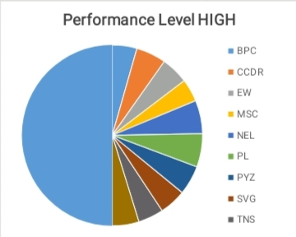
RESULTS
11

Slide 12
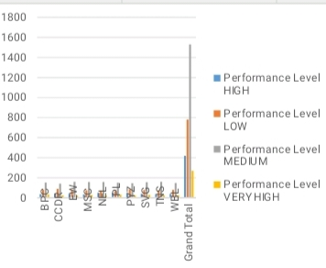

Slide 13
conclusion
1.conclusion is the last part of something, its end or result. When you write a paper, you always end by summing up your arguments and drawing a conclusion about what you've been writing about.
2.The purpose of a conclusion paragraph is to wrap up your writing and reinforce the main idea that you presented in the body of your paper.
3.strong conclusion can provide the reader with a different perspective or shed new insight on an old idea.

