Slide 1
Time Keeper
A time Management App
Sarah Riley

Slide 2
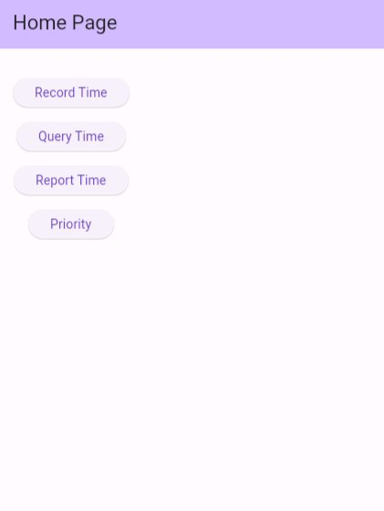
Home Page
The product is specifically designed to be user-friendly. No extra or unnecessary buttons.
Easy Navigation to all tasks
Separated into different sub-pages to limit over crowdedness.

Slide 3
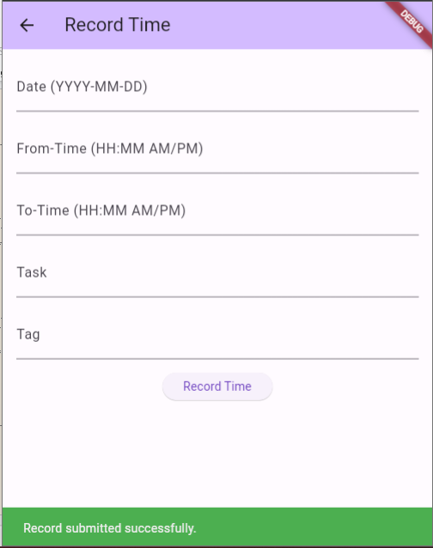
Record time
User Feedback for successful submissions

Slide 4
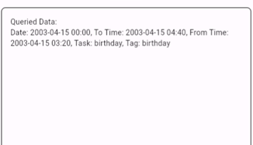
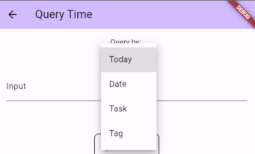
Query Activities
Navigate querying and receive data fast by picking from the 4 option in the drop-down menu: Today, Date, Task , or Tag
Receive queried date in the ‘Queried Data’ box

Slide 5
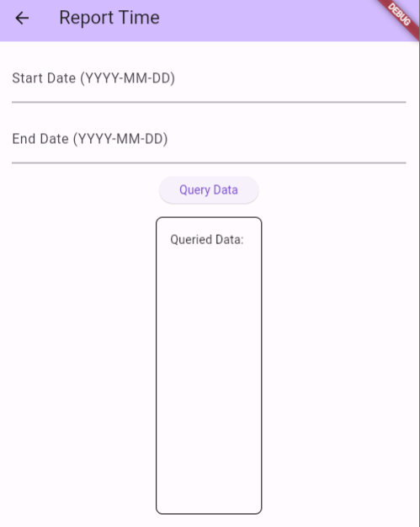
Generate reports
Generate reports quickly by entering a start and end date.

Slide 6
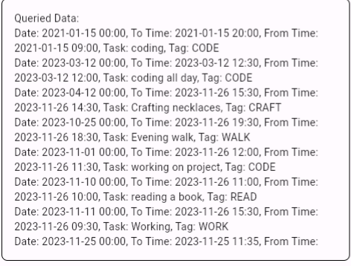
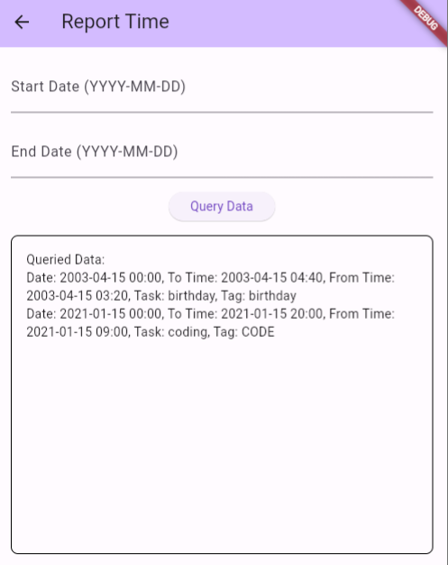
View your data in a scroll box for easy reference

Slide 7
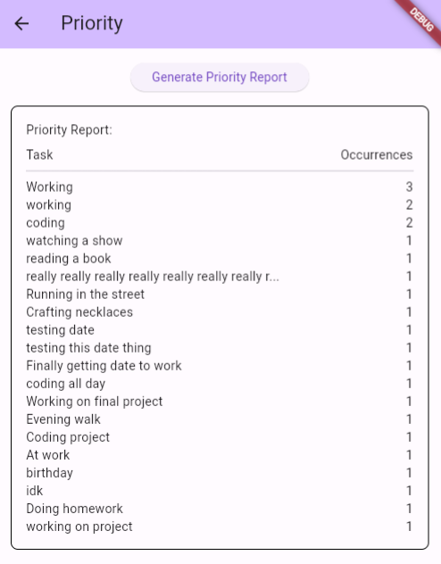
Generate a priority pull
View frequent activities and the number of times you have done the activity

