Slide 1


REGIONAL CROP DISEASE EARLY-WARNING SYSTEM
AgroGuard-AI
Diagnose sick plants from a photo, advise farmers in their language, and stop outbreaks spreading.
National Artificial Intelligence Competition · Crop Protection Track
CodeArena'26 · WeCodeX
Notes:
1

Slide 2



01 · WHY
Farmers wait days while disease spreads unseen
Delayed response
By the time an officer arrives on-site, disease has already spread.
Farmers can wait days for an agriculture officer, and by then a disease may have already spread across the field and into neighbouring farms. Officers have no visibility into where an outbreak is starting until it is too late — and by that point, containment is much harder and far more costly.
No regional visibility
Outbreaks aren't visible to officers until multiple farms are affected.
AgroGuard-AI closes that gap: diagnosis in seconds, advice in the farmer's own language, and regional visibility before an outbreak takes hold.
Language barriers
Generic advice rarely reaches farmers in the language they work in.
AgroGuard-AI
2
Notes:
2

Slide 3




01 · WHY
Four roles, one shared risk
Every actor in the containment loop has a distinct job — the platform is built around all four, not just the farmer.
Farmer
Agriculture Officer
Uploads leaf photos and receives multilingual diagnosis and treatment advice.
Reviews escalated cases, schedules and records field visits.
Research Lab
System Admin
Tests samples of new or unclear diseases and exports surveillance data.
Confirms outbreak declarations and improves the diagnostic model.
AgroGuard-AI
3
Notes:
3

Slide 4




02 · WHAT
A closed loop from photo to containment
AI foliar diagnosis & severity
Multilingual advisories
Live micro-climate telemetry
Vision-based disease ID with low / medium / high / critical severity and yield impact.
Diagnosis and treatment guidance in English, Sinhala, and Tamil.
Temperature, humidity, wind, rainfall and leaf-wetness pulled per farm GPS.
Deterministic risk engine
Outbreak clustering & map
Automated biosecurity alerts
Explainable 0–100 spread-risk index — no black-box confidence.
Haversine clustering surfaces active clusters on a live regional map.
Confirmed outbreaks notify every registered farm within the containment zone.
Scope: photo-based foliar diagnosis for Sri Lankan & tropical crops — not drone or soil sensing, and not a substitute for an officer's final sign-off on a confirmed outbreak.
AgroGuard-AI
4
Notes:
4

Slide 5


03 · HOW
Three layers, one containment loop
Frontend
Backend
Data & AI
  React 19 + Vite
  Tailwind CSS
  React Router
  Leaflet / OpenStreetMap
  Node.js + Express
  JWT authentication
  CORS + rate limiting
  REST API (cases, farms, visits…)
  Gemini Vision + PlantVillage KB
  Open-Meteo live telemetry
  PostgreSQL / Supabase schema
  Zero-config in-memory fallback
Leaf Photo
→
Vision AI + Weather
→
Risk Engine
→
Map + Alerts
AgroGuard-AI
5
Notes:
5

Slide 6

03 · HOW
Decisions that make it trustworthy
Strict confidence triage
Deterministic risk engine
≥90% confidence gives a full diagnosis; <75% suppresses speculative treatment and auto-escalates to the local officer — no guessing.
Spread-risk index (0–100) is a transparent, explainable formula — severity + leaf wetness + micro-climate + nearby cases.
Haversine outbreak clustering
Dual persistence
Active cases within 10km are grouped by pathogen; ≥3 cases in a radius forms a declared cluster with a real centroid.
Runs zero-config on an in-memory store with realistic seed data, or against PostgreSQL / Supabase in production.
AgroGuard-AI
6
Notes:
6

Slide 7
03 · HOW
End to end, exactly as briefed
Every “must work end to end” requirement from the problem brief, mapped to a working step.
01
02
03
04
05
Upload & diagnose
Plain code vs. AI
Escalate, don't guess
Cluster & map
Close the loop
Farmer uploads leaf photos and gets a diagnosis in Sinhala, Tamil, or English.
Weather and outbreak checks run as deterministic code; only image and severity use AI.
Low-confidence diagnoses skip the guess and route straight to an officer.
Confirmed clusters appear on the regional map and alert every farm at risk.
An officer's field visit updates the case, and the farmer is notified.
AgroGuard-AI
7
Notes:
7

Slide 8
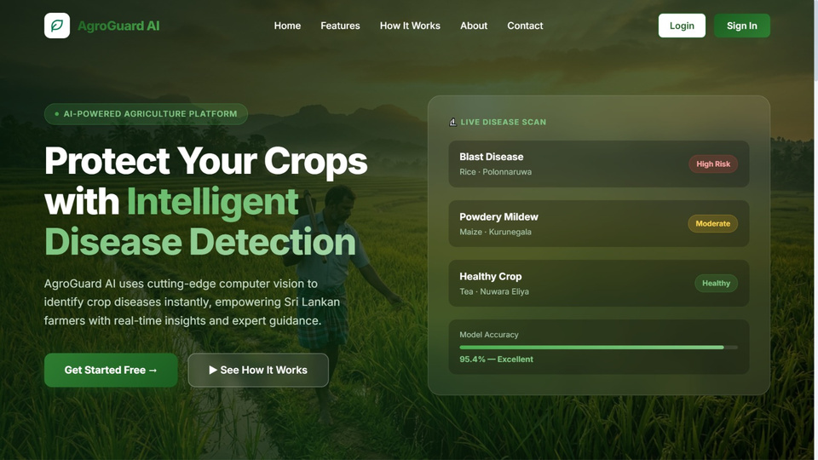
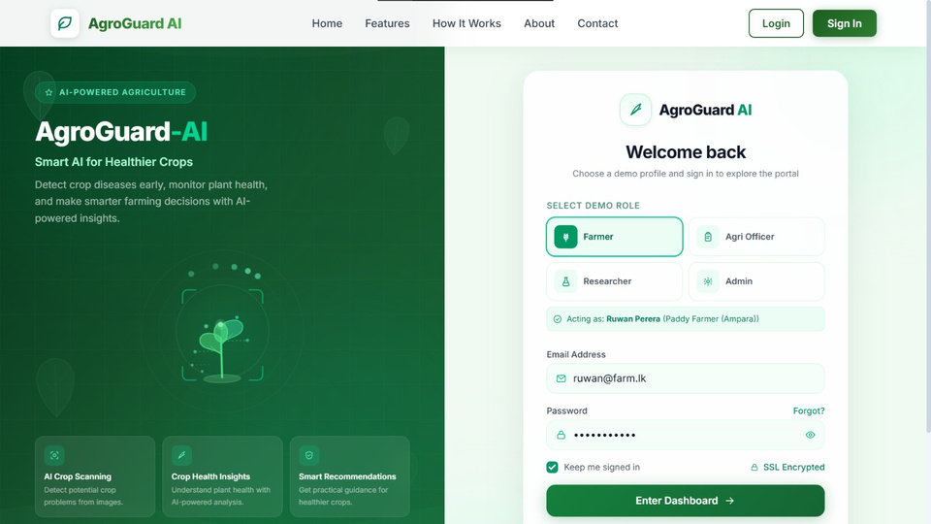
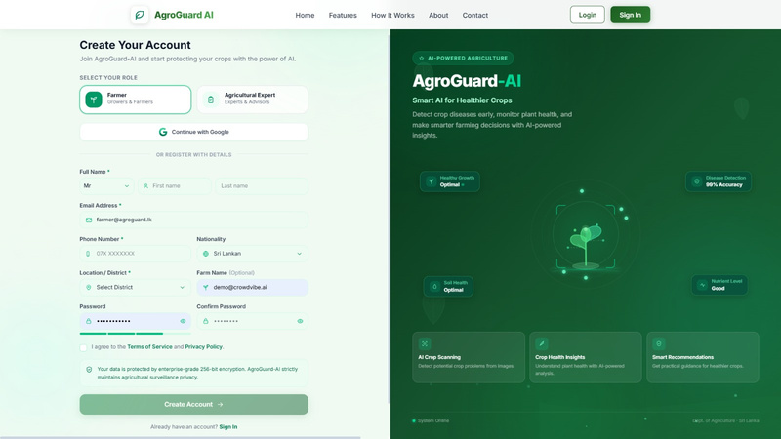
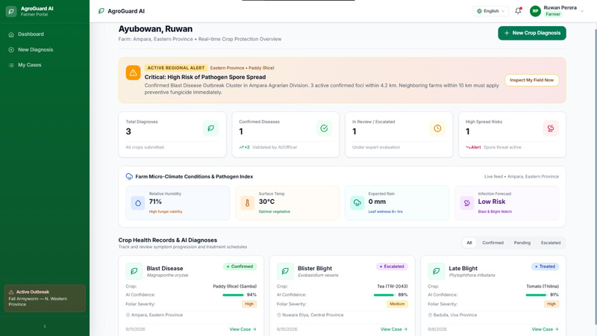
04 · PROOF
See it running
Swap each box below for a screenshot from the live system.
Landing Page
Login Page
Sign in Page
Farmer Dashboard
AgroGuard-AI
8
Notes:
8

Slide 9
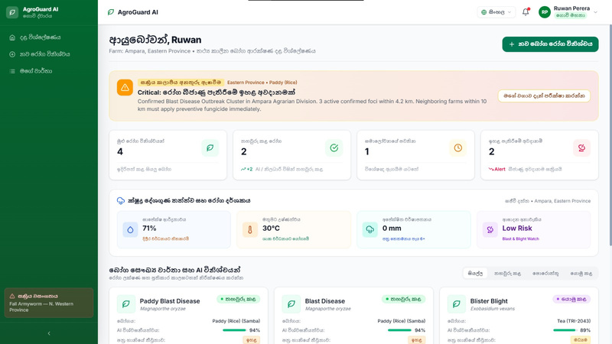
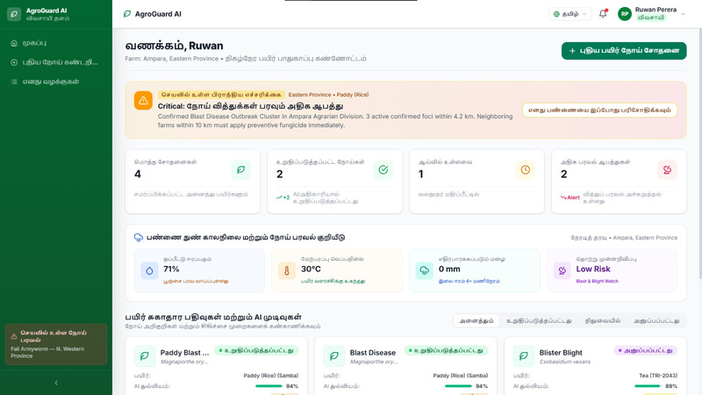
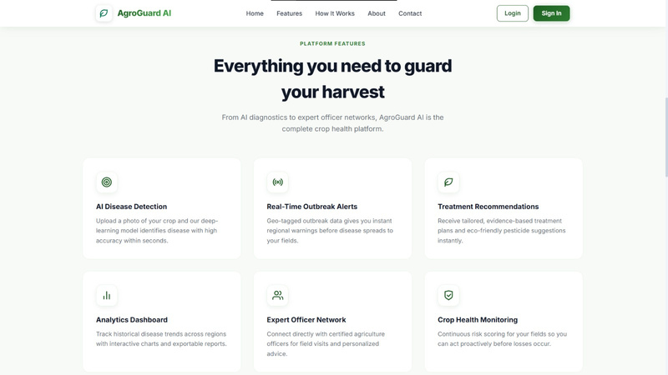
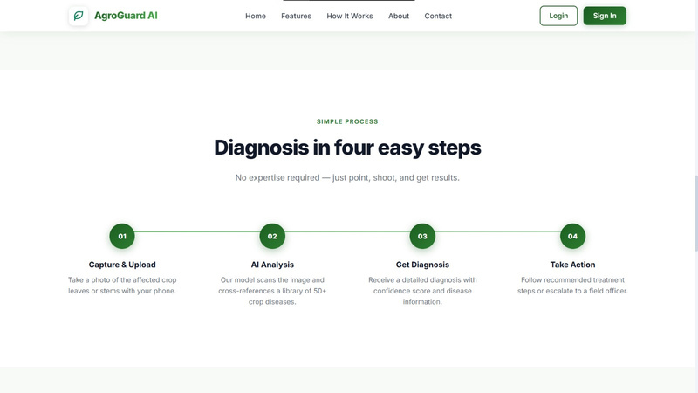
04 · PROOF
See it running
Swap each box below for a screenshot from the live system.
Interface in Sinhala Language
Interface in Tamil Language
Platform Features
Process Of The System Works
AgroGuard-AI
8
Schedule Extension Field Visits
Notes:
9

Slide 10
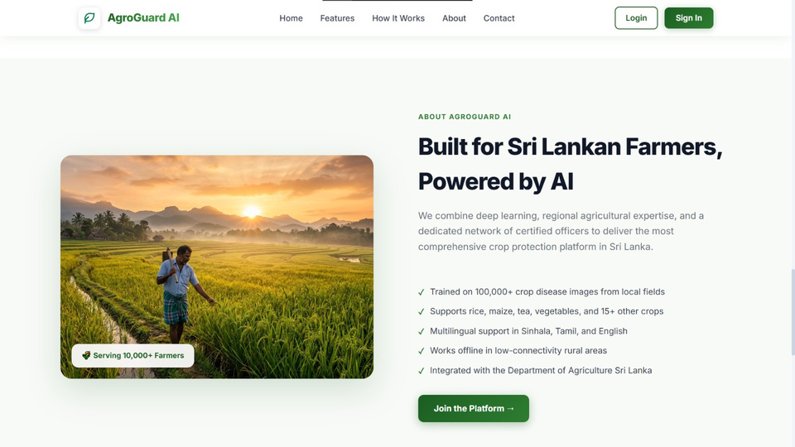
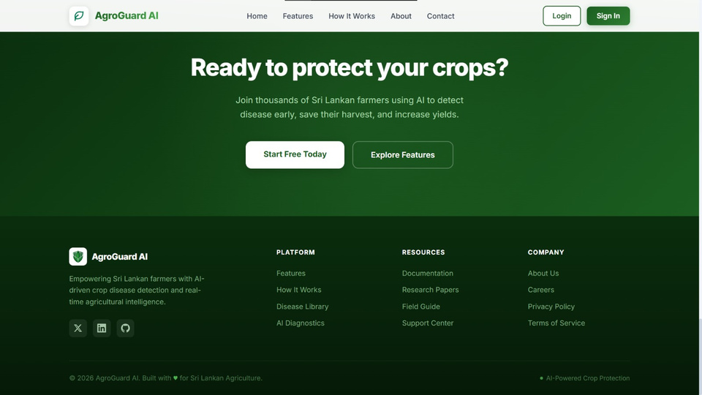
04 · PROOF
See it running
Swap each box below for a screenshot from the live system.
About Us Page
Contact Us Page
AgroGuard-AI
8
Schedule Extension Field Visits
Notes:
9

Slide 11
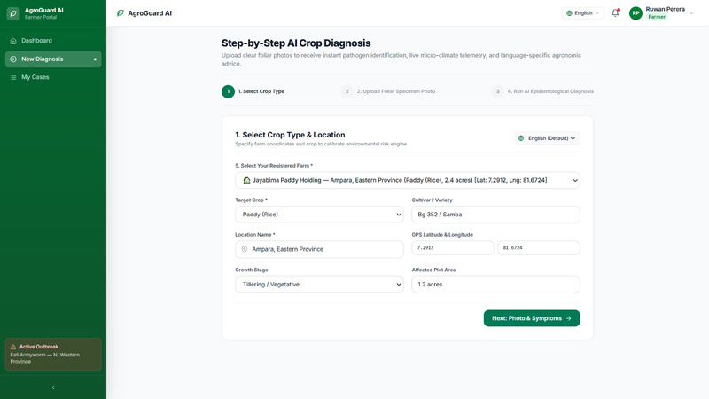
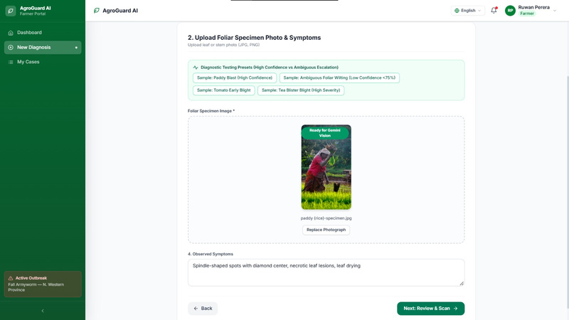
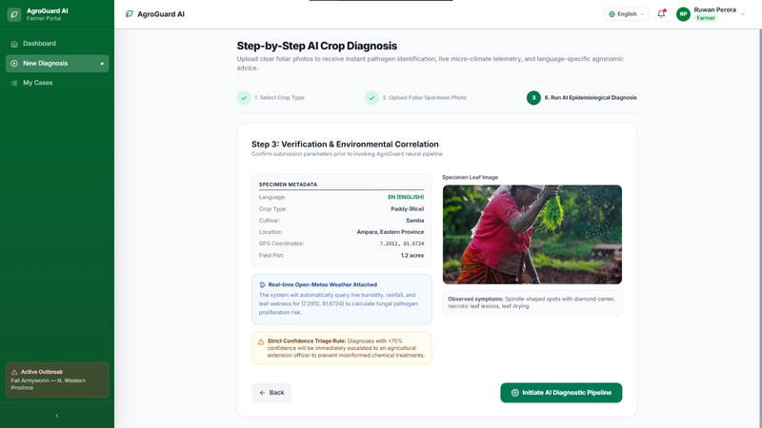
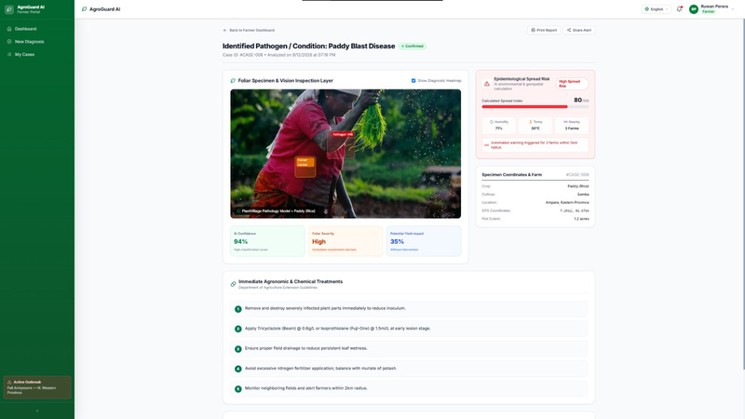
04 · PROOF
See it running
Swap each box below for a screenshot from the live system.
New Crop Diagnosis Form
Upload Foliar Specimen Photo & Symptoms
Verification & Environmental Correlation
Initiate AI Diagnostic Pipeline
AgroGuard-AI
8
Notes:
9

Slide 12
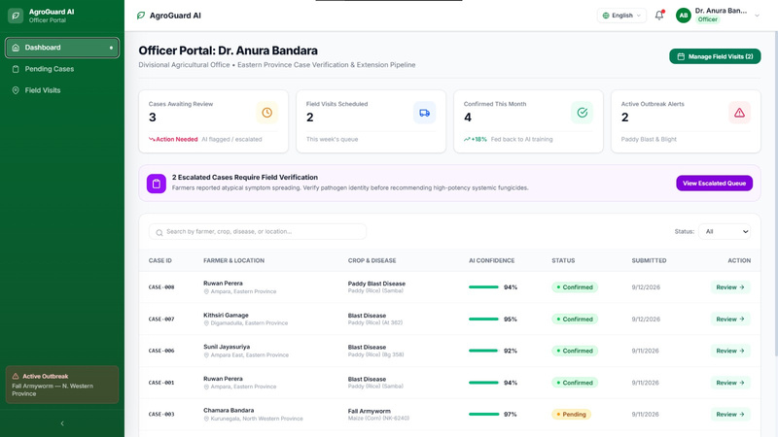
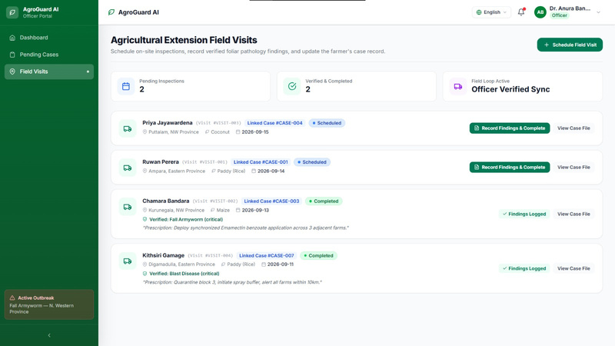
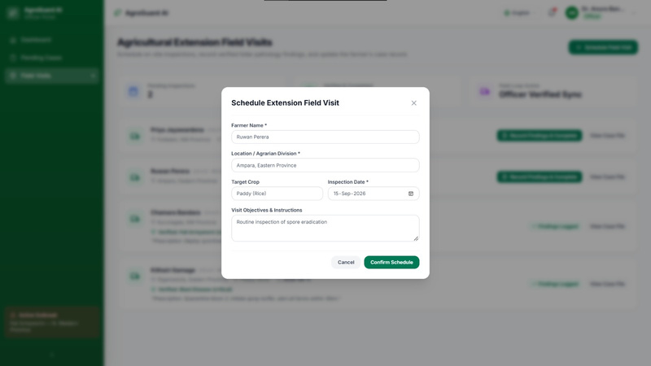
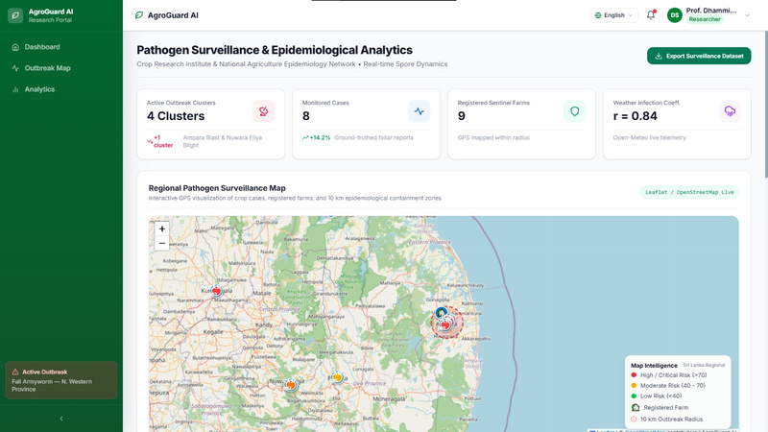
04 · PROOF
See it running
Swap each box below for a screenshot from the live system.
Agri Officer Dashboard
Agricultural Extension Field Visits
Schedule Extension Field Visits
Regional Pathogen Surveillance Map
AgroGuard-AI
8
Schedule Extension Field Visits
Notes:
9

Slide 13
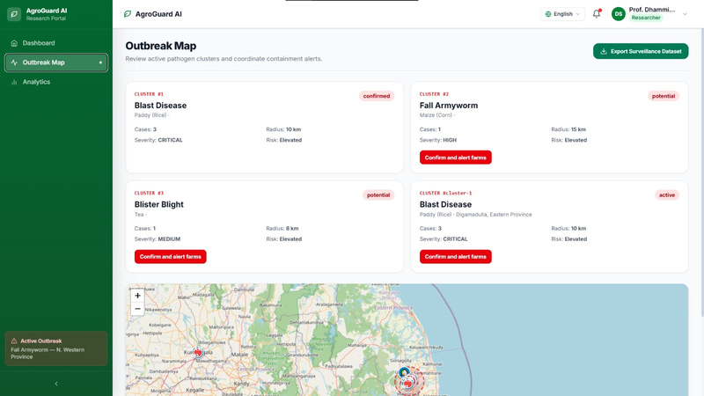
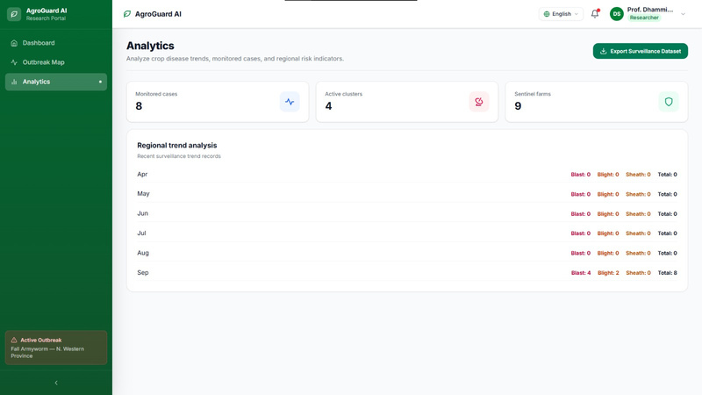
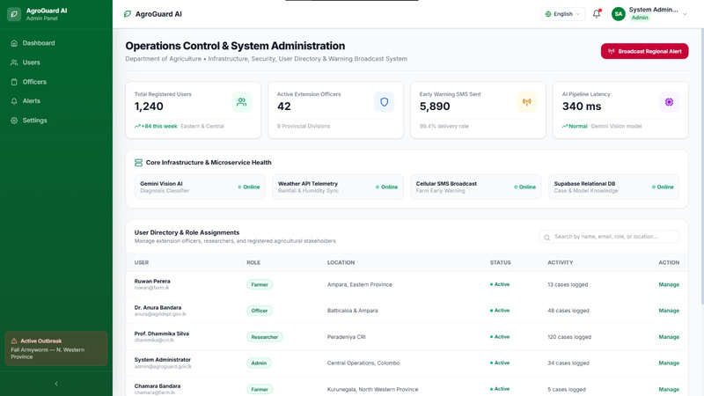
04 · PROOF
See it running
Swap each box below for a screenshot from the live system.
Researcher Dashboard
Outbreak Map
Regional Trend Analysis
Admin Dashboard
AgroGuard-AI
8
Schedule Extension Field Visits
Notes:
9

Slide 14
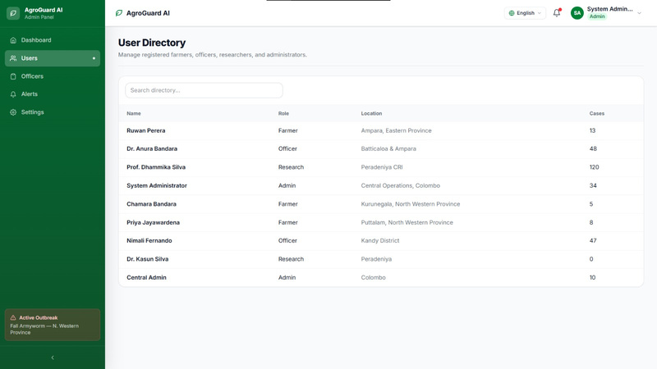
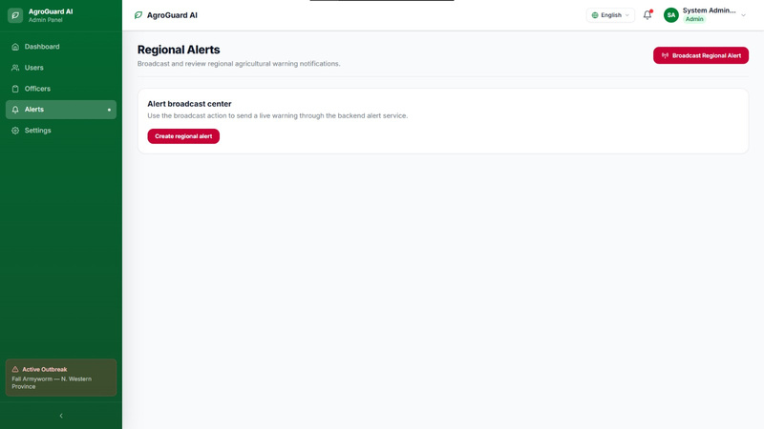
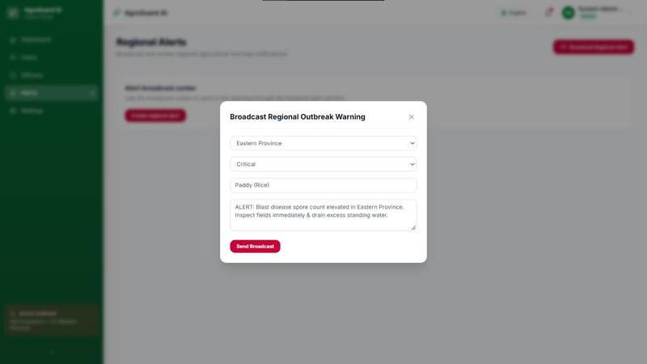
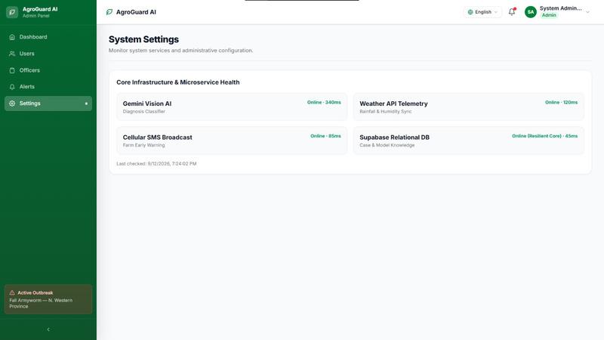
04 · PROOF
See it running
Swap each box below for a screenshot from the live system.
User Directory
Regional Alerts
Sending Broadcast Regional Outbreak Warning
System Settings
AgroGuard-AI
8
Schedule Extension Field Visits
Notes:
9

Slide 15

04 · PROOF
Verified against the brief
Automated test suite — backend/test-api.js
Demo access
Actor authentication & JWT issuance for all 4 roles
Live weather telemetry from Open-Meteo per farm
Role | Email
Farmer | ruwan@farm.lk
Extension Officer | anura@agridept.gov.lk
Epidemiologist | kamal@res.lk
Administrator | admin@agroguard.gov.lk
Registered farms with valid Sri Lankan GPS coordinates
Haversine clustering — 10km radius, min. 3 cases
Multilingual diagnosis — English, Sinhala, Tamil
Confirmed outbreak auto-alerts nearby farms
Confidence triage: <75% escalates without a guess
Field visit loop: findings recorded, farmer notified
Password for every role: password123
AgroGuard-AI
9
Notes:
10

Slide 16
05 · JUDGEMENT
What we achieved — and what's still ahead
Achieved
Known limitations
Next steps
  All 10 problem-brief scenarios implemented end to end
  Deterministic, explainable risk & clustering — no black boxes
  Runs zero-config, offline, with realistic seed data
  Vision diagnosis depends on an external Gemini API key
  Validated against seed data, not yet a live farmer pilot
  Voice input / read-aloud advice not yet built
  Voice input and read-aloud advice for non-typing farmers
  Expand beyond Sinhala, Tamil & English
  Pilot with a real Agricultural Extension office
  GitHub Repo Link: https://github.com/SarasiRajarathna/AgroGuard-AI
Thank you — questions welcome.
Team WeCodex · poojaap356@gmail.com
Notes:
11

