Slide 1
MEDIMAPPER
Navigating Healthcare Data for Precision Medicine

Slide 2
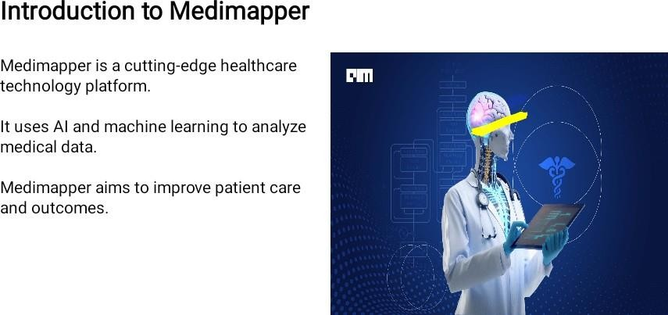

Slide 3


Slide 4
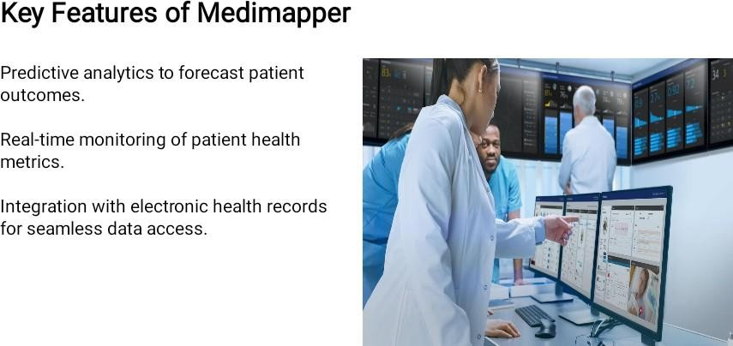

Slide 5
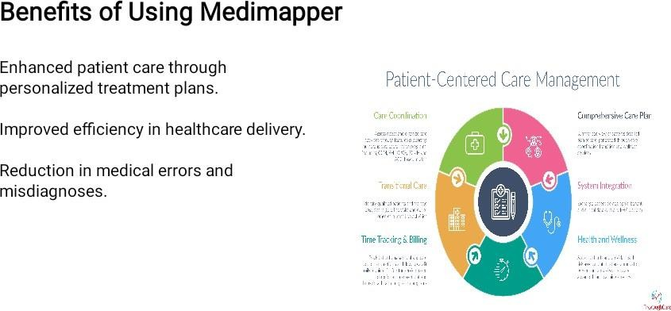

Slide 6
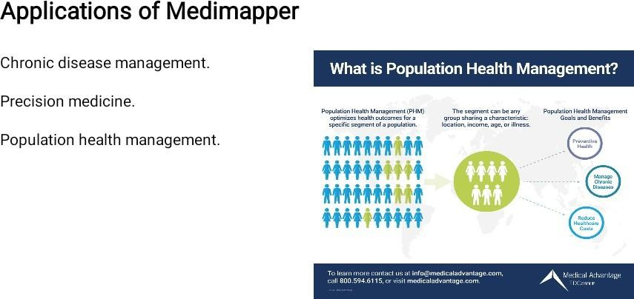

Slide 7
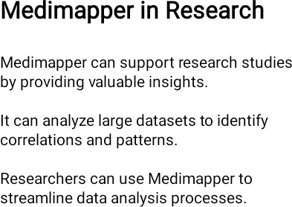


Slide 8


Slide 9
User interface of Medimapper
Intuitive dashboard for easy navigation
Customizable settings to tailor the platform to specific needs
Visual representation of data for better understanding

Slide 10
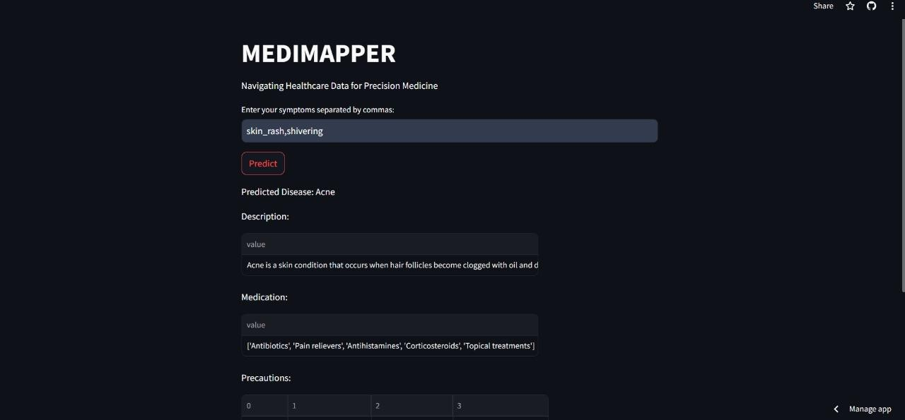
OUTPUT
OUTPUT

Slide 11


Slide 12


Slide 13


Slide 14


Slide 15


