Slide 1
PROJECT AZURE

Slide 2
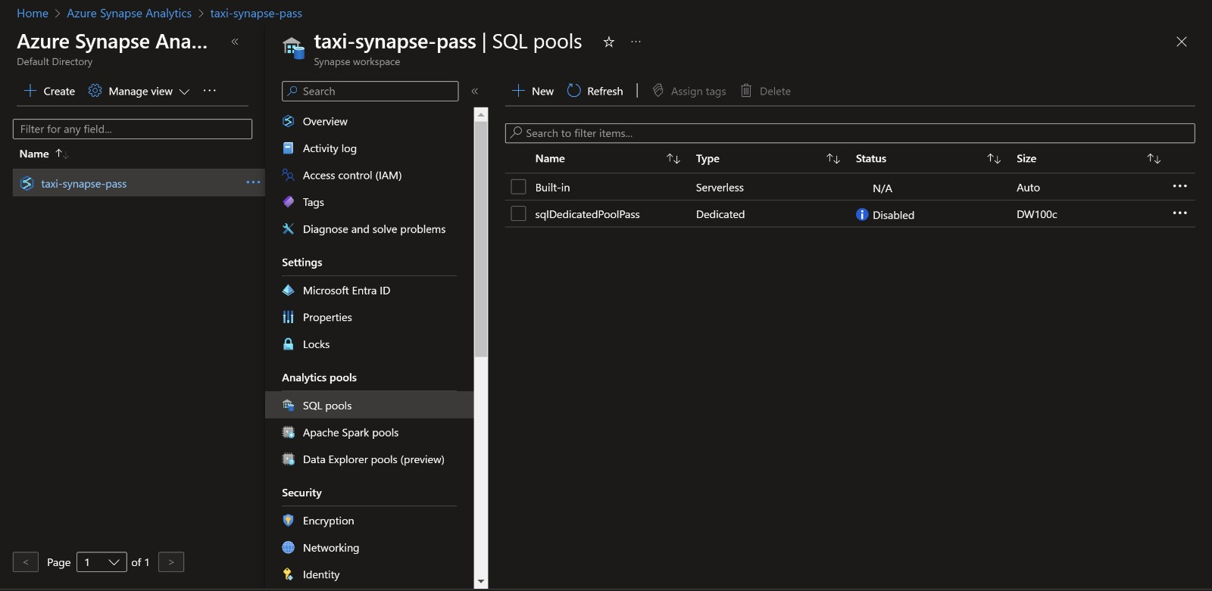

Slide 3
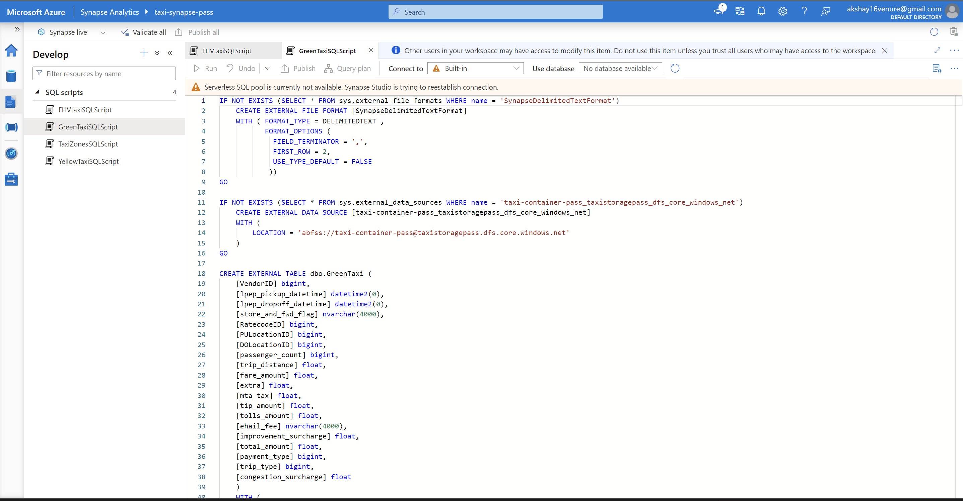

Slide 4
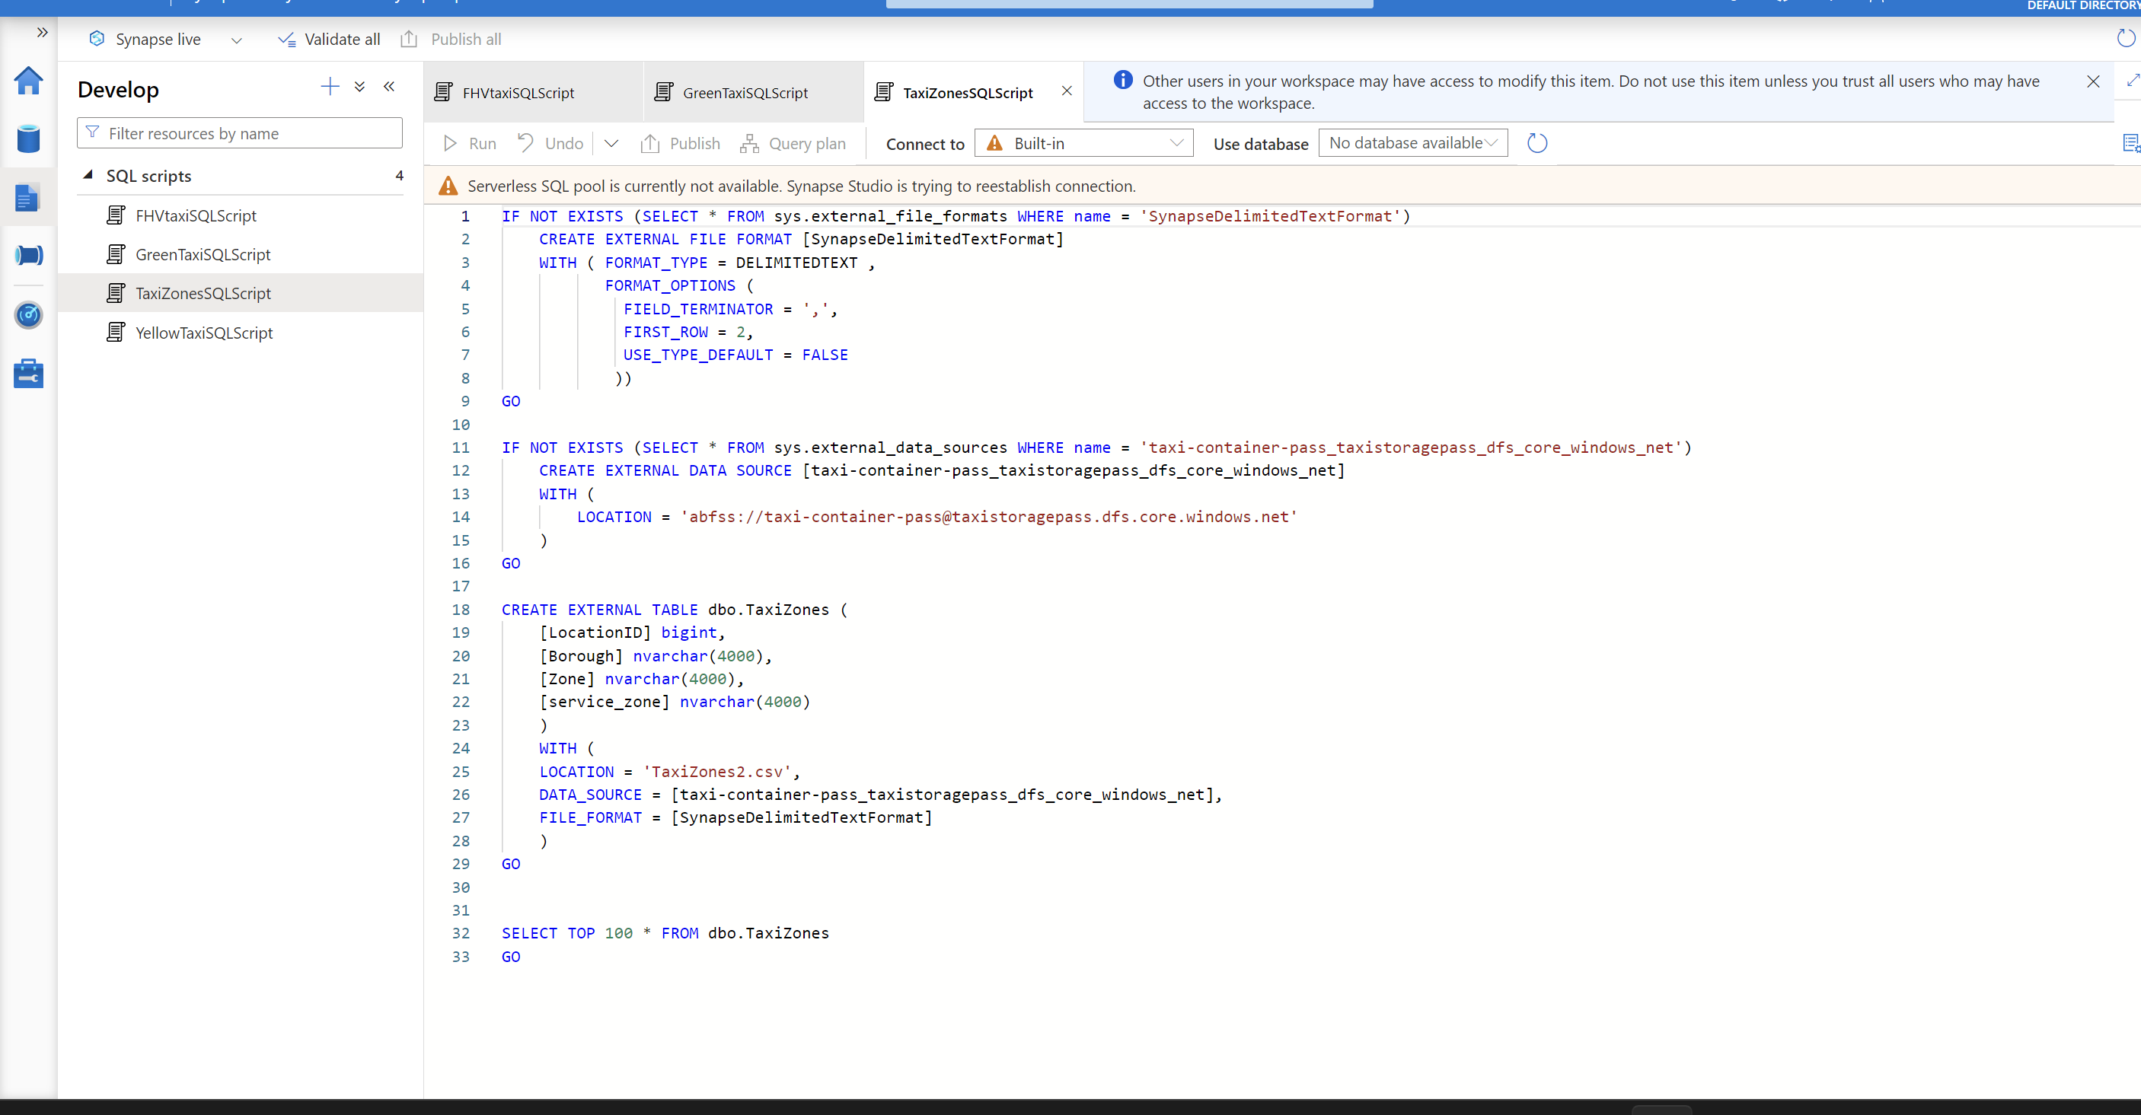

Slide 5
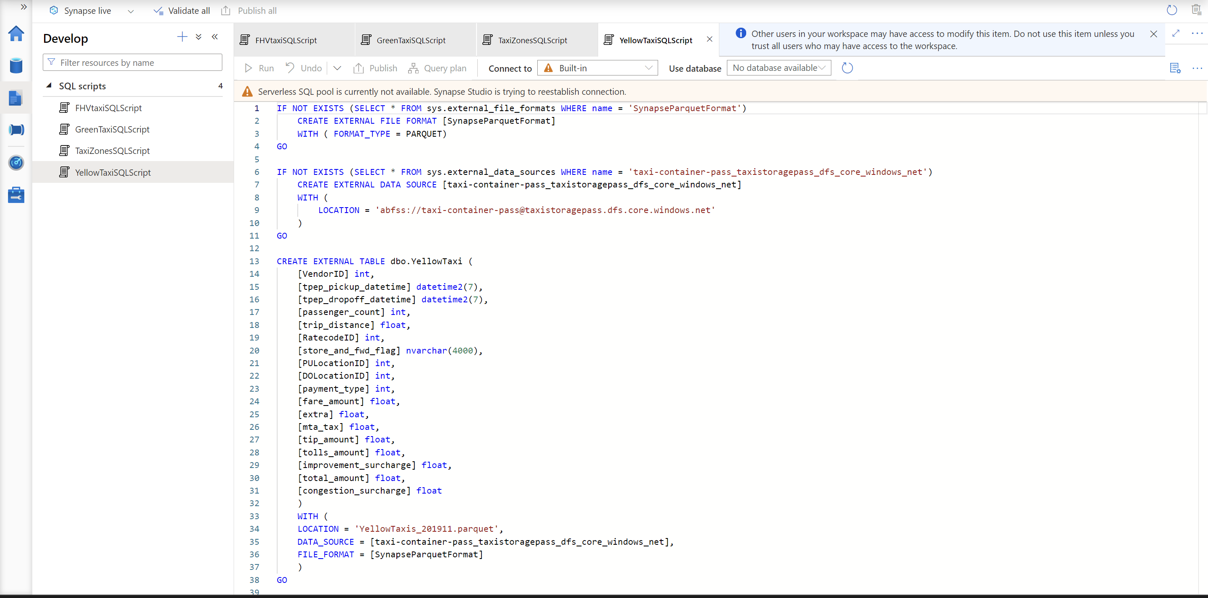

Slide 6
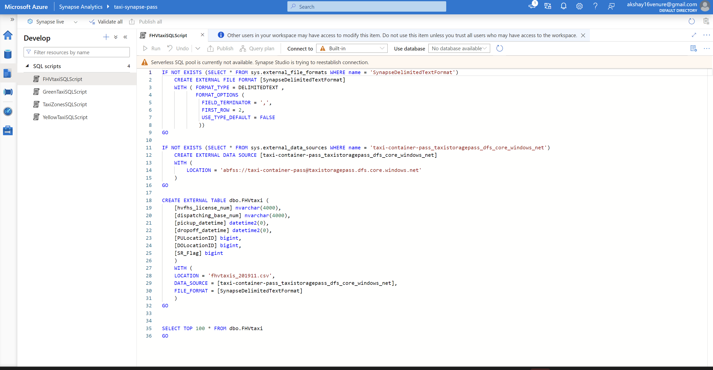

Slide 7
PROJECT B

Slide 8
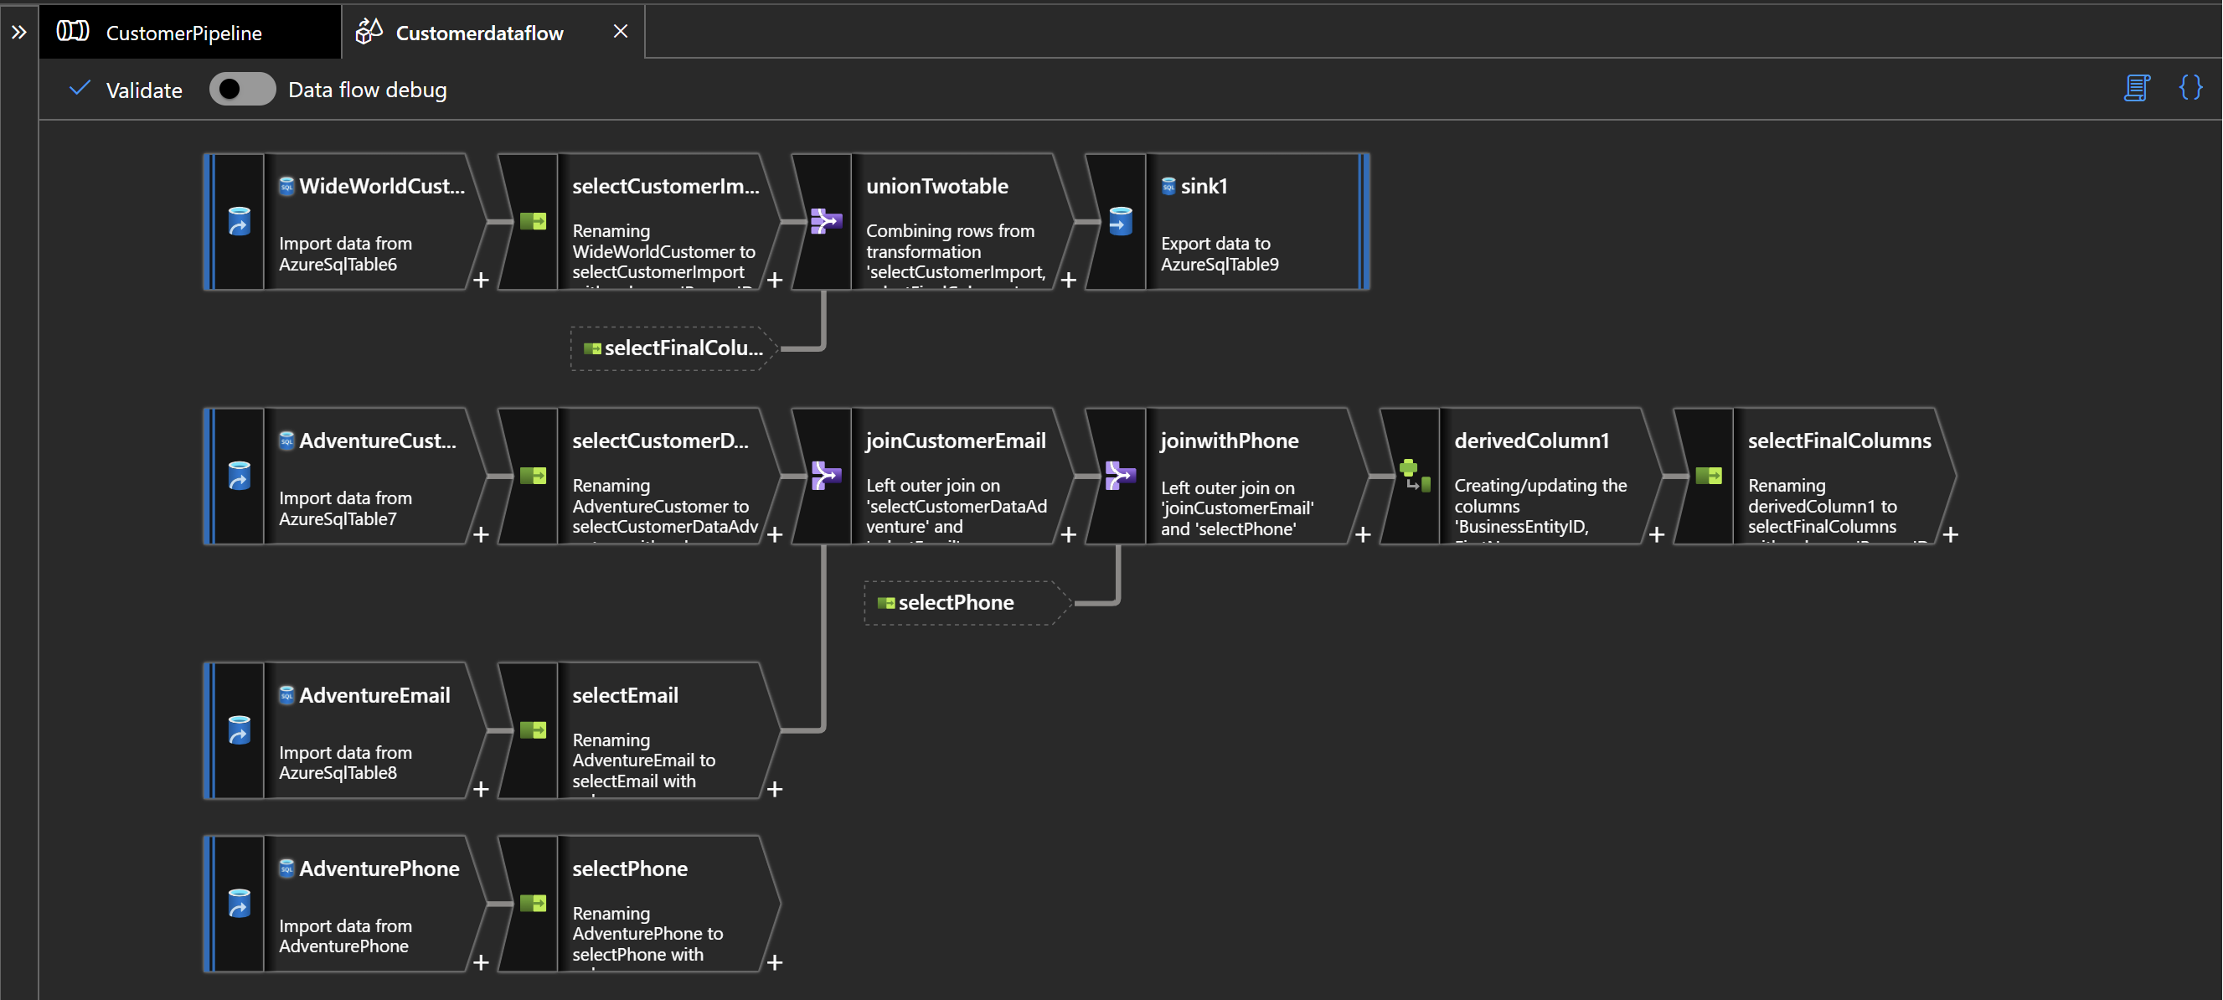

Slide 9
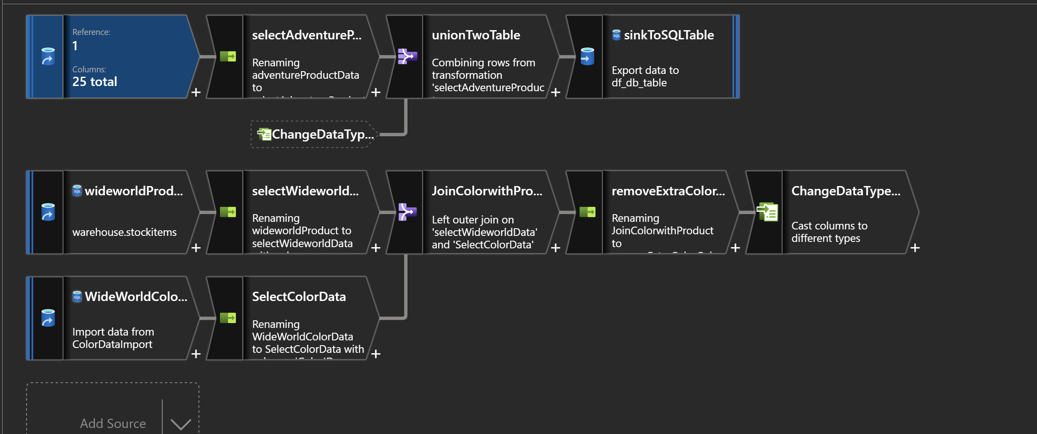

Slide 10
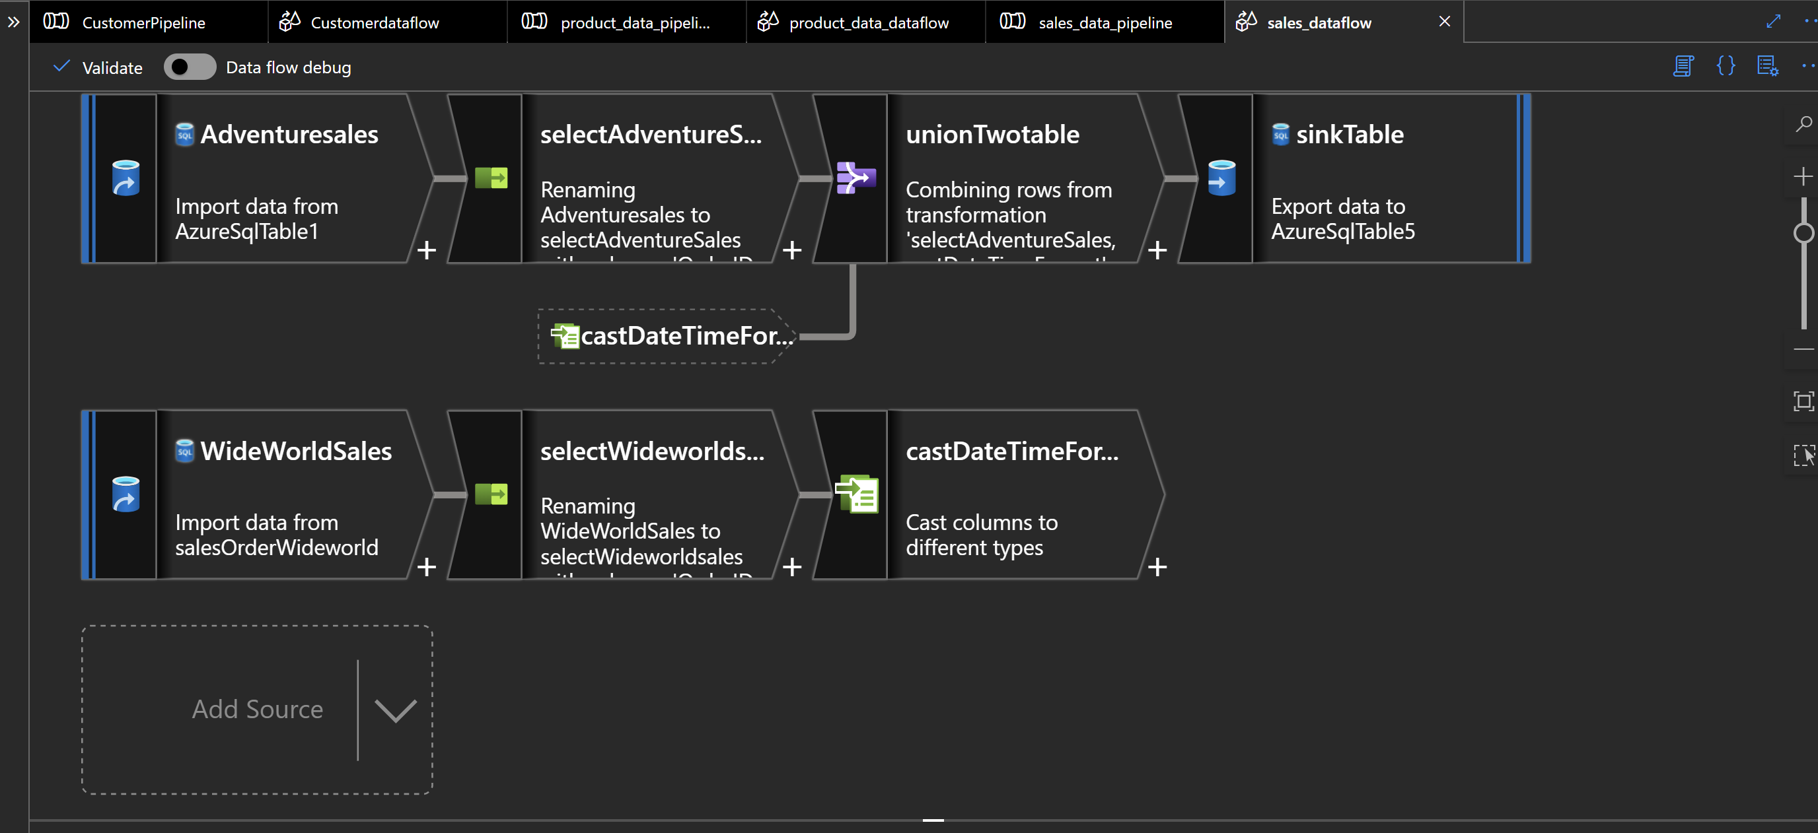

Slide 11
CHALLENGES
PROJECT A – LOADING OF JSON FILE DIRECTLY
PROJECT B – SELECTING THE REQUIRED COLUMN

