Slide 1



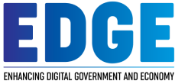
BANGABANDHU SHEIKH MUJIBUR RAHMAN
SCIENCE AND TECHNOLOGY UNIVERSITY,
GOPALGANJ, BANGLADESH
Introduction to Programming with Python
Project Report On
City Perspective Population Analysis in Bangladesh
EDGE-BSMRSTUCSE Digital Skills Training

Slide 2
Name: SARASWATI KARMAKAR
Batch ID: B05018

Slide 3
Introduction
Studying population trends in different cities in Bangladesh allows a clear understanding of population growth, upcoming populations, and how to manage a country's economy.
The dataset is collected from kaggle.com and is also freely available at citypopulation.de/en/Bangladesh/cities. The dataset was downloaded in CSV format and used as a raw file for this study.
The dataset consists of 10 variables such as Name, Abbreviation, Division, Established, Native, Area (Km2), and Population of different past years.
In this study, Python version 3.12.7 is used to analyse the dataset.

Slide 4
Objectives
To identify the population in different cities, towns, and divisions, compared with each other.
To closer look at the density of population in different regions of Bangladesh.
To produce critical identification of the population for a better understanding of the trends for policymakers, governments, and businessmen.

Slide 5
Features
Data Description (Mean, Standard Deviation, Minimum Value, Quartile, Maximum Value)
Obtained population density of different past years in every city in Bangladesh.
Obtained population density divisionally.
Observed population in past years divisionally.
Predicted future population in every city in Bangladesh.
Compared recent population with predicted population.

Slide 6
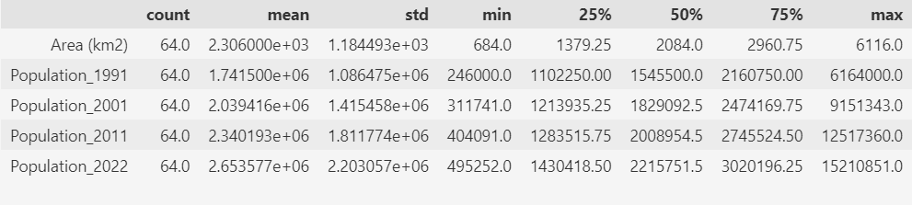
Implementation & Report
Summary of the Population and Area in Bangladesh:
We can see area of the biggest city of Bangladesh is 6116 (km2) and the lowest is 684 (km2).
About the population size in 2022 in Bangladesh, minimum population in a city is 4,95,252 whereas maximum is 15,210,851.

Slide 7
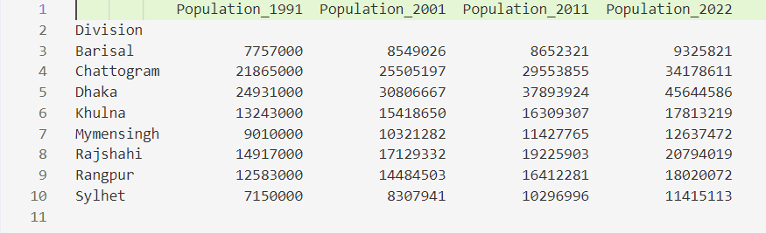
Implementation & Report
Summary of the Population in Bangladesh in Different Years:
This figure displays population data for various divisions in Bangladesh over four census years: 1991, 2001, 2011, and 2022.
The divisions listed are Barisal, Chattogram, Dhaka, Khulna, Mymensingh, Rajshahi, Rangpur, and Sylhet. Each division's population figures indicate significant growth over the years.

Slide 8
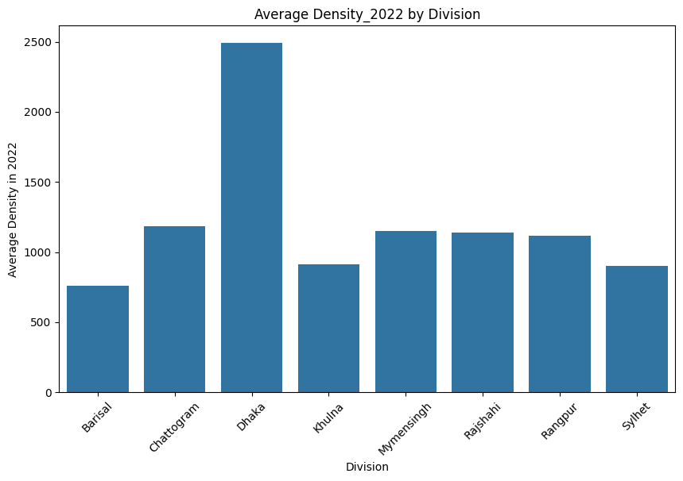
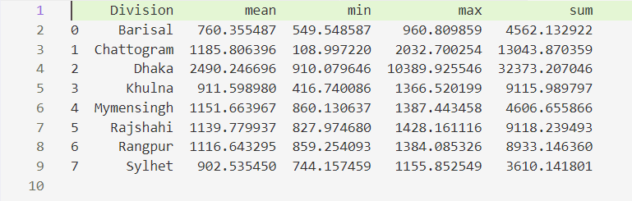
Implementation & Report
Summary of the Population Density in Bangladesh:
We can see the alarming density of the population in Dhaka.
The highly dense population can cause many problems including healthcare problems, and population, even it can increase crime in a heavy rate.

Slide 9
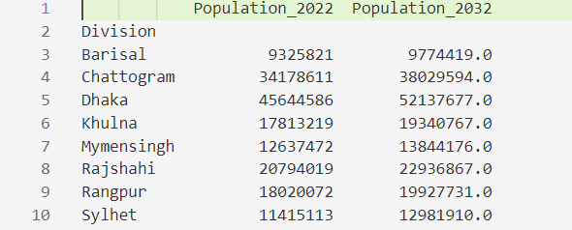
Implementation & Report
What Can Be the Future Population in Bangladesh:
We can observe higher population will be again in Dhaka Division which is 3.8 crore whereas, in 2022, it was 3.4 crore.
Other side, in the Barisal Division, the population will remain the lowest in 2032 as 2022.
According to our Linear Regression model, the population will be 97.74 lacks in the Barisal Division.

Slide 10
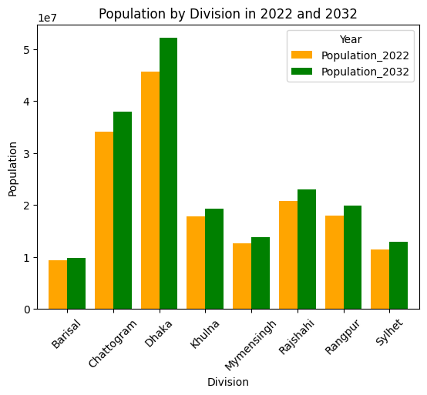
Implementation & Report
What Can Be the Future Population in Bangladesh:
Here we see the significant changes in Dhaka city, which means the future population in Dhaka will be higher than this.
Managing population density, traffic jams, and raw food materials can be challenging in Dhaka and Chittagong if the government does not take any steps about that.

Slide 11
Conclusion
Understanding population trends in different cities in Bangladesh is essential for planning sustainable growth.
The study shows population trends and predicted approximate future populations. Also, analyses population density in different areas of Bangladesh.
By identifying these areas with rapid expansion and higher density, governments and policymakers can better address urban challenges and improve resource distribution, infrastructure, and quality of life for city residents.

