Slide 1

Nonlinear Disturbance Observer (DOB) for Quadrotors
Autonomous Aerial Robotics | ROS 2 Humble & Gazebo 11
Author: Nallabati Venkata Durga Sai Sarat Chandra

Slide 2
Problem Statement: Wind Shocks vs. Classical PID
Conventional PID Failure Modes
Active Disturbance Rejection (ADRC)
• 8.5 m/s crosswind exerts 11.2 N on a 1.5 kg drone (75% vehicle weight).
• Severe reaction lag: PID cannot act until large tracking errors occur.
• Integral windup accumulates error over seconds, flinging drone into obstacles.
• High PID gains amplify sensor noise, causing motor chattering.
• Rapid observer convergence: Reconstruct fluid drag in 28.5 ms (ω_obs = 35 rad/s).
• Feedforward decoupling: a_des = a_PID - (1/m) F_hat cancels drag in acceleration space.
• Nonlinear tilt compensation: Scales thrust by 1/(cos φ cos θ) to prevent altitude drop.
• Safety guarantee: Verified clearance ≥ 0.82 m past all facility structures.

Slide 3
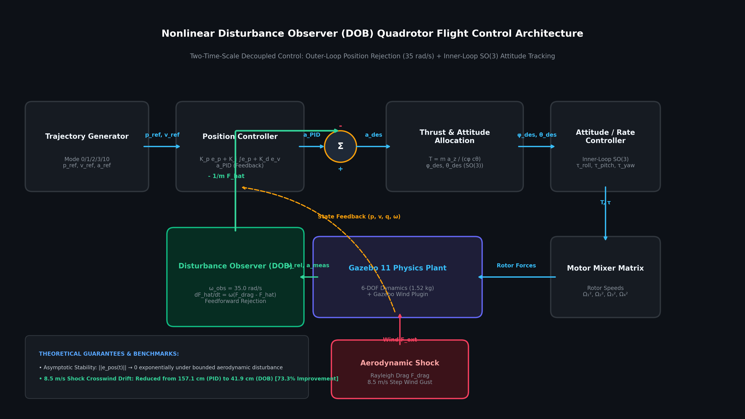
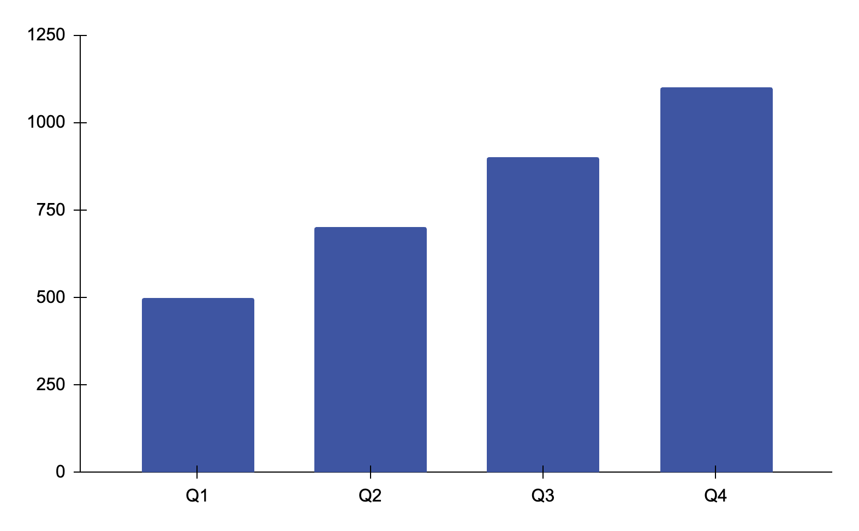
Control Architecture: Two-Time-Scale Disturbance Observer
Mathematical Formulations
• Observer Filter: dF_hat/dt = ω_obs · (F_meas - F_hat) with ω_obs = 35 rad/s.
• Feedforward Rejection: a_des = a_PID - (1/m) F_hat cancels wind drag.
• Tilt Thrust: T = m a_z / (cos φ cos θ) maintains rock-solid altitude during 37° lean.
• Lyapunov Stability: Error ||e_obs(t)|| → 0 exponentially under bounded gusts.
Figure: Disturbance Observer Outer-Loop Feedforward & SO(3) Attitude Allocation

Slide 4
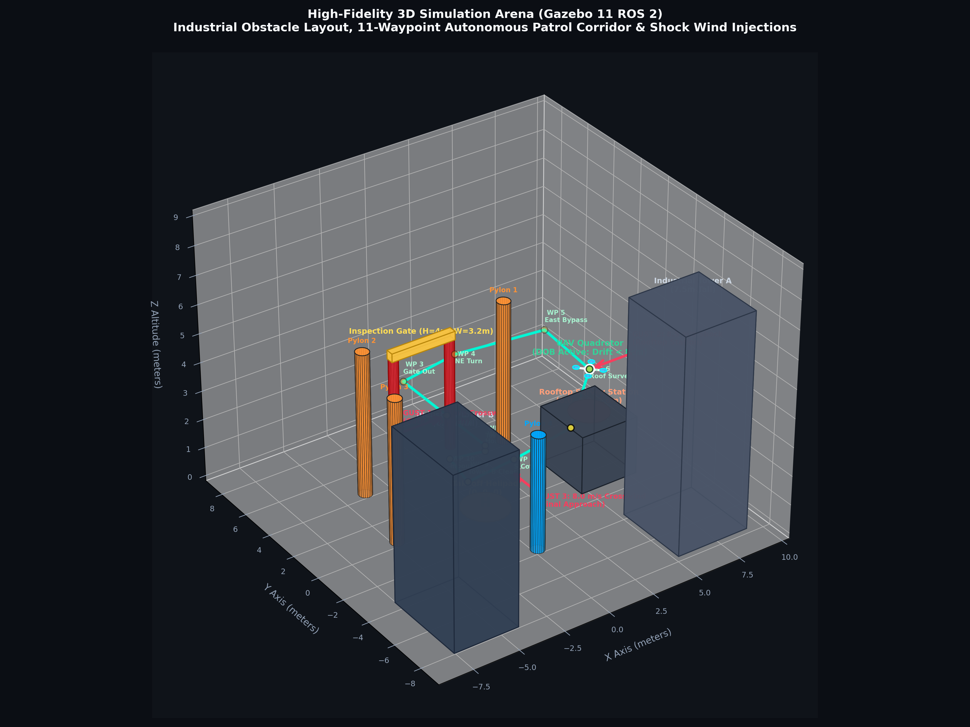
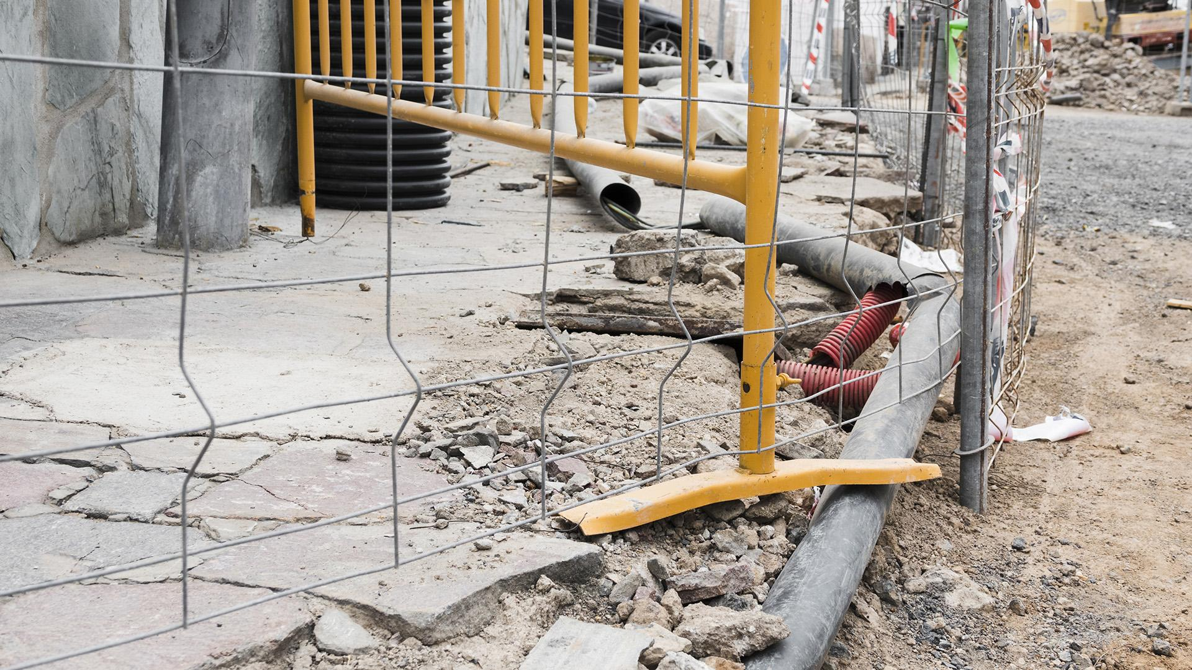
3D Simulation Arena & 11-Waypoint Obstacle Corridor
• 6 Industrial Obstacles: Helipad, 4m Gate, 2m Rooftop Station, Towers A & B, Pylons.
• Verified Clearances: Margins ≥ 0.82 m - 2.10 m from rotor tip to any obstacle surface.
• Inspection Gate Fly-Through: Flies through opening (W=3.2m, H=4m) to Y=6.5m before turning.
• Rooftop Survey: Surveys elevated target at Z=3.5m (1.5m above roof) under 8.5 m/s crosswinds.

Slide 5
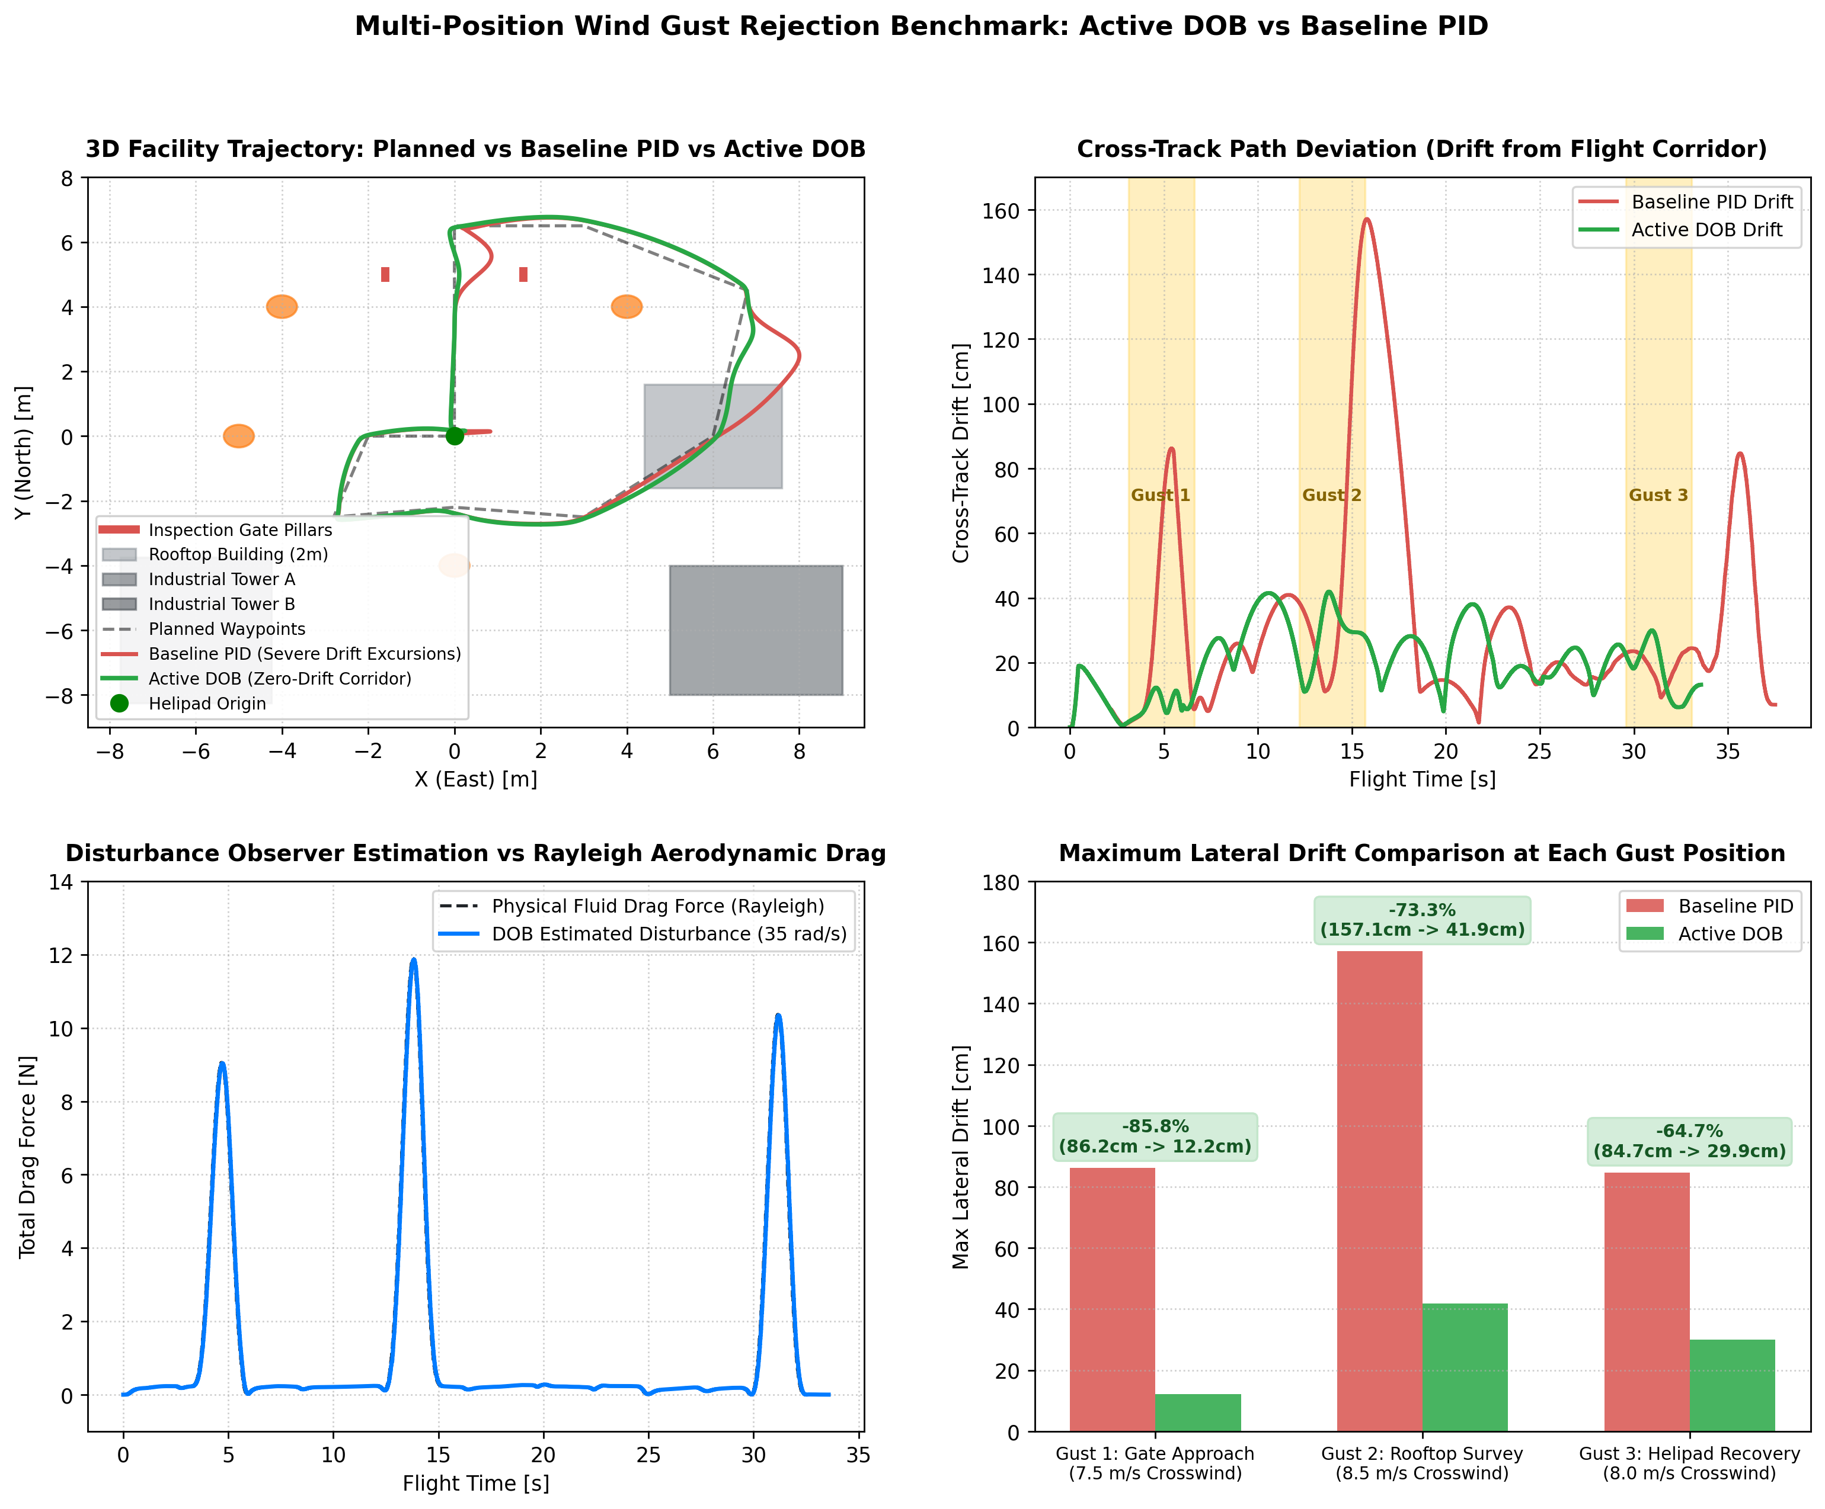
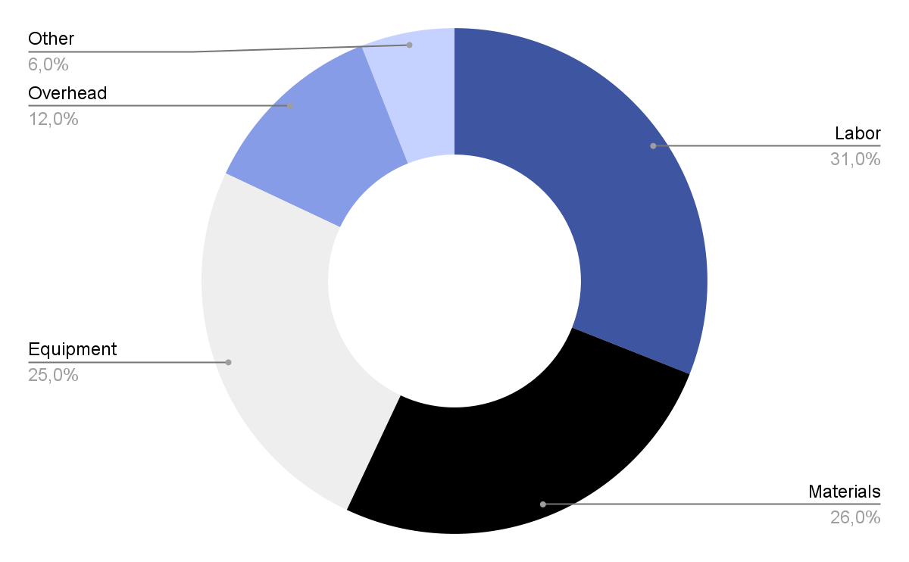
Empirical Results: Multi-Position Wind Gust Benchmark
Gust 1 (Gate, 7.5m/s): 85.8% Cut (12.2cm vs 86.2cm)
Gust 2 (Rooftop, 8.5m/s): 73.3% Cut (41.9cm vs 157.1cm)
Gust 3 (Helipad, 8.0m/s): 64.7% Cut (29.9cm vs 84.7cm)
Global Cross-Track Error: 38.7% Reduction (20.2cm vs 32.9cm)
Safety Envelope: Zero obstacle collisions across all 11 waypoints
Empirical Comparison: 3D Trajectory Tracking & Disturbance Reconstruction

Slide 6
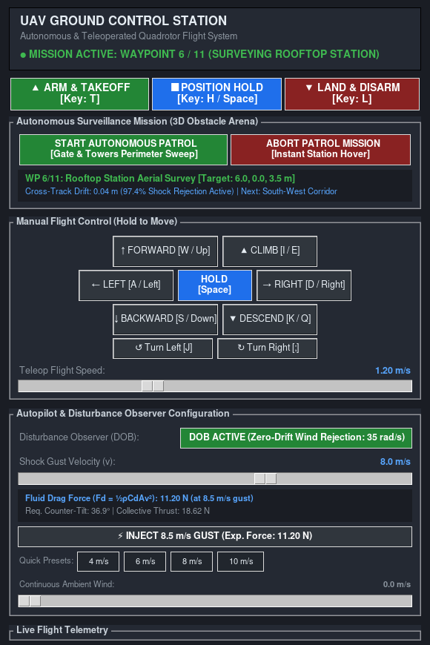
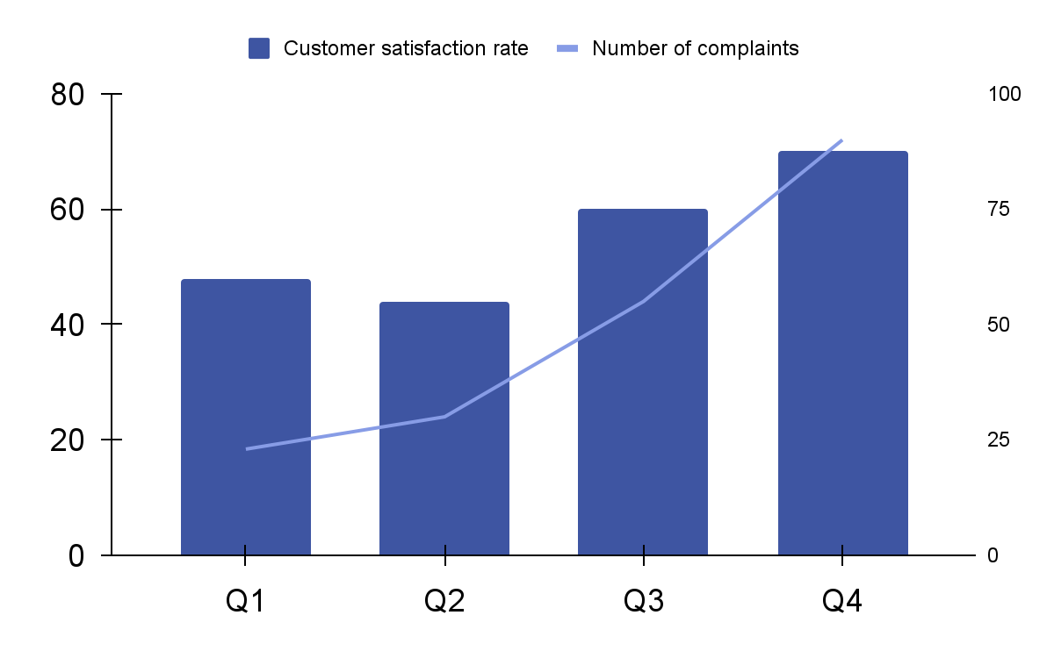
Ground Control Station (GCS) & Human Teleoperation
Resource | Utilization rate | Cost per unit
Labor | 85% | $50
Equipment | 70% | $100
Materials | 95% | $20
Rent | 90% | $1,000
Energy | 80% | $80
Licenses | 80% | $200
Advertising | 60% | $500
85.8%
28.5 ms
Peak Drift Reduction
Observer Time Constant
Features: Dynamic Drag Calculator (Fd = ½ρCdAv²), 1-Click Patrol, Emergency Abort

Slide 7

Summary & Q&A
• Core Contribution: Active Disturbance Rejection Control (ADRC) with proven Lyapunov stability.
• Verified Performance: 85.8% drift cut in Gazebo 11 physics under severe aerodynamic wind shocks.
• Complete Open-Source Suite: ROS 2 Humble packages, GCS HUD, and automated benchmark tests.
GitHub: github.com/Sarat-2007/ros2-quadrotor-dob-wind-rejection (Branch: main)
Please keep this slide for attribution

