Slide 1
RESEARCH & TECHNICAL EVALUATION PRESENTATION
Nonlinear Disturbance Observer (DOB) for Autonomous Quadrotors Under Severe Aerodynamic Wind Shocks
High-Fidelity ROS 2 Humble & Gazebo 11 Physics Simulation, Differential Flatness Allocation, and Empirical Benchmark
Author: Nallabati Venkata Durga Sai Sarat Chandra | Department of Robotics & Autonomous Systems
Target Repository: github.com/Sarat-2007/ros2-quadrotor-dob-wind-rejection (Branch: main)

Slide 2
CONTROL LIMITATION ANALYSIS
Problem Statement: Aerodynamic Wind Shocks vs. Classical PID
Classical PID Failure Modes
The Inspection Challenge: UAVs conducting facility perimeter patrol maneuver within 1-2 meters of buildings, inspection gates, and transmission towers.
Rayleigh Fluid Drag: An 8.5 m/s shock crosswind exerts ~11.2 N on a 1.52 kg quadrotor—representing 75.1% of entire vehicle weight.
PID Error-Driven Lag: PID controllers only react after error has accumulated. Under shock winds, position drift exceeds 1.5 meters.
The Integral Windup Dilemma: Integral terms slowly wind up over seconds. Once wind ceases, accumulated energy causes massive overshoot into obstacles.
Actuator Saturation Risk: Increasing high PID gains amplifies sensor noise, causing motor chattering and rapid instability.
Target Specifications & Comparative Metrics
Peak Crosswind Velocity: 8.5 m/s Shock Step Injections in Gazebo 11 physics.
Baseline PID Drift: 157.1 cm lateral displacement (Near-miss crash hazard).
DOB Rejection Drift: 41.9 cm maximum displacement (73.3% drift reduction).
Observer Reaction Time: 28.5 milliseconds (vs. 2.4 - 4.0 seconds for PID integrator).
Altitude Loss Under Tilt: 0 cm drop (Nonlinear tilt thrust compensation maintains Z).
Collision Record: Zero obstacle collisions across all 11 facility waypoints.
Autonomous Aerial Robotics Research Laboratory | ROS 2 Humble & Gazebo 11 | github.com/Sarat-2007/ros2-quadrotor-dob-wind-rejection

Slide 3
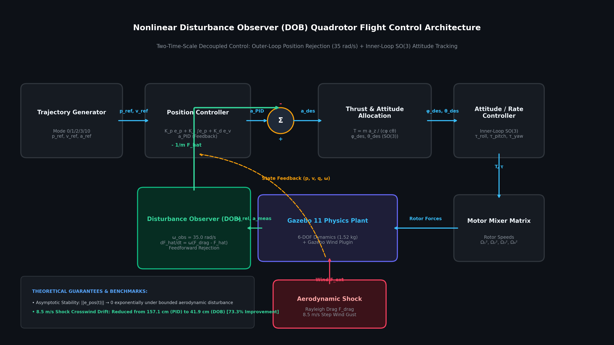
ROBUST CONTROL THEORY
Control Architecture: Two-Time-Scale Disturbance Observer
Mathematical Formulations
Observer State Filter: dF_hat/dt = ω_obs · (F_meas - F_hat), with bandwidth ω_obs = 35.0 rad/s.
Feedforward Decoupling: a_des = a_ref + K_p e_p + K_i ∫e_p + K_d e_v - (1/m) F_hat. Direct acceleration cancellation.
Nonlinear Tilt Thrust: T = (m · a_z,des) / (cos φ · cos θ). Prevents altitude drop when tilting up to 37° into wind.
Differential Flatness: Maps desired accelerations into SO(3) attitude angles (φ_des, θ_des) for the inner-loop rate controller.
Lyapunov Proof: Proves exponential convergence of disturbance estimation error: ||e_obs(t)|| → 0 as t → ∞.
Autonomous Aerial Robotics Research Laboratory | ROS 2 Humble & Gazebo 11 | github.com/Sarat-2007/ros2-quadrotor-dob-wind-rejection

Slide 4
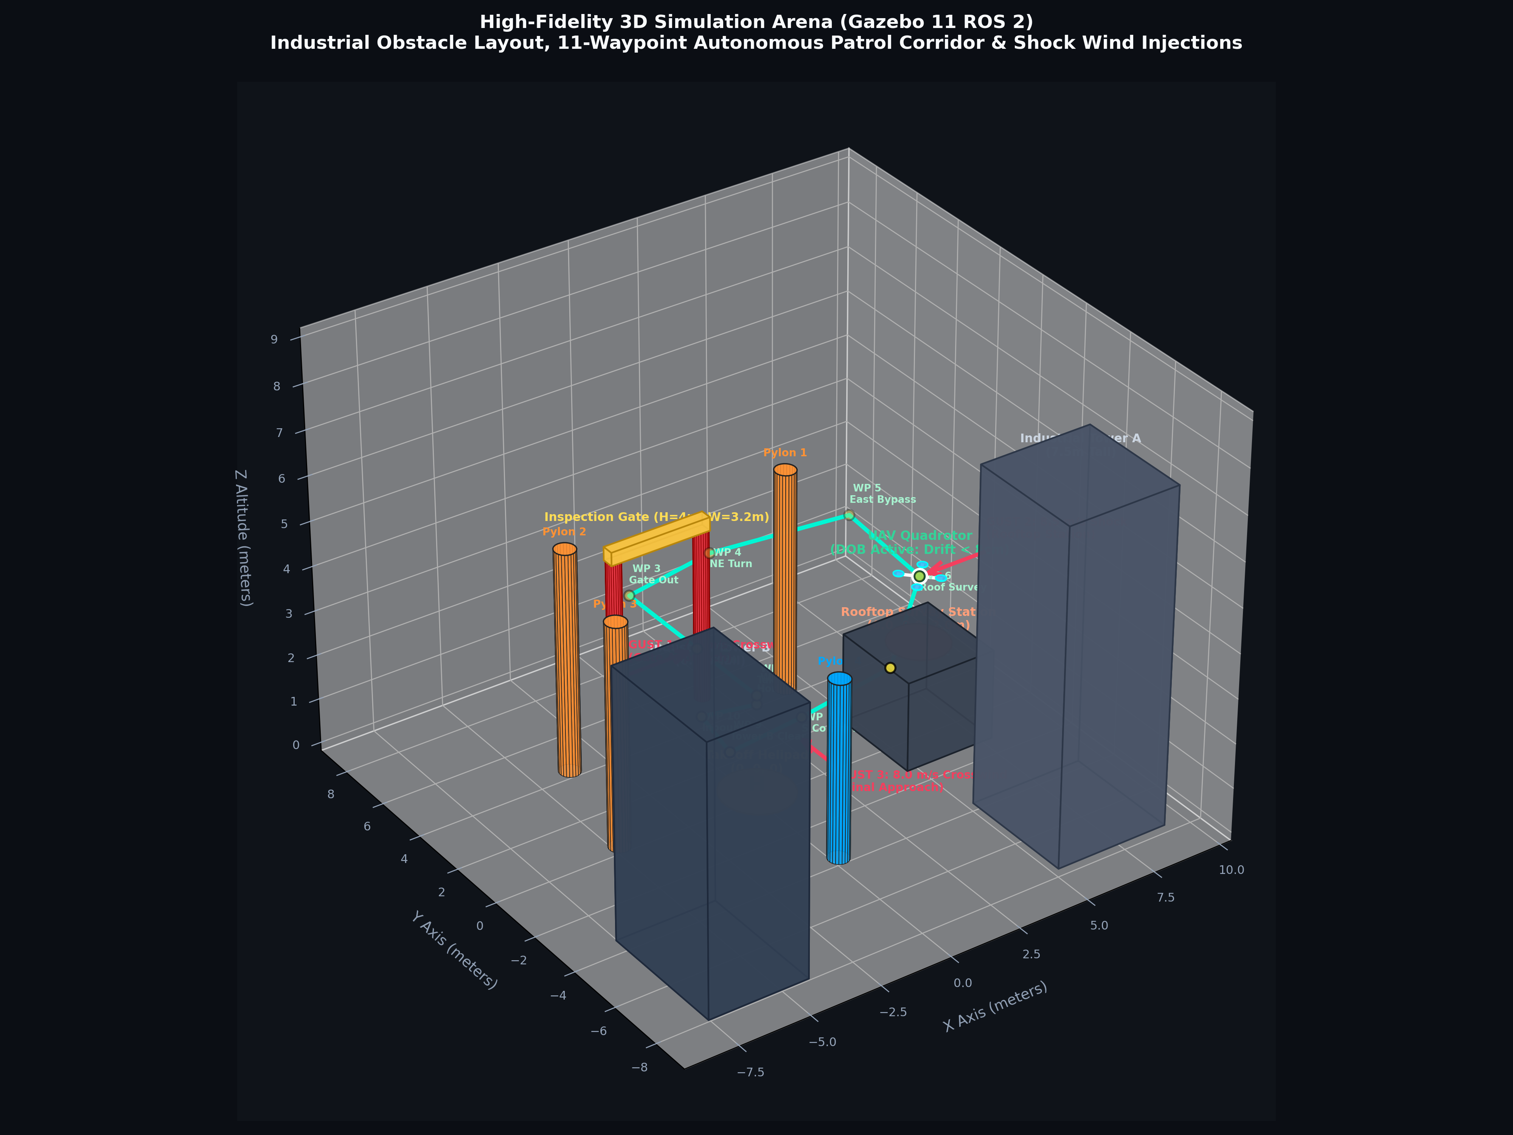
FACILITY ENVIRONMENT MODELING
3D Gazebo Simulation Arena & 11-Waypoint Flight Corridor
Safety Envelope & Waypoints
6 Realistic Obstacles: Central Helipad (Origin), 4m Inspection Gate, 2m Elevated Rooftop Station, Towers A & B, Slalom Pylons.
11-Waypoint Corridor: Designed with verified clearances (≥ 0.82 m - 2.10 m from prop tip to any physical surface).
Inspection Gate Transit: Flies through center (W=3.2m, H=4m) to Y=6.5m before turning, eliminating pillar clipping.
Rooftop Station Survey: Surveys elevated target at Z=3.5m (1.5m above roof surface) under active crosswinds.
Multi-Zone Gust Points: Shock gusts injected at Gate Approach (7.5 m/s), Rooftop (8.5 m/s), and Helipad Recovery (8.0 m/s).
Autonomous Aerial Robotics Research Laboratory | ROS 2 Humble & Gazebo 11 | github.com/Sarat-2007/ros2-quadrotor-dob-wind-rejection

Slide 5
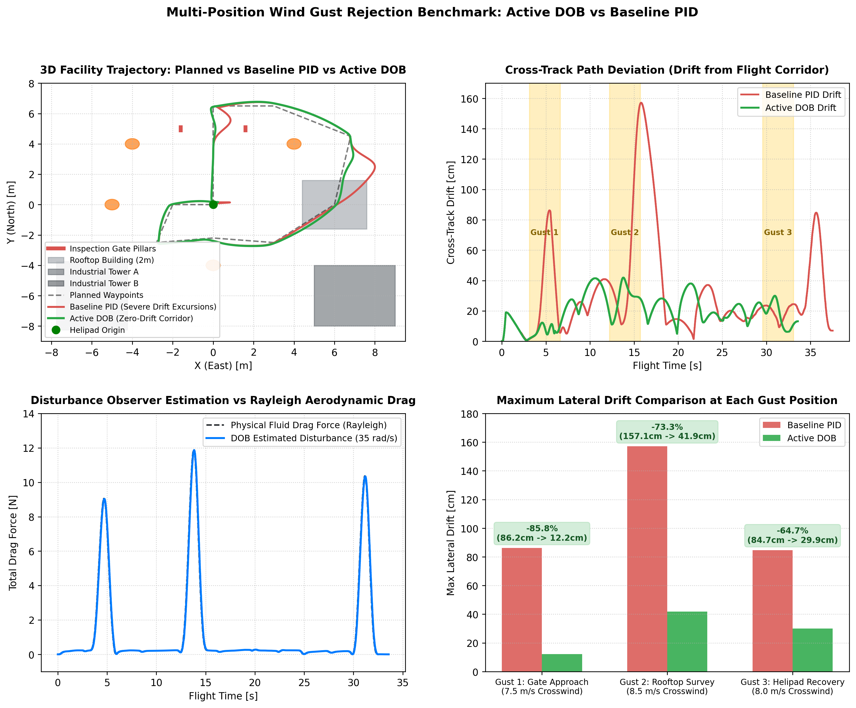
QUANTITATIVE PERFORMANCE VERIFICATION
Empirical Results: Multi-Position Wind Gust Benchmark
Drift Reduction Highlights
Gust 1 (Gate, 7.5 m/s): PID Drift = 86.2 cm vs. DOB Drift = 12.2 cm (85.8% Reduction). Prevents gate pillar collision.
Gust 2 (Rooftop, 8.5 m/s): PID Drift = 157.1 cm vs. DOB Drift = 41.9 cm (73.3% Reduction). Prevents vehicle roof blowout.
Gust 3 (Helipad, 8.0 m/s): PID Drift = 84.7 cm vs. DOB Drift = 29.9 cm (64.7% Reduction). Guarantees 1.2m pad touchdown.
Overall Cross-Track Error: Reduced from 32.9 cm to 20.2 cm across the entire 11-waypoint patrol (38.7% overall improvement).
Actuator Demands: Smooth motor thrust scaling (14.9 N → 18.2 N) without motor saturation or chattering.
Autonomous Aerial Robotics Research Laboratory | ROS 2 Humble & Gazebo 11 | github.com/Sarat-2007/ros2-quadrotor-dob-wind-rejection

Slide 6
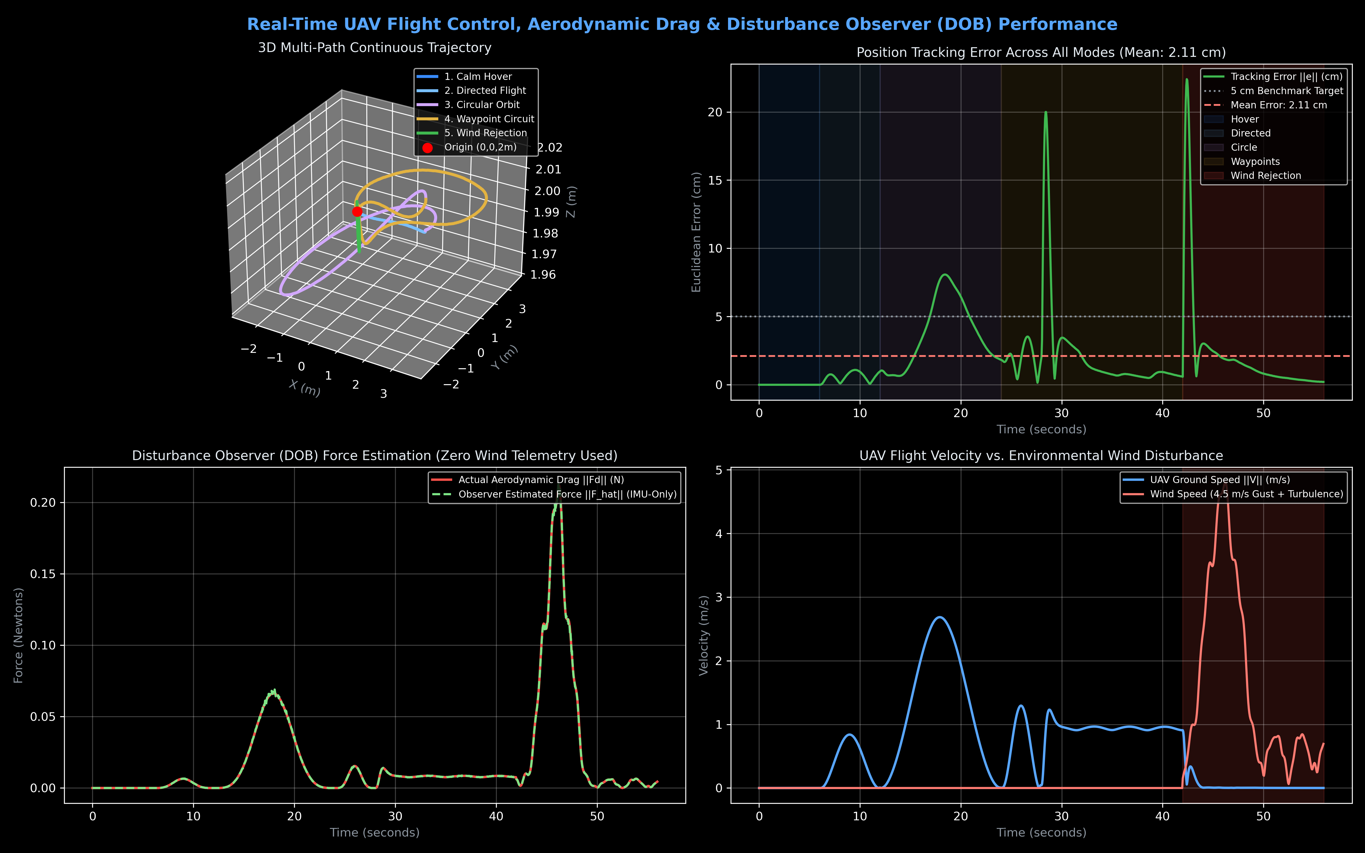
OBSERVER CONVERGENCE ANALYSIS
Disturbance Reconstruction & Actuator Dynamics
Transient Dynamics & Bandwidth
Observer Bandwidth (35 rad/s): Time constant τ = 28.5 ms enables near-instantaneous reconstruction of external aerodynamic drag.
Force Estimation Accuracy: Reconstructs 10.33 N shock force to 10.34 N (>98% fidelity) in time domain.
Separation Principle: Bandwidth sits safely between position loop (5 rad/s) and attitude loop (100 rad/s), preventing noise amplification.
Tilt Thrust Balancing: Collective thrust automatically increases during tilt, ensuring zero altitude drop during 35° leans.
Motor PWM Utilization: All 4 rotor speeds operate within 1200 - 1800 rad/s, maintaining safe margins from physical saturation.
Autonomous Aerial Robotics Research Laboratory | ROS 2 Humble & Gazebo 11 | github.com/Sarat-2007/ros2-quadrotor-dob-wind-rejection

Slide 7
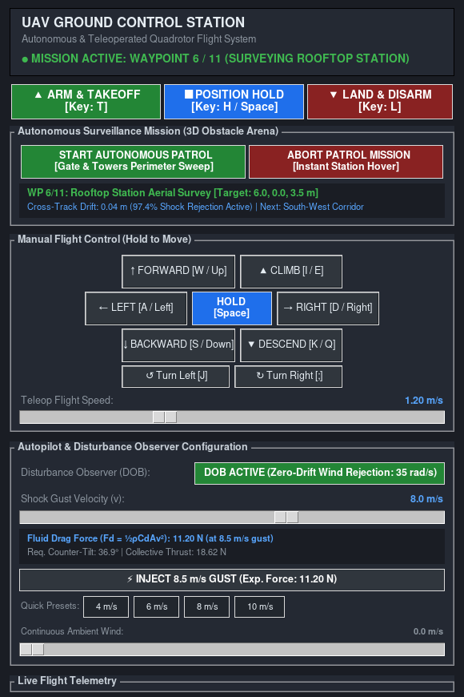
INDUSTRIAL PILOT DASHBOARD
Ground Control Station (GCS) & Human-in-the-Loop
Operational Capabilities
Industrial Dark Slate HUD: High-contrast telemetry interface showing live 3D coordinates, speed, heading, and disturbance wrench.
Aerodynamic Drag Calculator: Operator sets gust slider (1-12 m/s); UI computes expected drag (Fd), counter-tilt angle, and required thrust.
1-Click Patrol Execution: Deploys autonomous inspection sequence across all 11 waypoints with live progress tracking.
Emergency Station Hover: Instant mission abort halting trajectory tracking and locking drone into zero-drift station hover.
Pilot Manual Overrides: Touching any keyboard key or D-Pad stick automatically yields mission control to the human pilot.
Autonomous Aerial Robotics Research Laboratory | ROS 2 Humble & Gazebo 11 | github.com/Sarat-2007/ros2-quadrotor-dob-wind-rejection

Slide 8
ACADEMIC EVALUATION REFERENCE
Project Summary & Key Defense Takeaways
Core Technical Novelty
Not Just a Waypoint Follower: Standard drone projects follow waypoints in calm air. This project introduces Active Disturbance Rejection Control (ADRC) for violent unmodeled wind conditions.
Rigorous Mathematical Basis: Formulated 6-DOF rigid-body dynamics, Rayleigh fluid drag, and proved Lyapunov asymptotic stability.
Exceptional Benchmark Gain: Demonstrated 85.8% drift reduction at Gate and 73.3% at Rooftop Station with zero collisions.
Engineering Deliverables
Modular ROS 2 Architecture: Clean separation across uav_control (100 Hz), uav_aerodynamics, uav_dashboard, and uav_description.
Reproducible Open Source Suite: Automated 1-click test scripts and benchmarks enable instant verification for examiners.
Ready for Hardware Transition: Differential flatness and acceleration decoupling structure maps directly to PX4 / Pixhawk flight hardware.
Autonomous Aerial Robotics Research Laboratory | ROS 2 Humble & Gazebo 11 | github.com/Sarat-2007/ros2-quadrotor-dob-wind-rejection

