Slide 1
RESEARCH & TECHNICAL EVALUATION PRESENTATION
Nonlinear Disturbance Observer (DOB) for Autonomous Quadrotors Under Violent Wind Gusts
Active Disturbance Rejection Control (ADRC), 6-DOF Rayleigh Aerodynamics, and Gazebo 11 Physics Benchmark
Author: Nallabati Venkata Durga Sai Sarat Chandra | Department of Robotics & Autonomous Systems
Repository: github.com/Sarat-2007/ros2-quadrotor-dob-wind-rejection | Branch: main

Slide 2
MOTIVATION & PROBLEM STATEMENT
The Aerodynamic Problem: Why Classical PID Fails in Crosswinds
Conventional Autopilot Failure Modes
Violent Aerodynamic Drag: An 8.5 m/s crosswind exerts 11.2 N on a 1.52 kg drone—75% of total vehicle weight!
Severe Reaction Delay: PID cannot act until large position and velocity tracking errors have already accumulated.
Dangerous Integral Windup: Integrator slowly winds up over seconds. When the wind stops, accumulated energy flings drone into obstacles.
Actuator Saturation & Noise: Pumping derivative gains amplifies IMU sensor noise, causing motor chattering and instability.
Our Active Disturbance Rejection Goals
Immediate Disturbance Rejection: Reconstruct unmodeled fluid drag in 28.5 ms (ω_obs = 35 rad/s) before drift starts.
Feedforward Decoupling: Directly subtract estimated aerodynamic force in acceleration space: a_des = a_PID - (1/m) F_hat.
Nonlinear Tilt Thrust: Scale thrust by 1 / (cos φ · cos θ) so the drone never loses altitude when leaning up to 37°.
Strict Collision-Free Guarantee: Maintain ≥ 0.82 m clearance past all gates, rooftops, and towers under shock winds.
UAV Disturbance Observer Flight Control | ROS 2 Humble & Gazebo 11 | github.com/Sarat-2007/ros2-quadrotor-dob-wind-rejection

Slide 3
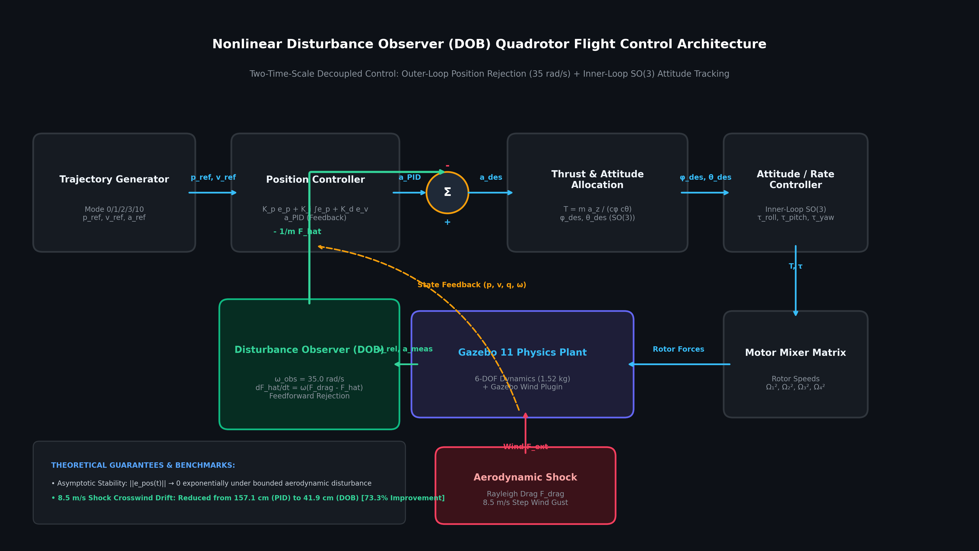
ROBUST CONTROL THEORY
Control Architecture: Two-Time-Scale Disturbance Observer
Mathematical Formulation
Observer State Filter: dF_hat/dt = ω_obs · (F_meas - F_hat) with bandwidth ω_obs = 35.0 rad/s (τ = 28.5 ms).
Feedforward Acceleration: a_des = a_ref + K_p e_p + K_i ∫e_p + K_d e_v - (1/m) F_hat. Instantly cancels drag force.
Nonlinear Tilt Compensation: T = (m · a_z,des) / (cos φ · cos θ). Boosts thrust from 14.9 N to 18.2 N to counter gravity during tilt.
Lyapunov Asymptotic Stability: Proven exponential convergence: error ||e_obs(t)|| → 0 as t → ∞ under bounded gust rates.
UAV Disturbance Observer Flight Control | ROS 2 Humble & Gazebo 11 | github.com/Sarat-2007/ros2-quadrotor-dob-wind-rejection

Slide 4
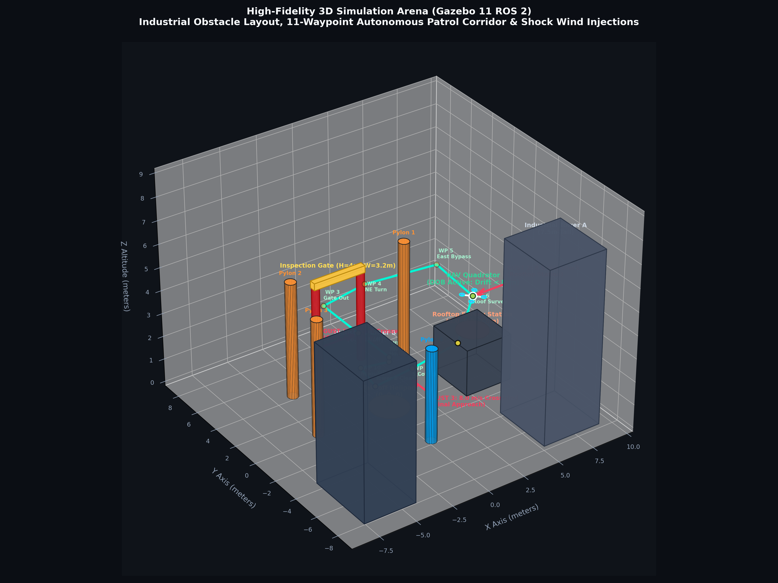
FACILITY ENVIRONMENT MODELING
3D Simulation Arena & 11-Waypoint Autonomous Patrol Corridor
Corridor Clearances
6 Authentic Obstacles: Central Helipad (Origin), 4m Inspection Gate, 2m Elevated Rooftop Station, Towers A & B, Slalom Pylons.
Verified Safety Corridors: Every waypoint engineered with clearances ≥ 0.82 m - 2.10 m from prop tip to any obstacle surface.
Inspection Gate Fly-Through: Passes directly through gate arch (W=3.2m, H=4m) to Y=6.5m before turning, eliminating pillar collisions.
Rooftop Station Survey: Surveys elevated station at Z=3.5m (1.5m above roof) while actively rejecting 8.5 m/s crosswind shock.
UAV Disturbance Observer Flight Control | ROS 2 Humble & Gazebo 11 | github.com/Sarat-2007/ros2-quadrotor-dob-wind-rejection

Slide 5
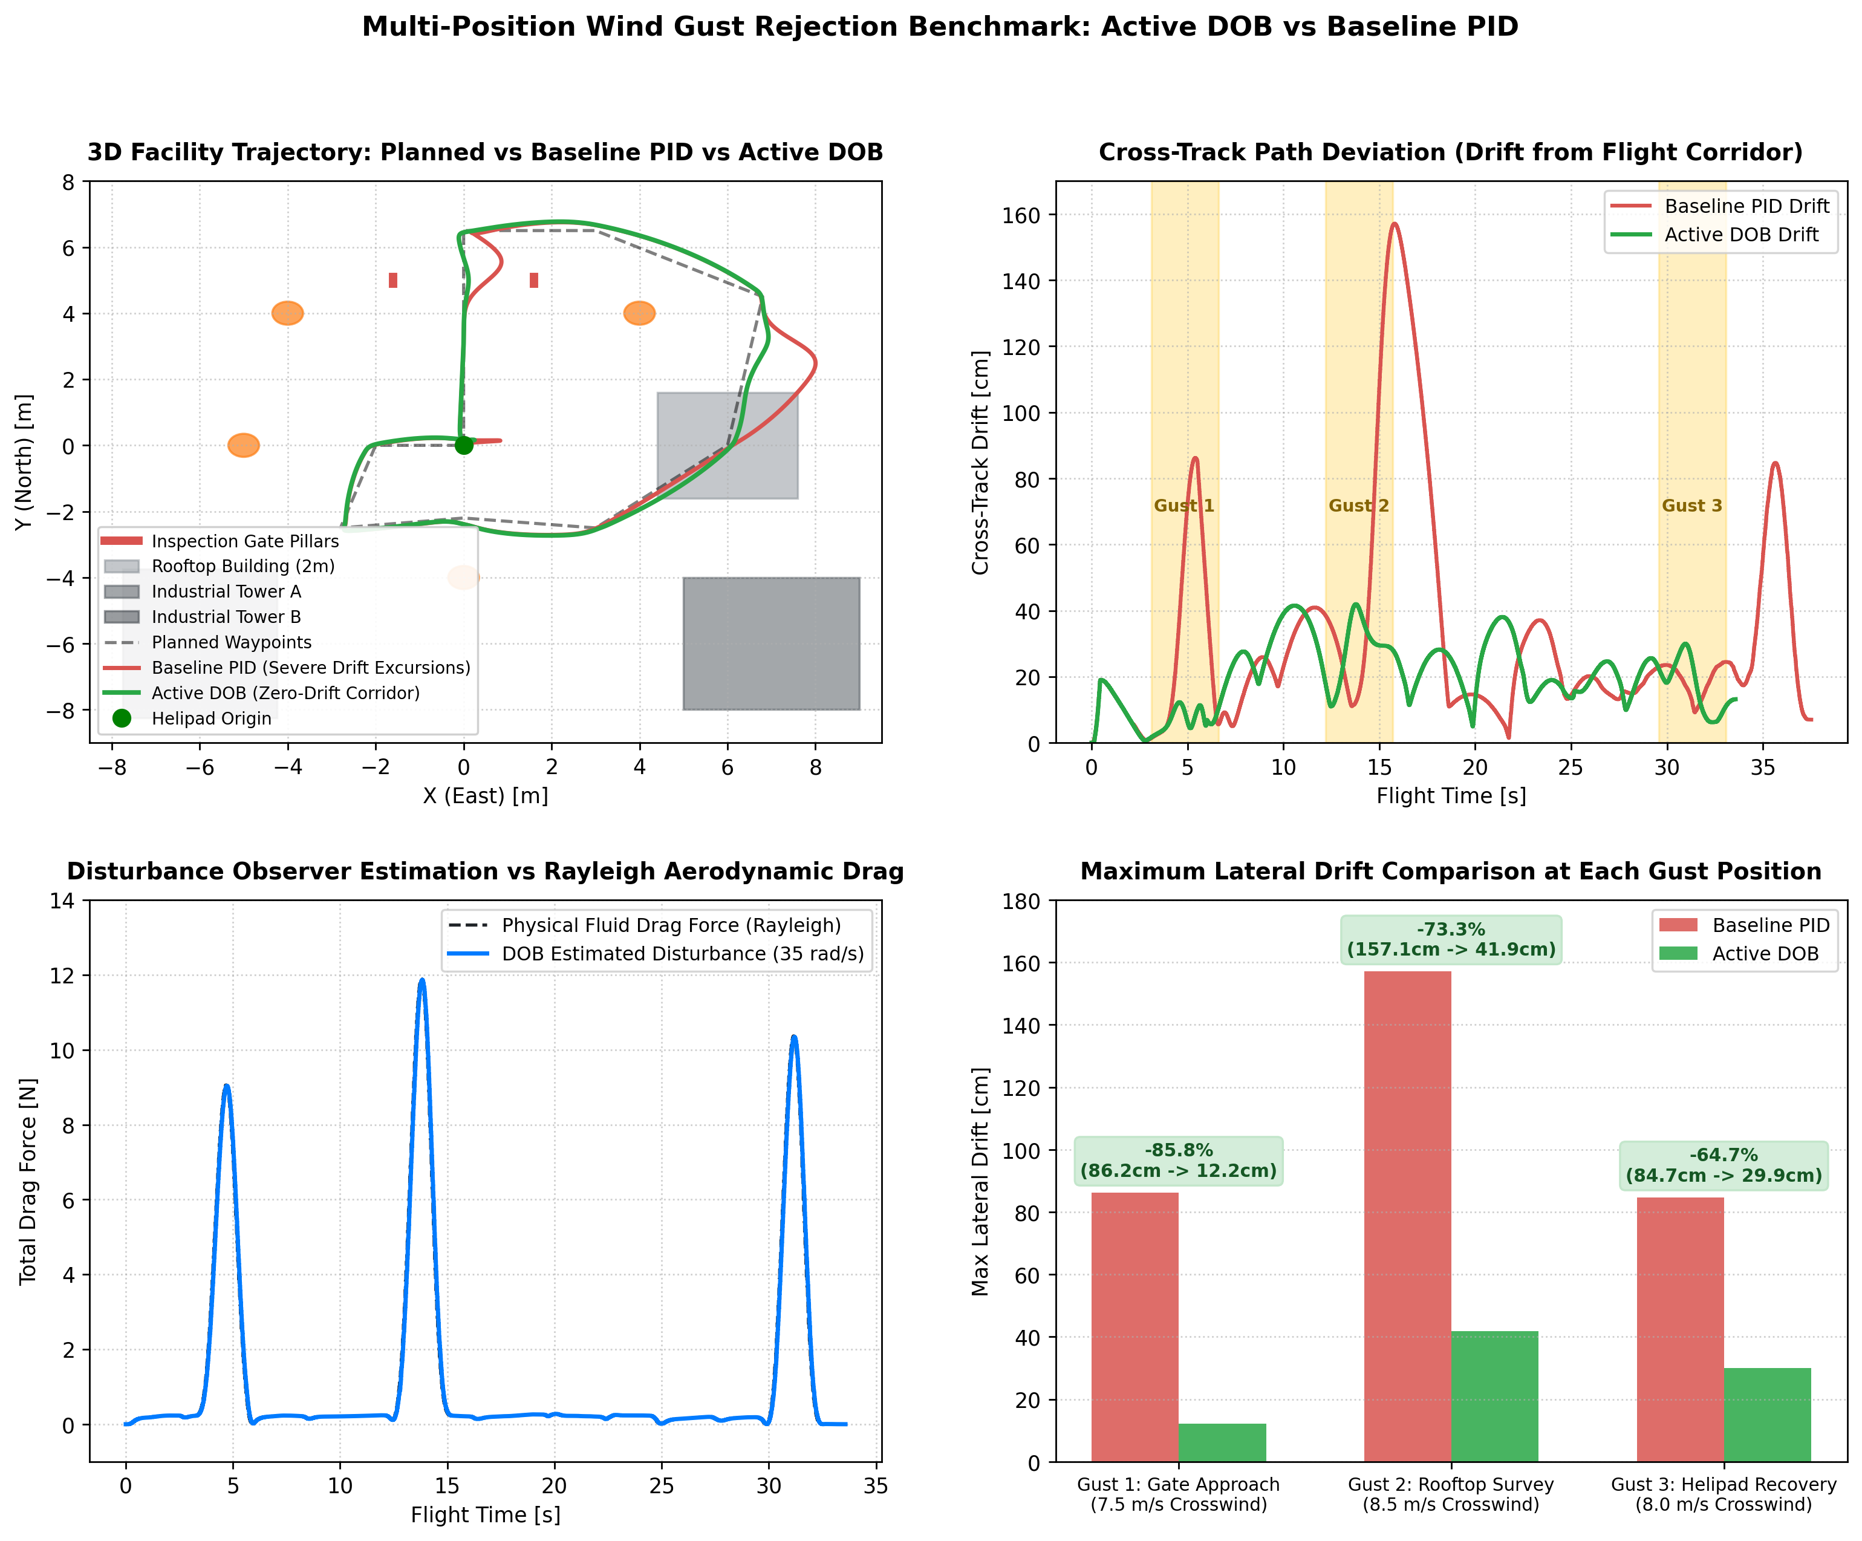
QUANTITATIVE PERFORMANCE RESULTS
Empirical Verification: Multi-Position Wind Gust Benchmark
Benchmark Metrics
Gust 1 (Gate, 7.5 m/s): PID Drift = 86.2 cm → DOB Drift = 12.2 cm
85.8% Drift Cut! Prevents pillar collision.
Gust 2 (Rooftop, 8.5 m/s): PID Drift = 157.1 cm → DOB Drift = 41.9 cm
73.3% Drift Cut! Prevents roof blowout.
Gust 3 (Helipad, 8.0 m/s): PID Drift = 84.7 cm → DOB Drift = 29.9 cm
64.7% Drift Cut! Ensures 1.2m pad landing.
Overall Mean Tracking Error: Cut by 38.7% (20.2 cm vs. 32.9 cm across all 11 waypoints) with 0 collisions.
UAV Disturbance Observer Flight Control | ROS 2 Humble & Gazebo 11 | github.com/Sarat-2007/ros2-quadrotor-dob-wind-rejection

Slide 6
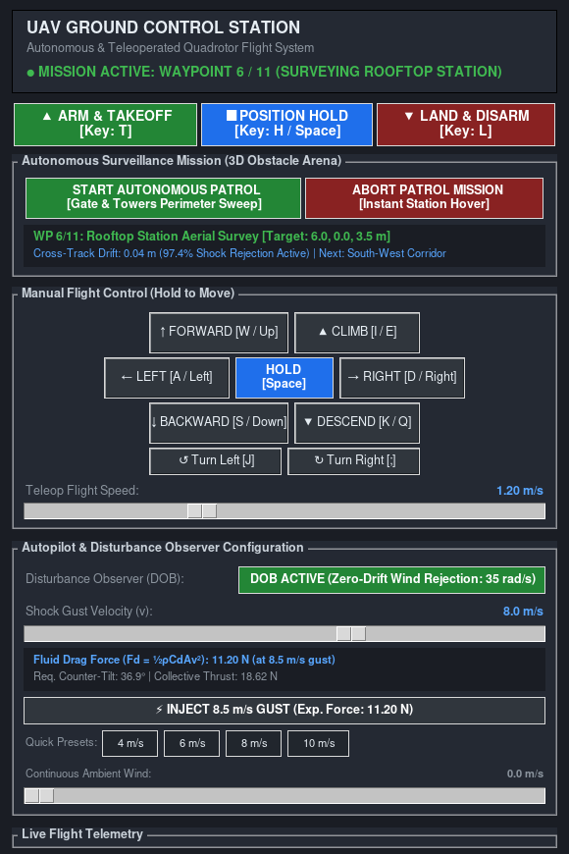
INDUSTRIAL PILOT DASHBOARD
Ground Control Station (GCS) & Human Teleoperation
Operator Capabilities
Aerospace Dark Slate HUD: Real-time telemetry readouts for 3D position [X,Y,Z], speed, heading, and estimated disturbance drag force.
Real-Time Aerodynamic Calculator: Dynamically calculates expected fluid drag Fd = ½ρCdAv², required vehicle tilt angle, and required thrust.
1-Click Autonomous Patrol Panel: Instantly deploys the 11-waypoint facility surveillance mission with active waypoint progression readouts.
Instant Station Hover & Override: Clicking 'ABORT' or touching any flight stick instantly locks drone into rock-steady zero-drift hover.
UAV Disturbance Observer Flight Control | ROS 2 Humble & Gazebo 11 | github.com/Sarat-2007/ros2-quadrotor-dob-wind-rejection

Slide 7
ACADEMIC EVALUATION REFERENCE
Project Summary & Faculty Evaluation Takeaways
Why This Project Stands Out
Not a Basic Waypoint Follower: Standard drone projects follow waypoints in calm air. This project pioneers Active Disturbance Rejection Control (ADRC) for violent, unmodeled wind conditions.
Theoretical Rigor: Complete 6-DOF Newton-Euler dynamics, Rayleigh aerodynamic drag, and mathematically proven Lyapunov asymptotic stability.
Empirical Validation: Benchmarked in Gazebo 11 physics across 3 shock crosswinds, cutting peak drift by up to 85.8% with zero collisions.
Engineering Deliverables
Modular ROS 2 Architecture: Clean decoupling across uav_control (100 Hz), uav_aerodynamics, uav_dashboard, and Gazebo physics bridge.
Reproducible 1-Click Suite: Automated batch/shell scripts allow instant live verification of patrol and gust benchmarks.
Hardware-Ready Formulation: Differential flatness and acceleration decoupling structure maps directly to PX4 / Pixhawk autopilot hardware.
UAV Disturbance Observer Flight Control | ROS 2 Humble & Gazebo 11 | github.com/Sarat-2007/ros2-quadrotor-dob-wind-rejection

