Slide 1
Subscription Retention Rate Analysis
Subscription Retention: The ratio of retained customers to the total number of customers at the start of that period.
Subscription Retention Rate = (E/S)*100
  E: Number of customers at the end of a period
  S: Total number of customers at the start of that period

Slide 2
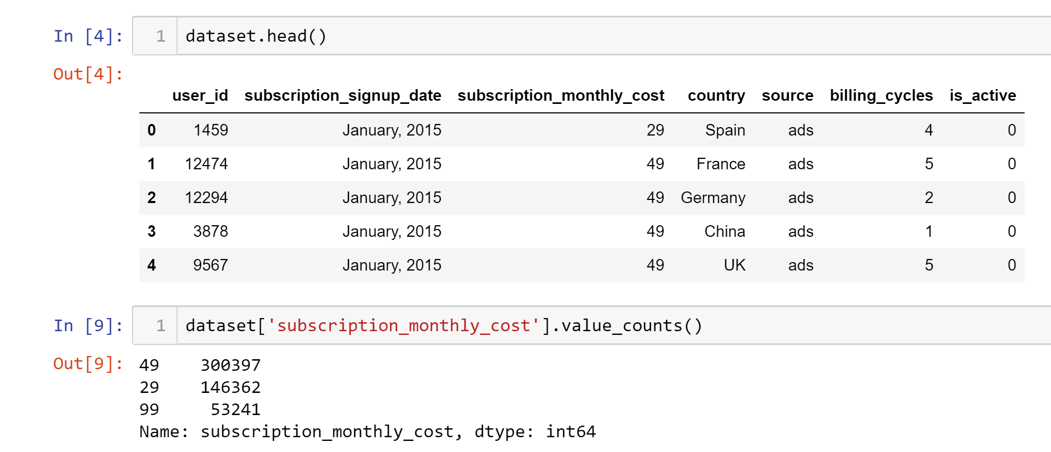
Dataset description
50000 data points
Seven Features
Supervised Learning Dataset
Regression Problem
No missing values and outliers

Slide 3
Problem Statement:
ML based Subscription Business Model.
Calculation of monthly Subscription Retention Rate for different price points.
Prediction of the retention rate after 12 months.
Role of country and source in the improvement of company revenue.

Slide 4
Data Preprocessing
Get the Dataset
Gaining Insights of the dataset (Check for missing values and outliers)
Feature Transformation
Data Visualization

Slide 5
Feature Selection and Transformation
Features are not suitable for solving the problem statement.
Calculation of Subscription Retention Rate for each price point using Billing_Cycles and Is_Active.

Slide 6
Subscription Retention Rate
Months | $29
1 month | 60.75%
2 months | 45.84%
3 months | 37.62%
4 months | 32.30%
5 months | 28.54%
6 months | 25.71%
7 months | 23.59%
Months | $49
1 month | 38.36%
2 months | 20.62%
3 months | 13.40%
4 months | 9.64%
5 months | 7.40%
6 months | 5.94%
7 months | 4.88%
Months | $99
1 month | 15.87%
2 months | 7.00%
3 months | 4.24%
4 months | 2.96%
5 months | 2.21%
6 months | 1.79%
7 months | 1.50%

Slide 7
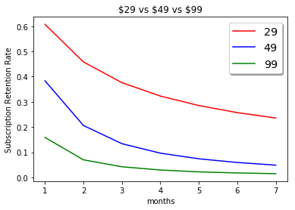
Monthly Retention Rate of different price points

Slide 8
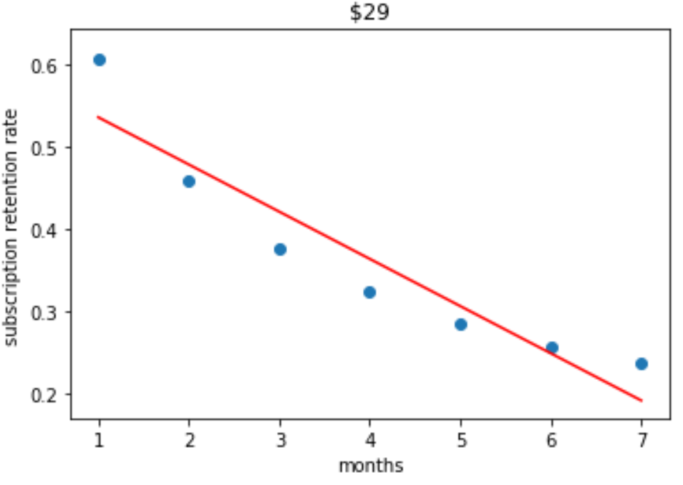
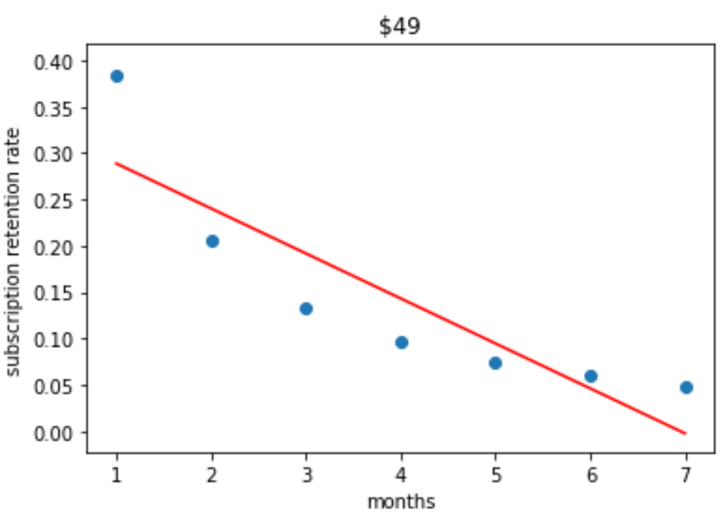
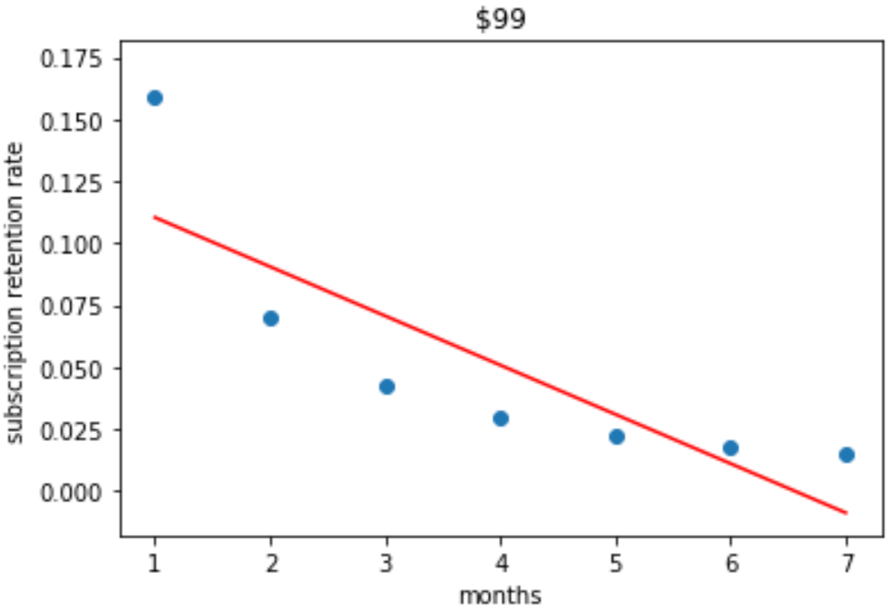
Linear Regression Fit

Slide 9
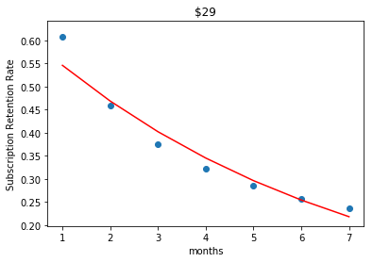
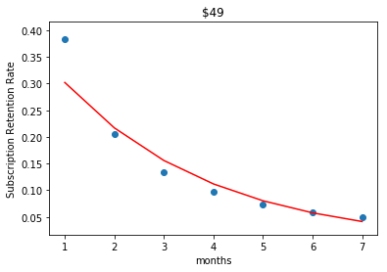
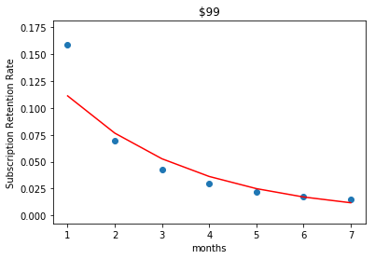
Exponential Regression Fit

Slide 10
RMSE values for Linear Regression and Exponential Regression
Monthly Cost | Linear Regression | Exponential Regression
$29 | 0.04084 | 0.02809
$49 | 0.05195 | 0.03292
$99 | 0.02589 | 0.01877

Slide 11
Predictions based on Exponential Regresssion
Months | $29 | $49 | $99
After 8 months | 18.76% | 2.97% | 0.81%
After 9 months | 16.10% | 2.13% | 0.56%
After 10 months | 13.83% | 1.53% | 0.38%
After 11 months | 11.87% | 1.10% | 0.26%
After 12 months | 10.19% | 0.79% | 0.18%

Slide 12
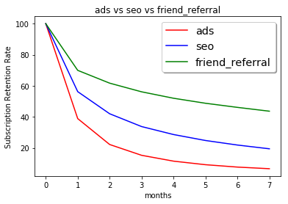
Comparison of Retention Rates of different sources

Slide 13
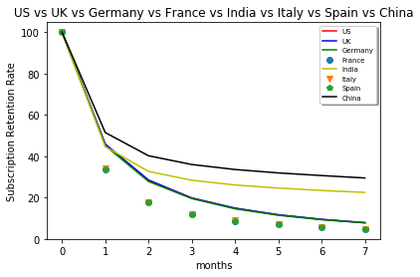
Comparison of Retention Rates of different countries

Slide 14
Business Recommendations
Company should invest less on ads as it has less retention rate.
Company should give special offers to users in India China to encourage more friend referrals which in turn will increase the retention rate

Slide 15
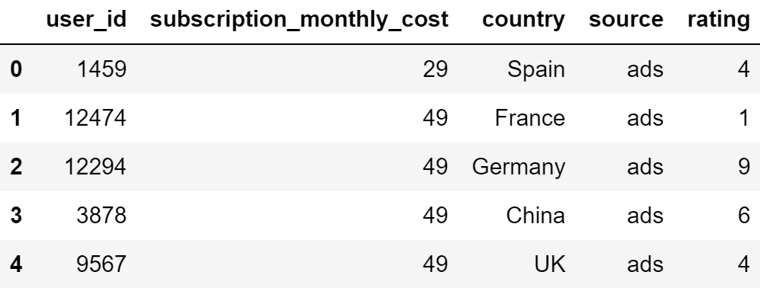
Recommendation Dataset

Slide 16


User Based Collaborative Filtering
US, ads
$29
User 1
$49
7 months
$99
User 2
US, ads

Slide 17
Challenges
The problem statement here is to predict subscription retention rate of monthly costs. However, that particular subscription retention rate class label was not present in the dataset initially.
The dataset is not suitable for creating s recommendation system. Therefore, we had to add new features to the dataset.

