Slide 1







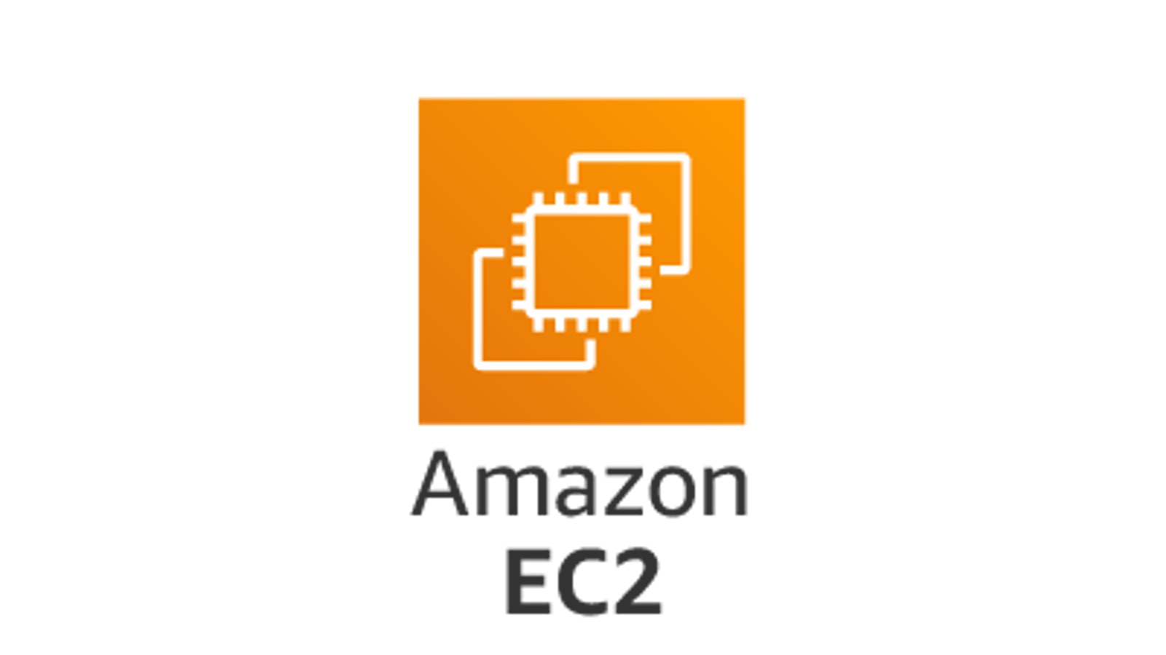
Data Collection
Feature Creation
Model Training
Major Tools Used
Data Cleaning
Data Cleaning
Model Selection
Data Fetching
Data Processing
Data Processing
Model Tuning
Data Cleaning
Schema Creation
Schema Creation
Model
Testing
Data
Preparation
Model Deployment
Data Extraction
Feature Creation
Data Ingestion
Model Building
Notes:
Initial Setup flow

Slide 2



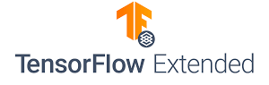



Fresh Data
Model Training
Drift is Negligible
Drift is noticed
Data Quality Check
Feature Creation
Model Selection
Data Fetching
Model Storage
Model Drift Check
Model Tuning
Data Cleaning
Data Drift Check
Model Rollout
Model
Testing
Data
Preparation
Log
Model Deployment
ETL Pipeline
Model Building

Slide 3




