Slide 1
NSS KARAYOGAM MANAGEMENT SYSTEM
ABHIRAMI SATHEESH
M21002
S4B1

Slide 2
CONTENTS
Modules
Database
Test case
Input and output design
Reports

Slide 3
MODULES
There are 4 users in this system
Administrator
Members
Treasurer
Guest

Slide 4
ADMINISTRATOR
Login
Add place
Add locations
Add scheme
Add loan type
Add scholarship type
Add finance head
Add proof type
Add members
View scholarship applications
Accept scholarship applications
View granted scholarship

Slide 5
Add relation type
Add events
Add election position
Election declaration
View and accept the election application

Slide 6
Add a new member :
The admin is added the new member into the system. And the member who has the account, he/she is add the other members into the system.
Event Scheduling :
Schedule events in the karayogam.
Scholarship :
Add scholarship type and scholarship name. Approve the application of scholarship.
Scheme :
Add scheme of chitty.

Slide 7
Add place :
Add place
Add locations :
Add locations
Add finance head :
  Add finance head
Add proof type :
Add proof type
Election position
Add election positions

Slide 8
Election declaration :
Declare the election.
Scholarship type :
Add scholarship types.
Accept the scholarship applications
Loan type :
Add name of loan type.
Add relation type

Slide 9
Treasurer
Login
View profile
Edit profile
Change password
Add chitty details
Add loan details
Add weekly and monthly collections
View chitty and loan applications
Accept/reject the loan and chitty applications
View the payments of chitty and loan
View payments of weekly and monthly collections

Slide 10
View accepted scholarship applications
Scholarship payment
Report

Slide 11
Profile :
View profile, edit profile and change password.
Chitty :
Finance head add the chitty name and its details. View the applications from members and relatives then accept/reject the applications. View the payment of chitty.
Loan :
Finance head add the loan name and its details. View the applications from members and relatives then accept/reject the applications. View the repayment of loan.
Monthly and weekly collection funds :
Add monthly and weekly collections and view the funds payment.

Slide 12
Scholarship :
Payment of accepted scholarship applications from admin.
Report :
Generate the report of chitty, loan, scholarship and weekly & monthly collections.

Slide 13
MEMBER
Login
Edit profile
Change password
View chitty and loan
Apply chitty and loan
View status of chitty and loan
Payment of chitty and loan
Repayment of chitty and loan

Slide 14
View scholarship
Apply scholarship
View status of scholarship
View monthly and weekly collections
Payment of monthly and weekly collections
Add relatives
Apply for election
Vote

Slide 15
Profile :
View profile , edit profile and change password.
Chitty :
View chitty details and apply the chitty. View the status of chitty and payment.
Loan :
View loan details and apply the loan. View the status of loan and payment.
Scholarship :
View scholarship details and apply the scholarship. View the status of scholarship and payment.

Slide 16
Weekly and monthly collection fund :
view weekly and monthly collection and its payment.
Relatives :
Member want to add the relatives.
Election :
Member can apply the election. View the candidate and also view the result.

Slide 17
GUEST
View site

Slide 18
DATABASE

Slide 19
TABLES
There are 29 tables
tbl_place
tbl_ location
tbl_financehead
tbl_loan
tbl_scheme
tbl_memberadding
tbl_proof
tbl_relationtype

Slide 20
9. tbl_scholarshiptype
10. tbl_ scholarshipname
11. tbl_ addloanname
12. tbl_ chitty
13. tbl_chittycalendar
14. tbl_loancalendar
15. tbl_monthlycollection
16. tbl_weeklycollection
17. tbl_chittyjoin
18. tbl_loanapply
19. tbl_monthlycollectionpayment
20. tbl_paymentchitty

Slide 21
21. tbl_ relatives
22. tbl_ repaymentloan
23. tbl_ scholarshipapply
tbl_ weeklycollectionpayment
tbl_electionposition
tbl_electiondeclaration
tbl_electionapply
tbl_voting
tbl_events

Slide 22
tbl_place
Description : Table for store place
PK : id
Field name | Type | Description
id | integer | Place id
place_name | character | Place name

Slide 23
2. tbl_ location
Description : Table for store location
PK : id
FK : place_id
Field name | Type | Description
id | integer | Location id
plcae_id | integer | place id
location_name | character | Location name

Slide 24
3. tbl_financehead
PK : id
Description : Table for store finance head details.
Field name | Type | Description
id | Integer | Finance head id
financehead_name | Character | Name of finance head
user_name | email | Email of finance head
password | password | Password of finance head
fdate | date | Starting date of finance head
tdate | date | Ending date of finance head

Slide 25
4. tbl_loan
Description : Table for store loan type.
PK : id
Field name | Type | Description
id | integer | Id of loan type
loan_name | character | Loan type name
5. tbl_proof
Description : Table for store proof type.
PK : id
Field name | Type | Description
id | integer | Id of proof type
proof_name | character | Proof name

Slide 26
6. tbl_scheme
Description : Table for store scheme.
PK : id
Field name | Type | Description
id | integer | Id of scheme
scheme_name | character | Scheme name

Slide 27
7. tbl_memberadding
Description : Table for store member details.
PK : id
FK : location_id
Field name | Type | Description
id | integer | Id of member
member_name | Character | Name of member
age | integer | Age of member
contact | integer | Phone number
email | email | Email of member
address | character | Address of member
gender | character | Gender of member
password | password | Password
location_id | integer | Location of member
photo | file | Photo of member

Slide 28
8. tbl_relationtype
Description : Table for store relation type.
PK : id
Field name | Type | Description
id | integer | Id of relation type
relation_type | character | Type of relation

Slide 29
9. tbl_scholarshiptype
Description : Table for store scholarship type.
PK : id
Field name | Type | Description
id | integer | Id of scholarship type
scholarship_type | character | Name scholarship type

Slide 30
10. tbl_ addloanname
Description : Table for store loan name.
PK : id
FK : head_id, loan_type_id
Field name | Type | Description
id | integer | Id of loan name
loan_name | character | Name of loan
loan_details | character | Details about loan
head_id | integer | Id of finance head
loan_type_id | integer | Id of loan type

Slide 31
11. tbl_ scholarshipname
Description : Table for store scholarship name and details.
PK : id
FK : scholarsgip_type_id, proof_name_id
Field name | Type | Description
id | integer | Id of scholarship name
scholarship_name | character | Name of scholarship
scholarship_details | character | Details about scholarship
scholarship_type_id | integer | Id of scholarship type
proof_name_id | integer | Id of proof type

Slide 32
12 tbl_ chitty
Description : Table for store chitty name and details.
PK : id
FK : head_id, scheme_id
Field name | Type | Description
id | integer | Id of chitty name
chitty_name | character | Name of chitty
chitty_details | character | Details about chitty
head_id | integer | Id of finance head
scheme_id | integer | Id of scheme

Slide 33
13 tbl_chittycalendar
Description : Table for store chitty details.
PK : id
FK : chitty_name_id, head_id
Field name | Type | Description
id | integer | Id of chitty calendar
amount | integer | Amount of installment
startdate | date | Starting date of chitty
enddate | date | Ending date of chitty
no_installment | integer | Number of installment
chitty_name_id | character | Chitty name
head_id | integer | Finance head id

Slide 34
14 tbl_loancalendar
Description : Table for store loan details.
PK : id
FK : loan_name_id, head_id
Field name | Type | Description
id | integer | Id of loan calendar
amount | integer | Amount of installment
startdate | date | Starting date of loan
enddate | date | Ending date of loan
no_installment | integer | Number of installment
loan_name_id | character | Loan name
head_id | integer | Finance head id

Slide 35
15 tbl_monthlycollection
Description : Table for store monthly collection details.
PK : id
FK : head_id
Field name | Type | Description
id | integer | Id of monthly collection
amount | integer | Amount of monthly collection
head_id | integer | Finance head id

Slide 36
16 tbl_weeklycollection
Description : Table for store weekly collection details.
PK : id
FK : head_id
Field name | Type | Description
id | integer | Id of weekly collection
amount | integer | Amount of weekly collection
head_id | integer | Finance head id

Slide 37
17 tbl_chittyjoin
Description : Table for store chitty joining details.
PK : id
FK : chittydata_id, memberdata_id, proof_name_id, relative_id
Field name | Type | Description
id | integer | Id of chitty joining
status | integer | Status of chitty application
document | file | Identity document
chittydata_id | integer | Id of chitty
memberdata_id | integer | Id of member
proof_name_id | integer | Id of proof
relative_id | integer | Id of relatives

Slide 38
18 tbl_loanapply
Description : Table for store loan apply details.
PK : id
FK : loan_name_id, member_name_id, proof_name_id
Field name | Type | Description
id | integer | Id of loan apply
status | integer | Status of loan application
document | file | Identity document
loan_name_id | integer | Id of loan name
member_name_id | integer | Id of member
proof_name_id | integer | Id of proof

Slide 39
19 tbl_monthlycollectionpayment
Description : Table for store monthly collection payment details.
PK : id
FK : monthycollection_id_id, member_name_id
Field name | Type | Description
id | integer | Id of monthly collection payment
monthlycollection_id_id | integer | Id of monthly collection
member_name_id | integer | Id of member

Slide 40
20 tbl_paymentchitty
Description : Table for store chitty payment details.
PK : id
FK : chitty_apply_id, member_name_id, relative_name_id
Field name | Type | Description
id | integer | Id of chitty payment
chitty_apply_id | integer | Id of chitty application
member_name_id | integer | Id of member
relative_name_id | integer | Id of relative

Slide 41
21 tbl_ relatives
Description : Table for store relatives details.
PK : id
FK : member_name_id, relation_type_id
Field name | Type | Description
id | integer | Id of relative
relative_name | character | Name of relative
age | integer | Age of relative
contact | integer | Phone number
email | email | Email of member
gender | character | Gender of member
photo | file | Photo of member
member_name_id | integer | Id of member
relation_type_id | integer | Id of relation type
refer_id | integer | Id of relatives

Slide 42
22 tbl_ repaymentloan
Description : Table for store repayment of loan.
PK : id
FK : loanapply_id, member_id
Field name | Type | Description
id | integer | Id of loan payment
loanapply_id | integer | Id of loan application
member_id | integer | Id of member

Slide 43
23 tbl_ scholarshipapply
Description : Table for store scholarship application.
PK : id
FK : member_name_id, relative_name_id, scholarship_name_id
Field name | Type | Description
id | integer | Id of scholarship application
status | integer | Status of scholarship application
document | file | Document for scholarship application
member_name_id | integer | Id of member
relative_name_id | integer | Id of relative
scholarship_name_id | integer | Id of scholarship name

Slide 44
24 tbl_ weeklycollectionpayment
Description : Table for store weekly collection fund.
PK : id
FK : weeklycollection_id, relative_name_id, member_name_id
Field name | Type | Description
id | integer | Id of weekly collection payment
weeklycollection_id_id | integer | Id of weekly collection
relative_name_id | integer | Id of relative
member_name_id | integer | Id of member

Slide 45
25. tbl_electionposition
Description : Table for store election position.
PK : id
FK : election_position
Field name | Type | Description
id | integer | Id of election position
election_position | character | Election position

Slide 46
26 tbl_electiondeclaration
Description : Table for store election declaration.
PK : id
Field name | Type | Description
id | integer | Id of election declaration
title | character | Election name or title
details | character | Details of election
nomination_date | date | Last date for nomination
verified_date | date | Last date of verification
election_date | date | Date of election
result_date | date | Date of result declaration
posting_date | date | Date of election declaration

Slide 47
27 tbl_electionapply
Description : Table for store election applications.
PK : id
FK : election_name_id, election_position_id, member_name_id
Field name | Type | Description
id | integer | Id of nomination
status | integer | Status of application
election_name_id | integer | Election name or title
election_position_id | integer | Position of nomination
member_name_id | integer | Member id

Slide 48
28 tbl_voting
Description : Table for store vote details.
PK : id
FK : election_apply_id, member_name_id, relative_name_id
Field name | Type | Description
id | integer | Id of voting
election_apply_id | integer | Id of election application of candidate
member_name_id | integer | Id of member
relative_name_id | integer | Id of relatives

Slide 49
  29. tbl_events
Description : Table for store event details.
PK : id
Field name | Type | Description
id | integer | Id of event
name | character | Name of event
details | character | Event details
Event_date | date | Date of event

Slide 50
TEST PLAN

Slide 51
TEST PLAN
Testing is a process of executing a program with the interest of finding an error. A good test is one that has a high probability of finding the yet undiscovered errors. Testing begins at the level and works outward towards the interaction of the entire software.
A series of testing are performed for this project before the system is ready for acceptance. Each web page, functionality validation scripts and other executable components were tested independently. The integrity of entire system is checked.

Slide 52
Some of testing strategies applied for the system are listed here. A test plan should contain the following :
Test unit specification
Features to be tested
Approach for testing
Test deliverables
Schedule

Slide 53
TEST CASE

Slide 54
ID | TEST CASE | INPUT DATA | EXPECTED RESULT | ACTUAL RESULT | REMARK
1 | Check admin login with valid data | Correct user name and password | Admin should login to the system | As expected | Pass
2 | Check admin login with invalid data | Incorrect user name and password | Admin get an error message | As expected | Pass
3 | Check treasurer login with valid data | Correct user name and password | Treasurer should login to the system | As expected | Pass

Slide 55
4 | Check treasurer login with invalid data | Incorrect user name and password | Treasurer get an error message | As expected | Pass
5 | Check member login with valid data | Correct user name and password | Member should login to the system | As expected | Pass
6 | Check member login with invalid data | Incorrect user name and password | Member get an error message | As expected | Pass
7 | Check relatives login with valid data | Correct user name and password | Relatives should login to the system | As expected | Pass

Slide 56
8 | Check relatives login with invalid data | Incorrect user name and password | relatives get an error message | As expected | Pass
9 | Check admin login by emptying the field | No data | Admin should alert to enter user name and password | As expected | Pass
10 | Check treasurer login by emptying the field | No data | Treasurer should alert to enter user name and password | As expected | Pass

Slide 57
11 | Check member login by emptying the field | No data | Member should alert to enter user name and password | As expected | Pass
12 | Check relatives login by emptying the field | No data | Relatives should alert to enter user name and password | As expected | Pass

Slide 58
INPUT AND OUTPUT DESIGN

Slide 59
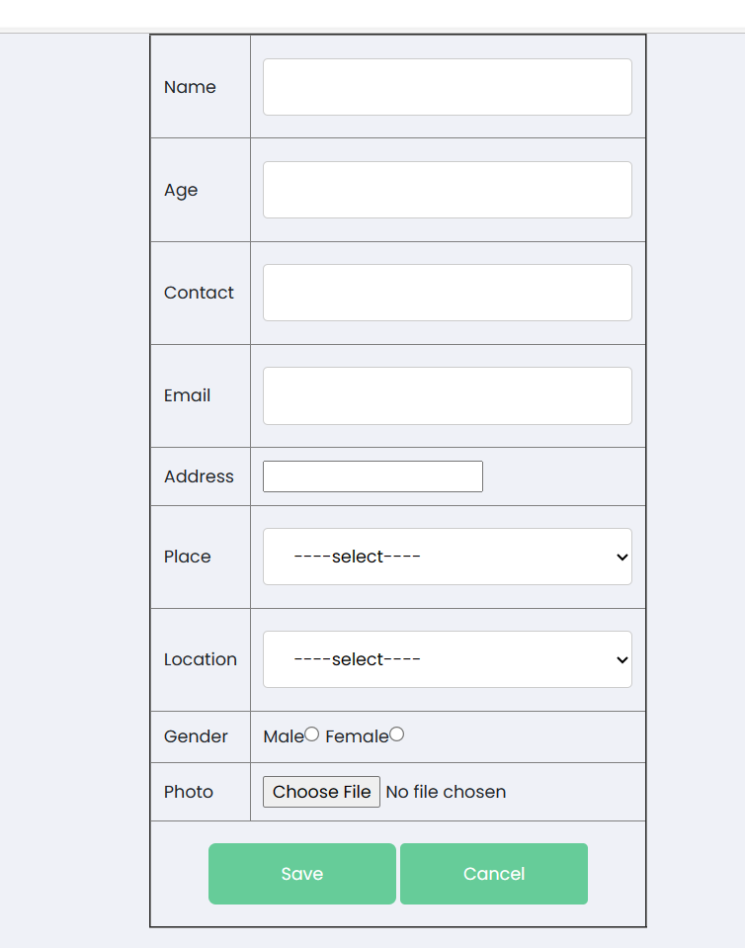
Member adding

Slide 60
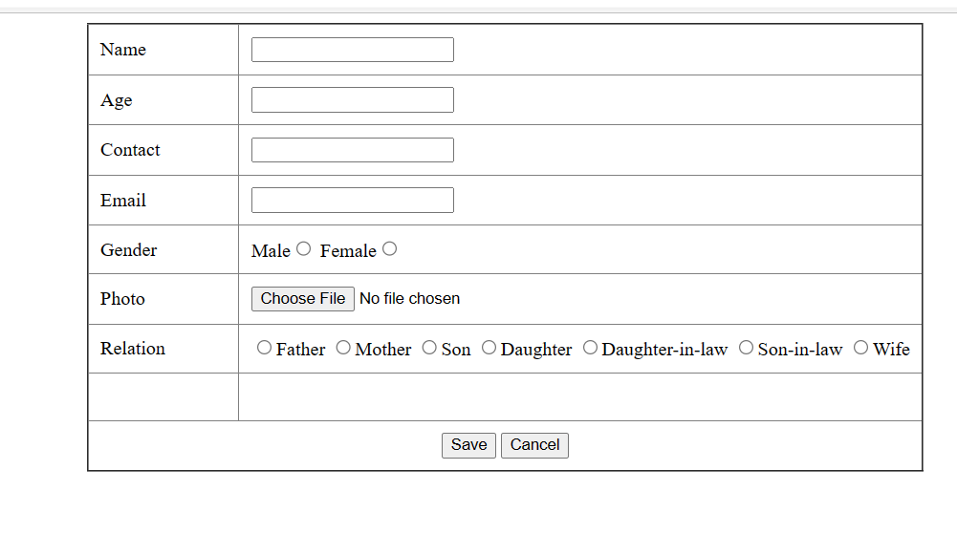
Relative adding

Slide 61
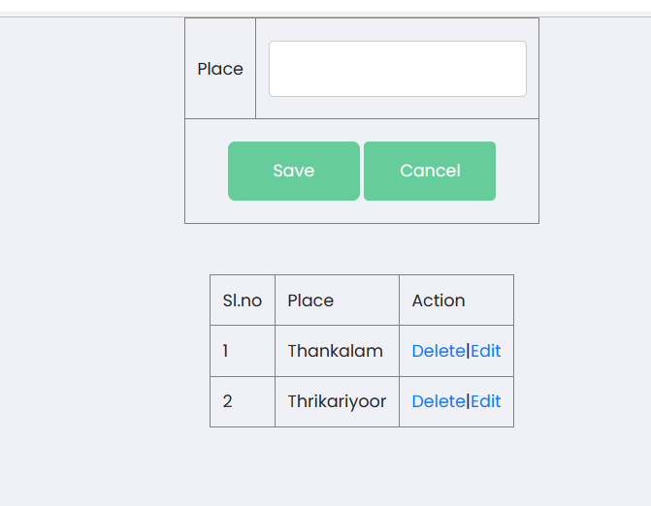
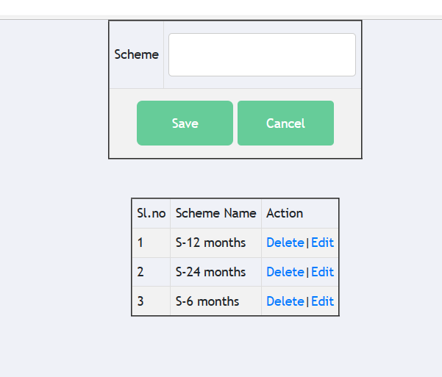
Add place
Add scheme

Slide 62
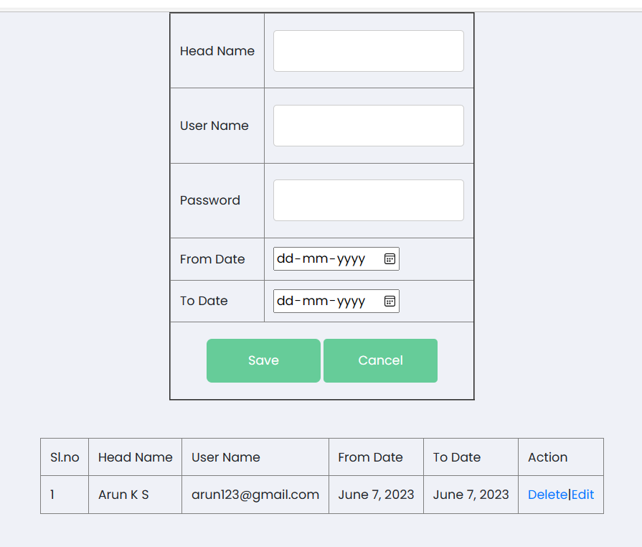
Add finance head

Slide 63
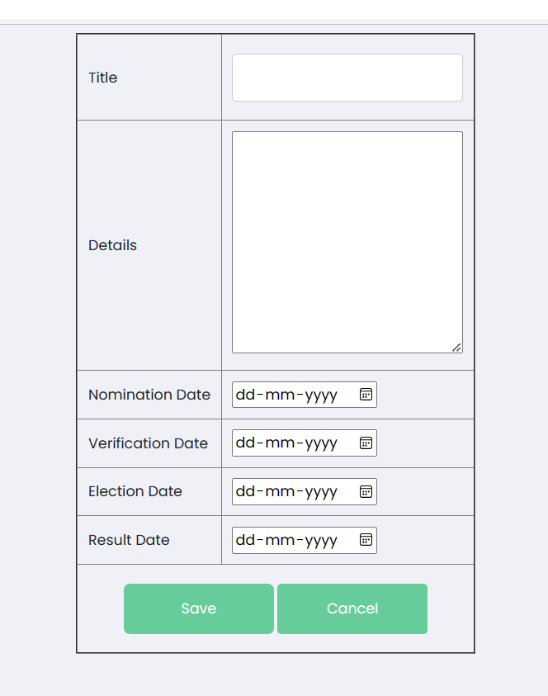
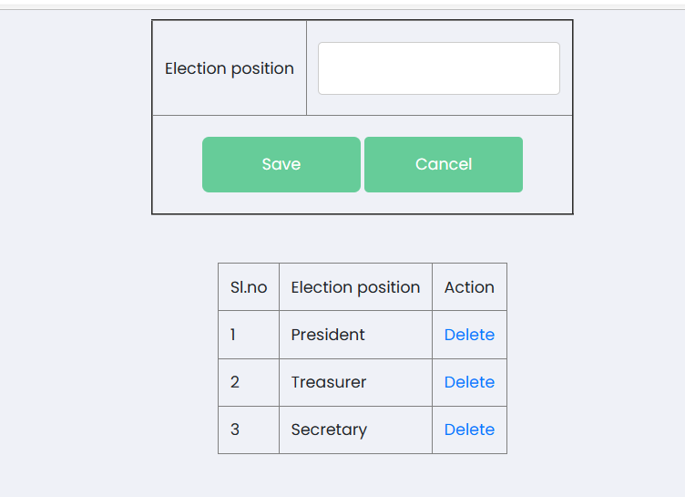
Election Declaration
Election Position

Slide 64
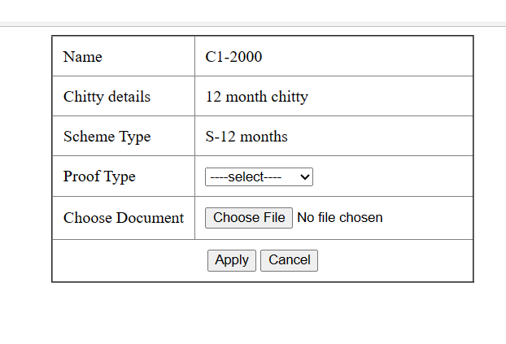

Chitty apply
Loan apply

Slide 65
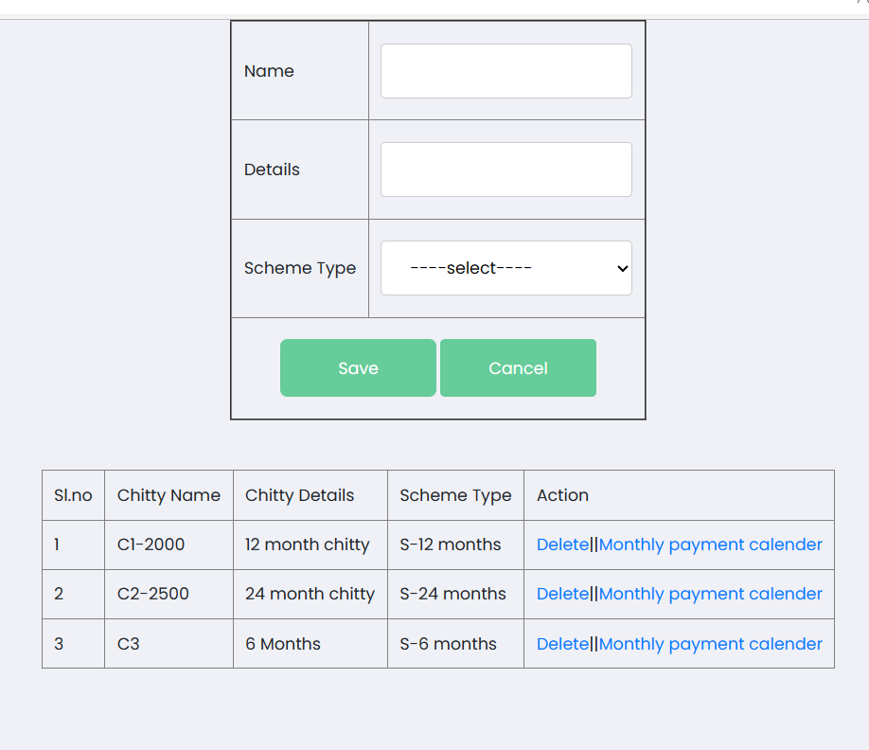
Chitty Details

Slide 66
REPORTS

Slide 67
Report of chitty based on scheme between two dates by treasurer.
Report of loan based on loan type between two dates by treasurer.
Report of scholarship based on scholarship type between two dates by treasurer.
Prepare a list of members and relatives by administrator.

Slide 68
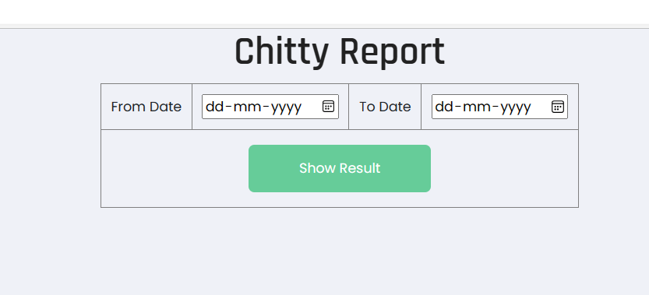


Slide 69
THANK YOU

