Slide 1
NSS KARAYOGAM MANAGEMENT SYSTEM
ABHIRAMI SATHEESH
M21002
S4B1

Slide 2
CONTENTS
Introduction
Abstract
Technology
Data Models
Planning
Scheduling

Slide 3
INTRODUCTION
The Nair Service Society (NSS) is an organization created for the social advancement and welfare of the Nair community that is found primarily in the state of Kerala in Southern part of India. It was established under the leadership of Mannathu Padmanabhan. The NSS is a three-tier organization with Karayogams at the base level, Taluk Unions at the intermediate level and a central headquarters operating from Perunna,Changanassery in Kerala.

Slide 4
ABSTRACT
The system is only for a particular karayogam. The karayogam is based on Taluk. In each karayogam there is a president, secretary, treasurer and members. In each karayogam has its own programs and financial details. Now the karayogam authorities store their financial details, members details, program scheduling details and other details as records.

Slide 5
That means it is handwritten. The aim of the project is reduced the time and work. That is the activities of NSS karayogam is convert into online system. The main advantage of online system is store the financial details, program scheduling, members details as online and it is safe. Also it reduce the time and handworks.

Slide 6
There are 4 uses in this system :
Admin
Members
Treasurer
Guest

Slide 7
ADMIN
The first user of NSS Karayogam management is Administrator. The admin is responsible for scheduling the program, add new members, add place and locations and add other scheme.

Slide 8
MEMBERS
In each members has their own user name and password to login the system. They can view their profile ,edit the profile, change password, view information and activities. Also add the other members in the house.

Slide 9
Treasurer
Finance is module in NSS Karayogam Management System. In this module , it manage all finance details and there is also a treasurer to manage the finance.

Slide 10
GUEST
In this module guest want to login to the system.

Slide 11
TECHNOLOGY
Front End : HTML, CSS, Java Script
Language : Python, version 3.11.3
Back End : Django, version 4.2.1
Technology : Python
Database : SQLite

Slide 12
DATA MODELS
Use Case Diagram
Sequence Diagram
Activity Diagram
Class Diagram

Slide 13
Use Case Diagram

Slide 14
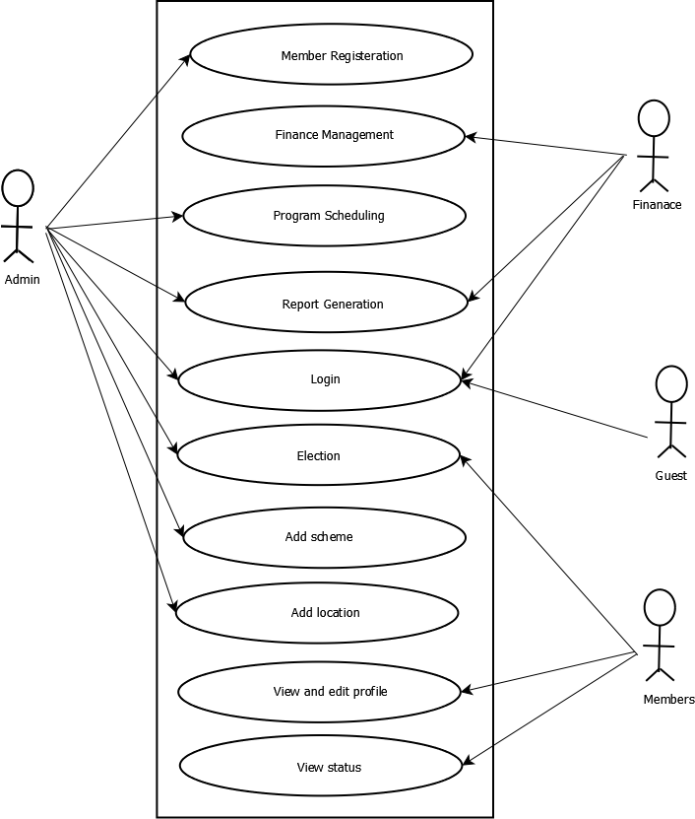

Slide 15
Sequence Diagram

Slide 16
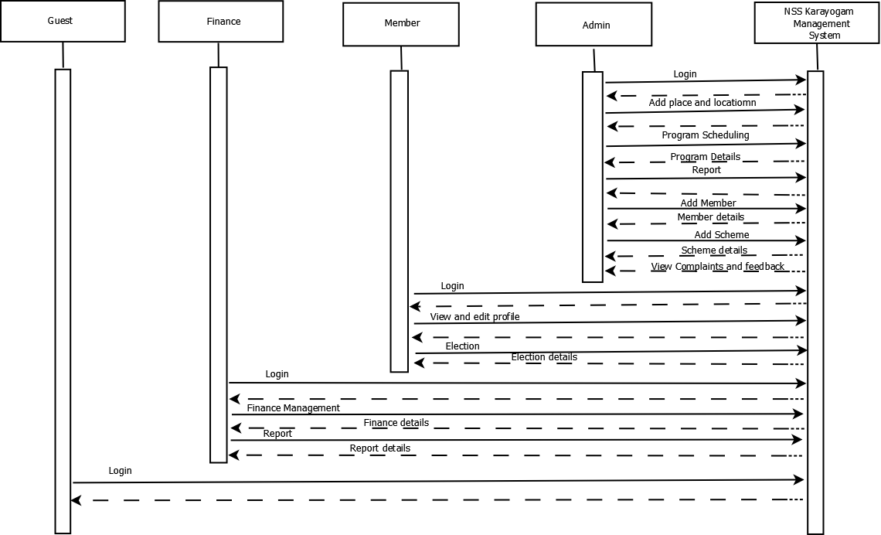

Slide 17
Activity Diagram

Slide 18
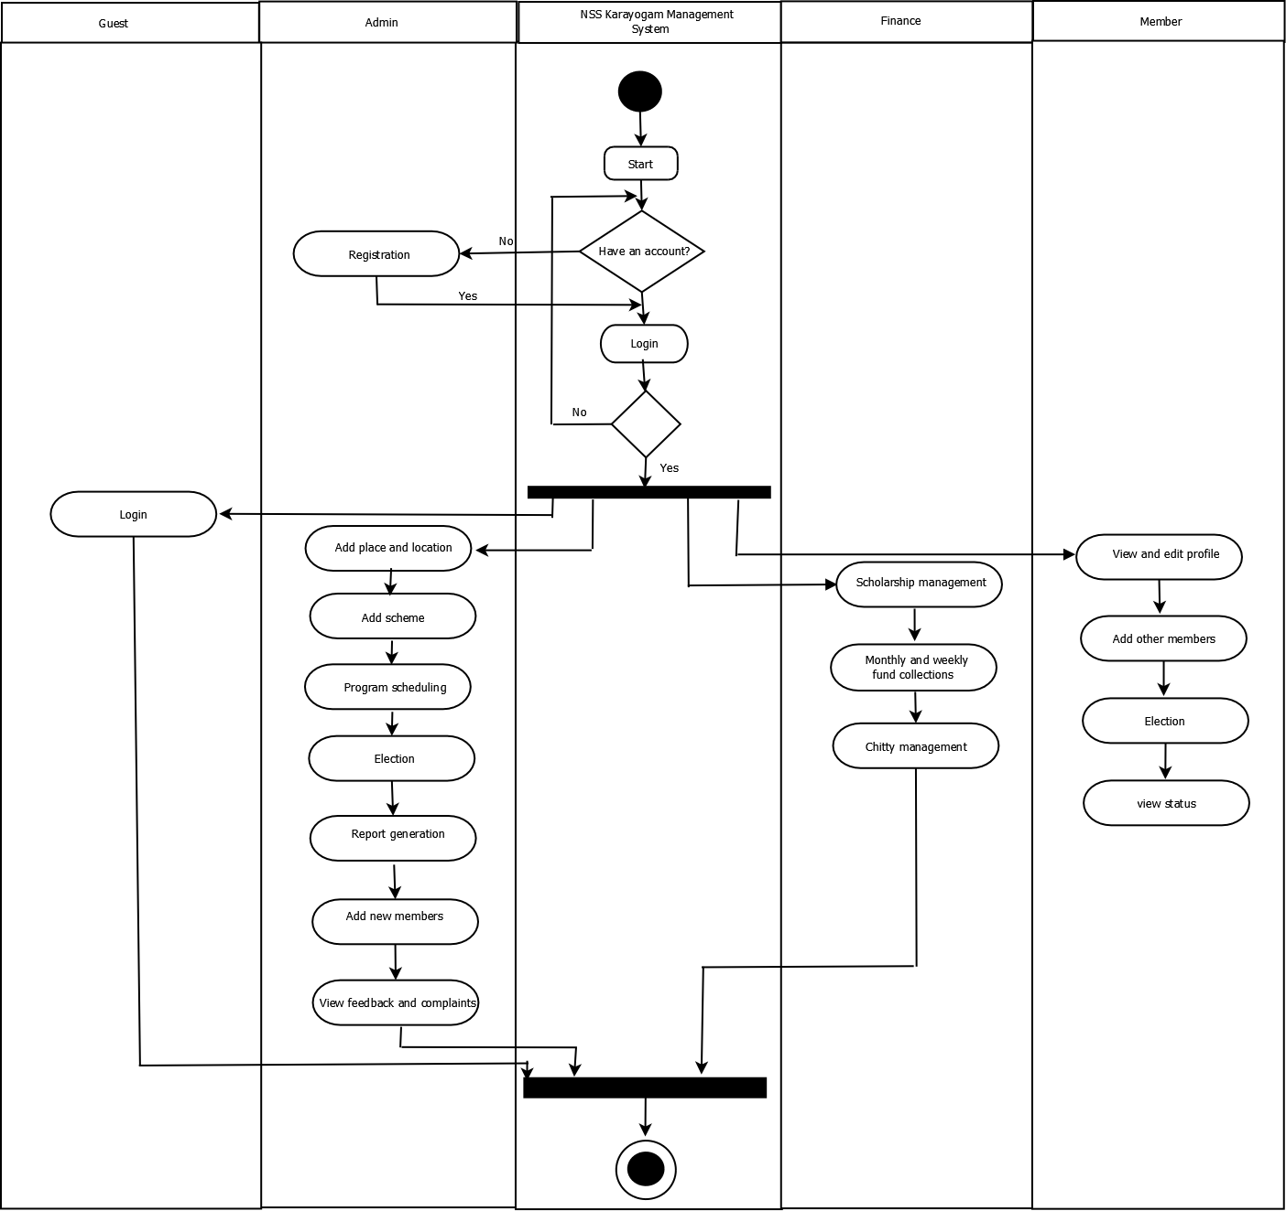

Slide 19
CLASS DIAGRAM

Slide 20
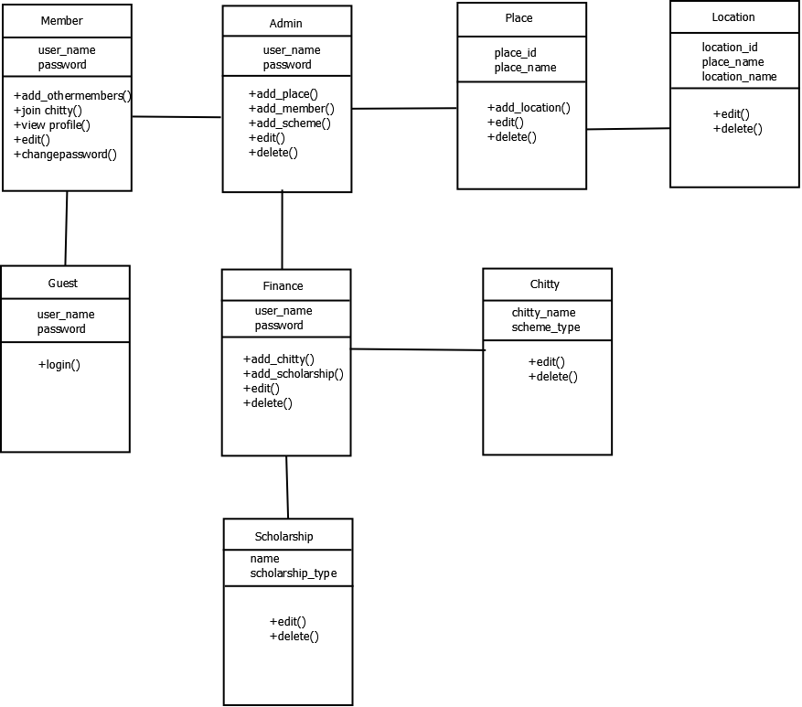

Slide 21
PLANNING
Topic : NSS Karayogam Management System
Exiting System :
The existing system of NSS Karayogam is manual.
Disadvantage
Time consuming
More work
More man power

Slide 22
Proposed System
All activities of NSS Karayogam Management System is converted into online. Activities such as meeting, program scheduling, add a new member, election, scheme adding, chitty, monthly and weekly fund collection and scholarship details.
Meeting Reports :
There are two types of meeting. Weekly meeting for women and monthly meeting for all members in the karayogam. The meeting reports contains, the present members in meeting, financial details and other decision made in the meeting. Other decisions such as program details, scholarship details, new agenda and chitty scheme.

Slide 23
Add a new member :
The admin is added the new member into the system. And the member who has the account, he/she is add the other members into the system.
Program Scheduling :
Schedule the annual program for karayogam members and its manage its financial details by financial head.

Slide 24
Monthly and weekly fund collection :
Collect the monthly and weekly funds and enter the details of the collected funds into the system by treasurer and make the report.
Scholarship :
Prepare a list of students for scholarship and keep the history also.
Scheme adding :
Admin is add new chitty scheme.

Slide 25
Chitty :
Treasurer or finance header in the finance module add new chitty and its details into the system.
Election :
Election is done by vote all members in karayogam who has age greater than 18.

Slide 26
SCHEDULING
Task | Start date | Duration | End date
System study | 10-02-2023 | 30 | 10-03-2023
Initial report | 10-03-2023 | 3 | 13-03-2023
Diagram | 24-04-2023 | 6 | 30-03-2023

Slide 27
Thank You

