Slide 1
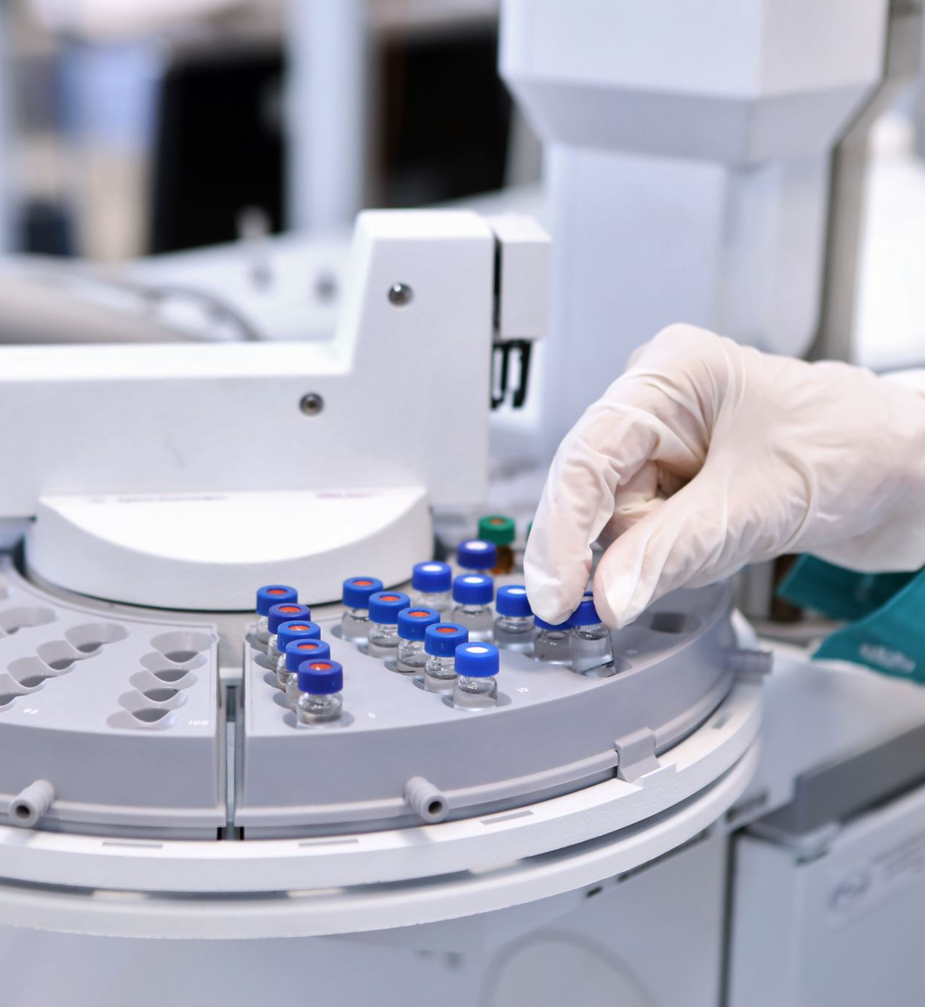
IMPACT OF COVID-19 ON EDUCATION

Slide 2
Introduction
Due to Covid-19, many changes came to our world.The Covid-19 impact was everywhere, which resulted in the closure of Schools and other educational institutions.
Initially, most governments have decided to temporarily close the schools to reduce the impact of Covid-19.
Though schools are closed, students are attending their classes through various education initiatives like online classrooms, radio programs, it is a good thing happening.

Slide 3
Advantages of online class
1. Efficiency
Online learning offers teachers an efficient way to deliver lessons to students.
2.Accessibility Of Time And Place
This allows students to access the learning material at a time of their comfort.
3. Affordability
Another advantage of online learning is reduced financial costs.
4. Improved Student Attendance
Since online classes can be taken from home or location of choice, there are fewer chances of students missing out on lessons.
5. Suits A Variety Of Learning Styles
It is the best way to create a perfect learning environment suited to the needs of each student.

Slide 4
Disadvantage of Online learning
1.Inability To Focus On Screens
With online learning, there is also a greater chance for students to be easily distracted by social media or other sites.
2.Technology Issues
Without a consistent internet connection for students or teachers, there can be a lack of continuity in learning for the child.
3. Sense Of Isolation
Students can learn a lot from being in the company of their peers.
4. Teacher Training
Training teachers with the latest technology updates so that they can conduct their online classes seamlessly.
5. Manage Screen Time
A good solution to this would be to give the students plenty of breaks from the screen to refresh their mind and their body.

Slide 5
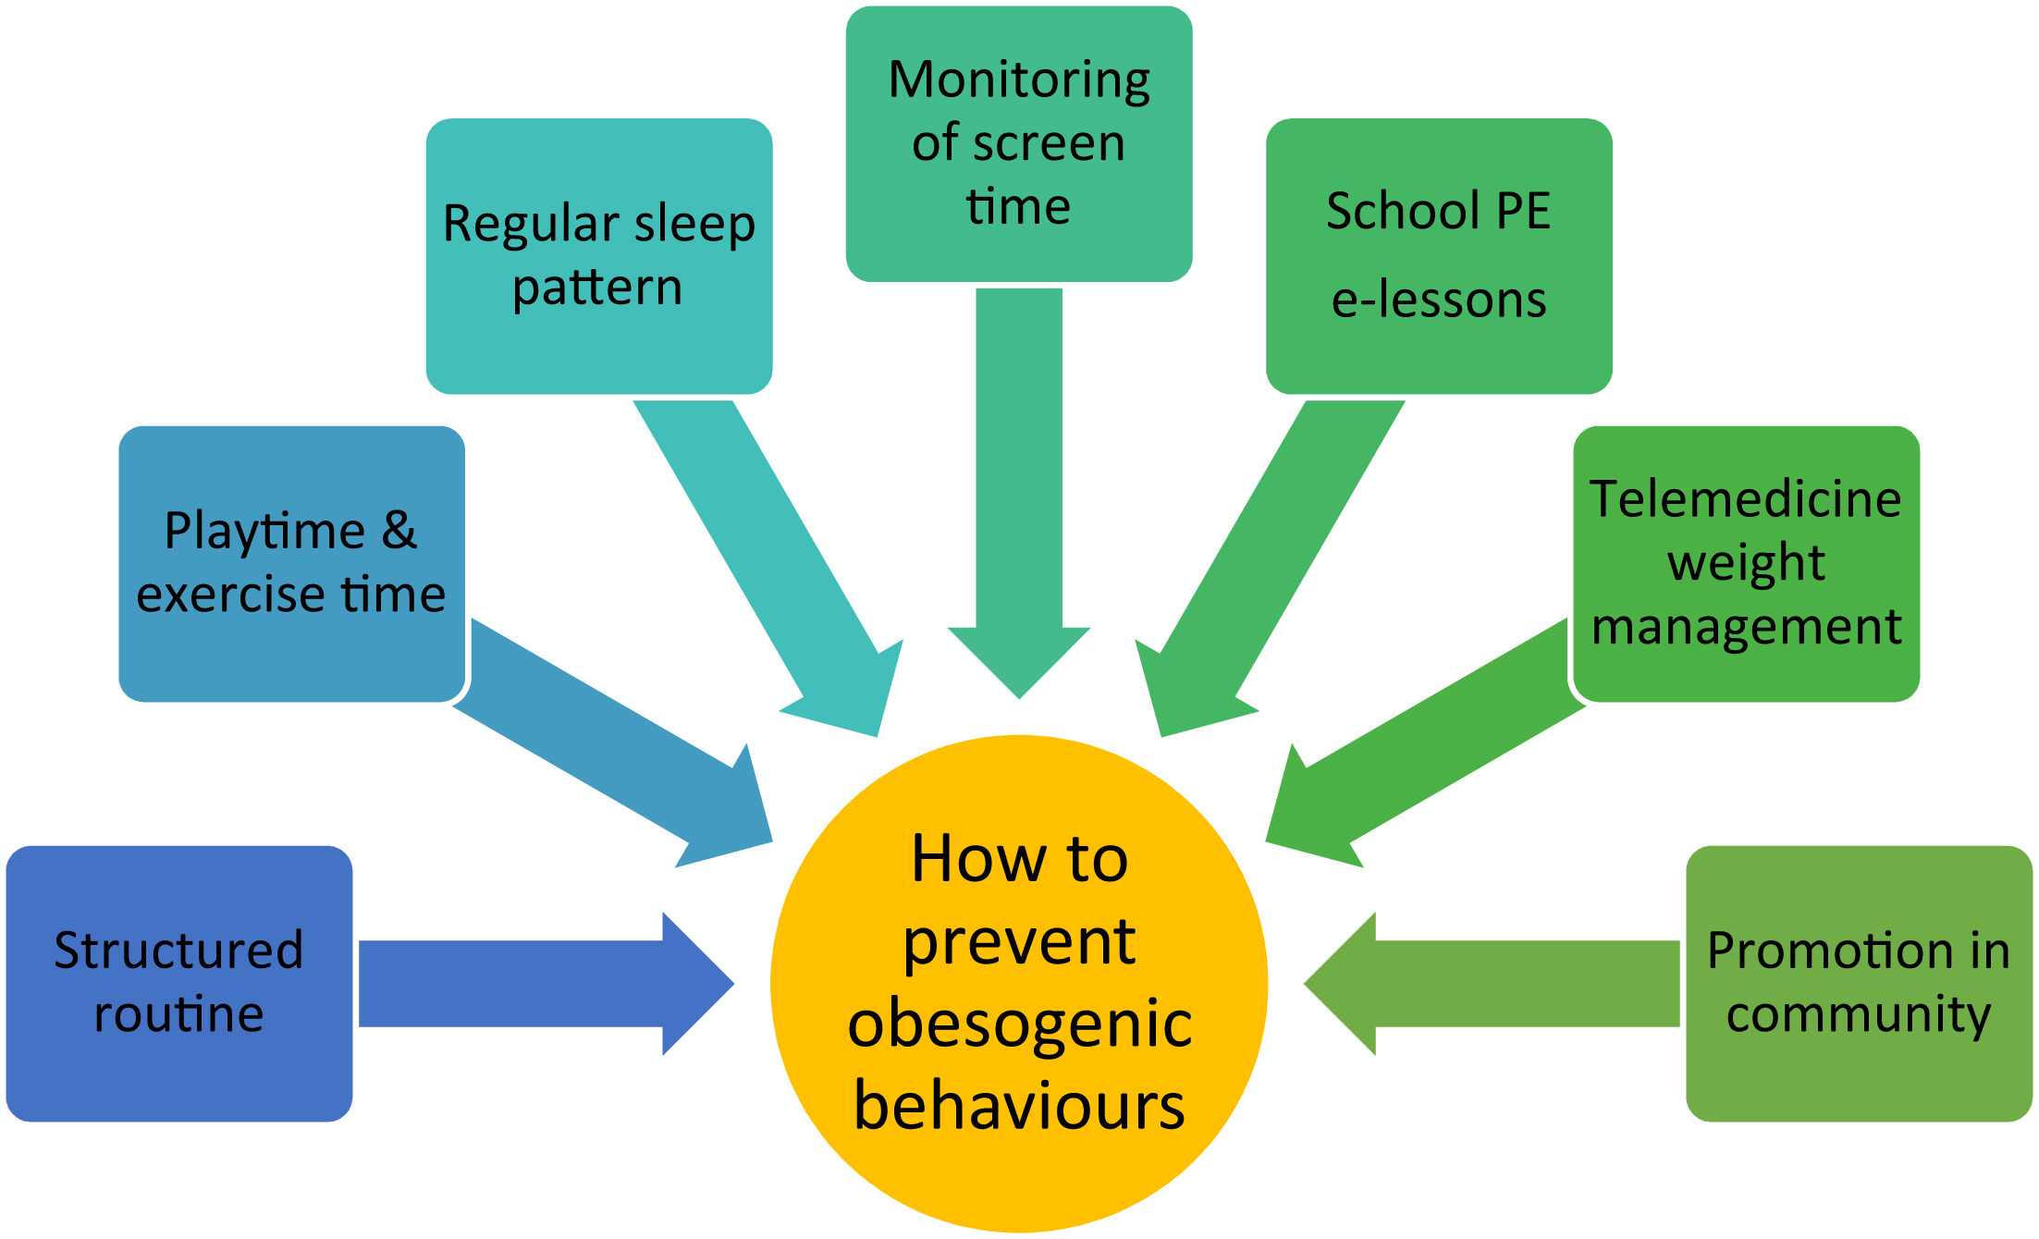

Slide 6
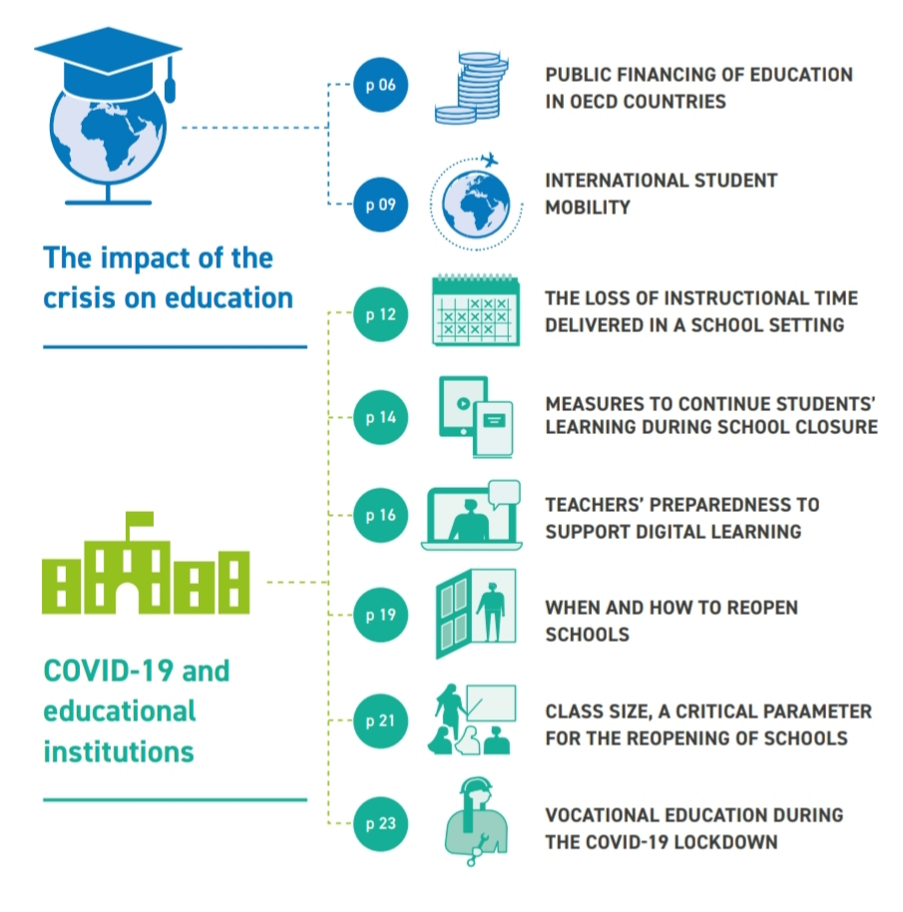
ANALYSIS

Slide 7
Conclusion
In this sense, the pandemic is also a call to renew the commitment to the Sustainable Development Goals.
Ensuring that all young people have the opportunity to succeed at
school and develop the knowledge, skills, attitudes and values
that will allow them to contribute to society.
The current crisis has tested our ability to deal with
large-scale disruptions. It is now up to us to build as its legacy
a more resilient society.

Slide 8
Thank you

