Slide 1
Create a dynamic dashboard with Power BI to track project progress
Sarath

Slide 2
Project context
Needs of the company Sanitoral
Power BI dashboard: track project progress, identify delays and monitor performance to guide your actions.
3 performance indicators: cost, duration and deliverables, with an alert if the gap between planned and actual exceeds 15%
Filter by: project type (IT or Marketing), project phase, project ID, region, country
Different levels of responsibility requiring a tailored view for each type of director: GM, RD and CD
Ability to ask questions
Autonomy to import new data in order to update the dashboard

Slide 3
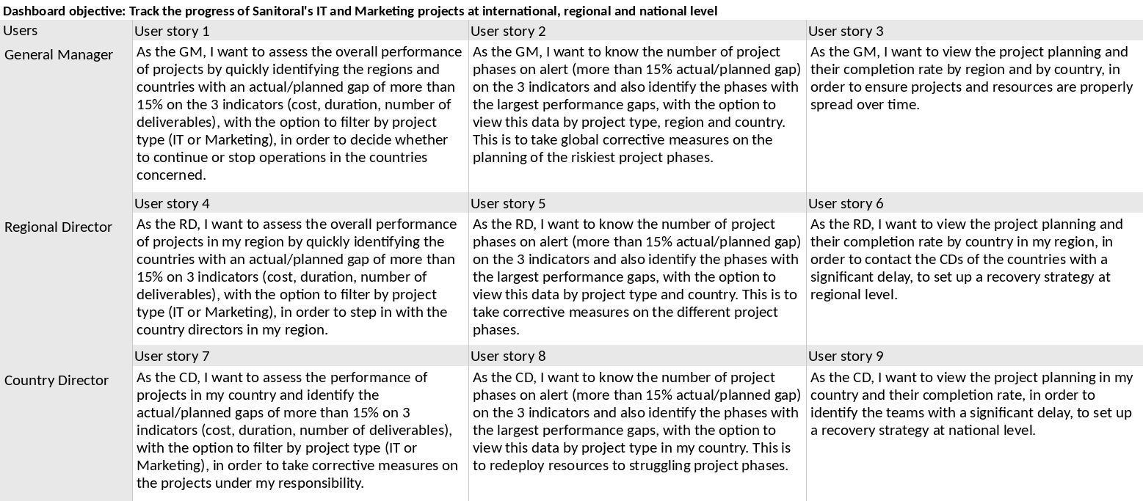
Product Strategy Canvas
Presentation of the canvas strategy for each user role

Slide 4
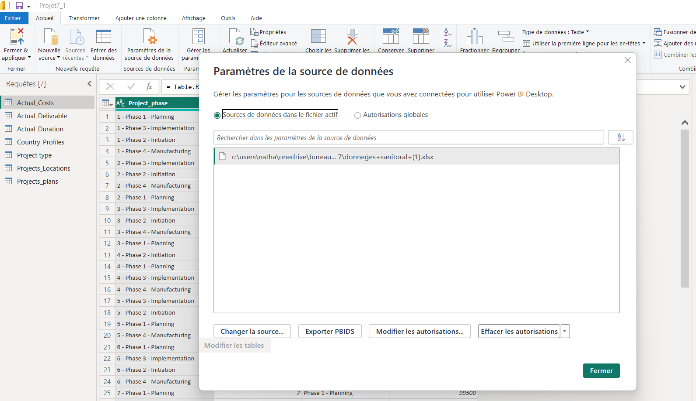
Data preparation and cleaning with Power Query Editor
I - Data import
Transform data opens Power Query Editor
Data source settings / change source

Slide 5
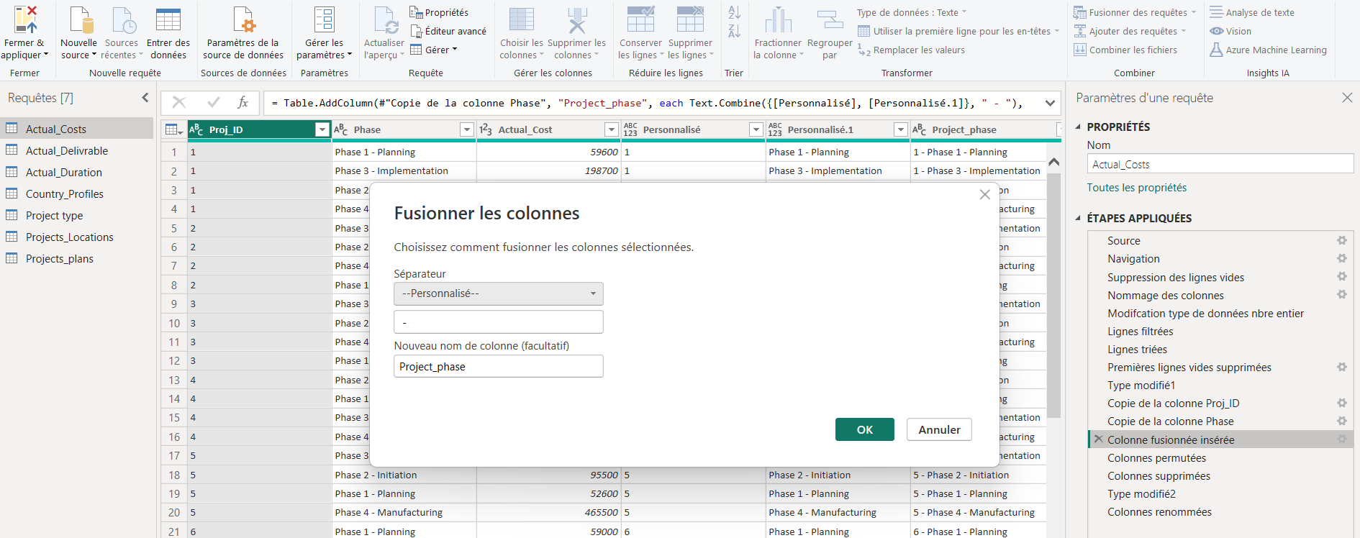
Data preparation and cleaning with Power Query Editor
II – Data processing
Using the M language to process the data:
data type formatting (text, whole number, $, %)
Adding / merging columns…

Slide 6
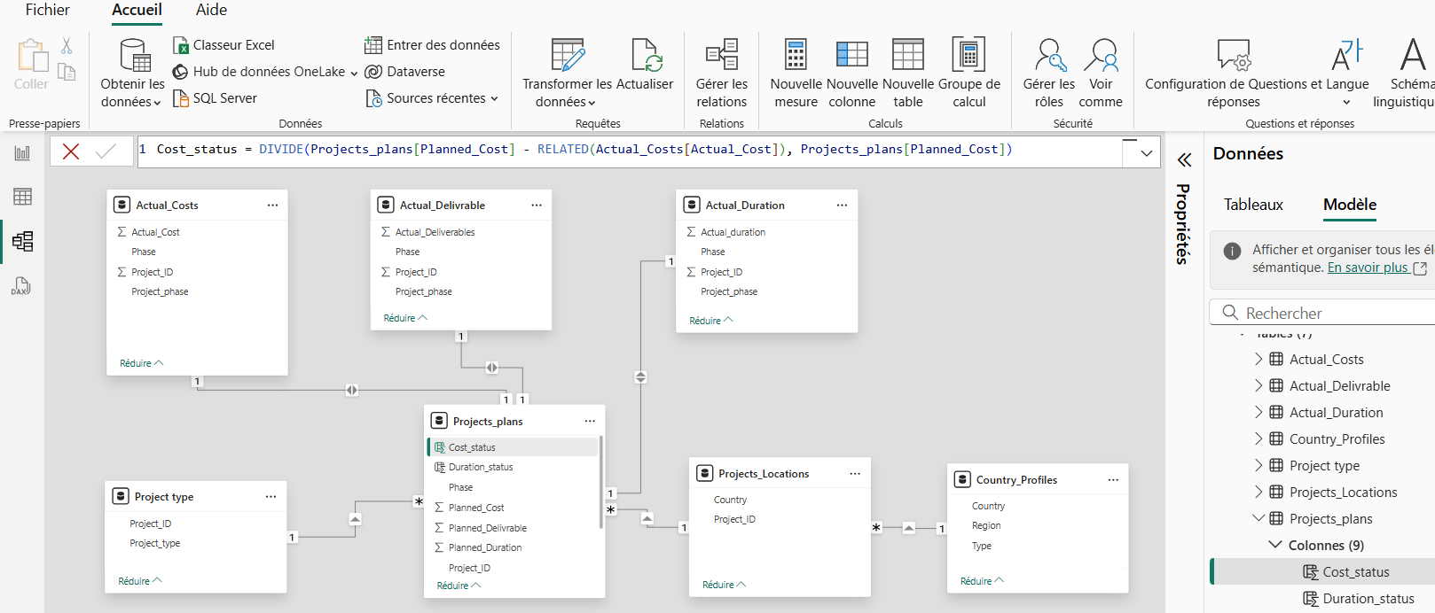
Data model
Using the DAX language
(Data Analysis Expressions)
With Power BI, you can create relationships between your data tables to run queries automatically, from the Manage relationships icon.

Slide 7
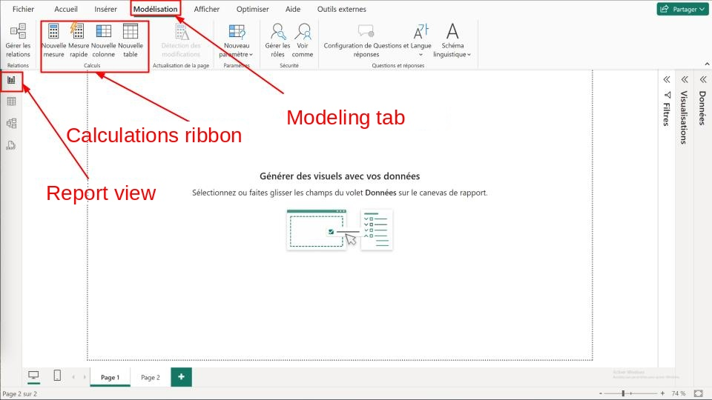
Data model
Using the DAX language
(Data Analysis Expressions)

