Slide 1
XGBoost for Regression

Slide 2
What is XGBoost?
Stands for eXtreme Gradient Boosting
Efficient, scalable gradient boosting implementation
Widely used in ML competitions and industry
Enhance gradient boosting with optimizations for efficiency and accuracy.

Slide 3
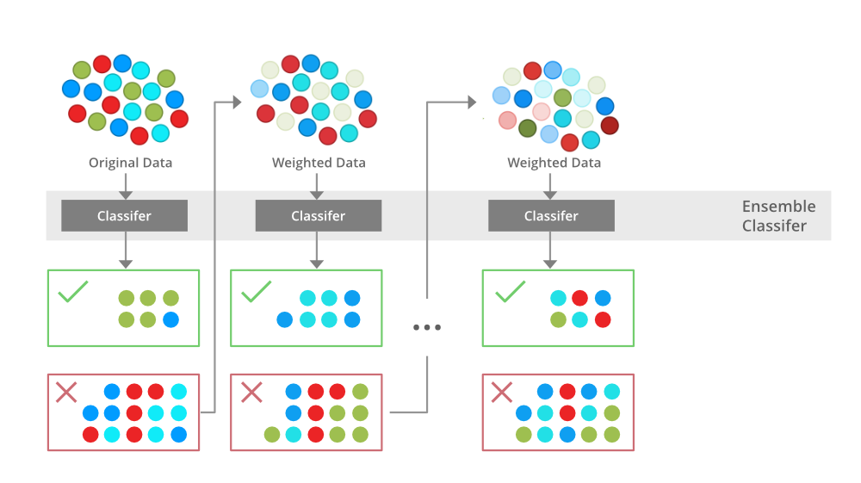

Slide 4
Hyperparameters
- n_estimators: boosting rounds
- max_depth: tree depth
- learning_rate: shrinkage
- subsample, colsample_bytree
- reg_alpha, reg_lambda

Slide 5
Python Example
from xgboost import XGBRegressor
model = XGBRegressor(n_estimators=100, max_depth=3,
learning_rate=0.1, objective='reg:squarederror')
model.fit(X_train, y_train)
preds = model.predict(X_test)

Slide 6
Applications
- House price prediction
- Sales forecasting
- Financial modeling
- Structured regression tasks

