Slide 1
GOODREADS BOOKS RATING PREDICTION
DEEP LEARNING
DIGITAL ASSIGNMENT- 2

Slide 2
TEAM MEMBERS
GITHUB LINK
SAI TEJA BANDARU (20BRS1129)
SARATH ADHITHYA S (20BRS1194)
https://github.com/SarathAdhi/DA2-DL-GoodReads-Rating-Prediction

Slide 3
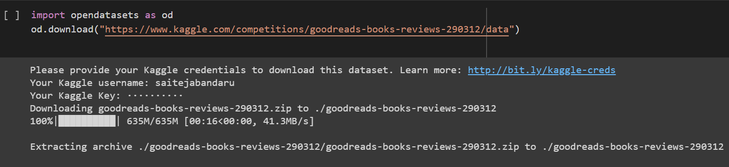
DATA COLLECTION
The opendatasets Python library is used to download the "Goodreads-books-reviews" competition dataset on Kaggle.
The od.download() function initiates the download of the dataset and saves it to the current working directory. By default, it extracts the contents of the downloaded zip file automatically.

Slide 4
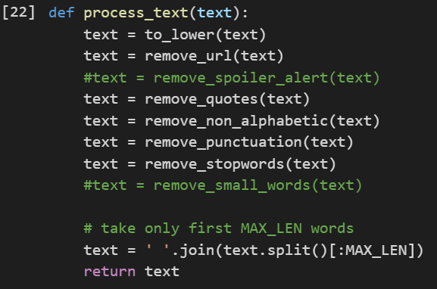
DATA PREPROCESSING
The text preprocessing procedures include:
to lower(): Every text will be converted to lowercase.
remove_url(): All URLs that were present in the text were deleted.
remove quotes(): Eliminates any quotes from the content.
non_alphabetic(): Eliminate any non-alphabetic characters from the text.
remove_punctuation(): Removes all punctuation from the text.
remove_stopwords(): Removes any stopwords that were present in the text.

Slide 5
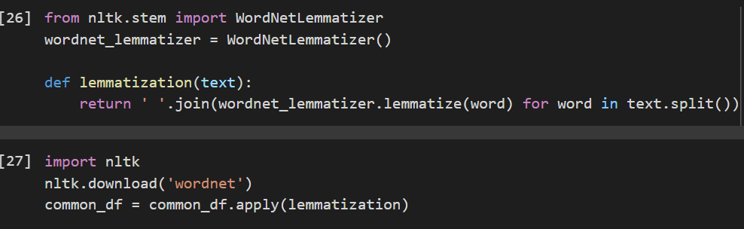
DATA PREPROCESSING
Lemmatization: Reducing a word to its simplest or dictionary form is a process called lemmatization.The WordNetLemmatizer is used by the lemmatization function to apply the lemmatization function to each word after splitting the input text into its component words.

Slide 6
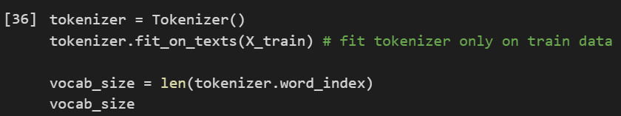
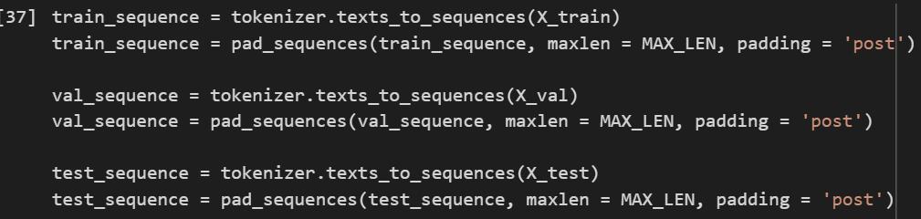
DATA PREPROCESSING
Tokenization: The Keras Tokenizer class is a strong text preparation tool that turns word sequences (text) into numerical sequences that may be used to train neural networks. It helps in drawing out relevant information from unstructured text data.

Slide 7
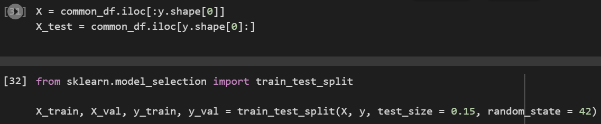
SPLITTING DATASET
The data is split into training and validation sets using the train test split function from the sklearn.model selection package.
We may use the validation set to fine-tune the machine learning model's hyperparameters and assess how well it performs on new data by dividing the data into training and validation sets.

Slide 8
COMPARISION OF MODELS
LSTM : Long Short-Term Memory, often known as LSTM, is a form of recurrent neural network (RNN) architecture created to solve the vanishing gradient issue that affects conventional RNNs. An LSTM network's basic component is a memory cell with long-term information storage capabilities. LSTMs are especially helpful for processing sequential data, such as text and speech, where the context and dependencies between the sequence's components are crucial for deciphering the meaning of the input.
SIMPLE RNN: A simple RNN is a kind of neural network made to handle sequential data by retaining a hidden state that records details of the sequences that have already been processed. The current input element and the previous hidden state are fed into the network as inputs at each time step, and it outputs a new hidden state along with an output. They can be used for text classification and sentiment analysis tasks and are useful for processing short sequences.
BIDIRECTIONAL LSTM: The bidirectional LSTM employs two independent LSTMs, one of which processes the input sequence in a forward manner and the other in a backward way. The output from each time step is then concatenated to include the dependencies in both directions. The bidirectional LSTM captures long-term dependencies in the data more effectively than a simple LSTM by processing the input sequence in both directions.

Slide 9
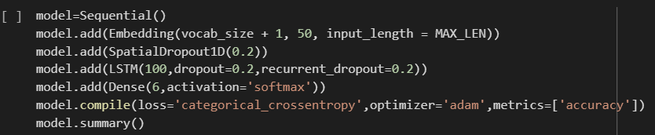
LSTM
The first layer of the model is an Embedding layer that takes as input the vocab_size and input_length of the sequence as parameters. Each word in the input sequence is given an embedding representation by the layer.
The SpatialDropout1D layer adds regularisation by randomly removing all of the 1D feature maps from the input during training with a probability of 0.2.
The LSTM layer, a recurrent layer with 100 units, applies the LSTM operation to the series of embeddings discovered by the preceding layer.
The softmax activation function is used in the sixth and final dense layer, which has six units (one for each class), to create a probability distribution over the classes.

Slide 10
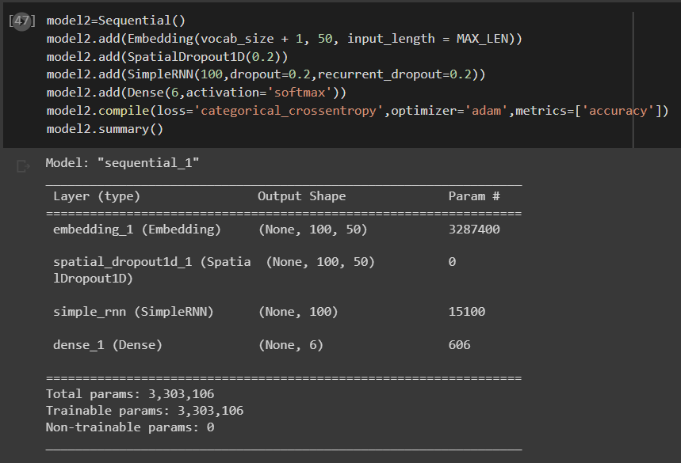
SIMPLE RNN

Slide 11
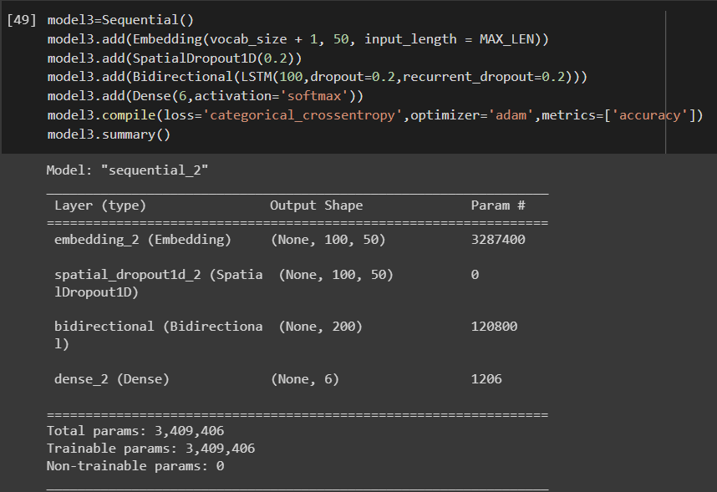
BIDIRECTIONAL LSTM

Slide 12
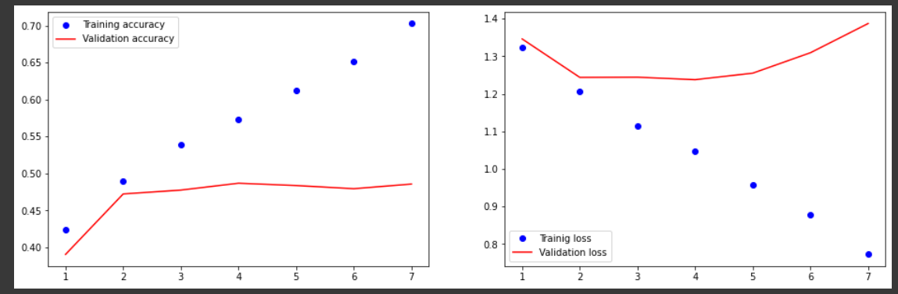
RESULTS(LSTM)
In LSTM the training accuracy has increased linearly with the number of epochs. The validation accuracy had increased upto 0.5 and remained stable after 2 epochs. The training loss is gradually decreasing with increasing epochs but the validation loss which was initially decreasing began to rise after 5 epochs.

Slide 13
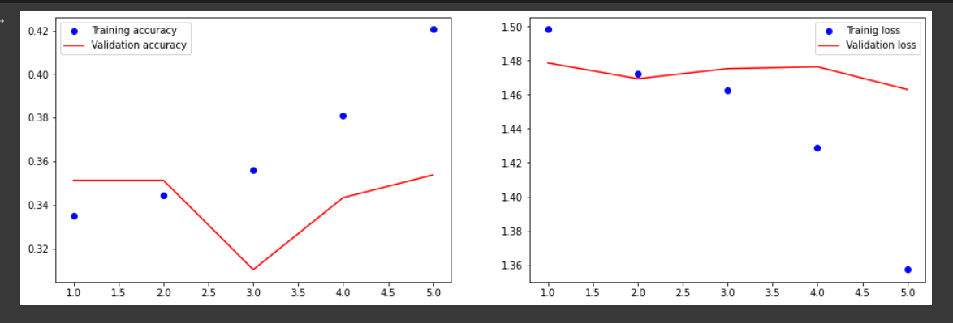
RESULTS(SIMPLE RNN)
In Simple RNN, the accuracy was much lesser when compared to LSTM, but with increasing epochs, even the training accuracy started to increase while the validation accuracy is fluctuating. The training loss also significantly reduced with the increasing epochs but the validation loss remained stable at 1.48.

Slide 14
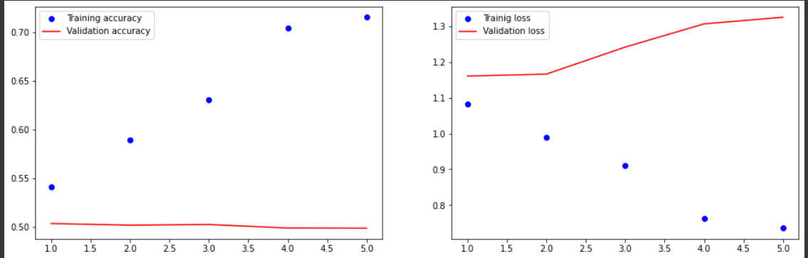
RESULTS(BIDIRECTIONAL RNN)
In Bidirectional RNN, the training accuracy peaked at 0.7 at the end of the 5th epoch while the validation accuracy remained constant at 0.5. Even the training loss was lesser when compared to LSTM and the validation loss increased after 2 epochs upto 1.3. It can be concluded that Bidirectional RNN has the best performance in terms of accuracy and loss when compared with the previous two models.

Slide 15
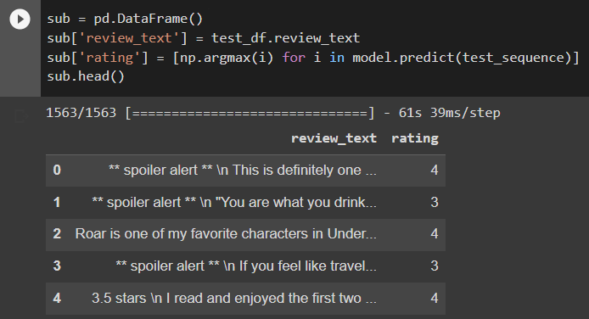
PREDICTIONS
The predicted ratings are acquired by calling the model object's predict method on the test sequence input data. The rating column holds the estimated ratings for each review, while the review text column has the review text from the test df dataFrame.

Slide 16

LEADERBOARD

Slide 17
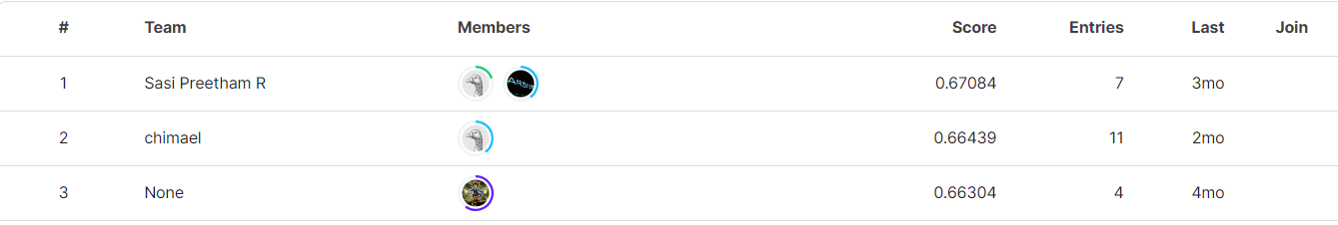
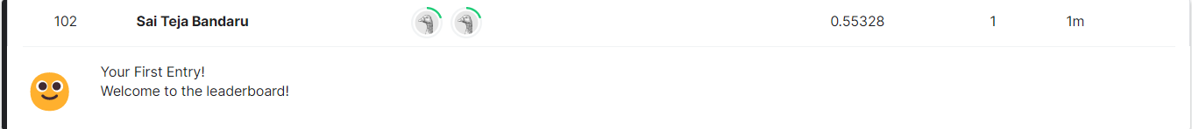
LEADERBOARD

Slide 18
THANK YOU

