Slide 1
Core Fundamentals of MongoDB
By
Sarath Baiju

Slide 2
Agenda
What is MongoDb?
Core Fundamentals of MongoDb
What Is Meant By NoSQL?

Slide 3
What Is Meant By NoSQL?
A NoSQL originally referring to non SQL or non relational is a database that provides a mechanism for storage and retrieval of data.
This data is modeled in means other than the tabular relations used in relational databases.
The data structures used by NoSQL databases are different from those used by default in relational databases which makes some operations faster in NoSQL

Slide 4
What is MongoDb?
MongoDB is a cross-platform
document oriented database.
MongoDB works on concept of collection and document.
It provides high performance, high availability, and easy scalability

Slide 5
Core Fundamentals of MongoDb
Database
Collection
Document
Database:
Database is a physical container for collections. Each database gets its own set of files on the file system. A single MongoDB server typically has multiple databases.
Collection
Collection is a group of MongoDB documents. It is the equivalent of an RDBMS table. A collection exists within a single database. Collections do not enforce a schema. Documents within a collection can have different fields. Typically, all documents in a collection are of similar or related purpose.
Document
A document is a set of key-value pairs. Documents have dynamic schema. Dynamic schema means that documents in the same collection do not need to have the same set of fields or structure, and common fields in a collection's documents may hold different types of data.

Slide 6
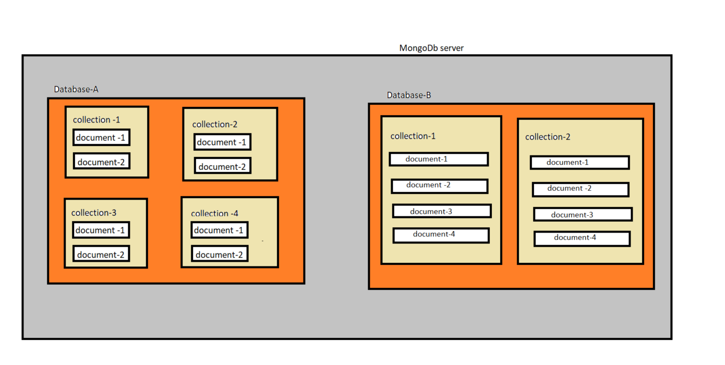

Slide 7
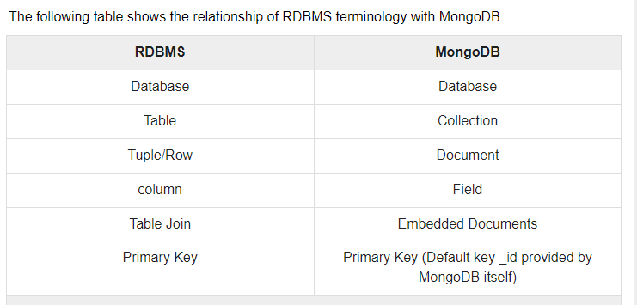
Relationship of RDBMS terminology with MongoDB.

Slide 8
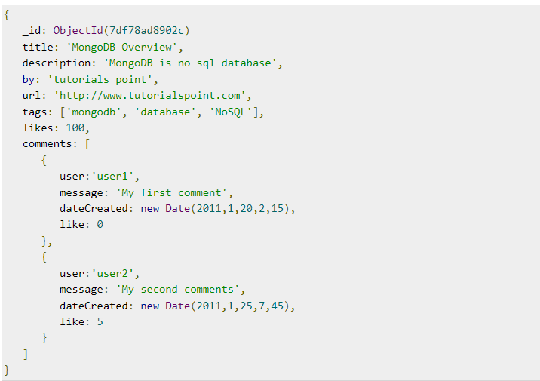
Sample Document

Slide 9
References
https://www.tutorialspoint.com/mongodb/index.htm
https://docs.mongodb.com/manual/introduction/

