Slide 1
CORE JAVA 8- day 1
Saratha Natarajan

Slide 2
AGENDA
Today’s Topic –
Introduction,
Difference between C# & Java and
IntelliJ Community Edition
Java Type System and Control Structures

Slide 3
Java Pre Assessment – Programming

Slide 4
INTRODUCTION
JAVA was originated at Sun Microsystems Inc., in 1991.
It was conceived by James Gosling and Patrick Naughton.
Simple programming language to write, compile and debug a program easily.
Helps to create modular programs and reusable code.

Slide 5
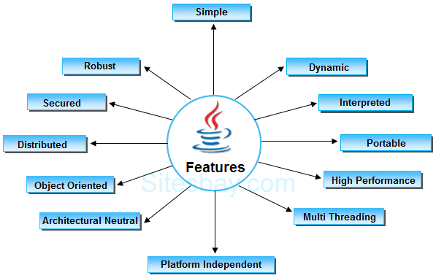
FEATURES

Slide 6
Powerful Features
Java has the following features
Object Oriented
Simplicity
Robustness
Platform Independence (Portable)
Security
Distributed Applications
Multithreading

Slide 7
Java is a Simple Language
Does not have complex features as other programming languages like
Operator overloading,
Multiple inheritance through classes, pointers and
Explicit memory allocation.

Slide 8
Java is Secure
Provides a virtual firewall between the application and the computer.
Java codes are confined within Java Runtime Environment (JRE).

Slide 9
Java is Distributed
Java is designed for the distributed environment of the internet.
Objects on one JVM can execute procedures on a remote JVM.

Slide 10
Multithreading
Enables a program to perform several tasks simultaneously.

Slide 11
Java is Platform Independent
An application developed on Java can run in any machine.
When Java is compiled, it is not compiled into platform specific machine or platform independent byte code.
The byte code is distributed over the web and interpreted by Java Virtual Machine (JVM) on whichever platform it is run.

Slide 12
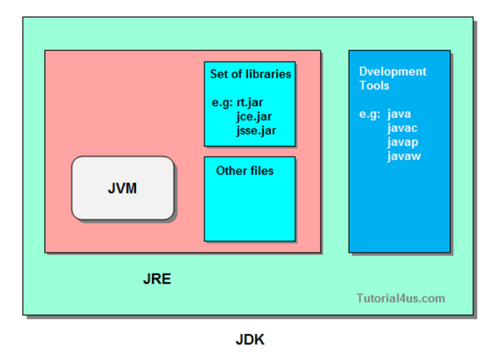

Slide 13
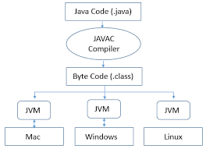
Java execution

Slide 14
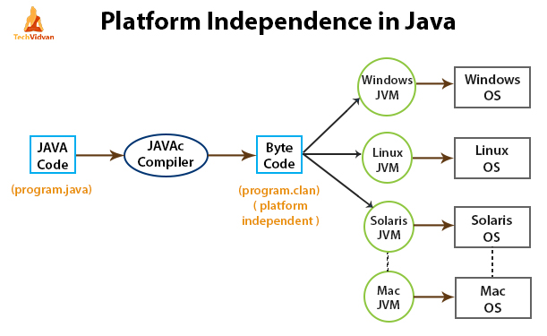

Slide 15
Installing and Using Java
First install Java JDK version 8
This can be downloaded from the official website of Java

Slide 16
Compilation and Execution of Java Program
To create a java code an editor such as notepad, text pad or an IDE like eclipse can be used.
Sample Java Program:
public class WelcomeApp {
public static void main(String[] args){
System.out.println(“Welcome to Java”);
}//End of main
}//End of WelcomeApp Class
Output : Welcome to Java

Slide 17
SAMPLE PROGRAM EXPLAINED
In the above program the class WelcomeApp has public access and hence declared public.
‘class’ is the keyword used to create a class.
For running stand alone programs ‘main’ method is needed which has a signature similar to the one defined in the above program.
‘Main’ method takes an array of strings as an argument. The name of the array can be anything.
To display the output, pass the string as an argument to the method system.out.println

Slide 18
JAVA VS C#
Differences between JAVA and C#

Slide 19
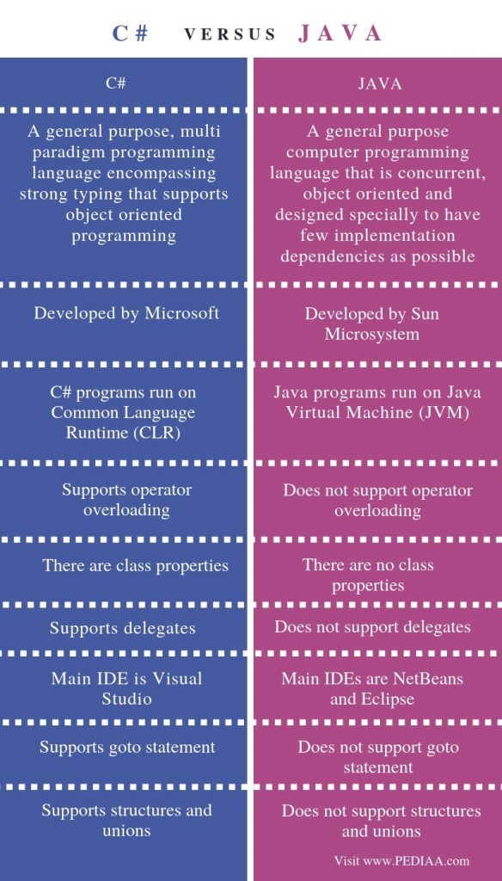

Slide 20
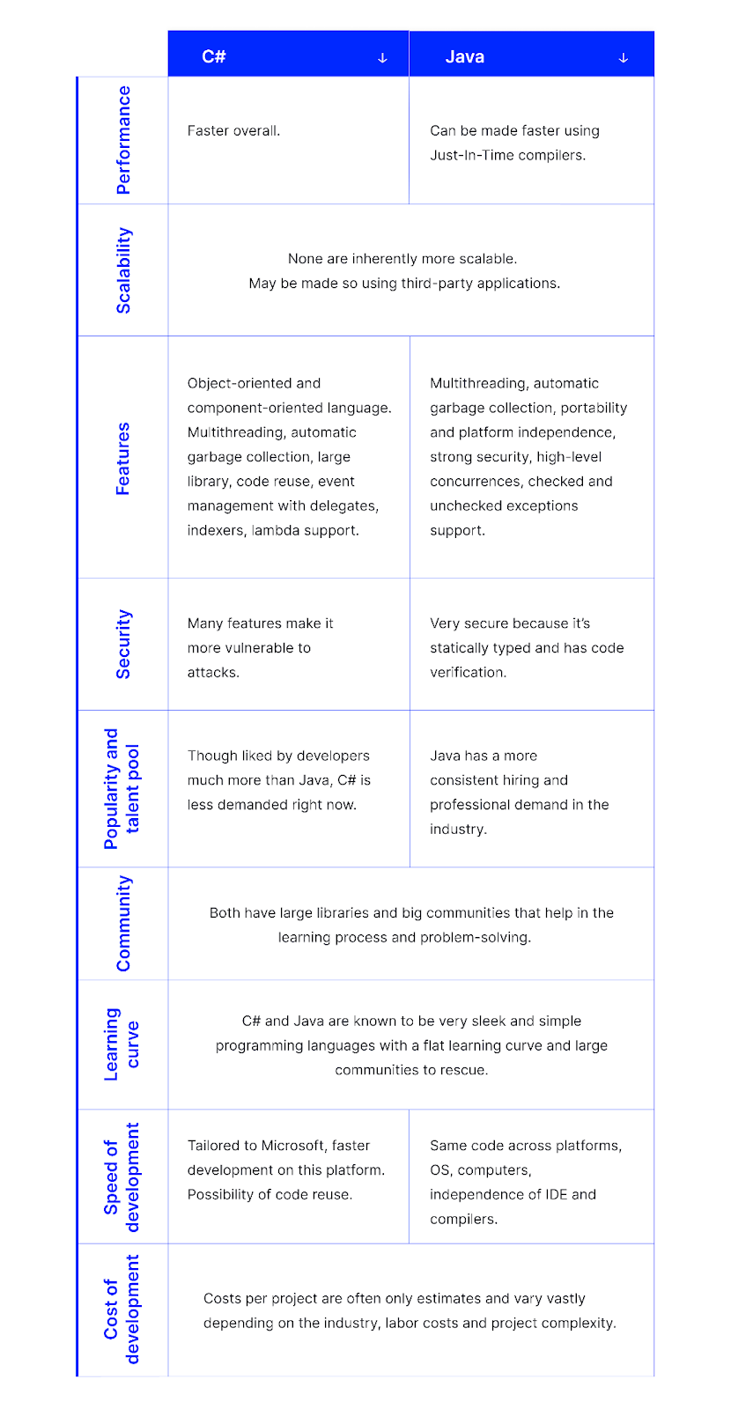

Slide 21
Where to Use C# and Java?
C# is used for
Web application development
Windows application
Games and apps
Java is used for
Web projects, Big Data, GUI Applications
Server-side programming language for backend development
Embedded systems, Android applications, and web applications

Slide 22
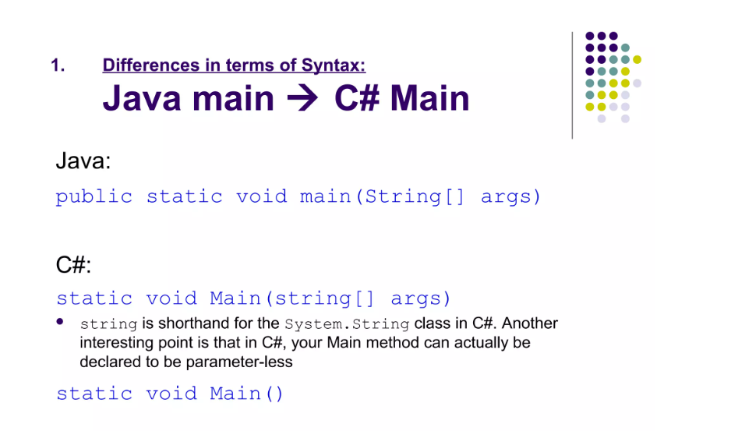

Slide 23
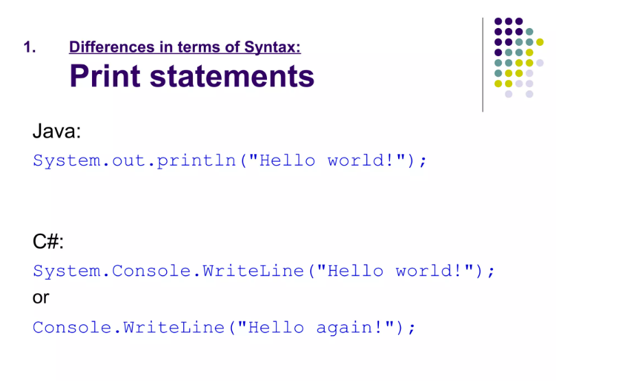

Slide 24
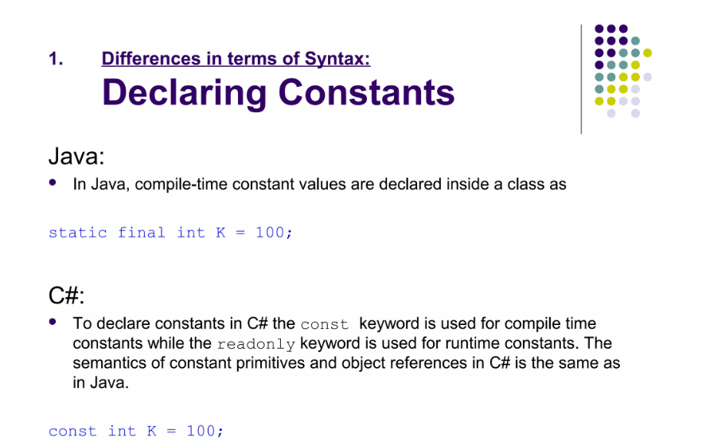

Slide 25
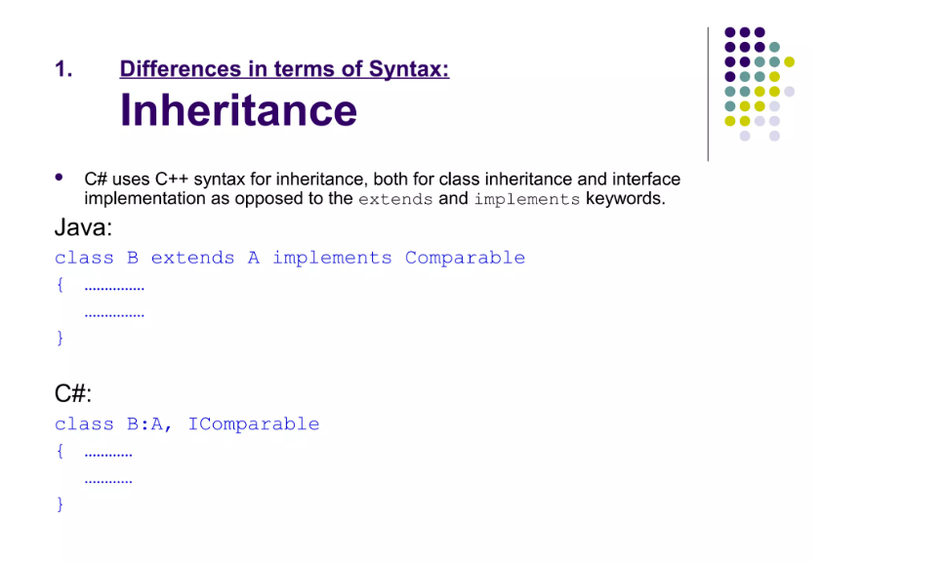

Slide 26
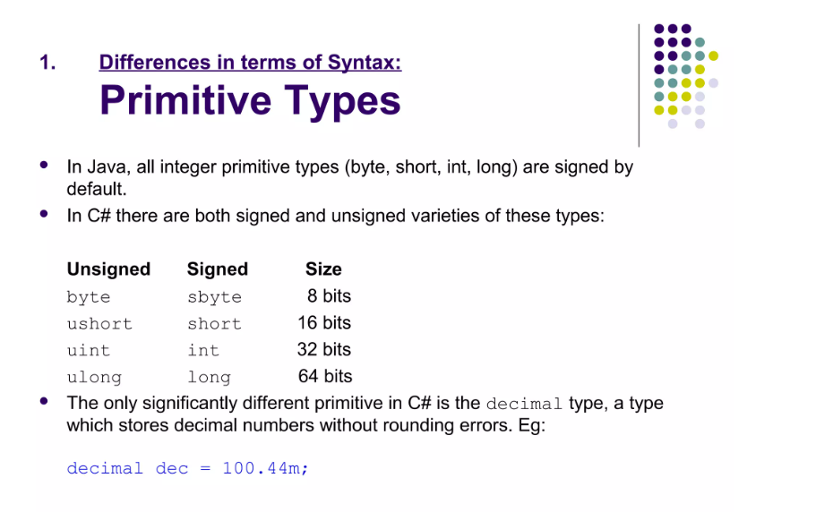

Slide 27
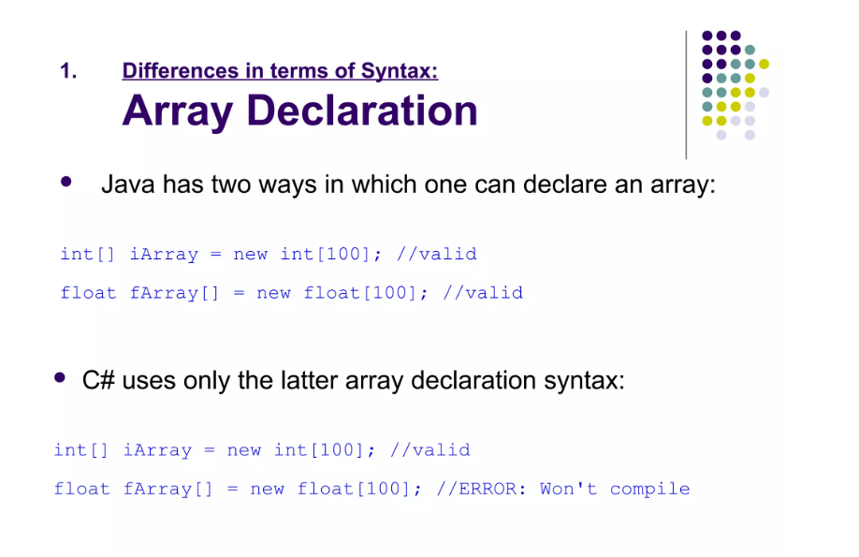

Slide 28
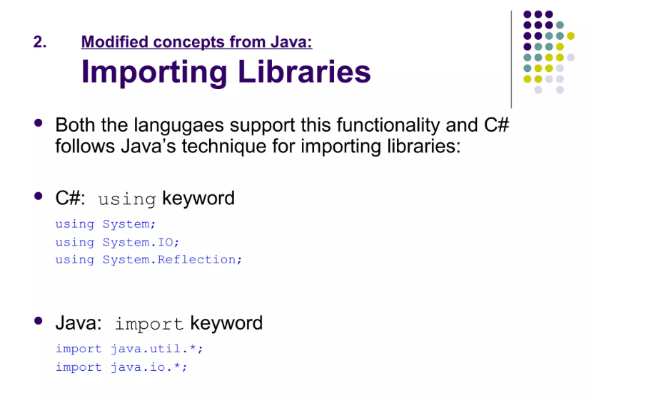

Slide 29
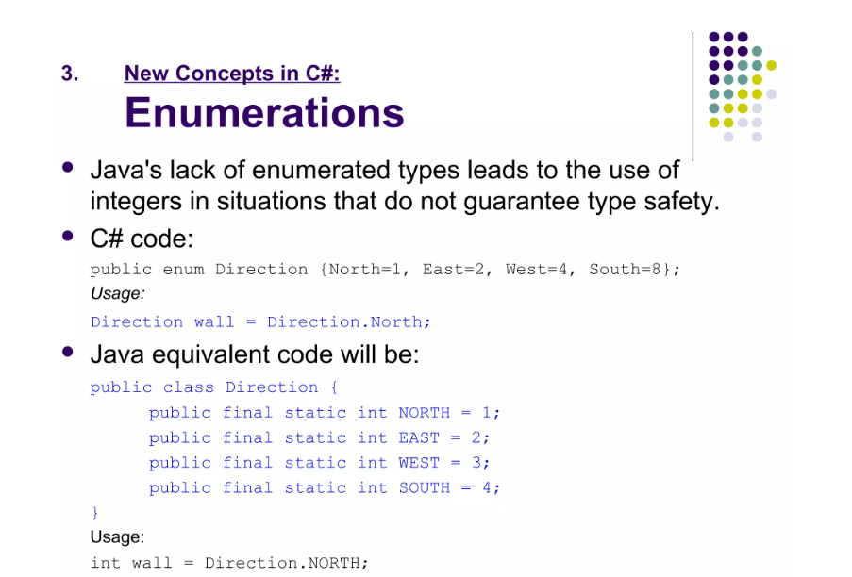

Slide 31
TODAY’S TOPIC - Declarations and Access Control
Declarations
Creating a variable is also referred to as declaring a variable
You must specify its type and name.

Slide 32
Identifiers & JavaBeans
Legal Identifier
Legal Java identifier should begin with a letter, a connecting character such as the underscore (_) or a currency character ($). An identifier shouldn't begin with a number!
After the first character, an identifier can have any combination of letters, number, currency characters or connecting characters.
An identifier can contain any number of characters.
The Java keywords cannot be used as identifiers.
Identifiers are case-sensitive in Java.

Slide 33
Identifiers(Examples)
Valid Identifiers
MyVariable
MYVARIABLE
myvariable
X
i
X1
i1
_myvariable
$myvariable
sum_of_array
abc123
Invalid Identifiers
My Variable // contains a space
123geeks // Begins with a digit
a+c // plus sign is not an alphanumeric character
variable-2 // hyphen is not an alphanumeric character
sum_&_difference // ampersand is not an alphanumeric character

Slide 34
JavaBeans
Beans are Java classes that contain properties
are classes that encapsulates many objects into a single object (the bean)
Other terms we say as “Re-usable components”
contains several elements like Constructors, Getter/Setter Methods and much more

Slide 35
Javabeans(...)
JavaBeans has several conventions that should be followed:
All the properties in java bean must be private with public getter & setter methods
Beans should have a default constructor (no arguments)
Beans should provide getter and setter methods
A getter method is used to read the value of a readable property
To update the value, a setter method should be called
Beans should implement java.io.serializable, as it allows to save, store and restore the state of a JavaBean you are working on.

Slide 36
Javabeans(...)
Syntax for getter methods:
It should be public in nature.
The return-type should not be void i.e. according to our requirement we have to give return-type.
The getter method should be prefixed with get.
It should not take any argument.
Syntax for setter methods:
It should be public in nature.
The return-type should be void.
The setter method should be prefixed with set.
It should take some argument i.e. it should not be no-arg method.

Slide 37
Javabeans(recap)
Must have
Variables in private
Constructor(optional)
Getter methods
Setter methods
Example:-
public class Student implements java.io.Serializable
{
private int id;
private String name;
public Student(){
}

Slide 38
Javabeans(...)
public void setId(int id) {
this.id = id;
}
public int getId() {
return id;
}
public void setName(String name) {
this.name = name;
}
public String getName() {
return name;
}
}

Slide 39
JAVA Beans(...)
Student stu = new Student();
Stu.setId(11);
Stu.setName(“Rahul”);

Slide 40
Assessment - 1
https://docs.google.com/forms/d/e/1FAIpQLSer600269TTnviIdJk3uIaGKmyweiu2VMyuOZIu97Dz1JZddw/viewform

Slide 41
Data types
There are two data types available in Java:
Primitive Data Types
Reference/Object Data Types

Slide 42
Variable declaration:-
Just declare a variable
Syntax
Datatype variableName;
Ex:- int num1;
Int –datatype , num1 – variable name
Multiple variables can be declared
Variable initalisation:-
Assign / initialise a variable with default value
Syntax
Datatype variableName = someValue;
Ex:- int num1 = 10, num2 = 20;
Int –datatype , num1 – variable name, 10, 20 – values
Multiple variables can be assigned/initialis

Slide 43
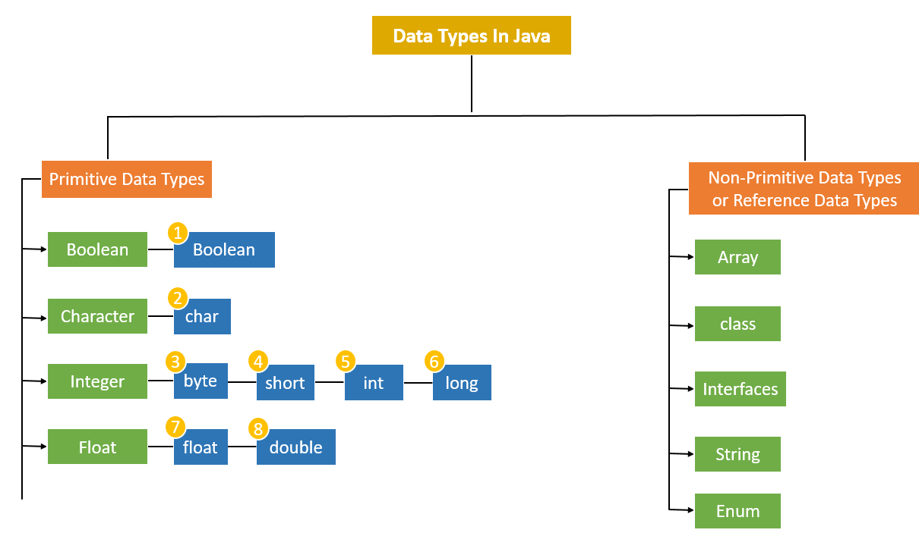

Slide 44
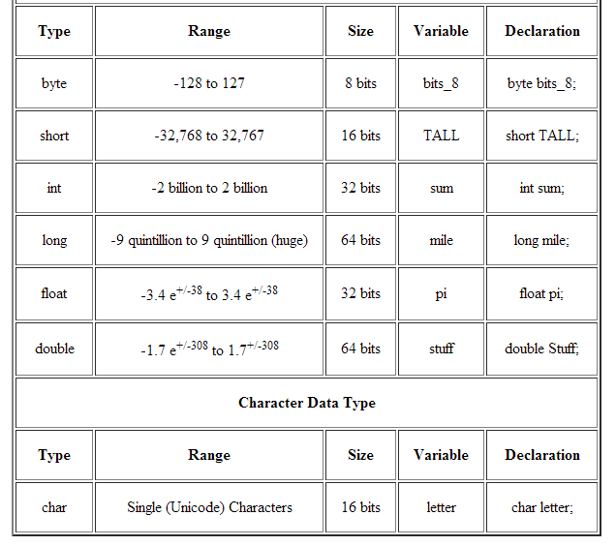

Slide 45
Sun's Java Code Conventions
line length - Lines should not be longer than 80 characters.
indentation - Each indentation unit must be 4 spaces.
wrapping lines - Break after a comma, before an operator, align new line with beginning of expression at same level of previous line. A wrapped line should begin by indenting twice to differentiate between a wrapped line and a scope change.
implementation comments vs. javadocs - Implementation comments (/*,//) are means for comments relating to the internal design of a class. Javadocs (/**) are meant to describe how to use a class from an implementation-free perspective.
combining variable declarations of like type - Declare each variable on it's own line.

Slide 46
Sun's Java Code Conventions (...)
initialization - Always initialize local variables where they are declared.
declaration placement - Always place variable declarations at the beginning of the block in which they will be used.
single-line if-statements - Always use braces after an if statement.
blank lines - Always insert two blank lines between code sections and between class and interface definitions. Insert a single line between local variables in a method and its first statement, before a block or single-line comment, or between logical sections inside a method, and between method declarations.
flow control statements - During "if/else" blocks, else should reside on the same line as the close curly brace of the preceding if. The same pattern should be used for "try/catch/finally" blocks.

Slide 47
Sun's Java Code Conventions (...)
setter and getter names - All properties (instance variables) are private, with public setters named with the following pattern, for an object thing:
The property declaration: private String thing;
The setter (always uses the word "set"): public void setThing(String thing){...}
The getter (uses get except for booleans, in which case "is" and "has" are allowed): public String getThing(){...}

Slide 48
Declare Classes
A class is a user defined blueprint or prototype from which objects are created. It represents the set of properties or methods that are common to all objects of one type. In general, class declarations can include these components, in order:
Modifiers: A class can be public or has default access
class keyword: class keyword is used to create a class.
Class name: The name should begin with an initial letter (capitalized by convention).

Slide 49
Declare Classes(...)
Superclass(if any): The name of the class’s parent (superclass), if any, preceded by the keyword extends. A class can only extend (subclass) one parent.
Interfaces(if any): A comma-separated list of interfaces implemented by the class, if any, preceded by the keyword implements. A class can implement more than one interface.
Body: The class body surrounded by braces, { }.

Slide 50
Source File Declaration Rules
A simple source file is considered to be a Java File, if it follows some rules and regulations. The Java Source file maintains a order and various elements that occur in that source file should follow the order. Java Source File structure should follow rules and order as follows :
The Java source file should have one and only one public class. The class name which is defined as public should be the name of Java source file along with .java extention

Slide 51
Source File Declaration Rules (...)
Java source file should start with a package declaration. The package declaration is optional for Java source file. If the package declaration is default than the package declaration is optional.
After the package declaration there comes a section of import declarations. Import declarations can be zero or more. These import statements introduce type or static member names in the source code. Its mandatory to place all import declarations before actual class declarations in Java source code.

Slide 52
Source File Declaration Rules (...)
After import statements comes the type declarations statements. These statements have type declarations which are considered top-level. There can be any number of such type declarations, generally consisting of class , interface and enum etc. The order of type declarations is not mandatory.

Slide 53
Class Declarations and Modifiers
Modifiers are keywords that you add to those definitions to change their meanings. Java language has a wide variety of modifiers, including the following −
Java Access Modifiers
Non Access Modifiers
To use a modifier, you include its keyword in the definition of a class, method, or variable. The modifier precedes the rest of the statement, as in the following example.

Slide 54
Class Declarations and Modifiers (...)
Example
public class className {
// ...
}
private boolean myFlag;
static final double weeks = 9.5;
protected static final int BOXWIDTH = 42;
public static void main(String[] arguments) {
// body of method
}

Slide 55
Class Declarations and Modifiers (...)
Access Control Modifiers
Java provides a number of access modifiers to set access levels for classes, variables, methods and constructors. The four access levels are −
Visible to the package, the default. No modifiers are needed.
Visible to the class only (private).
Visible to the world (public).
Visible to the package and all subclasses (protected).

Slide 56
Class Declarations and Modifiers (...)
Non-Access Modifiers
Java provides a number of non-access modifiers to achieve many other functionality.
The static modifier for creating class methods and variables.
The final modifier for finalizing the implementations of classes, methods, and variables.
The abstract modifier for creating abstract classes and methods.
The synchronized and volatile modifiers, which are used for threads.

