Slide 1
CORE JAVA 8- day 4
Saratha Natarajan

Slide 2
AGENDA
Today’s Topic – OOPS, Wrapper Classes, Instance Of
Exceptions

Slide 3
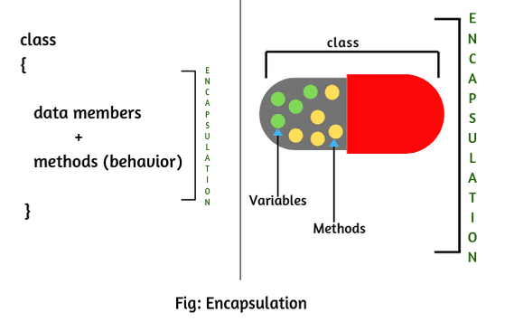
encapsulation
a process of wrapping code and data together into a single unit, for example, a capsule which is mixed of several medicines.
The Java Bean class is the example of a fully encapsulated class.

Slide 4
encapsulation
Realtime Example 1:
School bag is one of the most real examples of Encapsulation. School bag can keep our books, pens, etc.
Realtime Example 2:
When you log into your email accounts such as Gmail, Yahoo Mail, or Rediff mail, there is a lot of internal processes taking place in the backend and you have no control over it.
When you enter the password for logging, they are retrieved in an encrypted form and verified, and then you are given access to your account.
You do not have control over it that how the password has been verified. Thus, it keeps our account safe from being misused.

Slide 5
inheritance
is a mechanism in which one object acquires all the properties and behaviors of a parent object.
idea behind inheritance in Java is that you can create new classes that are built upon existing classes.
Inheritance represents the IS-A relationship which is also known as a parent-child relationship.
Why use inheritance in java
For Method Overriding (so runtime polymorphism can be achieved).
For Code Reusability.

Slide 6
Terms used in Inheritance
Class: A class is a group of objects which have common properties. It is a template or blueprint from which objects are created.
Sub Class/Child Class: Subclass is a class which inherits the other class. It is also called a derived class, extended class, or child class.
Super Class/Parent Class: Superclass is the class from where a subclass inherits the features. It is also called a base class or a parent class.
Reusability: As the name specifies, reusability is a mechanism which facilitates you to reuse the fields and methods of the existing class when you create a new class. You can use the same fields and methods already defined in the previous class.

Slide 7
Declare Classes(...)
The syntax of Java Inheritance
class Subclass-name extends Superclass-name
{
//methods and fields
}
The extends keyword indicates that you are making a new class that derives from an existing class. The meaning of "extends" is to increase the functionality.

Slide 8
Inheritance(...)
Programmer is the subclass and Employee is the superclass. The relationship between the two classes is Programmer IS-A Employee. It means that Programmer is a type of Employee.

Slide 9
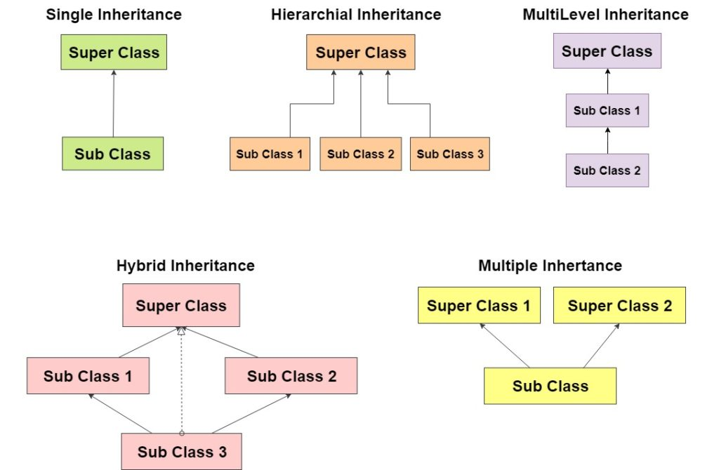
Inheritance - types

Slide 10
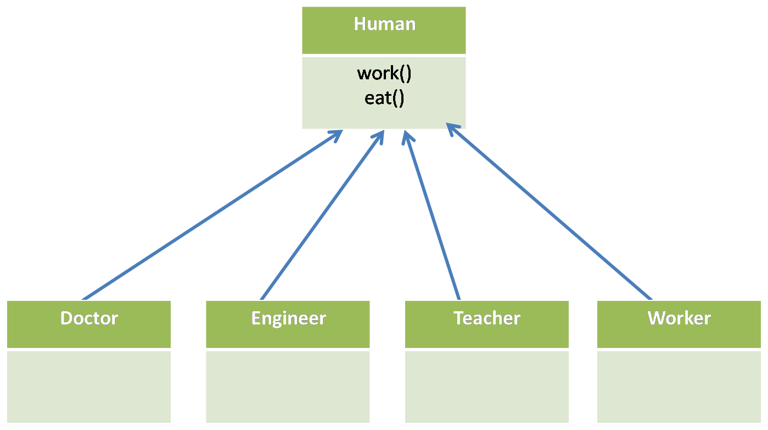

Slide 11
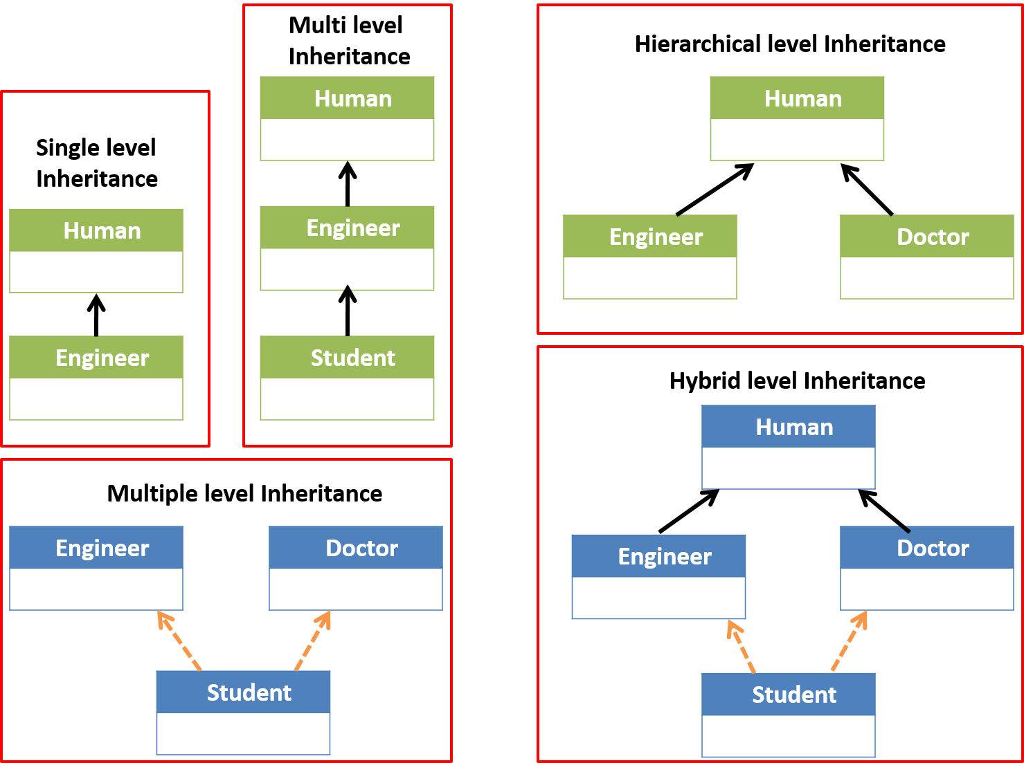
INHERITANCE(TYPES)

Slide 12
INHERITANCE(...)
“is-a” relationship
means that a certain class is the part of the parent class.
This is essential for code reusability. Inheritance is unidirectional which means that the child class is a type of parent class but the inverse is not true.
For example, a brush is a tool but all tools are not brushes.
This relationship gets implemented with the help of extends and implements keywords.

Slide 13
INHERITANCE(...)
“has-a” relationship
Composition is the other word of the “has-a” relationship.
It means that a certain instance of this class has a reference to another class or in the same class. This relationship also helps in code reusability.
For example, A square has edges, A brush has bristles, A cat has a tail. This implementation is possible if we use the new keyword.

Slide 14
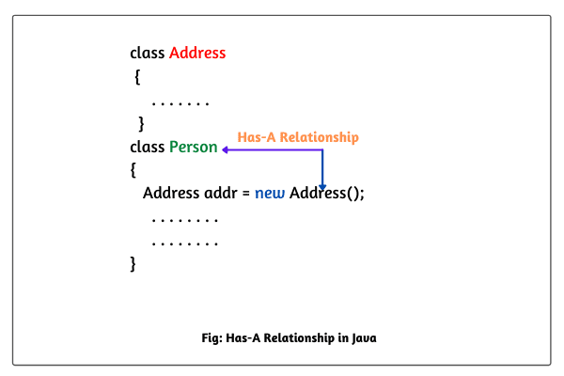

Slide 15
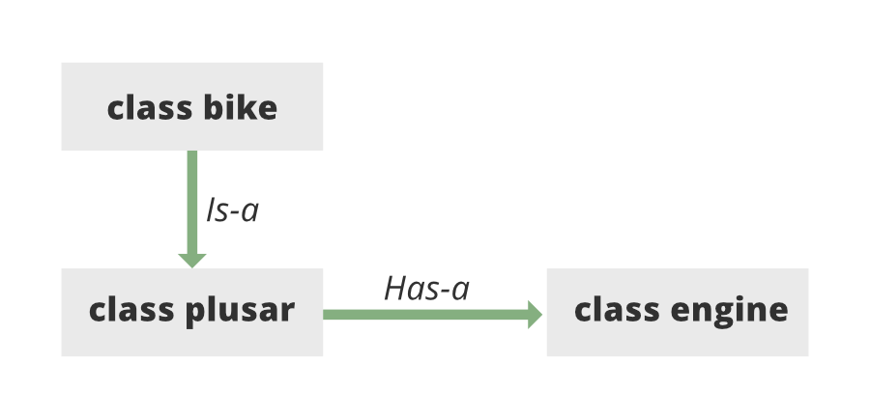

Slide 16
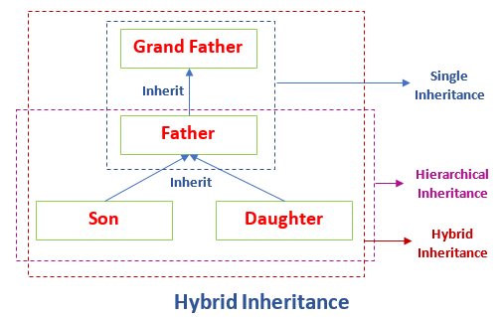
Inheritance(...)

Slide 17
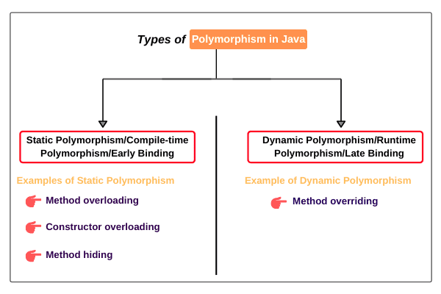
polymorphism

Slide 18
Polymorphism in Java is the task that performs a single action in different ways.
You can perform Polymorphism in Java via two different methods:
Method Overloading
Method Overriding
What is Method Overloading in Java?
is the process that can create multiple methods of the same name in the same class, and all the methods work in different ways. Method overloading occurs when there is more than one method of the same name in the class.

Slide 19
Method overriding is the process when the subclass or a child class has the same method as declared in the parent class.
Example
Base class Polygon, -> Square , -> both with have render methods
Base Class Language -> Java

Slide 20
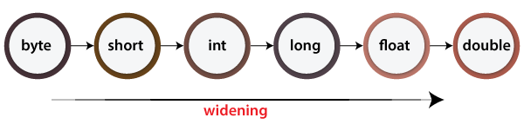
Implicit conversion
The process of converting one type of object and variable into another type is referred to as Typecasting. When the conversion automatically performs by the compiler without the programmer's interference, it is called implicit type casting or widening casting.

Slide 21

Explicit conversion
If we want to assign a value of a larger data type to a smaller data type we perform explicit type casting or narrowing.
This is useful for incompatible data types where automatic conversion cannot be done.
Here, the target type specifies the desired type to convert the specified value to.

Slide 22
Upcasting and Downcasting in Java
A process of converting one data type to another is known as Typecasting and Upcasting and Downcasting is the type of object typecasting.
In Java, the object can also be typecasted like the datatypes.
Parent and Child objects are two types of objects. So, there are two types of typecasting possible for an object, i.e., Child to Parent and Parent to Child or can say Upcasting and Downcasting.

Slide 23
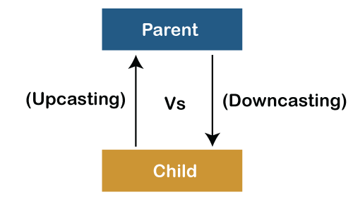

Slide 24
downcasting
Downcasting
Downcasting is another type of object typecasting. In Downcasting, we assign a parent class reference object to the child class.
In Java, we cannot assign a parent class reference object to the child class, but if we per
form downcasting, we will not get any compile-time error. However, when we run it, it throws the "ClassCastException". Now the point is if downcasting is not possible in Java, then why is it allowed by the compiler?
In Java, some scenarios allow us to perform downcasting. Here, the subclass object is referred by the parent class.
Below is an example of downcasting in which both the valid and the invalid scenarios are explained:

Slide 25
Class Declarations and Modifiers (...)
Non-Access Modifiers
Java provides a number of non-access modifiers to achieve many other functionality.
The static modifier for creating class methods and variables.
The final modifier for finalizing the implementations of classes, methods, and variables.
The abstract modifier for creating abstract classes and methods.
The synchronized and volatile modifiers, which are used for threads.

Slide 26
Class Declarations and Modifiers (...)
Static
mainly used for memory management
share the same variable or method of a given class
apply static keywords with variables, methods, blocks, and nested classes.
static keyword belongs to the class than an instance of the class.
When a member is declared static, it can be accessed before any objects of its class are created, and without reference to any object.

Slide 27
Class Declarations and Modifiers (...)
Static blocks
can declare a static block that gets executed exactly once, when the class is first loaded.
Static variables
a single copy of the variable is created and shared among all objects at the class level
Static variables are, essentially, global variables
All instances of the class share the same static variable.

Slide 28
Class Declarations and Modifiers (...)
Static methods
common example of a static method is the main( ) method
Any static member can be accessed before any objects of its class are created, and without reference to any object
Methods declared as static have several restrictions:
They can only directly call other static methods.
They can only directly access static data.
They cannot refer to this or super in any way.

Slide 29
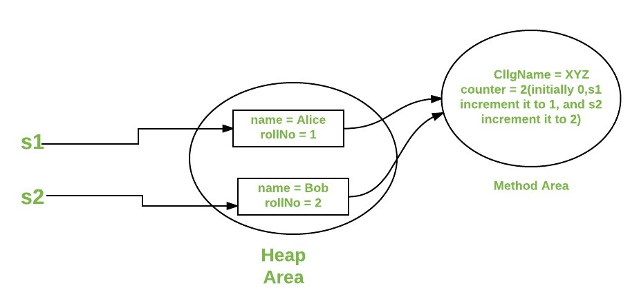
Class Declarations and Modifiers (...)
When to use static variables and methods?
Use the static variable for the property that is common to all objects.
For example, in class Student, all students share the same college name.
Use static methods for changing static variables.

Slide 30
Class Declarations and Modifiers (...)
Final
used to restrict the user.
java final keyword can be used in many context. Final can be:
Variable
Method
class
Java final variable – stop being modified
you make any variable as final, you cannot change the value of final variable(It will be constant).
Example
There is a final variable speedlimit, we are going to change the value of this variable, but It can't be changed because final variable once assigned a value can never be changed.

Slide 31
Final method – stop being overriden
If you make any method as final, you cannot override it.
Java final class – stop being extended
If you make any class as final, you cannot extend it.

Slide 32
abstract
abstract is a non-access modifier in java applicable for classes, methods but not variables. It is used to achieve abstraction which is one of the pillar of Object Oriented Programming(OOP).

Slide 33
Abstract classes
The class which is having partial implementation(i.e. not all methods present in the class have method definition). To declare a class abstract, use this general form :
abstract class class-name{
//body of class
}
Due to their partial implementation, we cannot instantiate abstract classes. Any subclass of an abstract class must either implement all of the abstract methods in the super-class, or be declared abstract itself.
Some of the predefined classes in java are abstract. They depends on their sub-classes to provide complete implementation. For example, java.lang.Number is a abstract class.

Slide 34
Abstract methods
Sometimes, we require just method declaration in super-classes.
This can be achieve by specifying the abstract type modifier.
These methods are sometimes referred to as subclasser responsibility because they have no implementation specified in the super-class. Thus, a subclass must override them to provide method definition. To declare an abstract method, use this general form:
abstract type method-name(parameter-list);

Slide 35
interface
is a blueprint of a class. It has static constants and abstract methods.
you can say that interfaces can have abstract methods and variables. It cannot have a method body.
Why use Java interface?
There are mainly three reasons to use interface. They are given below.
It is used to achieve abstraction.
By interface, we can support the functionality of multiple inheritance.
It can be used to achieve loose coupling.

Slide 36
How to declare an interface?
An interface is declared by using the interface keyword. It provides total abstraction; means all the methods in an interface are declared with the empty body, and all the fields are public, static and final by default. A class that implements an interface must implement all the methods declared in the interface.
Syntax:
interface <interface_name>{
// declare constant fields
// declare methods that abstract
// by default.
}

Slide 37
Day – 4 over
Activities- inheritance, static, abstract

