Slide 1
CORE JAVA 8- day 5
Saratha Natarajan

Slide 2
AGENDA
Today’s Topic – Wrapper classes, Exceptions, Threads

Slide 3
Wrapper classes
Wrapper class is a class whose object wraps or contains primitive data types. When we create an object to a wrapper class, it contains a field and in this field, we can store primitive data types.
In other words, we can wrap a primitive value into a wrapper class object.

Slide 4
Need of Wrapper Classes
They convert primitive data types into objects. Objects are needed if we wish to modify the arguments passed into a method (because primitive types are passed by value).
The classes in java.util package handles only objects and hence wrapper classes help in this case also.
Data structures in the Collection framework, such as ArrayList and Vector, store only objects (reference types) and not primitive types.
An object is needed to support synchronization in multithreading.

Slide 5
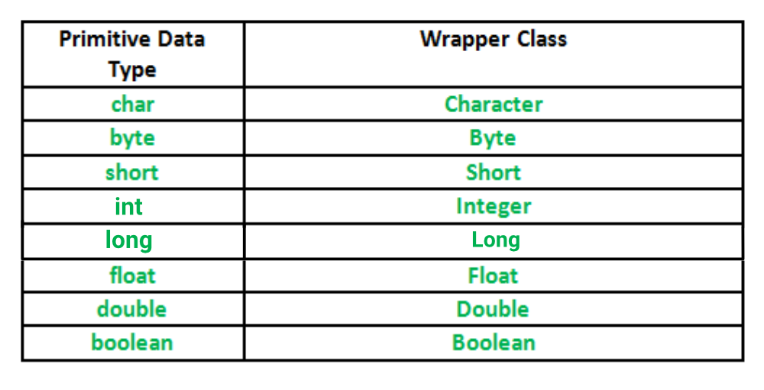
WRAPPER CLASSES

Slide 6
AUTOBOXING & unboxing
Autoboxing: Automatic conversion of primitive types to the object of their corresponding wrapper classes is known as autoboxing. For example – conversion of int to Integer, long to Long, double to Double etc.
Unboxing: It is just the reverse process of autoboxing. Automatically converting an object of a wrapper class to its corresponding primitive type is known as unboxing. For example – conversion of Integer to int, Long to long, Double to double, etc.

Slide 7
exceptions
Exception handling
Exception is an indication of problem during execution
“exception” occurs infrequently
e.g., divide by zero
Promotes robust and fault-tolerant software
Java’s Exception Handling nearly identical to C++

Slide 8
Exception-Handling Overview
Mixing program code with error-handling code makes program difficult to read, modify, maintain, debug
Uses of exception handling
Process exceptions from program components
Handle exceptions in a uniform manner in large projects
Remove error-handling code from “main line” of execution
A method detects an error and throws an exception
Exception handler processes the error
Uncaught exceptions yield adverse effects
Might terminate program execution

Slide 9
Exception Types

Slide 10
System errors
System errors are thrown by JVM and represented in the Error class. The Error class describes internal system errors. Such errors rarely occur. If one does, there is little you can do beyond notifying the user and trying to terminate the program gracefully.

Slide 11
Runtime exceptions
RuntimeException is caused by programming errors, such as bad casting, accessing an out-of-bounds array, and numeric errors.

Slide 12
Checked Exceptions vs. Unchecked Exceptions
RuntimeException, Error and their subclasses are known as unchecked exceptions. All other exceptions are known as checked exceptions, meaning that the compiler forces the programmer to check and deal with the exceptions.

Slide 13
Unchecked Exceptions
In most cases, unchecked exceptions reflect programming logic errors that are not recoverable. For example, a NullPointerException is thrown if you access an object through a reference variable before an object is assigned to it; an IndexOutOfBoundsException is thrown if you access an element in an array outside the bounds of the array. These are the logic errors that should be corrected in the program. Unchecked exceptions can occur anywhere in the program. To avoid cumbersome overuse of try-catch blocks, Java does not mandate you to write code to catch unchecked exceptions.

Slide 14
Unchecked exceptions

Slide 15
Try statement
To process an exception when it occurs, the line that throws the exception is executed within a try block
A try block is followed by one or more catch clauses, which contain code to process an exception
Each catch clause has an associated exception type and is called an exception handler
When an exception occurs, processing continues at the first catch clause that matches the exception type

Slide 16
Finally clause
A try statement can have an optional clause following the catch clauses, designated by the reserved word finally
The statements in the finally clause always are executed
If no exception is generated, the statements in the finally clause are executed after the statements in the try block complete
If an exception is generated, the statements in the finally clause are executed after the statements in the appropriate catch clause complete

Slide 17
Throw statement
A programmer can define an exception by extending the Exception class or one of its descendants
Exceptions are thrown using the throw statement
Usually a throw statement is nested inside an if statement that evaluates the condition to see if the exception should be thrown

Slide 18
throws
The Java throws keyword is used to declare an exception. It gives an information to the programmer that there may occur an exception. So, it is better for the programmer to provide the exception handling code so that the normal flow of the program can be maintained.
Syntax of Java throws
modifier return_type method_name() throws exception_class_name{
//method code
}

Slide 19
Checked exception
An exception is either checked or unchecked
A checked exception either must be caught by a method, or must be listed in the throws clause of any method that may throw or propagate it
A throws clause is appended to the method header
The compiler will issue an error if a checked exception is not handled appropriately

Slide 20
Unchecked exception
An unchecked exception does not require explicit handling, though it could be processed that way
The only unchecked exceptions in Java are objects of type RuntimeException or any of its descendants
Errors are similar to RuntimeException and its descendants
Errors should not be caught
Errors to not require a throws clause

Slide 21
Custom exception
Use the exception classes in the API whenever possible.
Define custom exception classes if the predefined classes are not sufficient.
Define custom exception classes by extending Exception or a subclass of Exception.

Slide 22
About Strings
There is a special syntax for constructing strings:
"Hello"
Strings, unlike most other objects, have a defined operation (as opposed to a method):
" This " + "is String " + "concatenation"

Slide 23
Java String Constructor
| String class supports several types of constructors in Java APIs.
The most commonly used constructors of the String class are as follows:
String()
String(String str)
String(char chars[ ])
String(char chars[ ], int startIndex, int count)
String(byte byteArr[ ])
String(byte byteArr[ ], int startIndex, int count)

Slide 24
1. String(): To create an empty String, we will call the default constructor. The general syntax to create an empty string in java program is as follows:
String s = new String();It will create a string object in the heap area with no value.
2. String(String str): It will create a string object in the heap area and stores the given value in it. The general syntax to construct a string object with specified string str is as follows:
String st = new String(String str); For example: String s2 = new String("Hello Java");Here, the object s2 contains Hello Java.
3. String(char chars[ ]): This constructor creates a string object and stores the array of characters in it. The general syntax to create a string object with a specified array of characters is as follows:
String str = new String(char char[])
For example:
char chars[ ] = { 'a', 'b', 'c', 'd' }; String s3 = new String(chars);

Slide 25
4. String(char chars[ ], int startIndex, int count): This constructor creates and initializes a string object with a subrange of a character array.
The argument startIndex specifies the index at which the subrange begins and count specifies the number of characters to be copied.
String str = new String(char chars[ ], int startIndex, int count); For example: char chars[ ] = { 'w', 'i', 'n', 'd', 'o', 'w', 's' }; String str = new String(chars, 2, 3);

Slide 26
5. String(byte byteArr[ ]): This constructor constructs a new string object by decoding the given array of bytes (i.e, by decoding ASCII values into the characters) according to the system’s default character set.
6. String(byte byteArr[ ], int startIndex, int count): This constructor also creates a new string object by decoding the ASCII values using the system’s default character set.

Slide 27
Useful String methods I
char charAt(int index)
Returns the character at the given index position (0-based)
boolean startsWith(String prefix)
Tests if this String starts with the prefix String
boolean endsWith(String suffix)
Tests if this String ends with the suffix String

Slide 28
Useful String methods II
boolean equals(Object obj)
Tests if this String is the same as the obj (which may be any type; false if it’s not a String)
boolean equalsIgnoreCase(String other)
Tests if this String is equal to the other String, where case does not matter
int length()
Returns the length of this string; note that this is a method, not an instance variable

Slide 29
Useful String methods III
int indexOf(char ch)
Returns the position of the first occurrence of ch in this String, or -1 if it does not occur
int indexOf(char ch, int fromIndex)
Returns the position of the first occurrence of ch, starting at (not after) the position fromIndex
There are two similar methods that take a String instead of a char as their first argument

Slide 30
Useful String methods IV
int lastIndexOf(char ch)
Returns the position of the last occurrence of ch in this String, or -1 if it does not occur
int lastIndexOf(char ch, int fromIndex)
Returns the position of the last occurrence of ch, searching backward starting at position fromIndex
There are two similar methods that take a String instead of a char as their first argument

Slide 31
Useful String methods V
String substring(int beginIndex)
Returns a new string that is a substring of this string, beginning with the character at the specified index and extending to the end of this string.
String substring(int beginIndex, int endIndex)
Returns a new string that is a substring of this string, beginning at the specified beginIndex and extending to the character at index endIndex - 1. Thus the length of the substring is endIndex-beginIndex

Slide 32
Understanding “index”
With charAt(index), indexOf(x), and lastIndexOf(x), just count characters (starting from zero)
"She said, \"Hi\""
0 1 2 3 4 5 6 7 8 9 10 11 12 13
With substring(from) and substring(from, to), it works better to count positions between characters
"She said, \"Hi\""
0 1 2 3 4 5 6 7 8 9 10 11 12 13 14
So, for example, substring(4, 8) is "said", and substring(8, 12) is ", \"H"
If indexOf(',') is 8, then substring(0, indexOf(',')) is "She said" and substring(indexOf(',') + 1) is " \"Hi\""

Slide 33
Useful String methods VI
String toUpperCase()
Returns a new String similar to this String, in which all letters are uppercase
String toLowerCase()
Returns a new String similar to this String, in which all letters are lowercase
String trim()
Returns a new String similar to this String, but with whitespace removed from both ends

Slide 34
Finally, a useless String method
String toString()
Returns this String
Why do we have this method?
Consistency--Every Object has a toString() method

Slide 35
Strings are immutable
A String, once created, cannot be changed
None of the preceding methods modify the String, although several create a new String
Statements like this create new Strings:
myString = myString + anotherCharacter;
Creating a few extra Strings in a program is no big deal
Creating a lot of Strings can be very costly

Slide 36
About StringBuffers
A StringBuffer has a capacity (the number of characters it can hold) and a length (the number of characters it is currently holding)
If the capacity is exceeded, the StringBuffer is copied to a new location with more room
StringBuffers are used to implement String concatenation
Whenever you say String s = "ab" + "cd", Java creates a StringBuffer containing the characters a and b, appends the characters c and d to it, and converts the result back to a String
As you might guess, this isn’t terribly efficient, but it’s fine if you don’t overdo it

Slide 37
StringBuffer constructors
StringBuffer()
Constructs a StringBuffer with a capacity of 16 characters
StringBuffer(int capacity)
Constructs a StringBuffer with the requested capacity
StringBuffer(String str)
Constructs a StringBuffer containing the String str

Slide 38
Useful StringBuffer methods I
StringBuffer append(X)
Appends X to the end of this StringBuffer; also (as a convenience) returns this StringBuffer
The append method is so heavily overloaded that it will work with any argument; if the argument is an object, its toString() method is used

Slide 39
Useful StringBuffer methods II
int length()
Returns the number of characters in this StringBuffer
void setLength(int newLength)
Sets the number of characters in this StringBuffer; this may result in truncation of characters at the end, or addition of null characters

Slide 40
Useful StringBuffer methods III
char charAt(int index)
Returns the character at the location index
void setCharAt(int index, char ch)
Sets the character at location index to ch
StringBuffer reverse()
The sequence of characters in this StringBuffer is replaced by the reverse of this sequence, and also returned as the value of the method

Slide 41
Useful StringBuffer methods IV
StringBuffer insert(int offset, X)
Insert X starting at the location offset in this StringBuffer, and also return this StringBuffer as the value of the method. Like append, this method is heavily overloaded
StringBuffer deleteCharAt(int index)
Deletes the character at location index
StringBuffer delete(int start, int end)
Deletes chars at locations start through end-1

Slide 42
Useful StringBuffer methods V
String substring(int start)
Returns a new String of characters from this StringBuffer, beginning with the character at the specified index and extending to the end of this string.
String substring(int start, int end)
Returns a new String of characters from this StringBuffer, beginning at location start and extending to the character at index end-1. Thus the length of the substring is end-begin
String toString()
Returns the characters of this StringBuffer as a String

Slide 43
When to use StringBuffers
If you make a lot (thousands) of changes or additions to a String, it is much more efficient to use a StringBuffer
If you are simply examining the contents of a String, then a String is at least as efficient as a StringBuffer
For incidental use (such as creating output lines), use Strings; they are more convenient

Slide 44
About StringTokenizers
A StringTokenizer is used to break a string into tokens, such as words
A StringTokenizer uses delimiters to separate tokens
A StringTokenizer can be made that will return the delimiters, or discard them
You construct a StringTokenizer for a particular String, use it for one pass through that String, after which the StringTokenizer is “used up”
There are only a few methods for StringTokenizers

Slide 45
StringTokenizer constructors
StringTokenizer(String str)
Constructs a tokenizer that uses the default (whitespace) delimiters " \t\n\r\f"; it does not return delimiters as tokens
StringTokenizer(String str, String delim)
Constructs a tokenizer that uses the given delimiters delim; it does not return delimiters as tokens
StringTokenizer(String str, String delim, boolean returnDelims)
Constructs a tokenizer that uses the given delimiters delim; it returns delimiters as tokens if returnDelims is true

Slide 46
StringTokenizer methods
boolean hasMoreTokens()
Tests if this tokenizer’s String has more tokens
String nextToken()
Returns the next token
String nextToken(String delim)
Permanently changes this tokenizer’s set of delimiters, then returns the next token
int countTokens()
Returns the number of tokens remaining

Slide 47
Example use of StringTokenizer
StringTokenizer st = new StringTokenizer("this is a test"); while (st.hasMoreTokens()) { System.out.println(st.nextToken()); }
Output:
this is a test

Slide 48
AGENDA
THREADS
COLLECTIONS FRAMEWORK

Slide 49
threads
To maintain responsiveness of an application during a long running task
To enable cancellation of separable tasks
Some problems are intrinsically parallel
To monitor status of some resource (e.g., DB)
Some APIs and systems demand it (e.g., Swing)

Slide 50
application thread
When we execute an application:
The JVM creates a Thread object whose task is defined by the main() method
The JVM starts the thread
The thread executes the statements of the program one by one
After executing all the statements, the method returns and the thread dies

Slide 51
Multiple threads in same app
Each thread has its private run-time stack
If two threads execute the same method, each will have its own copy of the local variables the methods uses
However, all threads see the same dynamic memory, i.e., heap (are there variables on the heap?)
Two different threads can act on the same object and same static fields concurrely

Slide 52
Creating threads
There are two ways to create our own Thread object
Subclassing the Thread class and instantiating a new object of that class
Implementing the Runnable interface
In both cases the run() method should be implemented

Slide 53
thread methods
void start()
Creates a new thread and makes it runnable
This method can be called only once
void run()
The new thread begins its life inside this method
void stop() (deprecated)
The thread is being terminated

Slide 54
Thread methods
void yield()
Causes the currently executing thread object to temporarily pause and allow other threads to execute
Allow only threads of the same priority to run
void sleep(int m) or sleep(int m, int n)
The thread sleeps for m milliseconds, plus n nanoseconds

Slide 55
Runnable object
When running the Runnable object, a Thread object is created from the Runnable object
The Thread object’s run() method calls the Runnable object’s run() method
Allows threads to run inside any object, regardless of inheritance

Slide 56
Thread state diagram
Alive
Running
new ThreadExample();
while (…) { … }
New Thread
Runnable
Dead Thread
thread.start();
run() method returns
Blocked
Object.wait()
Thread.sleep()
blocking IO call
waiting on a monitor

Slide 57
Threadgroup
ThreadGroup creates a group of threads. It offers a convenient way to manage groups of threads as a unit. This is particularly valuable in situation in which you want to suspend and resume a number of related threads.
The thread group form a tree in which every thread group except the initial thread group has a parent.
A thread is allowed to access information about its own thread group but not to access information about its thread group’s parent thread group or any other thread group.

Slide 58
Constructors
public ThreadGroup(String name): Constructs a new thread group. The parent of this new group is the thread group of the currently running thread.Throws: SecurityException - if the current thread cannot create a thread in the specified thread group.
public ThreadGroup(ThreadGroup parent, String name): Creates a new thread group. The parent of this new group is the specified thread group.Throws: NullPointerException - if the thread group argument is null. SecurityException - if the current thread cannot create a thread in the specified thread group.

Slide 59
Thread priority
Every thread has a priority
When a thread is created, it inherits the priority of the thread that created it
The priority values range from 1 to 10, in increasing priority

Slide 60
Thread Priority (cont.)
The priority can be adjusted subsequently using the setPriority() method
The priority of a thread may be obtained using getPriority()
Priority constants are defined:
MIN_PRIORITY=1
MAX_PRIORITY=10
NORM_PRIORITY=5
The main thread is
created with priority
NORM_PRIORITY

Slide 61
Daemon threads
Daemon threads are “background” threads, that provide services to other threads, e.g., the garbage collection thread
The Java VM will not exit if non-Daemon threads are executing
The Java VM will exit if only Daemon threads are executing
Daemon threads die when the Java VM exits
Q: Is the main thread a daemon thread?

Slide 62
synchrozination
Multi-threaded programs may often come to a situation where multiple threads try to access the same resources and finally produce erroneous and unforeseen results.
So it needs to be made sure by some synchronization method that only one thread can access the resource at a given point in time.
Java provides a way of creating threads and synchronizing their tasks using synchronized blocks. Synchronized blocks in Java are marked with the synchronized keyword.
A synchronized block in Java is synchronized on some object. All synchronized blocks synchronize on the same object can only have one thread executing inside them at a time.
All other threads attempting to enter the synchronized block are blocked until the thread inside the synchronized block exits the block.

Slide 63
Following is the general form of a synchronized block:
// Only one thread can execute at a time.
// sync_object is a reference to an object
// whose lock associates with the monitor.
// The code is said to be synchronized on
// the monitor object
synchronized(sync_object) {
// Access shared variables and other
// shared resources
}
This synchronization is implemented in Java with a concept called monitors. Only one thread can own a monitor at a given time. When a thread acquires a lock, it is said to have entered the monitor. All other threads attempting to enter the locked monitor will be suspended until the first thread exits the monitor.

Slide 64
SHARED RESOURCES
If one thread tries to read the data and other thread tries to update the same date, it leads to inconsistent state.
This can be prevented by synchronising access to the data.
Use “Synchronized” method:
public synchronized void update()
{
…
}

Slide 65
SHARED RESOURCES
Applications Access to Shared Resources need to be coordinated.
Printer (two person jobs cannot be printed at the same time)
Simultaneous operations on your bank account.
Can the following operations be done at the same time on the same account?
Deposit()
Withdraw()
Enquire()

Slide 66
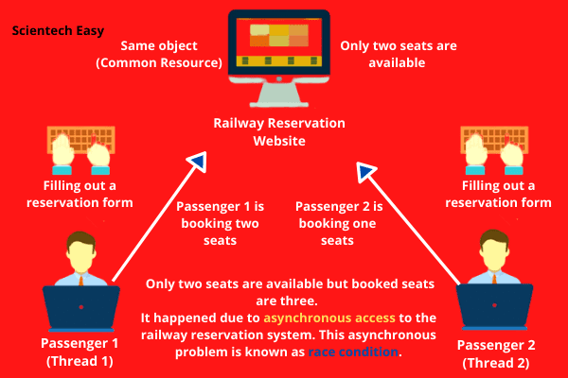

Slide 67
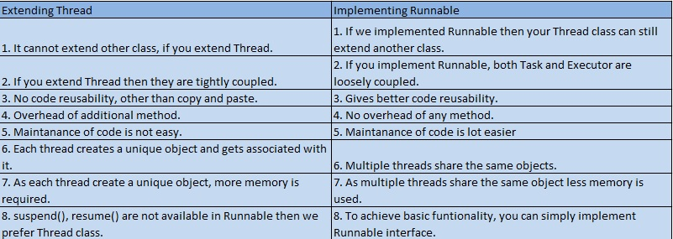
thread vs runnable

Slide 68
Day – 4 over
Activities- FLOW CONTROL , ARRAYS

