Slide 1
MAVEN , GRADLE, MOCKITO

Slide 2
AGENDA
MAVEN
GRADLE
MAVEN VS GRADLE
MOCKITO - JAVA

Slide 3
Introduction to Maven

Slide 4
Build
Preprocessing
Compilation
Postprocessing
Distribution
Deployment

Slide 5
What is Maven?
Mostly used as a build tool for Java projects
It is more than a build tool
Project Object Model (POM)
Project lifecycles
Dependency management
Plugin framework
It is a project management tool

Slide 6
A Simple Maven Example
pom.xml
<project>
<modelVersion>4.0.0</modelVersion>
<groupId>edu.calstatela.cs520</groupId>
<artifactId>maven-exmaple</artifactId>
<version>1.0</version>
</project>
Run:
mvn compile
mvn package

Slide 7
pom.xml and modelVersion
pom.xml is a description of the project
modelVersion is the version of the “grammar” of the description

Slide 8
Maven Coordinates
groupId
Name of the company, organization, team etc., usually using the reverse URL naming convention
artifactId
A unique name for the project under groupId
version
packaging, default: jar
classifier
Maven coordinates uniquely identifies a project.

Slide 9
Convention Over Configuration
Systems, libraries, and frameworks should assume reasonable defaults.

Slide 10
Default Directory Structure
src/main/java
src/main/resources for files that should be placed under classpath
src/main/webapp for web applications
src/test/java
target

Slide 11
Build Lifecycle
The process for building and distributing a project
A build lifecycle consists of a number of steps called phases.

Slide 12
Some Default Lifecycle Phases
validate
compile
test
package
deploy
http://maven.apache.org/guides/introduction/introduction-to-the-lifecycle.html#Lifecycle_Reference

Slide 13
Goals and Plugins
Goals, a.k.a. Mojos, are operations provided by Maven plugins

Slide 14
Some Maven Plugins
resources
compiler
surefire
jar, war
http://maven.apache.org/plugins/index.html

Slide 15
Example of Using a Plugin
<build><plugins><plugin>
<groupId>org.apache.maven.plugins</groupId>
<artifactId>maven-compiler-plugin</artifactId>
<version>2.3.2</version>
<executions><execution>
<id>default-compile</id>
<phase>compile</phase>
<goals>
<goal>compile</goal>
</goals>
<configuration>
<target>1.6</target>
</configuration>
</execution></executions>
</plugin></plugins></build>

Slide 16
About The Plugin Example
A plugin is uniquely identified by its coordinates just like any other project
Goals are usually associated (i.e. bound) to a build lifecycle phase
The behavior of a goal can be customized with additional parameters in the <configuration> section

Slide 17
Run a Maven Build
mvn <phase>
Maven will go through each build lifecycle phase up to the specified phase
In each phase, execute the goals bound to that phase

Slide 18
Run a Maven Build in Eclipse
Need the m2e Eclipse plugin
Right click on the project then select Run As → Maven Build …
Give the build a name
Enter the phase name for Goals
Click Run

Slide 19
Why Not Just Use an IDE
Can your IDE do everything you want?
Deploy a web application to a remote server
Generate source code from some metadata files
Create a zip package of selected files for homework submission
…

Slide 20
Why Use Maven
Everybody uses it!
Common framework for project build and management
Project Object Model
Build lifecycles
Archetype
Dependency management
Resource filtering

Slide 21
Archetype
An archetype is a template for a Maven project which can be used to create new projects quickly
Example: creating a project from archetype
maven-archetype-quickstart
maven-archetype-webapp
Users can create new archetypes and publish them through catalogs
Main Maven archetype catalog: http://repo1.maven.org/maven2/archetype-catalog.xml

Slide 22
Dependency Management
A dependency of a project is a library that the project depends on
Adding a dependency to a project is as simple as adding the coordinates of the library to pom.xml
Maven automatically downloads the library from an online repository and store it locally for future use

Slide 23
Dependency Example
<dependencies>
<dependency>
<groupId>javax.servlet</groupId>
<artifactId>javax.servlet-api</artifactId>
<version>3.0.1</version>
</dependency>
</dependencies>
Add a dependency to pom.xml
Add a dependency in Eclipse

Slide 24
Dependencies and Repositories
Search for dependency coordinates at http://mvnrepository.com/
Maven Central Repository - http://repo1.maven.org/maven2/
Additional libraries and repositories - https://maven.nuxeo.org/

Slide 25
More About Dependency Management
Dependencies of a dependency are automatically included
Dependency conflicts are automatically resolved
See CSNS2 for example

Slide 26
Resource Filtering
Use placeholders in resource files and replace them with actual value during the build process
<param name="File" value="${app.dir.log}/csns2.log" />
<param name="File" value="F:/TEMP/csns2/csns2.log" />

Slide 27
Resource Filtering Example
<build>
<filters>
<filter>build.properties</filter>
</filters>
<resources>
<resource>
<directory>src/main/resources</directory>
<filtering>true</filtering>
</resource>
</resources>
</build>

Slide 28
Summary
Project Object Model (POM)
Coordinates
Lifecycles and phases
Plugins and goals
Archetype
Dependency management
Resource filtering

Slide 29
Further Readings
Maven: The Definitive Guide by Sonatype

Slide 30
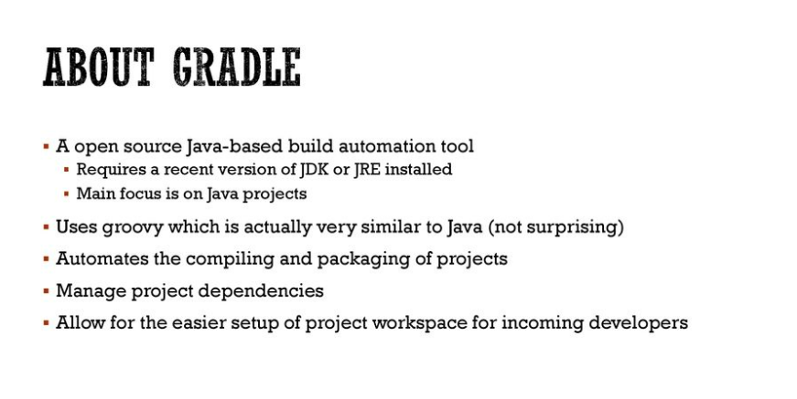

Slide 31
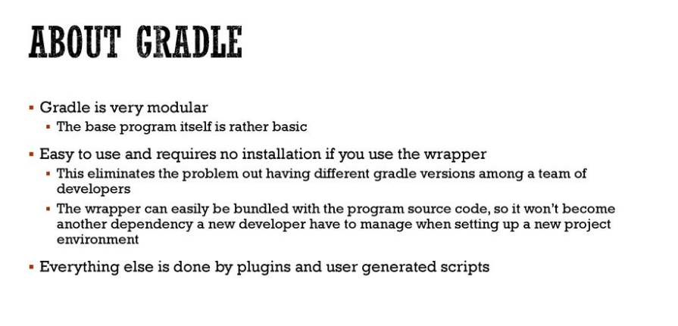

Slide 32
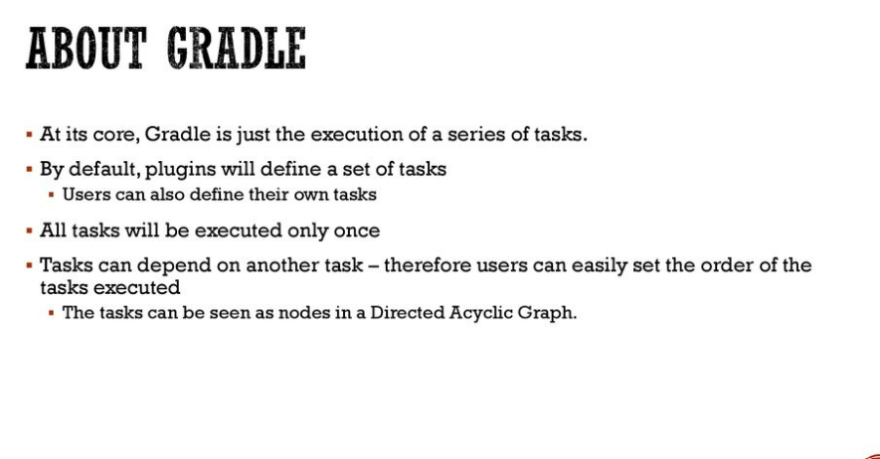

Slide 33
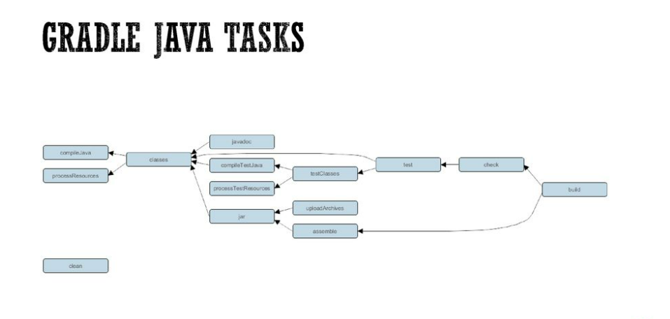

Slide 34
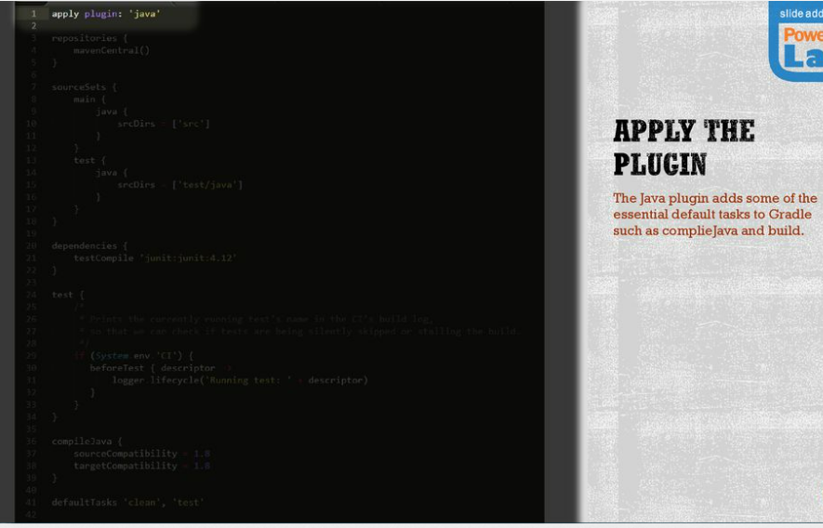

Slide 35
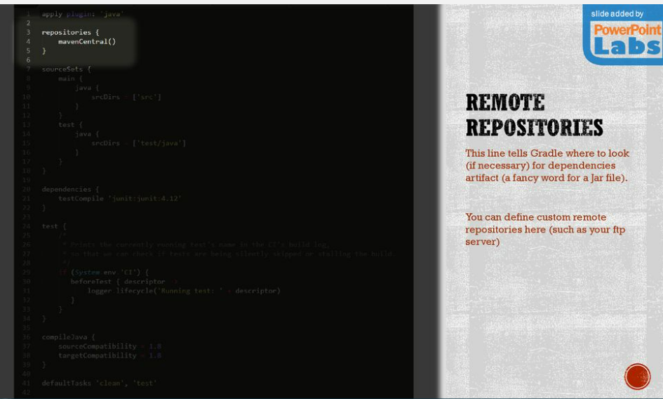

Slide 36
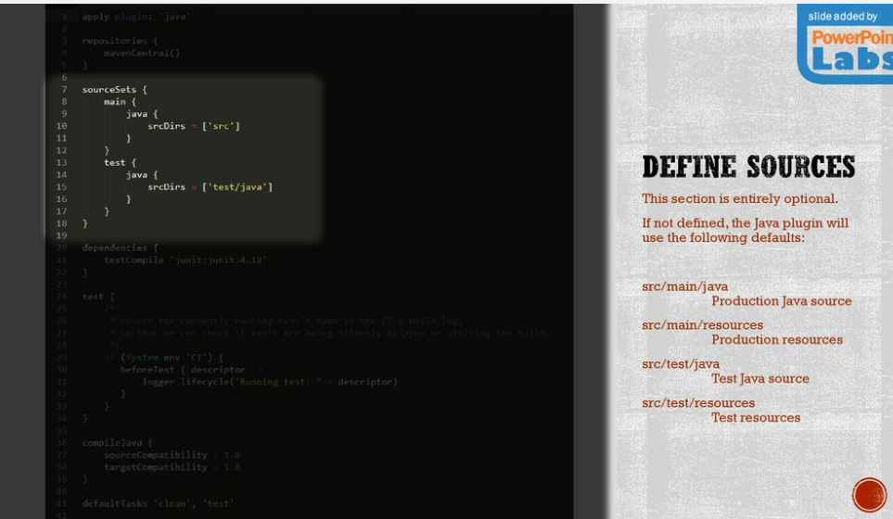

Slide 37
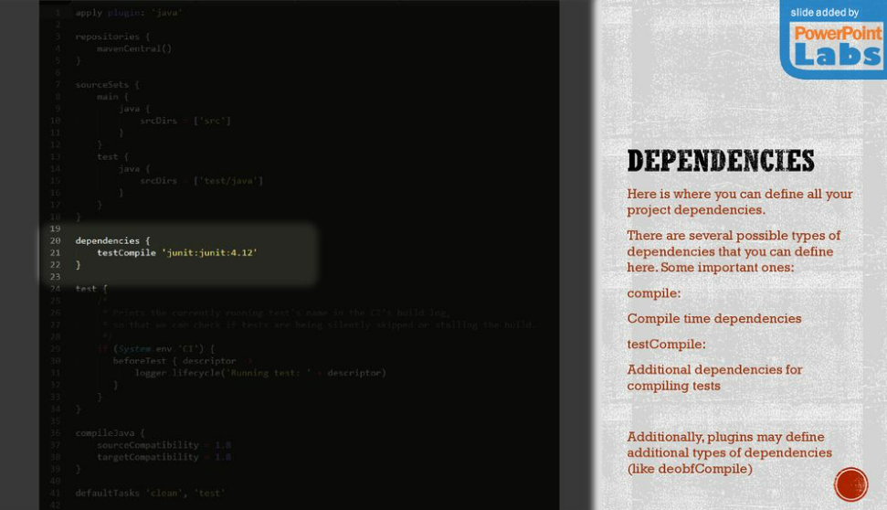

Slide 38
