Slide 1
Types of Learning (Machine Learning in Python)

Slide 2
Types of Learning
There are 3 main types of learning in artificial intelligence
– SUPERVISED LEARNING –
we have a dataset with the labels for the machine learning algorithm

Slide 3
Types of Learning
There are 3 main types of learning in artificial intelligence
– SUPERVISED LEARNING –
we have a dataset with the labels for the machine learning algorithm
– UNSUPERVISED LEARNING –
we have just the dataset and the machine learning algorithm finds the relationships present in the data

Slide 4
Types of Learning
There are 3 main types of learning in artificial intelligence
– SUPERVISED LEARNING –
we have a dataset with the labels for the machine learning algorithm
– UNSUPERVISED LEARNING –
we have just the dataset and the machine learning algorithm finds the relationships present in the data
– REINFORCEMENT LEARNING –
there is no dataset at all and the machine learning algorithms interact with the environment to learn

Slide 5
Types of Learning
SUPERVISED LEARNING
We have a dataset with samples and labels as well. Most of the
machine learning techniques rely heavily on datasets
WE GIVE THE ALGORITHM THE RIGHT ANSWERS !!!
During the training procedure:
→ the input is the features (x,y)
→ the output is the x XOR y label
The aim is to make sure that the prediction made
by the algorithm is approximately the same
as the label in the dataset
x
y
x XOR y
0
0
0
0
1
1
1
0
1
1
1
0

Slide 6
Types of Learning
SUPERVISED LEARNING
We have a dataset with samples and labels as well. Most of the
machine learning techniques rely heavily on datasets
WE GIVE THE ALGORITHM THE RIGHT ANSWERS !!!
During the training procedure:
→ the algorithm will find out what is the
difference between the two classes
x₂
x₁

Slide 7
Types of Learning
SUPERVISED LEARNING
We have a dataset with samples and labels as well. Most of the
machine learning techniques rely heavily on datasets
WE GIVE THE ALGORITHM THE RIGHT ANSWERS !!!
During the training procedure:
→ the algorithm will find out what is the
difference between the two classes
x₂
this is the so-called decision boundary
that defines the separation
between the classes
x₁

Slide 8
Types of Learning
UNSUPERVISED LEARNING
We have a dataset without labels. The algorithm itself will
find patterns in the unlabeled dataset (such as clustering algorithms)
WE DO NOT GIVE THE ALGORITHM THE RIGHT ANSWERS !!!
During the training procedure:
→ the algorithm will find the most relevant
features to make the classification
x₂
x₁

Slide 9
Types of Learning
UNSUPERVISED LEARNING
We have a dataset without labels. The algorithm itself will
find patterns in the unlabeled dataset (such as clustering algorithms)
WE DO NOT GIVE THE ALGORITHM THE RIGHT ANSWERS !!!
During the training procedure:
→ the algorithm will find the most relevant
features to make the classification
x₂
x₁

Slide 10
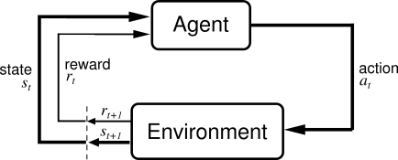
Types of Learning
REINFORCEMENT LEARNING
In this case we do not have a dataset at all. The artificial intelligence agent
interacts with the environment (states) and figures out what to do (action)
UPON DOING ACTIONS THE AGENT RECEIVES A REWARD/PENALTY !!!
finding the shortest path – there are states (cells) and
actions (we can visit the neighbor cells)

Slide 11
Types of Learning
REINFORCEMENT LEARNING
reinforced learning can be used to learn
playing tic-tac-toe game
environment are the cells on the board
the agent (computer player) makes a move
according to the board states
move is the location of the X
eventually the game will end: agent will receive
reward (win) or receive penalty (lose)
0
X
0
X
The computer (agent) initially plays poorly but after the training procedure (so playing a lot)
it will be able to choose the right actions and moves

Slide 12
Why to Learn AI and Machine Learning? (Machine Learning in Python)

Slide 13
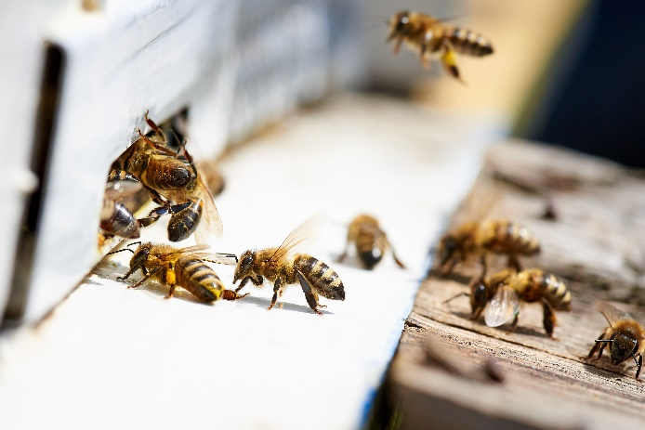
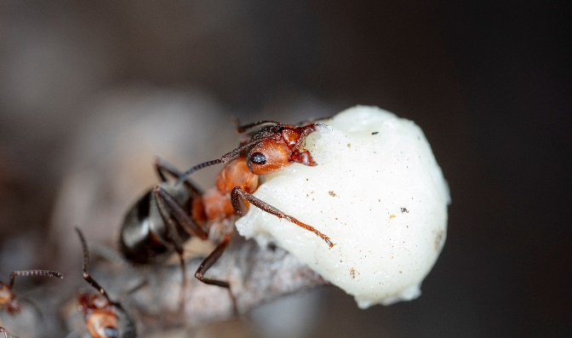
Why to Learn Artificial Intelligence?
1.) OPTIMIZATION ALGORITHMS
determinsitic algorithms are working fine usually such as graph algorithms
or other optimization algorithms (dynamic programming etc.)
BUT THEY ARE GETTING EXTREMELY SLOW AS
THE SEARCH SPACE INCREASES !!!
there are heuristic and meta-heuristic
approaches to deal with this problem
genetic algorithms, ant colony optimization
bee colony optimization etc.

Slide 14


Why to Learn Artificial Intelligence?
2.) ROBOTICS
An interesting problem is how to navigate and move robots in an unknown
environment (such as exploration robots on Mars)
we need shortest path algorithms to navigate
the exploration robot as efficient as possible
graph algorithms are useful such as A* search

Slide 15
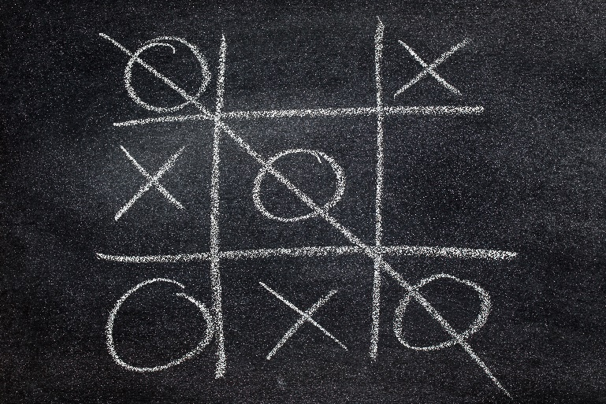

Why to Learn Artificial Intelligence?
3.) GAMES
We can use artificial intelligence and machine learning to construct perfect
or nearly-perfect players for games (such as chess or tic-tac-toe)
minimax algorithm that used depth-first
search and recursion to find the
optimal next move
alpha-beta pruning method

Slide 16
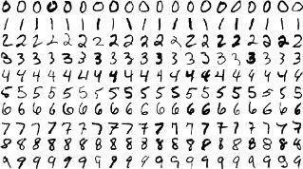

Why to Learn Artificial Intelligence?
4.) NEURAL NETWORKS AND DEEP LEARNING
Neural networks, machine learning and deep learning are in the center of
artificial intelligence (of course becasue these approaches are working fine)
handwritten digit classification
face detection algorithms and face
recognition algorithms
natural language processing (NLP) and
sentiment analysis (text clustering)

Slide 17

Why to Learn Artificial Intelligence?
5.) REINFORCEMENT LEARNING
Reinforcement learning has several applications (self-driving cars) but
the most interesting one is related to games
it is the state of the art approach to deal
with 2 player games
→ chess and AlphaGo etc.

Slide 18
Linear Regression (Machine Learning in Python)

Slide 19
Linear Regression
Linear regression is an approach for modelling the relationship between
scalar dependent variable y and one or more explanatory variables x
SIMPLE LINEAR REGRESSION
single explanatory variable x
we want to approximate the price
of houses if we know the size

Slide 20
Linear Regression
Linear regression is an approach for modelling the relationship between
scalar dependent variable y and one or more explanatory variables x
SIMPLE LINEAR REGRESSION
single explanatory variable x
we want to approximate the price
of houses if we know the size
MULTIPLE LINEAR REGRESSION
several explanatory variables x
we want to approximate the price of
houses if we know the sizes and
the number of rooms etc.

Slide 21
Linear Regression
WHAT IS THE AIM OF LINEAR REGRESSION?
want to find some linear relationship
between the features
prices [$]
500
400
x is the independent variable we use to
make predictions (size of house)
300
H(x) = b₀ + b₁ x
200
H(x) is the dependent variable that we
are trying to predict or estimate
(price of the house)
100
size of houses [m²]
30
50
80
100

Slide 22
Linear Regression
So we build a model based on the dataset
→ it is a linear model so the
result is a linear line
→ the model defines the relationship
between the variables
→ we can make predictions with the
trained model
What does it mean? If we have a new x feature
(size of the house) we can get the H(x) price
of the house accordingly
prices [$]
500
400
300
200
100
size of houses [m²]
30
50
80
100

Slide 23
Linear Regression
we have a dataset (all machine learning algorithm needs one)

Slide 24
Linear Regression
we have a dataset (all machine learning algorithm needs one)
we train the model which means finding the linear relationship
between the H(x) and x variables

Slide 25
Linear Regression
we have a dataset (all machine learning algorithm needs one)
we train the model which means finding the linear relationship
between the H(x) and x variables
H(x) = b₀ + b₁ x
OPTIMIZATION !!!

Slide 26
Linear Regression
we have a dataset (all machine learning algorithm needs one)
we train the model which means finding the linear relationship
between the H(x) and x variables
H(x) = b₀ + b₁ x
OPTIMIZATION !!!
after the training we have the b values which means
we can make predictions with the model for new datapoints

Slide 27
Linear Regression
we have a dataset (all machine learning algorithm needs one)
we train the model which means finding the linear relationship
between the H(x) and x variables
H(x) = b₀ + b₁ x
OPTIMIZATION !!!
after the training we have the b values which means
we can make predictions with the model for new datapoints

Slide 28

Linear Regression
Mean Squared Error (MSE)
it is the difference between the y labels present in the
dataset (supervised learning) and the H(x) values
predicted by the model
ε₇
ε₉
ε₄
ε₆
ε₈
ε₁
ε₃
ε₅
[ H(x) – y ]²
„cost-function”
ε₂
if this term is small (small error): it means the model
predictions are very close to the actual values
$$\sum_{i}{ε}$$
MSE =
2
i
if this term is large (large error): it means the model
predictions differ from the actual values

Slide 29
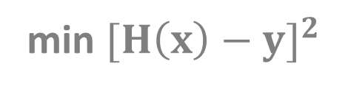
Linear Regression
OPTIMIZATION PROBLEM
this is why optimization algorithms are so important
no matter what problems we are dealing with finally we have to use
some optimization methods to solve it
H(x) is the prediction from
our linear model (linear regression)
min ${[H\left(x\right)−y]}^{2}$
OPTIMIZATION !!!
b
we want to find the minimum
by tuning these parameters
y is the value we know from
the training data

Slide 30
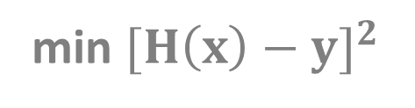
Linear Regression
https://onlinecourses.science.psu.edu/stat501/node/382
OPTIMIZATION PROBLEM
this is why optimization algorithms are so important
no matter what problems we are dealing with finally we have to use
some optimization methods to solve it
DESIGN MATRIX APPROACH (linear algebra)
We can transform the problem into linear equations and
use the standard method (using matrix operations)
min ${[H\left(x\right)−y]}^{2}$
-1
b = (X’X) X’ y
b
GRADIENT DESCENT
It is a first-order iterative optimization algorithm
for finding the minimum of a function

Slide 31
Linear Regression
DESIGN MATRIX APPROACH
it is the best approach
for low-dimensional problems
low dimension means few features
if the matrix is large then the
matrix operations are expensive
in higher dimensions
matrix inversion takes O(N³)
usually there are large number
of feautres
GRADIENT DESCENT
this is an iterative
approach
this algorithm works fine
even in high dimensions
(large number of features)
THIS APPROACH IS PREFERRED !!!

Slide 32
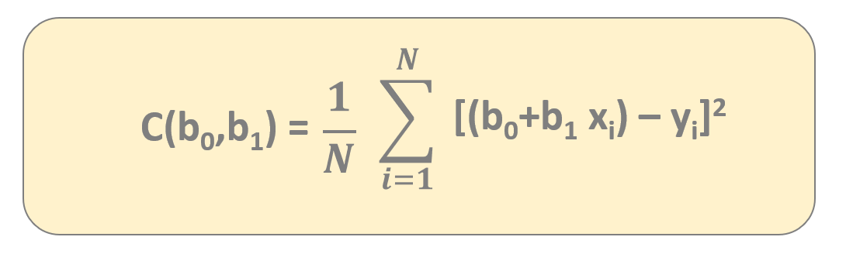


Gradient Descent
$$\sum_{i=1}^{N}{}$$
$$\frac{1}{N}$$
[(b₀+b₁ x_{i}) – y_{i}]²
C(b₀,b₁) =
we can express the C(b₀,b₁) cost-function
because this is the formula we need fr gradient descent

Slide 33
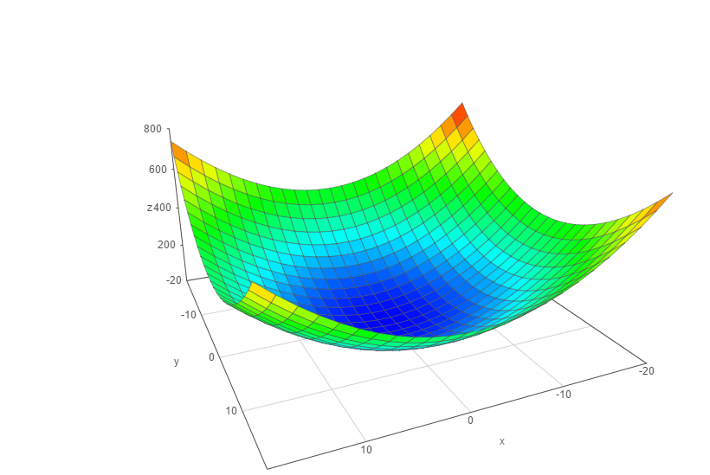
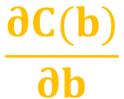
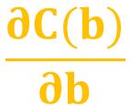
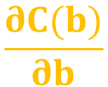

Gradient Descent
We have to know the partial derivative of the C(b) cost function
and go to the direction of the gradient (partial derivative)
C(b)
$$\frac{∂C(b)}{∂b}$$
$$\frac{∂C(b)}{∂b}$$
0
1
the f(x) gradient of a given f(x) function
is pointing in the direction of maximum
Δ
we are after the minimum so we have to use
- f(x) instead (negative gradient)
b
Δ
1
b
make iterations {
}
0
$$\frac{∂C(b)}{∂b}$$
$$\frac{∂C(b)}{∂b}$$
b ← b – α
b ← b – α
0
0
1
1
0
1

Slide 34
Gradient Descent
α: learning-rate
→ small learning-rate: the algorithm takes small
steps towards the minimum and it takes
more time to converge
→ large learning-rate: the algorithm takes big
steps towards the minimum so the algorithm
is faster but not as accurate
C(b)
b
1
b
0

Slide 35



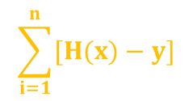
Linear Regression Parameters
2
The R statistic is defined as follows:
2
$$\frac{RSS}{TSS}$$
the higher the better the model fits the data
R = 1 -
measures the accuracy of the regression models
It is the square of the correlation coefficient r
~ so it measures how strong of a linear relationship is
between two variables !!!
RSS - „residual sum of squares”
Measures the variability left unexplained after performing the regression
TSS - „total sum of squares”
It measure the total variance in y
$$\sum_{i=1}^{n}{[H(x)−y]}$$
2
$$\frac{1}{n}$$
$$\sum_{i=1}^{n}{(y−μ)}$$
2

Slide 36
Logistic Regression (Machine Learning in Python)

Slide 37
Logistic Regression
Linear regression solves the problem of regression which means the
result is a scalar value (such as the price of a house)
LOGISTIC REGRESSION SOLVES THE
PROBLEM OF CLASSIFICATION !!!
→ usually we use logistic regression for binary classification
and the output is dicrete (0 or 1)
→ problems such as spam detection for emails, predicting if a customer will
default on a loan (credit scoring problem)
it assigns probabilities to given outcomes so the output is a probability
that the given input belongs to a certain class

Slide 38
Logistic Regression
Applying linear regression for classification problems is not a good idea
we want to deal with probabilities as well
paying back
the debt
it is sensitive to outliers (the model changes dramatically)
it has values outside the [0,1] range and we are after
a binary classification with 2 possible outcomes
1 (YES)
0 (NO)
balance on
credit card
300
500
800
1000

Slide 39
Logistic Regression
Applying linear regression for classification problems is not a good idea
we want to deal with probabilities as well
paying back
the debt
it is sensitive to outliers (the model changes dramatically)
it has values outside the [0,1] range and we are after
a binary classification with 2 possible outcomes
1 (YES)
0 (NO)
balance on
credit card
300
500
800
1000

Slide 40
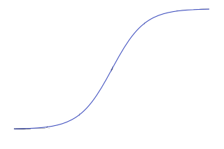
Logistic Regression
Applying linear regression for classification problems is not a good idea
we want to deal with probabilities as well
paying back
the debt
it is sensitive to outliers (the model changes dramatically)
it has values outside the [0,1] range and we are after
a binary classification with 2 possible outcomes
1 (YES)
1
f(x) =
1 + e
-x
this is the so-called logistic function
that has the features we have discussed earlier
0 (NO)
balance on
credit card
300
500
800
1000

Slide 41
Logistic Regression
1
this is the so-called logistic function
that has values in the range [0,1]
f(x) =
1 + e
-x
we are able to solve the problems we have discussed in the
previous lectures and slides
it has a value between [0,1] so it can be interpreted as probability
this logistic function is not sensitive to outliars

Slide 42
Logistic Regression
So instead of a linear model we have to deal with the sigmoid-function
1
p(x) =
1 + e
- (b + b * x)
0
1
the probability of default given x balance
p(x) = P(y=1|x=balance)
these are the model parameters b₀ and b₁
there are several ways to fit the model
→ gradient descent
→ maximum-likelihood method

Slide 43
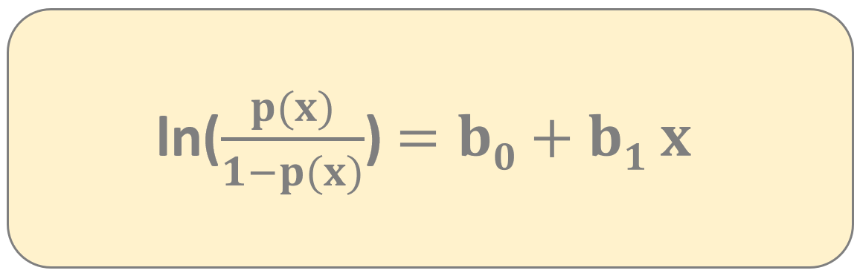
Logistic Regression
So instead of a linear model we have to deal with the sigmoid-function
„logit transformation”
the point of the logit transformation is to make it linear – so logistic regression
is a linear regression on the logit transformation
we can fit the b parameters with gradient descent and maximum-likelihood method
Logistic regression is a generalized linear model not because the estimated probability
of the response is linear but because the logit of the estimated
probability response is a linear function of the parameters

Slide 44
Logistic Regression
SIMPLE LOGISTIC REGRESSION MULTINOMIAL LOGISTIC REGRESSION
we have just a single x parameter
for example balance on credit card
we have multiple x parameters
for example balance on credit card, age,
gender, demographics, loan to income ratio etc.
1
1
p(x) =
p(x) =
- (b + b * x)
1 + e
- (b + b * x + ... + b x )
1 + e
0
1
0
1
1
n
n
Usually we use logistic regression for binary classification so with 2 output classes
for example email classification (spam or not) or a client is sick or healthy ...

Slide 45
Logistic Regression
Maximum likelihood estimation is a method of estimating the parameters of a
statistical model given observations by finding the parameter values that
maximize the likelihood of making the observations given the parameters
l(β,x) = ln L(β,x)
this is the log
likelihood-function
this is the
likelihood-function
The aim is the same as we have seen for linear regression so we are after the
optimal b values that maximizes the likelihood-function
b such that arg max l(β,x)
b

Slide 46
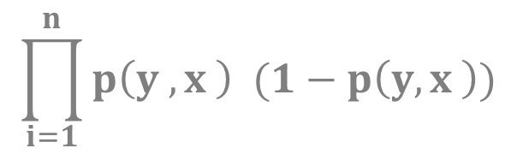
Logistic Regression
Maximum likelihood estimation is a method of estimating the parameters of a
statistical model given observations by finding the parameter values that
maximize the likelihood of making the observations given the parameters
$$\prod_{i=1}^{n}{p\left(y ,x \right) (1−p\left(y,x \right))}$$
y
1-y
L(β) =
i
i
i
i
i
i
likelihood-function for
logistic regression
1
p(y ,x ) =
i
i
1 + e
- (x’ * b )
i
this estimate is usually obtained by using the
iterative Newton-Raphson method

Slide 47
Cross Validation (Machine Learning in Python)

Slide 48
Cross Validation
TRAINING DATASET
TEST DATASET
~ 70% of the original dataset
~ 30% of the original dataset
We fit the model to the training dataset then we test the model on the test dataset
We only have information how the model performs to our in-sample data
but we would like to see the accuracy when dealing with new data
OVERFITTING model has trained „too well” on the training dataset
→ it means it is very accurate on the training dataset but yields
poor results on the test set (due to too complex models)
→ the model learns the „noise” instead of the actual relationships
between the variables in the data (of course this noise
is not present in the test set...)
x
2
x
1

Slide 49
Cross Validation
TRAINING DATASET
TEST DATASET
~ 70% of the original dataset
~ 30% of the original dataset
We fit the model to the training dataset then we test the model on the test dataset
We only have information how the model performs to our in-sample data
but we would like to see the accuracy when dealing with new data
UNDERFITTING model has not been fitted well to the training dataset
→ misses the trends in the training dataset
→ this is usually the case when we use too
simple models for the problem
x
2
x
1

Slide 50
Cross Validation
K-FOLDS CROSS VALIDATION
helps to avoid underfitting as well as overfitting (by the way it helps
to avoid overfitting more than underfitting)
the aim is to be able to generalize the model to new datasets with same accuracy
we use all the data for training (no need to split the original dataset)

Slide 51
Cross Validation
K-FOLDS CROSS VALIDATION
helps to avoid underfitting as well as overfitting (by the way it helps
to avoid overfitting more than underfitting)
the aim is to be able to generalize the model to new datasets with same accuracy
we use all the data for training (no need to split the original dataset)
DATASET

Slide 52
Cross Validation
K-FOLDS CROSS VALIDATION
helps to avoid underfitting as well as overfitting (by the way it helps
to avoid overfitting more than underfitting)
the aim is to be able to generalize the model to new datasets with same accuracy
we use all the data for training (no need to split the original dataset)
split the data into k folds
(for example k=5)

Slide 53
Cross Validation
K-FOLDS CROSS VALIDATION
helps to avoid underfitting as well as overfitting (by the way it helps
to avoid overfitting more than underfitting)
the aim is to be able to generalize the model to new datasets with same accuracy
we use all the data for training (no need to split the original dataset)
split the data into k folds
(for example k=5)
we run k separate learning experiments with k-1 folds
for training and 1 fold for the test set we and finally we average
the results from this k experiments

Slide 54
Cross Validation
K-FOLDS CROSS VALIDATION
helps to avoid underfitting as well as overfitting (by the way it helps
to avoid overfitting more than underfitting)
the aim is to be able to generalize the model to new datasets with same accuracy
we use all the data for training (no need to split the original dataset)
split the data into k folds
(for example k=5)
we run k separate learning experiments with k-1 folds
for training and 1 fold for the test set we and finally we average
the results from this k experiments

Slide 55
Cross Validation
K-FOLDS CROSS VALIDATION
helps to avoid underfitting as well as overfitting (by the way it helps
to avoid overfitting more than underfitting)
the aim is to be able to generalize the model to new datasets with same accuracy
we use all the data for training (no need to split the original dataset)
split the data into k folds
(for example k=5)
we run k separate learning experiments with k-1 folds
for training and 1 fold for the test set we and finally we average
the results from this k experiments

Slide 56
Cross Validation
K-FOLDS CROSS VALIDATION
helps to avoid underfitting as well as overfitting (by the way it helps
to avoid overfitting more than underfitting)
the aim is to be able to generalize the model to new datasets with same accuracy
we use all the data for training (no need to split the original dataset)
split the data into k folds
(for example k=5)
we run k separate learning experiments with k-1 folds
for training and 1 fold for the test set we and finally we average
the results from this k experiments

Slide 57
Cross Validation
K-FOLDS CROSS VALIDATION
helps to avoid underfitting as well as overfitting (by the way it helps
to avoid overfitting more than underfitting)
the aim is to be able to generalize the model to new datasets with same accuracy
we use all the data for training (no need to split the original dataset)
split the data into k folds
(for example k=5)
we run k separate learning experiments with k-1 folds
for training and 1 fold for the test set we and finally we average
the results from this k experiments

Slide 58
Cross Validation
K-FOLDS CROSS VALIDATION
helps to avoid underfitting as well as overfitting (by the way it helps
to avoid overfitting more than underfitting)
the aim is to be able to generalize the model to new datasets with same accuracy
we use all the data for training (no need to split the original dataset)
split the data into k folds
(for example k=5)
HUGE ADVANTAGE
all observations are used for both training and validation
and each observations are used for validation exactly once

Slide 59
Cross Validation
K-Folds Cross Validation
helps to avoid underfitting as well as overfitting
(help to avoid overfitting more than underfitting)
the aim is to be able to generalize the model to new datasets with same accuracy
we use all the data for training !!!
Let’s split the data into k folds (for example k=5)
we run k separate learning experiments
k-1 folds for training and 1 fold for the test set
we average the results from this k experiments
ADVANTAGE: all observations are used for both training and validation
+ each observations are used for validation exactly once

Slide 60
Confusion Matrix
PREDICTED
0
1
122
12
0
ACTUAL
34
89
1
Describes the performance of a classification models
diagonal elements are the correct classifications
off-diagonals are the incorrect predictions

Slide 61
Normalization (Machine Learning in Python)

Slide 62
Confusion Matrix
features are usually transformed into a range before the kNN algorithm is applied
WHY?
the distance formula depends on how features are measured
if certain features have much larger values than others the distance measurements will be strongly dominated by the larger values
we have to rescale the various features such that each one contributes relatively equally to the distance formula
min-max normalization
z-transformation

Slide 63
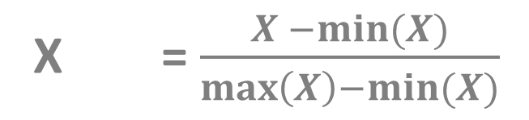
Confusion Matrix
MIN-MAX NORMALIZATION
this process transforms a feature such that all of its values
fall in a range between 0 and 1
normalized feature values can be interpreted as indicating how
far from 0% to 100% the original value fall along the
range between the original minima and maxima
X = $\frac{X −min⁡(X)}{\max\left(X\right)−min⁡(X)}$
new

Slide 64
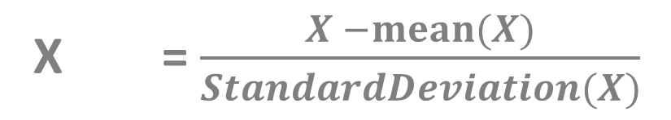
Confusion Matrix
Z-SCORE TRANSFORMATION
it is a way of normalizing the dataset as well: the algorithm
uses mean and standard deviation to do so
X = $\frac{X −mean⁡(X)}{StandardDeviation(X)}$
new
for Principle Component Analysis (PCA) we prefer using z-score normalization
but for image processing pixel intensities have to be normalized to fit within a
certain range + neural networks requires data that on a 0-1 scale

Slide 65
K-Nearest Neighbors Classifier (Machine Learning in Python)

Slide 66
K-Nearest Neighbors Classifier
it was first developed by Evelyn Fix and Joseph Hodges in 1951
k-nearest neighbors (kNN) classifier can classify examples by assigning them the class of the most similar labeled examples
very simple BUT extremely powerful algorithm
kNN is well suited for classification tasks where the relationships between the features are very complex and hard to understand

Slide 67
K-Nearest Neighbors Classifier
we have a training dataset so examples that are classified into several categories
we have a new example (with the same number of features as the training data) kNN algorithm identifies k elements in the training dataset that are the „nearest” in similarity
the unlabeled test example is assigned to the class of the majority of the k nearest neighbors

Slide 68
K-Nearest Neighbors Classifier
INGREDIENTS
SWEETNESS
CRUNCHINESS
TYPE
apple 10 9 fruit
bacon 1 4 protein
banana 10 1 fruit
carrot 7 10 vegetable
cheese 1 1 protein

Slide 69
K-Nearest Neighbors Classifier
INGREDIENTS
SWEETNESS
CRUNCHINESS
TYPE
apple 10 9 fruit
bacon 1 4 protein
banana 10 1 fruit
carrot 7 10 vegetable
cheese 1 1 protein
tomato 6 4 ???

Slide 70
K-Nearest Neighbors Classifier
crunchiness
carrot
cucumber
apple
bacon
orange
fish
banana
cheese
sweetness

Slide 71
K-Nearest Neighbors Classifier
crunchiness
carrot
cucumber
apple
bacon
orange
fish
banana
cheese
sweetness

Slide 72
K-Nearest Neighbors Classifier
crunchiness
the algorithm needs a distance-function to be able
to classify new data points (such as tomato)
Euclidean-distance or Manhattan-distance
carrot
cucumber
apple
tomato
bacon
orange
fish
banana
cheese
sweetness

Slide 73
K-Nearest Neighbors Classifier
lazy learners does not learn anything
we just store the training data – training is very fast (because there is no training at all) but making the prediction is rather slow (calculating the distances is expensive)
this is who dimension reduction approaches can be applied with principle components (PCA)
WE DO NOT BUILD A MODEL !!!
this is a non-parametric learning so no parameters are to be learned about the data
with linear regression and logistic regression we have to learn the b parameters either with gradient descent or with maximum likelihood method

Slide 74
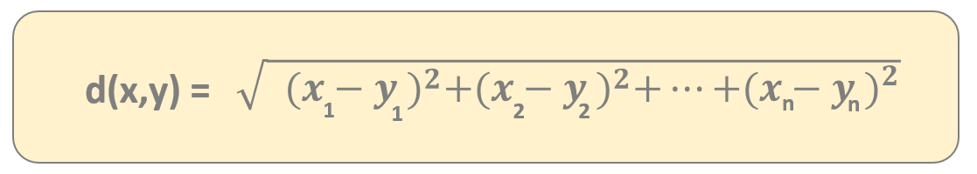
K-Nearest Neighbors Classifier
There are several types of distance metrics
Q(x₂, y₂)
in mathematics a metric or distance function is a function
that gives a distance between each pair of
point elements of a set
THIS IS HOW WE CAN MEASURE THE SIMILARITY !!!
d(P,Q)
P(x₁, y₁)
„Euclidean-distance”

Slide 75
K-Nearest Neighbors Classifier
There are several types of distance metrics
Q(x₂, y₂)
in mathematics a metric or distance function is a function
that gives a distance between each pair of
point elements of a set
THIS IS HOW WE CAN MEASURE THE SIMILARITY !!!
d(P,Q)
P(x₁, y₁)
dist(x,y) = |x₁-y₁| + |x₂-y₂| + ... + |x_{n}-y_{n}|
„Manhattan-distance”

Slide 76
K-Nearest Neighbors Classifier
EUCLIDEAN-DISTANCE
usually not recommended in higher dimensions
scales poorly with the number of dimensions
we can deal with the square euclidean distance as well
MANHATTAN-DISTANCE
Manhattan-distance is usually preferred
scales well with the number of dimensions

Slide 77

K-Nearest Neighbors Classifier
crunchiness
the algorithm needs a distance-function to be able
to classify new data points (such as tomato)
Euclidean-distance or Manhattan-distance
carrot
cucumber
apple
dist(tomato,carrot) =
$\sqrt{{ {(6−7)}^{2}+(4−10)}^{2}}$ = 6.083
tomato
bacon
orange
fish
banana
cheese
sweetness

Slide 78

K-Nearest Neighbors Classifier
crunchiness
the algorithm needs a distance-function to be able
to classify new data points (such as tomato)
Euclidean-distance or Manhattan-distance
carrot
cucumber
apple
dist(tomato,apple) =
$\sqrt{{ {(6−10)}^{2}+(4−9)}^{2}}$ = 6.403
tomato
bacon
orange
fish
banana
cheese
sweetness

Slide 79

K-Nearest Neighbors Classifier
crunchiness
the algorithm needs a distance-function to be able
to classify new data points (such as tomato)
Euclidean-distance or Manhattan-distance
carrot
cucumber
apple
dist(tomato,bacon) =
$\sqrt{{ {(6−1)}^{2}+(4−4)}^{2}}$ = 5
tomato
bacon
orange
fish
banana
cheese
sweetness

Slide 80

K-Nearest Neighbors Classifier
crunchiness
the algorithm needs a distance-function to be able
to classify new data points (such as tomato)
Euclidean-distance or Manhattan-distance
carrot
cucumber
apple
dist(tomato,banana) =
$\sqrt{{ {(6−10)}^{2}+(4−1)}^{2}}$ = 5
tomato
bacon
orange
fish
banana
cheese
sweetness

Slide 81

K-Nearest Neighbors Classifier
crunchiness
the algorithm needs a distance-function to be able
to classify new data points (such as tomato)
Euclidean-distance or Manhattan-distance
carrot
cucumber
apple
dist(tomato,cheese) =
$\sqrt{{ {(6−1)}^{2}+(4−1)}^{2}}$ = 5.83
tomato
bacon
orange
fish
banana
cheese
sweetness

Slide 82
K-Nearest Neighbors Classifier
crunchiness
k=1
we consider the smallest distance (bacon and banana)
k=2
we consider the 2 smallest distances (bacon and banana)
50%-50% that tomato is a fruit or a protein
carrot
k=3
we consider the 3 smallest distances bacon, banana
and cheese so tomato appears to be a protein
cucumber
apple
tomato
bacon
orange
fish
banana
cheese
sweetness

Slide 83
K-Nearest Neighbors Classifier
BIAS AND VARAINCE TRADE-OFF
bias and variance trade-off is an important concept in machine learning
the bias is the error from the incorrect assumptions in the algorithm
high bias (underfitting) oversimplifies the model and miss the relationships between the features and target variables
E[H(x)] – y
the bias is essentially the difference between
the model predition and the label

Slide 84
K-Nearest Neighbors Classifier
BIAS AND VARAINCE TRADE-OFF
bias and variance trade-off is an important concept in machine learning
variance is the error from the sensitivity to random fluctuations in the training dataset
high variance (overfitting) focuses on the training data and does not generalize well on data it has not seen before
E[(H(x)– E[H(x)])²]
the variance is the expected value of the squared
deviation of a random variable from its mean

Slide 85
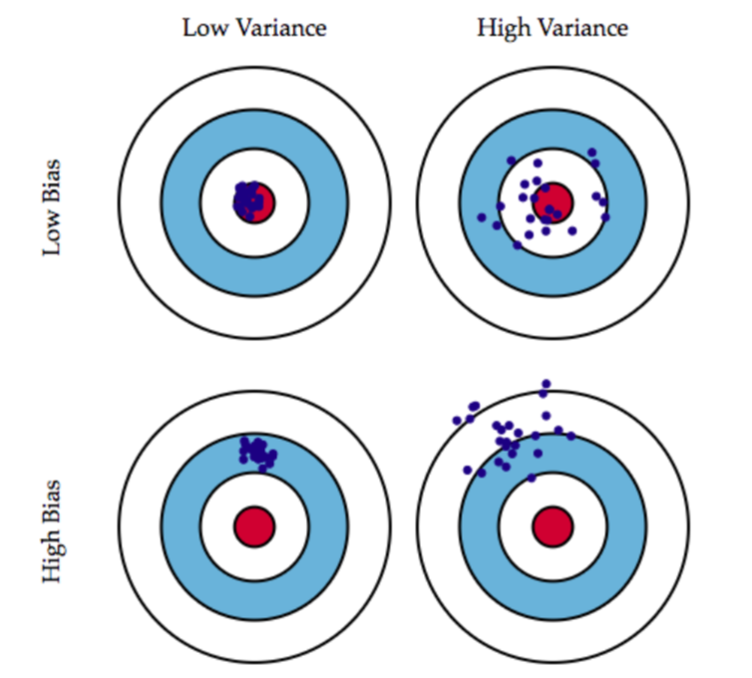
K-Nearest Neighbors Classifier
BIAS AND VARIANCE TRADE-OFF

Slide 86
K-Nearest Neighbors Classifier
BIAS AND VARIANCE TRADE-OFF
this is the case of
underfitting

Slide 87
K-Nearest Neighbors Classifier
BIAS AND VARIANCE TRADE-OFF
this is the case of
overfitting

Slide 88
K-Nearest Neighbors Classifier
HOW TO CHOOSE THE OPTIMAL K VALUE
Deciding how many neighbors to use for kNN determines how well the model will generalize and work on other datasets. There is a trade-off between bias and variance.
SMALL k VALUE
noisy data or outliers have a huge
impact on our classifier
this is the case of overfitting
high variance and low
bias model
LARGE k VALUE
the classifier has the tendency to
predict the majority class regardless
of which neighbors are nearest
this is called underfitting
variance is low but the
bias is high

Slide 89
Naïve Bayes Classifier (Machine Learning in Python)

Slide 90
Naive Bayes Classifier
naive bayes classifier is a very efficient supervised learning classification algorithm
it scales well even in high dimensions (several features)
it is able to compete with SVM or random forest classifiers
naive bayes classifier can make good predictions even when the training data is relatively small
WHY IS IT CALLED NAIVE?
the naive assumption is that each input variable (feature) is independent

Slide 91
Naive Bayes Classifier
Naive means there is a strong independence assumptions
between the given features (input variabes)
For example: a fruit can be considered to be an apple if it is red, rounded
and about 8 cm in diameter
→ naive Bayes classifier considers each of these features contribute
independently to the probability that this fruit is an apple
→ it does not care about the correlation between color,
roundness, diameter and other features

Slide 92
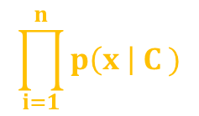
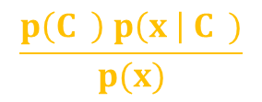
Naive Bayes Classifier
ABSTRACT MATHEMATICAL APPROACH
x are the features
P(C | x x ... x )
this model relies heavily on conditional probability
k
1
2
n
C is the possible
outcome of k classes
$$\frac{p\left(C \right) p\left(x \right| C )}{p(x)}$$
this is the Bayes theorem stating that
we can decompose the conditional probability
P(C | x x ... x ) =
k
-
k
k
1
2
n
-
the same for all c values
k
P( x x ... x | C ) = P(x | C ) P(x | C ) ... P(x | C )
FEATURES ARE INDEPENDENT
THIS IS WHY THE PROBABILITY IS
EASIER TO COMPUTE !!!
1
2
n
k
1
k
2
k
n
k
$$\prod_{i=1}^{n}{p\left(x \right| C )}$$
P(C | x x ... x ) p(C )
k
1
2
n
~
k
i
k

Slide 93
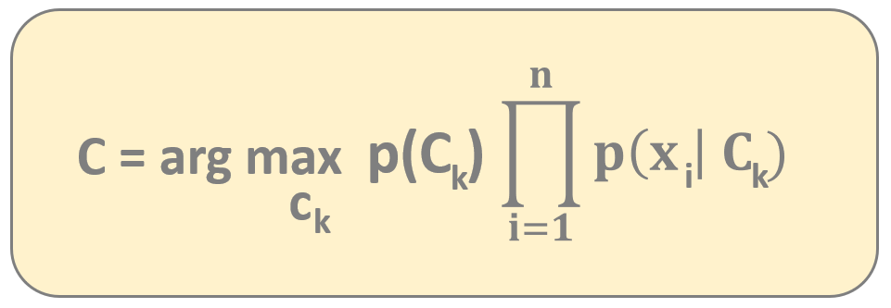
Naive Bayes Classifier
ABSTRACT MATHEMATICAL APPROACH
If we assume the features are independent we can come up with
a powerful probability-based classification algorithm
→ we have to choose the C class with the highest probability
k
NAIVE BAYER CLASSIFIER FORMULA

Slide 94
Naive Bayes Classifier
DISADVANTAGES
naive Bayes classifier has the
assumption that the features
are independent ...
... and of course it is usally
not true at all

Slide 95
Naive Bayes Classifier
DISADVANTAGES
naive Bayes classifier has the
assumption that the features
are independent ...
... and of course it is usally
not true at all
ADVANTAGES
it is relatively simple
to undertand the model
it is a relatively fast algorithm
and can be trained on
small datasets as well
naive Bayes classifier is
not sensitive to
irrelevant features

Slide 96
Naive Bayes Classifier
Why is it so powerful with text classification?
The 2 assumptions of naive Bayes classifier:
→ the probability of occurrence of any word given the class label is
independent of the probability of occurrence of
any other word given that label
→ the probability of occurrence of a word in a document is independent
of the location of that word within the document
It is the same assumption of bag-of-words model – documents are
just a bunch of words thrown together
THESE ASSUMPTIONS ARE TRUE FOR TEXT CLASSIFICATION !!!

Slide 97
Naive Bayes Classifier

Slide 98
Naive Bayes Classifier
x

Slide 99


Naive Bayes Classifier
P(yellow) = $\frac{7}{17}$
P(green) = $\frac{10}{17}$
x

Slide 100


Naive Bayes Classifier
P(yellow) = $\frac{7}{17}$
P’(x | green) = $\frac{3}{10}$
P(green) = $\frac{10}{17}$
P’(x | yellow) = $\frac{1}{7}$
x

Slide 101
Naive Bayes Classifier
P(yellow) = $\frac{7}{17}$
P’(x | green) = $\frac{3}{10}$
P(green) = $\frac{10}{17}$
P’(x | yellow) = $\frac{1}{7}$
x
posterior probability P’’(x is green ) = P(green) * P’(x | green) = $\frac{10}{17}$ * $\frac{3}{10}= \frac{30}{170}$

Slide 102
Naive Bayes Classifier
P(yellow) = $\frac{7}{17}$
P’(x | green) = $\frac{3}{10}$
P(green) = $\frac{10}{17}$
P’(x | yellow) = $\frac{1}{7}$
x
posterior probability P’’(x is green ) = P(green) * P’(x | green) = $\frac{10}{17}$ * $\frac{3}{10}= \frac{30}{170}$
posterior probability P’’(x is yellow ) = P(yellow) * P’(x | yellow) = $\frac{7}{17}$ * $\frac{1}{7}= \frac{7}{119}$

Slide 103
Naive Bayes Classifier
P(yellow) = $\frac{7}{17}$
P’(x | green) = $\frac{3}{10}$
P(green) = $\frac{10}{17}$
P’(x | yellow) = $\frac{1}{7}$
x
posterior probability P’’(x is green ) = P(green) * P’(x | green) = $\frac{10}{17}$ * $\frac{3}{10}= \frac{30}{170}$
posterior probability P’’(x is yellow ) = P(yellow) * P’(x | yellow) = $\frac{7}{17}$ * $\frac{1}{7}= \frac{7}{119}$

Slide 104
Support Vector Machines (SVMs) (Machine Learning in Python)

Slide 105
Support Vector Machines (SVMs)
very popular and widely used supervised learning classification algorithm
the great benefit is that it can operate even in infinite dimensions
it defines a margin (decision boundary) between the data points in the multidimensional space
the goal is to find a flat boundary ( also known as the hyperplane) that leads to a homogeneous partition of the data
a good separation is achieved by the hyperplane that has the largest distance to the nearest training-data point of any class since in general the larger the margin the lower the generalization error of the classifier
SO WITH SUPPORT VECTOR MACHINE ALGORITHM WE MAXIMIZE THE MARGIN

Slide 106
Support Vector Machines (SVMs)
x
2
x
1

Slide 107
Support Vector Machines (SVMs)
x
2
we want to find a hyperplane
in this case a linear line that separates
the different data points with
the maximum margin
x
1

Slide 108
Support Vector Machines (SVMs)
x
2
we want to find a hyperplane
in this case a linear line that separates
the different data points with
the maximum margin
x
1

Slide 109
Support Vector Machines (SVMs)
x
2
we are looking for the margin (decision
boundary) with the largest width
THIS IS THE MAXIMUM MARGIN !!!
x
1

Slide 110
Support Vector Machines (SVMs)
the points that are closest to the
maximum margin are called
the support-vectors
THE SUPPORT VECTORS STORE
THE INFORMATION FOR THE
DECISION BOUNDARY !!!
if we change the positions (feature values)
of other data points then
nothing happens
~ but if we change the support vectors
then the model changes as well
x
2
x
1

Slide 111
Support Vector Machines (SVMs)
each class have at least one support vector
we can use the support vectors exclusively to reconstruct the hyerplane so the decision boundary
THIS IS AN EXTREMELY POWERFUL FEATURE
the classification model can be stored even when there are an extemely huge amount of features

Slide 112
Support Vector Machines (SVMs) (Machine Learning in Python)

Slide 113
Support Vector Machines (SVMs)
in geometry a hyperplane is a subspace
that has one dimension fewer than
its ambient space
THE HYPERPLANE SEPARATES THE
SPACE INTO TWO PARTS !!!
the general equation for a
hyperplane is w^{T}x + b = 0
x
2
x
1

Slide 114
Support Vector Machines (SVMs)
in geometry a hyperplane is a subspace
that has one dimension fewer than
its ambient space
THE HYPERPLANE SEPARATES THE
SPACE INTO TWO PARTS !!!
the general equation for a
hyperplane is w^{T}x + b = 0
x
2
y = ax + b
y - ax - b = 0
x
1

Slide 115
Support Vector Machines (SVMs)
in geometry a hyperplane is a subspace
that has one dimension fewer than
its ambient space
THE HYPERPLANE SEPARATES THE
SPACE INTO TWO PARTS !!!
the general equation for a
hyperplane is w^{T}x + b = 0
x
2
T
y = ax + b
y - ax - b = 0
1
y
- b = 0
-a
x
x
1

Slide 116
Support Vector Machines (SVMs)
x
2
y = -x + 5
y + x – 5 = 0
x
1

Slide 117
Support Vector Machines (SVMs)
(10,10)
x
2
(1,1)
y = -x + 5
y + x – 5 = 0
x
1

Slide 118
Support Vector Machines (SVMs)
(10,10)
T
1
1
- 5 = -3 < 0
1
1
x
2
(1,1)
y = -x + 5
y + x – 5 = 0
x
1

Slide 119
Support Vector Machines (SVMs)
(10,10)
T
1
10
- 5 = 15 > 0
1
10
x
2
(1,1)
y = -x + 5
y + x – 5 = 0
x
1

Slide 120
Support Vector Machines (SVMs)
>
>
>
x
>
2
>
<
<
<
y = -x + 5
y + x – 5 = 0
<
x
1

Slide 121
Support Vector Machines (SVMs)
x
2
H₁ = H+δ
H
H₂ = H-δ
x
1

Slide 122
Support Vector Machines (SVMs)
for all the data points in this
side of the hyperplane
w^{T}x + b > δ
x
2
for all the data points in this
side of the hyperplane
w^{T}x + b < -δ
H₁ = H+δ
H
H₂ = H-δ
x
1

Slide 123
Support Vector Machines (SVMs)
for all the data points in this
side of the hyperplane
w^{T}x + b > δ
for mathematical convenience we usually set the delta offset to one (δ=1) to simplify the design of the classifier and the output labels are +1 and -1 accordingly
x
2
for all the data points in this
side of the hyperplane
w^{T}x + b < -δ
H+δ
H
H-δ
x
1

Slide 124
Support Vector Machines (SVMs)
It is convenient to define δ=1
because it allows the classification constraints to be combined into a single constraint
we define the H hyperplane such that
w x_{i} + b ≥ 1 when y_{i} = 1 and
w x_{i} + b ≤ -1 when y_{i} = -1
y_{i}(w x_{i} + b) ≥ 1
this is the single constraint
we have to deal with !!!
(and of course support vectors are when y_{i}(w x_{i} + b) = 1)
x
2
H₁ = H+1
H
H₂ = H-1
x
1

Slide 125
Support Vector Machines (SVMs)
we define the H hyperplane such that
w x_{i} + b ≥ 1 when y_{i} = 1 and
w x_{i} + b ≤ -1 when y_{i} = -1
points on the H₁ and H₂ lines are
called the support vectors
the distance between H₁ and H₂ lines is δ₊ + δ₋
WHAT IS THE TOTAL DISTANCE BETWEEN H₁ AND H₂ ?
it is crucial because SVM is a maximum margin classifier so we have to maximize the distance
x
2
H₁ = H+1
H
H₂ = H-1
x
1

Slide 126


Support Vector Machines (SVMs)
the distance between H and H₁ (and this is the distance between H and H₂ as well) is defined by the following formula
and if we want to get the total distance between H₁ and H₁ then:
so this is a typical maximization problem
$$\frac{1}{|\left|w\right||}$$
x
2
H₁ = H+1
$$\frac{2}{|\left|w\right||}$$
H
H₂ = H-1
x
1

Slide 127
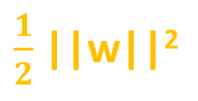
Support Vector Machines (SVMs)
every maximization problem can be transformed into a minimization problem
we can minimize this function instead and we can transform the problem into:
so this is a typical minimization problem
||w||
x
2
$\frac{1}{2}$ ||w||²
H₁ = H+1
min
w
H
y_{i}(w x_{i} + b) ≥ 1 i=1...N
H₂ = H-1
x
1

Slide 128
Support Vector Machines (SVMs)
every maximization problem can be transformed into a minimization problem
we can minimize this function instead and we can transform the problem into:
so this is a typical minimization problem
||w||
PRIMAL FORM OF
THE PROBLEM !!!
x
2
$\frac{1}{2}$ ||w||²
H₁ = H+1
min
w
H
y_{i}(w x_{i} + b) ≥ 1 i=1...N
H₂ = H-1
x
1

Slide 129
Support Vector Machines (SVMs) (Machine Learning in Python)

Slide 130
Support Vector Machines (SVMs)
the main problem is that in real-world problems are non-linearly separable
instead of classifying all the data points correctly – we allow some mistakes
in many real-world applications the relationships between variables are usually non-linear
a key feature of SVMs is their ability to map the problem into a higher dimensional space using a process known as the „kernel trick”
non-linear relationship may suddenly appears to be quite linear

Slide 131
Support Vector Machines (SVMs)
the main problem is that in real-world problems are non-linearly separable
instead of classifying all the data points correctly – we allow some mistakes
in many real-world applications the relationships between variables are usually non-linear
a key feature of SVMs is their ability to map the problem into a higher dimensional space using a process known as the „kernel trick”
non-linear relationship may suddenly appears to be quite linear

Slide 132
Support Vector Machines (SVMs)
x
a_{j}
2
a_{i}
we allow misclassifications
because real-world problems
can not be sepratared linearly
a_{i} (slack variables) define the
distances from the decision boundary
x
1

Slide 133


Support Vector Machines (SVMs)
$$\sum_{i}{a}$$
$\frac{1}{2}$ ||w||²
min [ ]
+ C
w
i
y_{i}(w x_{i} + b) ≥ 1-a_{i} i=1...N
C is the cost parameter to all points that violate the constraints
(by the way a_{i} is 0 for the points that are classified correctly)
we make our optimization on this cost function
we can tune the C parameter: we can modify the penalty
for the data points that are misclassified
C is very large then the algorithm tries to find a 100% separation
C is low then wider overall margin is allowed with more misclassified data points

Slide 134
Support Vector Machines (SVMs)
DISADVANTAGES
SVM deals with a large number
of parameters and kernels
quite slow especially when there is
a large number of features
quite hard to understand
„black box model”
there are no probabilities
associated with the predictions
ADVANTAGES
SVM can be used both for
regression and classification as well
it uses a subset of the dataset
(support vectors) in the decision
function so it is memory friendly
SVM is working fine
even in inifinite dimensions
easier to use than neural netoworks

Slide 135
Support Vector Machines (SVMs) (Machine Learning in Python)

Slide 136
Support Vector Machines (SVMs)
x₁
(latitude)
x₂
(longitude)

Slide 137
Support Vector Machines (SVMs)
φ(x)
„kernel function”
x₁
(latitude)
x₁² + x₂²
(alitude)
x₂
(longitude)
x₂
(longitude)
with the kernel function we can transform
the problem into a higher dimensional space
that is a linearly separable one
(additional variabe is altitude )

Slide 138
Support Vector Machines (SVMs)
φ(x)
„kernel function”
x₁
(latitude)
x₁² + x₂²
(alitude)
x₂
(longitude)
x₂
(longitude)
SVM LEARNS CONCEPTS (FEATURE) THAT WERE NOT EXPLlCITLY
MEASURED IN THE ORIGINAL DATASET !!!

Slide 139
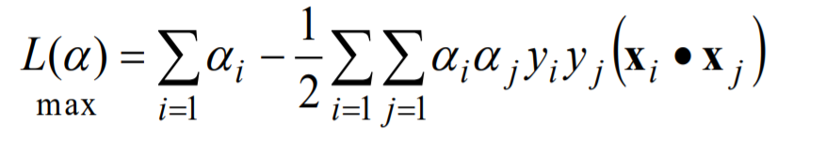
Support Vector Machines (SVMs)
so with the help of the φ(x) kernel-function we transform all the points in the dataset one by one
and we end up with a higher dimensional space (because we have additional features)
in the loss-function we just have to use φ(x_{i}) * φ(x_{j})
after applying the kernel-function
BUT THIS IS EXPENSIVE IN COMPUTATION AND MEMORY HEAVY OPERATION AS WELL !!!

Slide 140
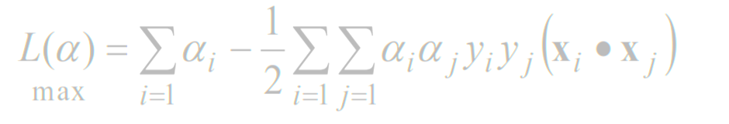
Support Vector Machines (SVMs)
so with the help of the φ(x) kernel-function we transform all the points in the dataset one by one
and we end up with a higher dimensional space (because we have additional features)
THIS IS WHY THE KERNEL TRICK IS SO POWERFUL
- we can calculate φ(x_{i}) * φ(x_{j}) without dealing with the higher dimensional features and data -
in the loss-function we just have to use φ(x_{i}) * φ(x_{j})
after applying the kernel-function
BUT THIS IS EXPENSIVE IN COMPUTATION AND MEMORY HEAVY OPERATION AS WELL !!!

Slide 141
Support Vector Machines (SVMs)
kernel-functions define inner products in the transformed (higher dimensional) space
IT DEFINES THE SIMILARITY IN THE TRANSFORMED SPACE !!!
the most powerful statement is that we do not need to compute φ(x) at all to compute K(x_{i},x_{j}) = φ(x_{i}) * φ(x_{j})

Slide 142
Support Vector Machines (SVMs)
kernel-functions define inner products in the transformed (higher dimensional) space
IT DEFINES THE SIMILARITY IN THE TRANSFORMED SPACE !!!
the most powerful statement is that we do not need to compute φ(x) at all to compute K(x_{i},x_{j}) = φ(x_{i}) * φ(x_{j})
K(x_{i},x_{j})

Slide 143
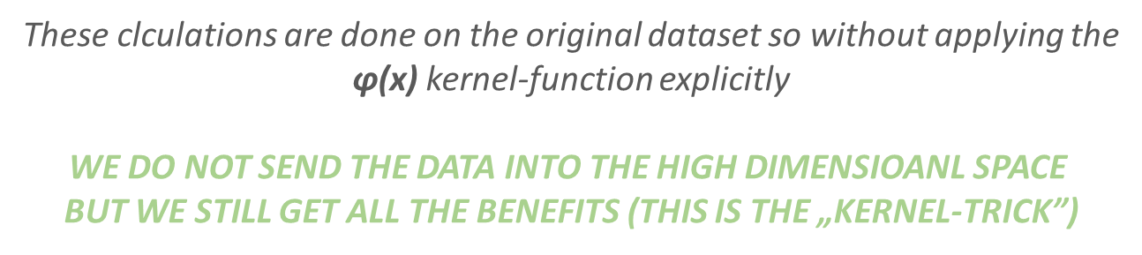
Support Vector Machines (SVMs)
K(x_{i} , x_{j} ) = x_{i} * x_{j}
linear kernel that does not transform the data
K(x_{i} , x_{j} ) = (x_{i} * x_{j} + 1)^{d}
polynomial kernel
2
-
|| x_{i} - x_{j} ||
K(x_{i} , x_{j} ) =
exp
gaussian radial basis function kernel
2σ²
These clculations are done on the original dataset so without applying the
$\text{φ}\text{(}\text{x}\text{)}$ kernel-function explicitly
WE DO NOT SEND THE DATA INTO THE HIGH DIMENSIOANL SPACE
BUT WE STILL GET ALL THE BENEFITS (THIS IS THE „KERNEL-TRICK”)

Slide 144
K-Means Clustering (Machine Learning in Python)

Slide 145
K-Means Clustering
was first proposed by Stuart Lloyd in 1957 and Edward W. Forgy published essentially the same method
this is why it is also known as Lloyd–Forgy algorithm
very popular unsupervised learning algorithm in data mining
automatically divides the data into clusters of similar items and it does this without having been told what the groups should look like ahead of time
PROBLEM: how could a computer possibly know where one group ends and another begins?
elements inside a cluster should be very similar to each other, but very different from those outside

Slide 146
K-Means Clustering
MAIN PROBLEM
– how could a computer possibly know where
one group ends and another begins? –
basic idea is that elements inside a cluster should be very similar
to each other but very different from those outside

Slide 147
K-Means Clustering
k-means clustering aims to partition N observations into k clusters in which each observation belongs to the cluster with the nearest mean
the same can be achieved with graph algorithms – we just ahve to construct the minimum spanning tree and remove the last k edges
it is an NP-hard problem (so quite hard to solve)
Lloyd-algorithm is very common nowadays

Slide 148
K-Means Clustering
initialize the centroids at random – these are the centers of a given cluster

Slide 149
K-Means Clustering
initialize the centroids at random – these are the centers of a given cluster
decide for every point in our dataset what centroid is the nearest to them

Slide 150
K-Means Clustering
initialize the centroids at random – these are the centers of a given cluster
decide for every point in our dataset what centroid is the nearest to them
calculate the new means of every distinct cluster

Slide 151
K-Means Clustering
initialize the centroids at random – these are the centers of a given cluster
decide for every point in our dataset what centroid is the nearest to them
we have to run these
steps until convergence
calculate the new means of every distinct cluster

Slide 152
K-Means Clustering
x₂
x₁

Slide 153
K-Means Clustering
x₂
x₁

Slide 154
K-Means Clustering
d₁
d₂
x₂
d₃
x₁

Slide 155
K-Means Clustering
x₂
x₁

Slide 156
K-Means Clustering
x₂
x₁

Slide 157
K-Means Clustering
x₂
x₁

Slide 158
K-Means Clustering
x₂
x₁

Slide 159
K-Means Clustering
x₂
x₁

Slide 160
K-Means Clustering
x₂
x₁

Slide 161
K-Means Clustering
x₂
x₁

Slide 162
K-Means Clustering
x₂
x₁

Slide 163
K-Means Clustering
x₂
x₁

Slide 164
K-Means Clustering
x₂
x₁

Slide 165
K-Means Clustering
x₂
x₁

Slide 166
K-Means Clustering
x₂
x₁

Slide 167
K-Means Clustering
x₂
x₁

Slide 168
K-Means Clustering
x₂
x₁

Slide 169
K-Means Clustering
x₂
x₁

Slide 170
K-Means Clustering – Finding k Value
sometimes we have some a priori knowledge that we know how many clusters we want to construct
Without any a priori knowledge: k is approximately equal to the square root of n/2 is the number of elements in the dataset
ELBOW METHOD: we monitor the change of homogeneity within the clusters with different k values
then we consider the percentage of variance explained as a function of the number of clusters
one should choose a number of clusters so that adding another cluster does not give much better modeling of the data
we have to find the elbow point – that defines the value of k

Slide 171
K-Means Clustering – Finding k Value
percentage of variance
explained [0%-100%]
number of k clusters

Slide 172
K-Means Clustering
DISADVANTAGES
not so sophisticated
because it uses an element
of random chance, it is not
guaranteed to find the optimal
set of clusters
we have to know the k parameter
in advance so how many clusters
we want to find
ADVANTAGES
k-means clustering
is a rather simple model
it is quite flexible and efficient
and it is guaranteed
to converge

Slide 173
K-Means Clustering
clustering is different from classification or numerical predictions
with classification and regression the result is a model that relates features to an outcome
CLUSTERING ALGORITHMS CREATE NEW DATA !!!
unlabeled examples are given a cluster label and inferred entirely from the relationships within the data

Slide 174
DBSCAN Algorithm (Machine Learning in Python)

Slide 175
DBSCAN Algorithm
it is a data clustering algorithm proposed by Martin Ester, Hans-Peter Kriegel, Jörg Sander and Xiaowei Xu in 1996
Density-Based Spatial Clustering of Applications with Noise (DBSCAN)
there are no parameters – it is a non-parametric clustering algorithm
it is a density-based algorithm – given a set of points in some space, it groups together points that are closely packed together
very common clustering algrithm

Slide 176
DBSCAN Algorithm
there are given points in the 2 dimensional space
try to find every points that are separated by a distance no more than a given ε epsilon (the threshold distance)
if we can hop from a given node to another by hopping no more than ε epsilon then the points are in the same cluster
ε

Slide 177
DBSCAN Algorithm

Slide 178
DBSCAN Algorithm

Slide 179
DBSCAN Algorithm

Slide 180
DBSCAN Algorithm

Slide 181
DBSCAN Algorithm

Slide 182
DBSCAN Algorithm

Slide 183
DBSCAN Algorithm

Slide 184
DBSCAN Algorithm

Slide 185
DBSCAN Algorithm

Slide 186
DBSCAN Algorithm

Slide 187
DBSCAN Algorithm

Slide 188
DBSCAN Algorithm

Slide 189
DBSCAN Algorithm

Slide 190
DBSCAN Algorithm

Slide 191
DBSCAN Algorithm

Slide 192
DBSCAN Algorithm

Slide 193
DBSCAN Algorithm

Slide 194
DBSCAN Algorithm

Slide 195
DBSCAN Algorithm

Slide 196
DBSCAN Algorithm

Slide 197
DBSCAN Algorithm

Slide 198
DBSCAN Algorithm

Slide 199
DBSCAN Algorithm
DISADVANTAGES
it is not deterministic
(the order the data is processed
is crucial in some cases)
relies on distance metrics and it is
hard to find a good value for ε
„curse of dimensionality”
choosing a meaningful distance
threshold ε epsilon can be difficult
ADVANTAGES
DBSCAN can find non-linearly
separable clusters
we do not have to specify the
number of clusters in advance
the algorithm is robust to outliers
the result does not depend on the
starting conditions
it has O(NlogN) running time

Slide 200
Hierarchical Clustering (Machine Learning in Python)

Slide 201
Hierarchical Clustering
the main disadvantage of k-means clustering is that we have to specify the k number of clusters
hierarchical clustering does not need this parameter
we build a tree like structure that essentially contains all the possible k number of clusters
SCALING IS CRUCIAL IN THIS ALGORITHM (z-transformation)

Slide 202
Hierarchical Clustering
In data mining hierarchical clustering is a method of cluster analyis that seeks to build a hierarchy of clusters
AGGLOMERATIVE APPROACH (BOTTOM UP)
each obsevation (item) starts in its own cluster and pairs of clusters are merged as one moves up the hierarchy
the merges and splits are determined in a greedy manner
it has O(N³) runing time complexity
the results of hierarchical clustering is usually presented in a so-called dendogram

Slide 203
Hierarchical Clustering
initialize each data point in its own cluster
(initialization phase)

Slide 204
Hierarchical Clustering
initialize each data point in its own cluster
(initialization phase)
find the two closest clusters and merge them – dendogram represents these merge operations)

Slide 205
Hierarchical Clustering
initialize each data point in its own cluster
(initialization phase)
find the two closest clusters and merge them – dendogram represents these merge operations)
repeat the algorithm until just a single cluster left

Slide 206
Hierarchical Clustering
HOW TO MEASURE THE DISTANCE BETWEEN THE CLUSTERS?
we usually calculate the distance between the averages of the clusters’ elements
Euclidean-approach is when we assume that observations are simiar if the calculated distance is small
the correlation-based distance assumes observations to be similar if the features are highly correlated

Slide 207
Value Iteration
HOW TO MEASURE THE DISTANCE BETWEEN THE CLUSTERS?
x₂
x₁

Slide 208
Hierarchical Clustering
HOW TO MEASURE THE DISTANCE BETWEEN THE CLUSTERS?
x₂
d₁
x₁

Slide 209
Hierarchical Clustering
5
x₂
1
3
2
4
1
2
3
4
5
x₁

Slide 210
Hierarchical Clustering
5
x₂
1
3
2
4
1
2
3
4
5
x₁

Slide 211
Hierarchical Clustering
5
x₂
1
23
4
1
2
3
4
5
x₁

Slide 212
Hierarchical Clustering
5
x₂
1
23
4
1
2
3
4
5
x₁

Slide 213
Hierarchical Clustering
5
x₂
1
234
1
2
3
4
5
x₁

Slide 214
Hierarchical Clustering
5
x₂
1
234
1
2
3
4
5
x₁

Slide 215
Hierarchical Clustering
5
x₂
2341
1
2
3
4
5
x₁

Slide 216
Hierarchical Clustering
5
x₂
2341
1
2
3
4
5
x₁

Slide 217
Hierarchical Clustering
23415
x₂
1
2
3
4
5
x₁

Slide 218
Hierarchical Clustering
5
x₂
1
3
2
4
1
2
3
4
5
x₁

Slide 219
Hierarchical Clustering
5
x₂
1
3
2
4
1
2
3
4
5
x₁

Slide 220
Hierarchical Clustering
5
x₂
1
3
2
4
1
2
3
4
5
x₁

Slide 221
L1 and L2 Regularization (Machine Learning in Python)

Slide 222
L1 Regularization
L1 regularization helps to reduce overfitting
overfitting means that the model (hypothesis) fits the training data but the model’s performance is poor on unseen data
usually it means that the model is too complex
random forest classifiers (boosting algorithms) and neural networks have the tendency to overfit
REGULARIZATION IS ADDED TO THE COST FUNCTION (we add some bias into our model)
L1 is known as L1 norm or Lasso when used in linear regression

Slide 223
L1 Regularization
L1 regularization helps to reduce overfitting
overfitting means that the model (hypothesis) fits the training data but the model’s performance is poor on unseen data
usually it means that the model is too complex
random forest classifiers (boosting algorithms) and neural networks have the tendency to overfit
REGULARIZATION IS ADDED TO THE COST FUNCTION (we add some bias into our model)
L1 is known as L1 norm or Lasso when used in linear regression

Slide 224
L1 Regularization
$$\sum_{i=1}^{N}{}$$
$$\frac{1}{N}$$
[(b₀+b₁ x_{i}) – y_{i}]²
C(b₀,b₁) =
we can express the C(b₀,b₁) cost-function
because this is the formula we need for gradient descent

Slide 225
Gradient Descent
We have to know the partial derivative of the C(b) cost function
and go to the direction of the gradient (partial derivative)
C(b)
$$\frac{∂C(b)}{∂b}$$
$$\frac{∂C(b)}{∂b}$$
0
1
the f(x) gradient of a given f(x) function
is pointing in the direction of maximum
Δ
we are after the minimum so we have to use
- f(x) instead (negative gradient)
b
Δ
1
b
make iterations {
}
0
$$\frac{∂C(b)}{∂b}$$
$$\frac{∂C(b)}{∂b}$$
b ← b – α
b ← b – α
0
0
1
1
0
1

Slide 226
L1 and L2 Regularization (Machine Learning in Python)

Slide 227
L1 Regularization
L1 regularization helps to reduce overfitting
overfitting means that the model (hypothesis) fits the training data but the model’s performance is poor on unseen data
usually it means that the model is too complex
random forest classifiers (boosting algorithms) and neural networks have the tendency to overfit
REGULARIZATION IS ADDED TO THE COST FUNCTION (we add some bias into our model)
L1 is known as L1 norm or Lasso when used in linear regression

Slide 228
LSTM and Time Series (Machine Learning in Python)

Slide 229
Time Series Analysis with LSTM
data
t-2
data
t-1
data
t
PRED
t+1
S(t)
stock price
t
time

Slide 230
Time Series Analysis with LSTM
data
t-2
data
t-1
data
t
PRED
t+1
S(t)
stock price
x₁₁
x₁₂
x₁₃
P₁
t
time

Slide 231
Time Series Analysis with LSTM
data
t-2
data
t-1
data
t
PRED
t+1
S(t)
stock price
x₁₁
x₁₂
x₁₃
P₁
x₂₁
x₂₂
x₂₃
P₂
t
time

Slide 232
Time Series Analysis with LSTM
data
t-2
data
t-1
data
t
PRED
t+1
S(t)
stock price
x₁₁
x₁₂
x₁₃
P₁
x₂₁
x₂₂
x₂₃
P₂
x₃₁
x₃₂
x₃₃
P₃
t
time

Slide 233
Time Series Analysis with LSTM
data
t-2
data
t-1
data
t
PRED
t+1
S(t)
stock price
x₁₁
x₁₂
x₁₃
P₁
x₂₁
x₂₂
x₂₃
P₂
x₃₁
x₃₂
x₃₃
P₃
x₄₁
x₄₂
x₄₃
P₄
t
time

