Slide 1
decision tree is a type of supervised learning approach primarily used for classification problems but also applicable to regression
works well with both categorical and continuous input variables
each node in the tree represents a decision point or test on a feature, and the branches represent the outcomes of these tests
the leaves of the tree represent the final outcomes or predictions

Slide 2
we perform a split based
on a single x feature
we have a single feature x, representing the number of hours a student spent studying and we want to predict y, the probability of passing the exam
x < 5
x > 5
FAIL
PASS

Slide 3
root node represents the entire dataset (population)
which is further divided into several subsets with root
node corresponds to the best predictor
internal nodes serve as decision points
where the dataset is split based on
specific feature values to partition
the data further
leaf node (or terminal node)
represents the final outcome or
prediction for a specific path in the tree
HOW TO DECIDE WHAT NODES (FEATURES) ARE IMPORTANT?
WHAT SHOULD BE THE ROOT NODE?

Slide 4
There are several algorithms available to construct decision trees
GINI INDEX APPROACH
INFORMATION ENTROPY (ID3 or C4.5 METHODS)
VARIANCE REDUCTION

Slide 5
OUTLOOK
TEMPERATURE
HUMIDITY
WIND
PLAY
sunny
hot
high
false
NO
OUTLOOK
sunny
hot
high
true
NO
overcast
hot
high
false
YES
rainy
mild
high
false
YES
RAINY
OVERCAST
SUNNY
rainy
cold
normal
false
YES
rainy
cold
normal
true
NO
overcast
cold
normal
true
YES
WINDY
YES
HUMIDITY
sunny
mild
high
false
NO
sunny
cold
normal
false
YES
rainy
mild
normal
false
YES
TRUE
FALSE
HIGH
NORMAL
sunny
mild
normal
true
YES
overcast
mild
high
true
YES
NO
YES
NO
YES
overcast
hot
normal
false
YES
rainy
mild
high
true
NO

Slide 6
TEMPERATURE
HUMIDITY
WIND
PLAY
mild
high
false
YES
RAINY
cold
normal
false
YES
cold
normal
true
NO
mild
normal
false
YES
mild
high
true
NO
TEMPERATURE
HUMIDITY
WIND
PLAY
OUTLOOK
OVERCAST
hot
high
false
YES
cold
normal
true
YES
mild
high
true
YES
hot
normal
false
YES
TEMPERATURE
HUMIDITY
WIND
PLAY
hot
high
false
NO
SUNNY
hot
high
true
NO
mild
high
false
NO
cold
normal
false
YES
mild
normal
true
YES

Slide 7
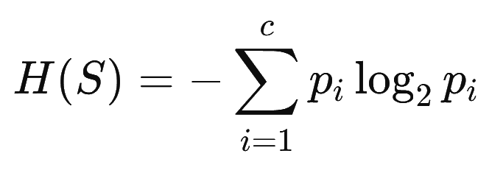
Usually ID3 algorithm is used to build the decision tree – it is a top-down
greedy search of possible branches
It uses entropy and information gain to build the tree
The H(X) Shannon-entropy of a dicrete random variable X with possible values
x₁ x₂ ... x_{n} and probability mass function P(X) is defined as
For completely homogoeneous dataset (all TRUE or all FALSE values): entropy is 0
If the dataset is equally divided (same amount of TRUEs and FALSEs): entropy is 1

Slide 8
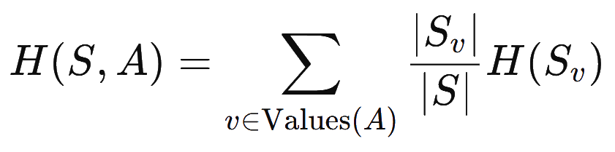
After splitting, we have to calculate the weighted entropy of the subsets
and weight each subset’s entropy by its proportion of the total dataset size
v is each unique value of feature A
∣S_{v}​∣ is the number of instances in subset S_{v}
∣S∣ is the total number of instances in the dataset

Slide 9
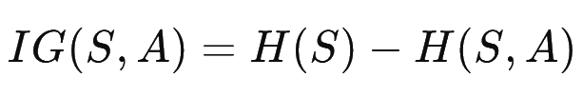
Finally we can calculate the information gain based on the entropy
The feature with the highest information gain is chosen to split
the dataset at that node – this ensures that the split reduces the uncertainty
(entropy) about the target as much as possible
WE STOP WHEN ENTROPY IS ZERO
AND NO FURTHER SPLITTING IS NEEDED !!!

Slide 10
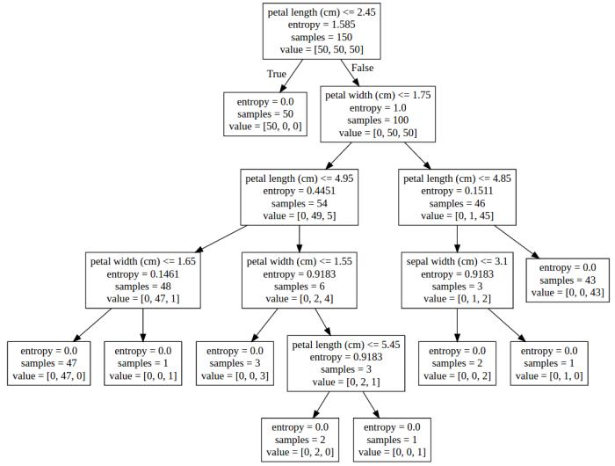
IRIS-SETOSA
IRIS-VERSICOLOR
IRIS-VIRGINICA

Slide 11
SIMPLE TO UNDERSTAND AND INTERPRET
Decision trees are intuitive and easy to visualize. Non-technical employees can understand how decisions are made by examining the tree structure
HANDLES BOTH NUMERICAL AND CATEGORICAL DATA
Decision trees can work with various data types, making them versatile. No need for extensive pre-processing (e.g. one-hot encoding)
NON-PARAMETRIC
Decision trees make no assumptions about the distribution of data, making them suitable for complex datasets

Slide 12
FEATURE IMPORTANCE
Decision trees can provide insight into which features are most important for making predicitons (e.g. root node and higher-level splits)
HANDLING SMALL DATASETS
Effective even with limited data, especially compared to more complex models like neural networks

Slide 13
OVERFITTING
Decision trees can easily overfit the training data, especially if the tree is very deep. This occurs when the tree becomes too complex, capturing noise instead of the true data pattern.
INSTABILITY (HIGH VARIANCE)
Small changes in the data can lead to significantly different trees because of the hierarchical nature of splits. This makes decision trees less robust.
GREEDY SPLITTING
The algorithm selects the best split greedily – it does not backtrack or revise earlier decisions

Slide 14
BIAS TOWARDS FEATURES WITH MORE LEVELS
Features with more categorical or distinct values are more likely to be chosen as splits (they may appear to have higher information gain).
NOT SUITABLE FOR HIGH-DIMENSIONAL DATA
In datasets with many features or sparse data, decision trees may struggle to indentify meaningful splits without overfitting.
POOR PERFORMANCE WITH IMBALANCED DATA
If one class dominates, the algorithm may favor the dominant class, leading to poor predictions for the minority class

Slide 15
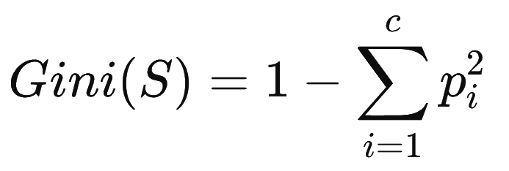
Gini index approach is another metric used to build the decision tree – it is a
top-down greedy search of possible branches
It uses Gini index insted of entropy to build the tree
This approach focuses on the probability of misclassifying an instance when
it is randomly labeled according to the class distribution
For completely homogoeneous dataset (all TRUE or all FALSE values): index is 0
If the dataset is equally divided (same amount of TRUEs and FALSEs): index is 0.5

Slide 16
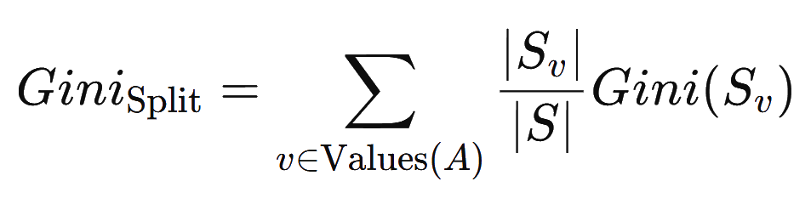
After splitting, we have to calculate the weighted Gini index of the subsets
and weight each subset’s index by its proportion of the total dataset size
v is each unique value of feature A
∣S_{v}​∣ is the number of instances in subset S_{v}
∣S∣ is the total number of instances in the dataset
THE FEATURE THAT MINIMIZES THE WEIGHTED GINI INDEX IS SELECTED FOR THE SPLIT !!!

Slide 17
UNDERFITTING
model has not been fitted well to the training dataset so it misses the trends in the training dataset
this is usually the case when we use too simple models for the problem
OVERFITTING
model has been trained on the training dataset „too well”
(the model learned the noise)
it means it is very accurate on the training dataset but yields poor results on the test set
x
x
2
2
x
x
1
1

Slide 18
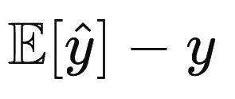
I.)
BIAS
bias is considered a systematic error that occurs in the machine learning model itself due to incorrect assumptions in the process. Technically, we can define bias as the error between average model prediction and the ground truth
a high-bias model makes strong assumptions about the data and often fails to capture the underlying patterns adequately
bias refers to the error introduced by approximating a real-world problem (which may be complex) with a simplified model

Slide 19
I.)
BIAS
high bias implies underfitting, but underfitting does not always mean high bias
x
2
insufficient training, regularization and poor features may lead to underfitting without high bias
x
1

Slide 20
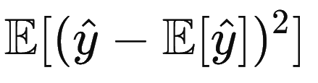
II.)
VARIANCE
variance is an error caused by an algorithm that is too sensitive to fluctuations in data, creating an overly complex model that sees patterns in data that are actually just randomness
variance refers to the sensitivity of a model to small changes in the training data and it measures how much the model's predictions would vary if it were trained on different subsets of the data
a model with high variance learns the training data very closely, including its noise and random fluctuations – low error on training data, high error on test data

Slide 21
II.)
VARIANCE
high variance implies overfitting, but overfitting does not always mean high variance
x
2
simplify the model, use techniques like cross-validation and increase the size and diversity of the training data to combat overfitting
x
1

Slide 22
total error
variance
ERROR
bias
MODEL COMPLEXITY

Slide 23
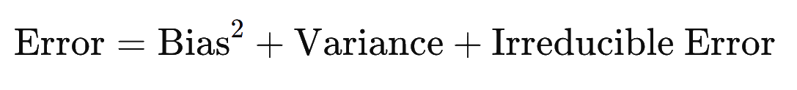

Slide 24
decision trees are prone to overfitting the data, which can lead to poor performance on test data
decision trees are unstable classifiers which means a small perturbation in the data can cause a significant change in the tree – low bias high variance model
a smaller tree structure with fewer splits may result in a better predictor, at the cost of a little extra bias
BETTER SOLUTION: grow a large tree and then prune it back to create a smaller subtree (weakest link pruning)

Slide 25
BEFORE PRUNING

Slide 26
AFTER PRUNING

Slide 27
bagging or bootstrap aggregation is about combining weak learners that can prove to be an extremely powerful classifier („wisdom of the crowd)
the basic idea is to train multiple instances of the same model on different subsets of the data and then combine their predictions
usually we use decision chunks that are decision trees with depth 1
WE CAN REDUCE VARIANCE WITHOUT EXTRA BIAS !!!

Slide 28
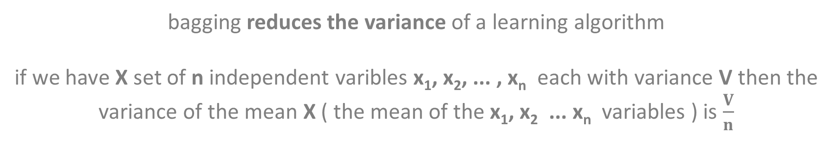
bagging reduces the variance of a learning algorithm
if we have X set of n independent varibles x₁, x₂, ... , x_{n} each with variance V then the
variance of the mean X ( the mean of the x₁, x₂ ... x_{n} variables ) is $\frac{V}{n}$
WE CAN REDUCE THE VARIANCE BY AVERAGING A SET OF OBSERVATIONS !!!
create multiple subsets of the data by sampling with replacement. This means that each subset may contain duplicate examples and may omit others.
grow decision trees (fully grown, unpruned and independent trees) on these subsets, so each subset of data is used to train a separate model.

Slide 29
we have the results from all the subsets with independent
models that we have trained
FINALLY WE COMBINE THE PREDICTIONS !!!
For classification, the final prediction is made by taking a majority vote from all the individual models. For regression, the final prediction is typically the average of the predictions made by all the models.

Slide 30
One problem with bagging: the constructed trees are highly correlated
Why do correlation occur?
Because every dataset has a strong feature (predictor). All the bagged trees tend
to make the same splits because they share the same features, which is
why these trees often look very similar
TREE #1
TREE #2
TREE #3
TREE #4
CORRELATED TREES BECAUSETHE ALGORITHM USES ALL THE FEATURES

Slide 31
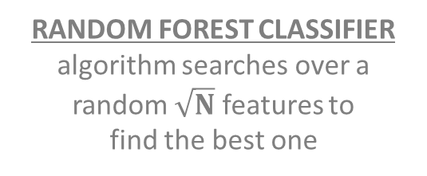
the random forest classifier is better than bagging because it decorrelates the individual decision trees that are constructed during the algorithm
BAGGING
algorithm searches over all the N features to find the best feature that best splits the data at that node
this further reduces variance when averaging the trees
we construct decision trees on the training data, but at each split in the tree, a random subset of features is selected from the full dataset
RANDOM FOREST CLASSIFIER
algorithm searches over a random $\sqrt{N}$ features to
find the best one
the number of features considered at each split is typically approximately equal to the square root of the total number of features in classification tasks

Slide 32
X dataset
N features
N features
N features
N features
1
2
3
4
TREE #1
TREE #2
TREE #3
TREE #4
CLASS C
CLASS D
CLASS B
CLASS C
MAJORITY VOTING
FINAL CLASS

Slide 33
Random Forest Classifier
Why is it good?
if one or a few features are very strong predictors for the response variable (target output), these features will be selected in many of the decision trees: so they will become correlated
huge advantage: at some point the variance stops decreasing no matter how many more trees we add to our random forest + it is not going to produce overfitting !!!

