Slide 1

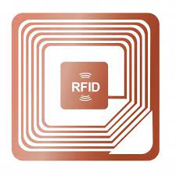




Scan Rfid API
The mobile will send the radio frequency once the rf wil hit the RFID it send response signal encoded with digital or numeric values.
Scan
The blue signal contain the digital value in that signal
(EX : 52486228633258996332)
Check with DB
Check with DB and send msg to the user

