Slide 1
ABSTRACT:
We are going to examine the given multi-spectral image of a particular area and use it to differentiate the vegetative and forest areas. We are going to use image processing powered by ‘Tensor flow’ libraries by Convolutional Neural Networks.

Slide 2
PROBLEM DEFINITION:
Design and Implement algorithm for automated mapping of trees/plantation and farmland from 5m multispectral multi-temporal (LISS IV) data.
Participants need to develop algorithm for automatically classifying vegetation areas as either farm or tree/plantation by analysing seasonal changes apparent in multi-temporal satellite imagery.
Data Set: https://vedas.sac.gov.in/vcms/en/sih2020.html

Slide 3
METHODOLOGY:
TENSORFLOW LIBRARIES:
Tensor Flow is a free and open-source software library for dataflow and differentiable programming across a range of tasks.
It is a symbolic math library, and is also used for machine learning applications such as neural networks.
The Layers API provides a simpler interface for commonly used layers in deep learning models.
On top of that sit higher-level APIs, including Keras & the Estimator API, which makes training and evaluating distributed models easier.
Tensor Flow allows developers to create dataflow graphs - structures that describe how data moves through a graph, or a series of processing nodes
Each node in the graph represents a mathematical operation, and each connection or edge between nodes is a multidimensional data array, or tensor.

Slide 4
CONVOLUTIONAL NEURAL NETWORKS:
The primary purpose of Convolution in case of a CNNs is to extract features from the input image.
A convolutional neural network (CNN) is a type of artificial neural network used in image recognition and processing that is specifically designed to process pixel data.
The layers of a CNN consists of:
Input Layer,
Hidden Layer,
Output Layer.
Hidden Layer - where artificial neurons take in a set of weighted inputs and produce an output through an activation function.

Slide 5
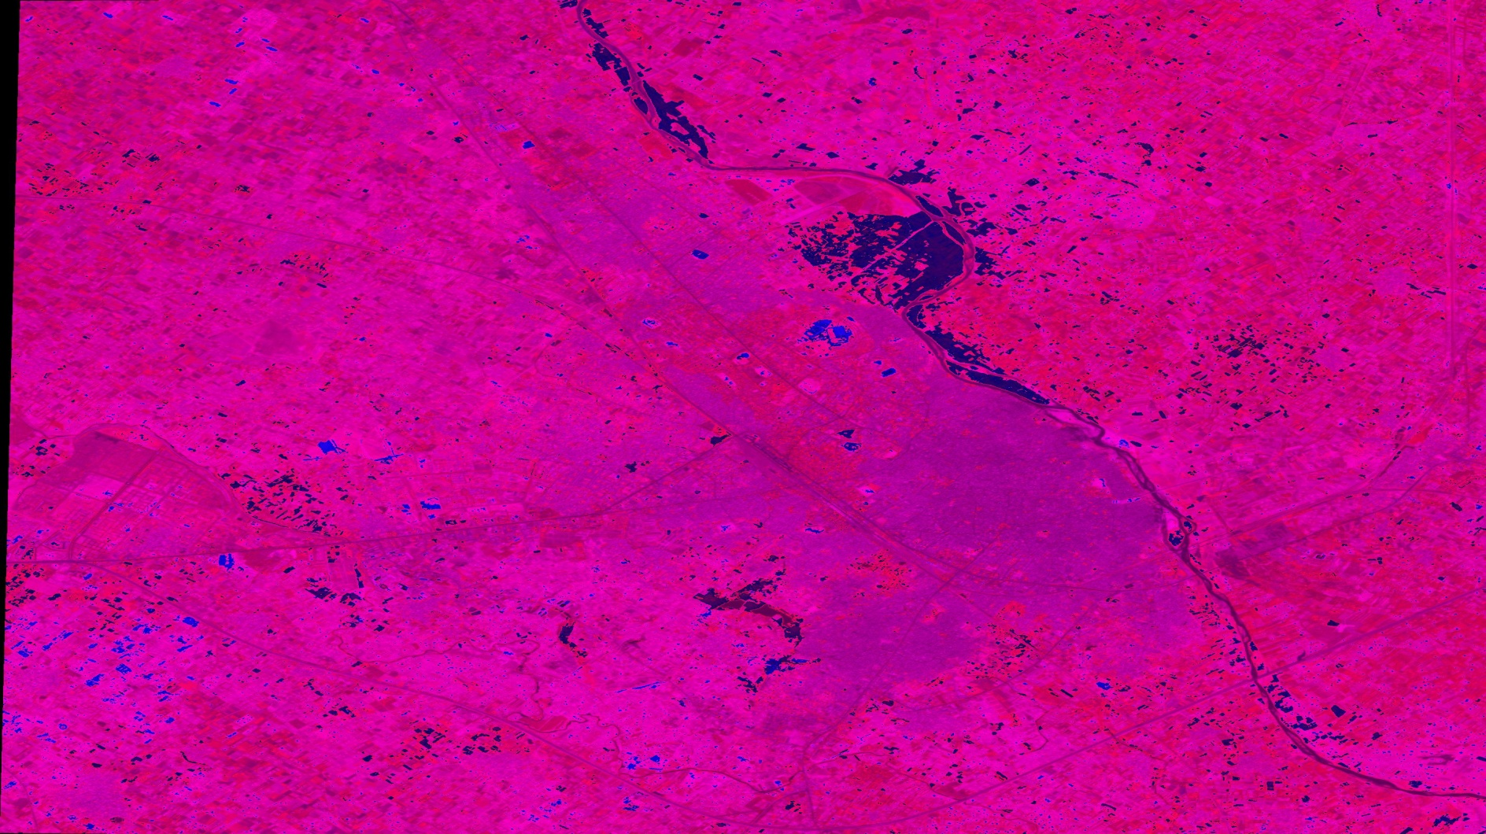
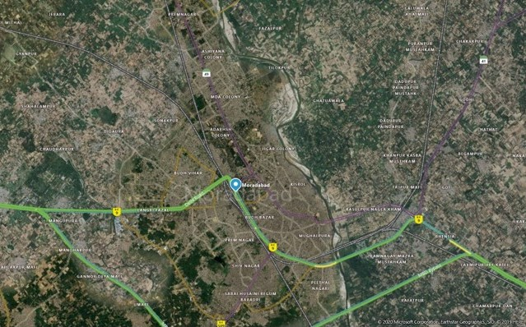
MORADABAD:
Satellite spectral image
Satellite aerial image

Slide 6
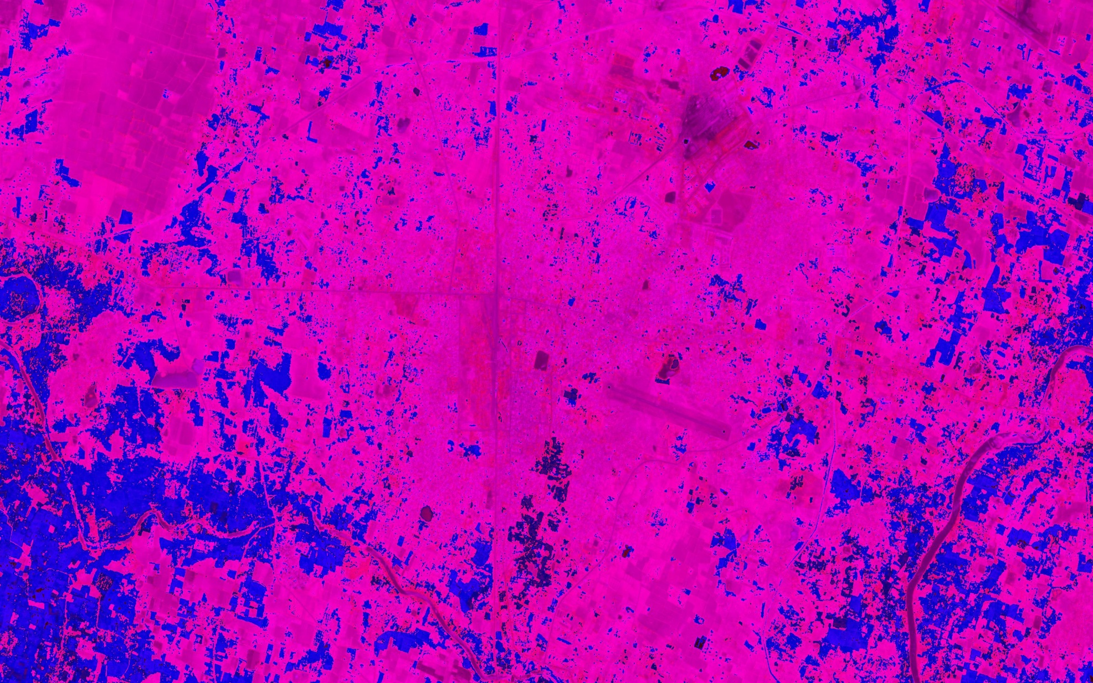
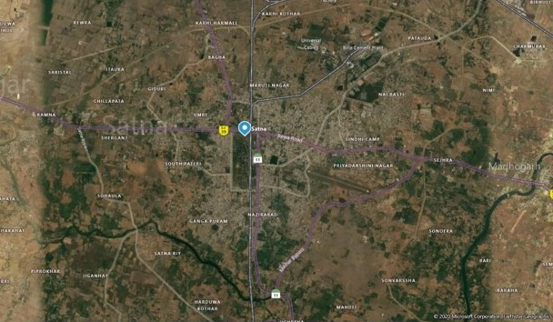
SATNA:
Satellite spectral image
Satellite aerial image

Slide 7
Approach:
Firstly, we downloaded the multi-spectral sat-image and then converted it to .jpeg format(original format was .tiff)
We determine the spectral wavelength of different parts of the image by pixel color difference
We build a CNN model to identify the images
We then train the model to identify vegetation, buildings, rivers, forest, roads etc.
We test the accuracy of the model by comparing the our test data(separate satellite images) with the given spectral image
We then try to increase the accuracy of the model .

Slide 8


