Slide 1
SESSION

Slide 2
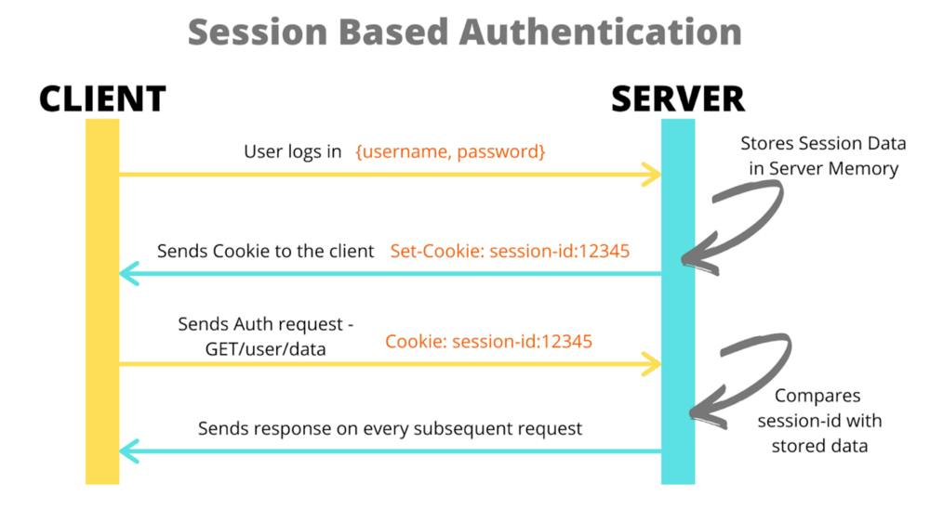

Slide 3
JSON WEB TOKEN

Slide 4
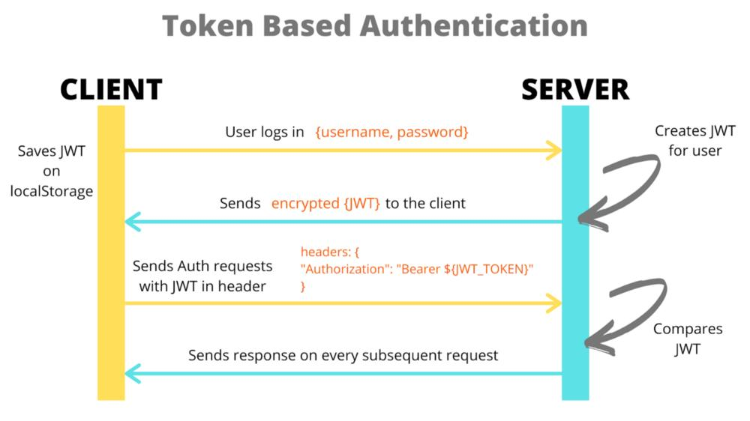

Slide 5
Main Difference Between Session and JWT
1.STORAGE LOCATION:
JWT: JWTs are self-contained tokens encoded as JSON objects. They are typically stored on the client-side, such as in local storage or cookies.
Sessions: Session data is stored on the server-side, often in memory, a database, or a distributed cache.
2.STATELESSNESS
JWT: JWTs are stateless, meaning each request to the server includes all necessary information within the token itself. The server does not need to maintain any session state.
Sessions: Sessions are stateful. The server keeps track of each client session and associated data, usually through session IDs stored in cookies or sent as part of requests.

Slide 6
Main Difference Between Session and JWT
3.SERVER LOAD:
JWT: Since JWTs are stateless, they reduce the server load by eliminating the need to store and manage session data on the server-side.
Sessions: Sessions require the server to manage session data for each active session, which can increase server load and resource usage, especially in applications with many concurrent users.
4.SCALABILITY:
JWT: JWTs are more scalable because they do not require server-side storage of session data. This makes it easier to distribute authentication across multiple servers or microservices.
Sessions: Session-based authentication can be less scalable, especially in distributed systems, as it requires centralized storage and management of session data.

Slide 7
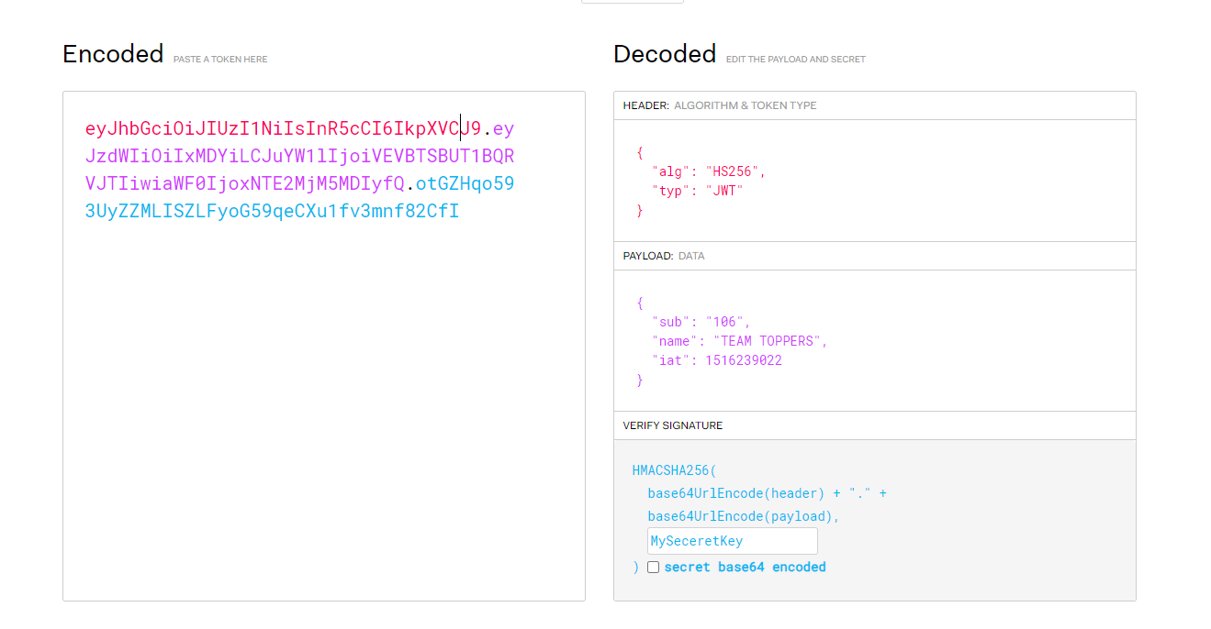

Slide 8
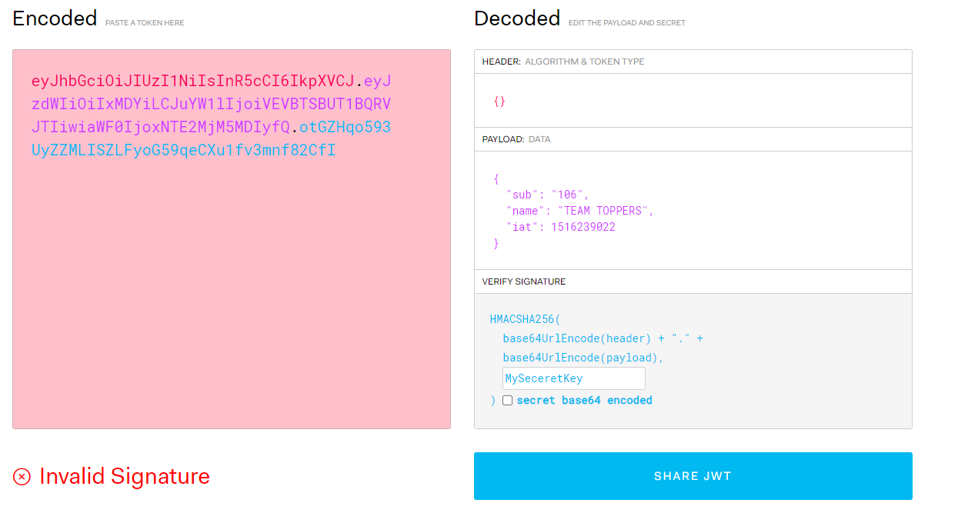

Slide 9
Using JWT to authorize operations across Server
JWTs are well-suited for server-to-server or microservice-to-microservice communication scenarios within a backend architecture. In this context, JWTs serve as a means of securely transmitting information between services for authorization and authentication purposes.
Say you have one server where you are logged in, SERVER1, which redirects you to another server, SERVER2, to perform some kind of operation.
SERVER1 can issue you a JWT that authorizes you to SERVER2. Those two servers don’t need to share a session or anything to authenticate you. The token is perfect for this use case.

Slide 10
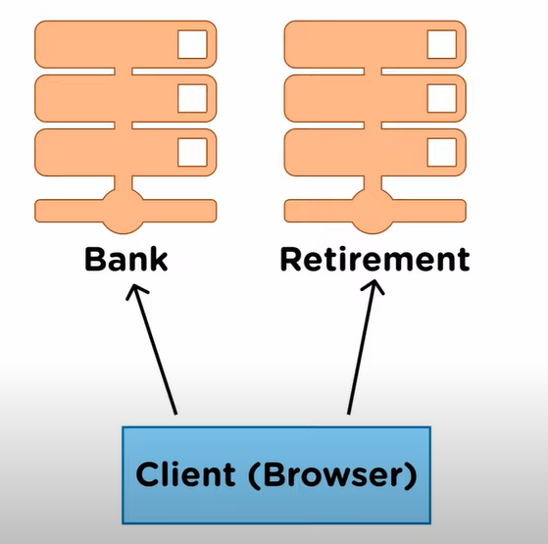

Slide 11
DISADVANTAGE OF JWT
1.SIZE CONSTRAINT:
In complex applications, storing extensive information in JWTs can lead to either excessive overhead per request or exceed the allowed storage space for cookies (4KB).
Storing JWTs in localStorage to circumvent size limitations exposes sensitive data to XSS attacks, as any script within the page can access it.
2.Token invalidation:
Invalidating a single JWT token is challenging due to its self-contained nature and lack of a central authority for invalidation, unlike traditional session mechanisms.
Changing the server secret key to invalidate all JWTs inconveniences users by causing their tokens to expire without reason, effectively logging everyone out.
Maintaining a list of invalidated tokens in the database undermines the built-in expiration functionality of JWTs and contradicts the efficiency they offer.

Slide 12
DISADVANTAGE OF JWT
3.LESS SECURE
While sending JWTs over HTTPS minimizes security risks, interception remains a possibility, exposing user data to potential attackers.
JWTs are serialized, not encrypted, meaning intercepted tokens can be decoded and viewed by anyone, compromising user privacy and security.

