Slide 1


Department of Artificial Intelligence and Data Science
Smart city analysis using pollution data
Presented By:
Saravanan J (231801158)
Thavatharani (231801180)
Dr.Suresh Kumar

Slide 2
Introduction
What is a Smart City? 🏙️
An urban area that leverages technology, especially the Internet of Things (IoT) and data analytics, to improve the quality of life for its citizens.
Problem Statement
Current air quality systems provide delayed and area-specific data.
There is no real-time, continuous, or predictive monitoring for effective pollution control.
Need for a low-cost, scalable, and intelligent system for real-time air pollution analysis.
Project Objectives
To develop an IoT-based system for real-time air quality monitoring.
To analyze and predict pollution levels using machine learning algorithms.
To visualize air quality data through an interactive dashboard for decision-making.

Slide 3
Abstract
The Smart City Sensor Analytics project aims to monitor and predict air pollution using IoT sensors and data analytics.
Sensors collect data such as CO₂, NO₂, PM2.5, temperature, and humidity from multiple locations.
The data is processed and analyzed using machine learning models to detect pollution trends and anomalies.
A real-time dashboard visualizes air quality metrics, enabling data-driven decision-making for urban sustainability.

Slide 4
Literature Survey
Existing Systems:
Rely mainly on static monitoring stations — limited coverage and slow updates.
Manual data collection and delayed reporting.
Lack of predictive analytics for future pollution levels.
Limitations:
High setup cost for traditional air quality monitoring stations.
Low spatial resolution and lack of real-time public access.
Need for Proposed System:
To enable real-time, low-cost, and predictive monitoring using IoT and analytics.
Our project aims to bridge these gaps with a modular, cost-effective, and integrated approach.

Slide 5
Architecture
Architecture Overview:
Sensor Layer: IoT sensors deployed across city areas collect air quality data.
Architecture Overview:
Sensor Layer: IoT sensors deployed across city areas collect air quality data.
Data Transmission Layer: Data is sent via Wi-Fi/LoRa/4G to a cloud server.
Cloud Processing Layer: Data stored and processed in cloud platforms (e.g., Azure, AWS, or ThingSpeak).
Analytics Layer: Machine learning models (SVM, LSTM, or ARIMA) analyze and forecast air pollution.
Application Layer: Dashboard visualizes air quality index (AQI) with alerts and trends.
Cloud Processing Layer: Data stored and processed in cloud platforms (e.g., Azure, AWS, or ThingSpeak).
Analytics Layer: Machine learning models (SVM, LSTM, or ARIMA) analyze and forecast air pollution.
Application Layer: Dashboard visualizes air quality index (AQI) with alerts and trends.

Slide 6
Modules
Data Collection Module
Uses IoT sensors (MQ135, DHT11, etc.) to collect real-time air quality parameters.
Data Transmission Module
Sends sensor data via Wi-Fi (ESP8266) or MQTT protocol to a cloud server.
Data Storage Module
Stores readings in cloud databases for analytics and historical trends.
Analytics & Prediction Module
Machine learning algorithms (like SVM, LSTM, or ARIMA) analyze data patterns.
Predicts pollution levels for upcoming hours/days.
Visualization & Alert Module
Real-time dashboard displays AQI with color-coded zones (Good, Moderate, Poor).
Sends alerts when pollution exceeds threshold levels.

Slide 7
Implementation
Frontend: Python
Backend: Python (Flask API), Node.js
Database: PostgreSQL, MongoDB
Analytics Engine: Apache Spark, Scikit-learn
Deployment: Docker, AWS/Google Cloud
Key Algorithms: LSTM
AQ Prediction: ARIMA / LSTM for time-series forecasting.
Classification: Used to categorize pollution levels (Good, Moderate, Unhealthy)

Slide 8
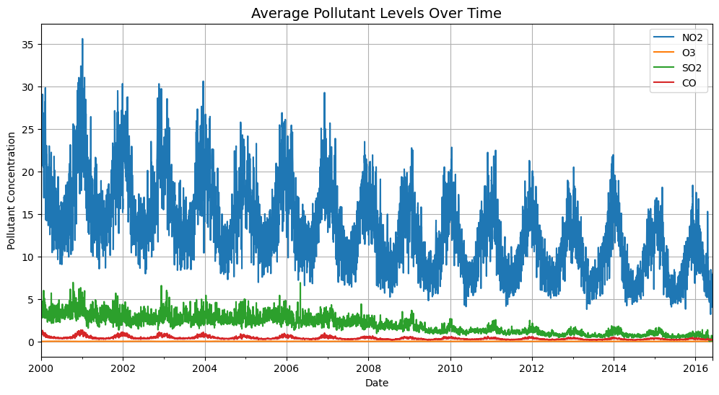
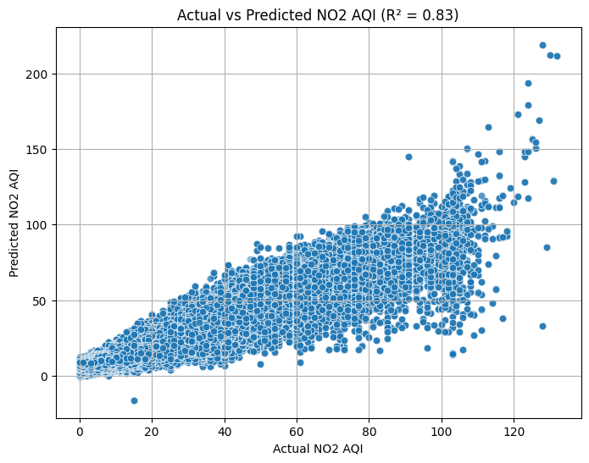
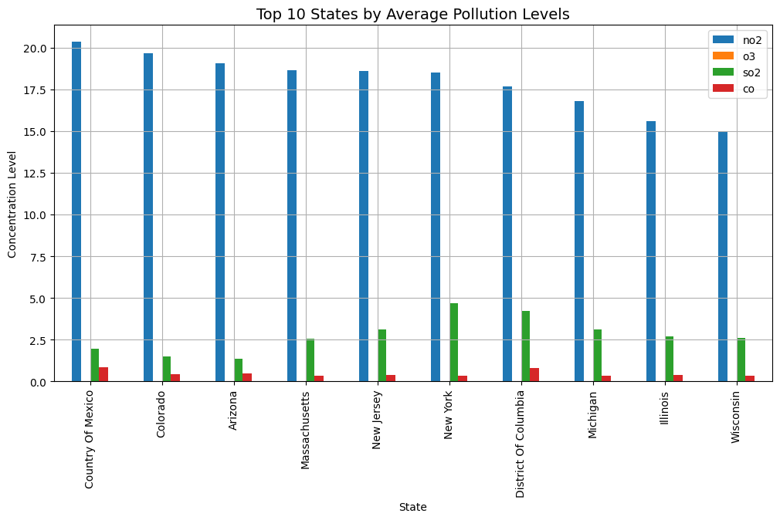
Result
Dashboard:

Slide 9
Conclusion
In conclusion, this project has successfully demonstrated the feasibility and immense value of an integrated Smart City Analysis platform. By breaking down the traditional "data silos" that isolate urban information, we have created a unified system that provides a holistic, real-time view of city operations. Our work moves beyond mere data collection; it transforms raw data from traffic, waste management, and air quality sensors into actionable intelligence. The predictive models for traffic congestion and the optimized routes for waste collection are tangible examples of how this intelligence can lead to significant gains in efficiency, resource conservation, and sustainability. This platform serves as a powerful blueprint, proving that a data-driven approach is no longer a futuristic concept but a practical tool for building more responsive, resilient, and livable urban environments for citizens.

Slide 10
Future References
Expand to New Domains: Integrate modules for smart water management, energy grid monitoring, and public safety (CCTV analytics). 💡
Predictive Maintenance: Use sensor data to predict when city infrastructure (e.g., streetlights, water pumps) will need maintenance.
Citizen Engagement App: Develop a mobile app for citizens to report issues (e.g., potholes) and receive personalized alerts.
AI & Deeper Learning: Implement more advanced AI models for complex tasks like autonomous traffic control and city-wide event simulation.
Application: Predict urban flooding zones during heavy rains (especially relevant for cities like Chennai) and automatically trigger alerts for residents and manage stormwater systems.
Smart Energy Grid: Integrate data from smart meters to analyze and manage energy consumption across the city.
Goal: Promote renewable energy usage by balancing power loads, predicting demand spikes, and preventing outages.

Slide 11
Thank You

